Slide 1

Introduction in Community Medicine
Dr. Amina Muftah Elsaid
Community Medicine

Slide 2
Objectives
To understand the concept of community health
compare between clinical and community medicine
To understand the aims and goals of community medicine
To know the branches of community medicine
To understand the differences between clinical and community medicine

Slide 3
Concepts of community medicine
When we joined the medical school our understanding was that we are going to work in a clinic or hospital, we receive patients having a complaint or suffering from a disease, we examine our patients, diagnose and treat them
this is Curative Medicine

Slide 4
In public health and community medicine
We are concerned about the individual for his/her self, as a member of the family , and living within a community.
Our concern extends throughout the health spectrum from being perfectly healthy to being seriously affected by a disease or its complications.

Slide 5


  Community Medicine
  Concerned with frequencies and types of injuries and illness in groups of people
    Focus is not on the individual
  Concerned with factors that influence the distribution of illness and injuries

Slide 6
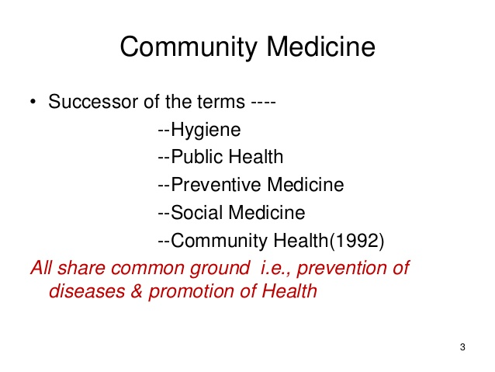

Slide 7
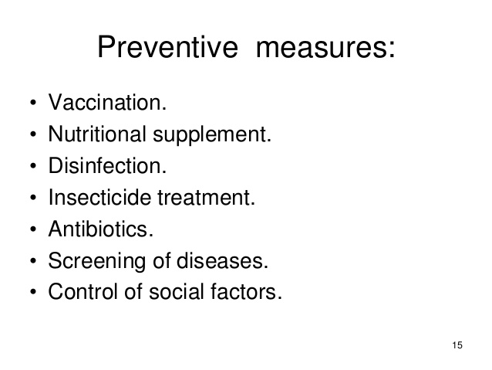

Slide 8
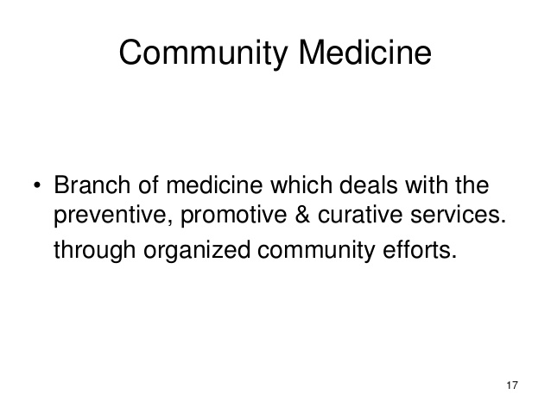
Prevention better than cure
Prevention is also
* Simpler than cure
* Safer than cure
* Cheaper than cure
* Easier than cure

Slide 9
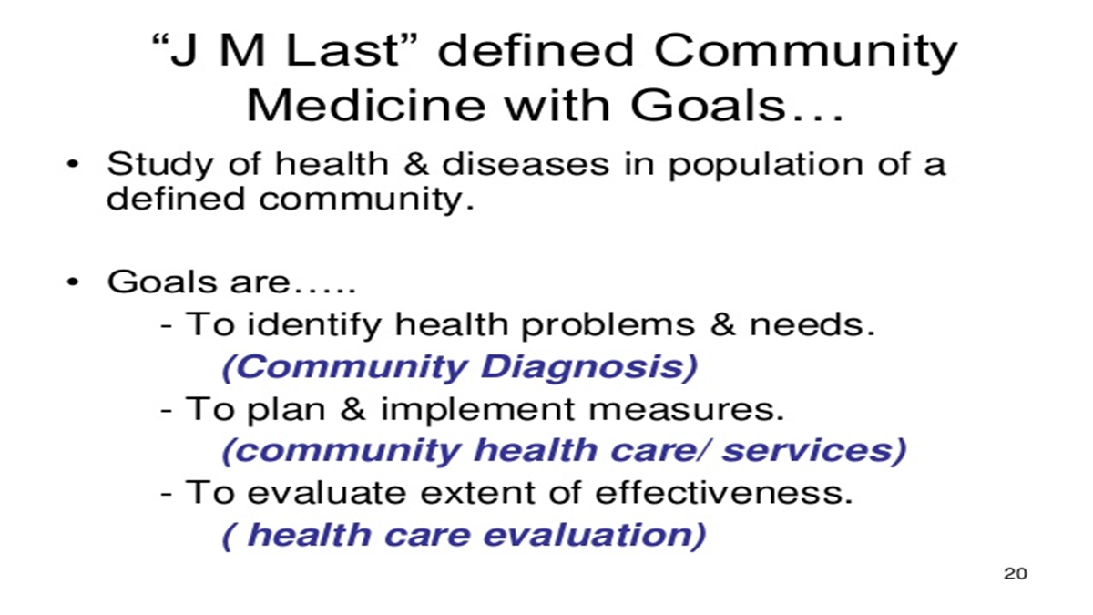

Slide 10
Branches , divisions, components of community medicine
Epidemiology
Community nutrition
Health education
Family medicine
Environmental health
Occupational health
Control of communicable diseases
Control of non- communicable diseases
Health service administration ( planning , implementation , evaluation )
Biostatics
Demography

Slide 11
Five Stars Doctor
Care provider
Decision maker
Communicator
Community leader
Manager

Slide 12
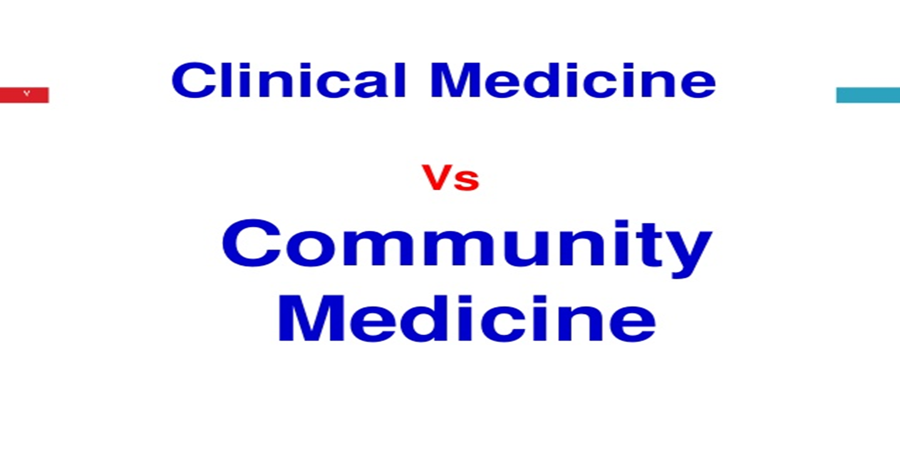

Slide 13
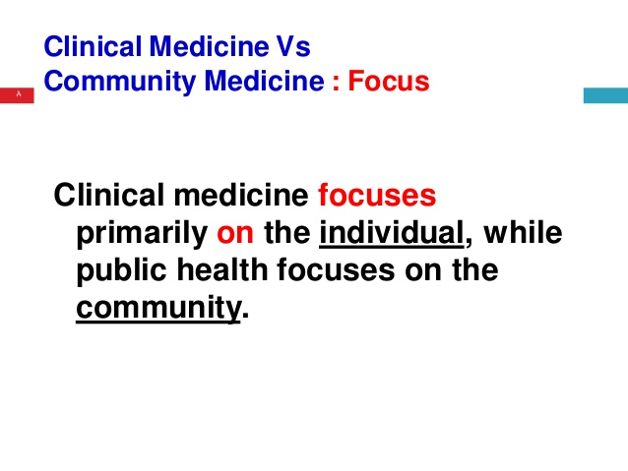

Slide 14
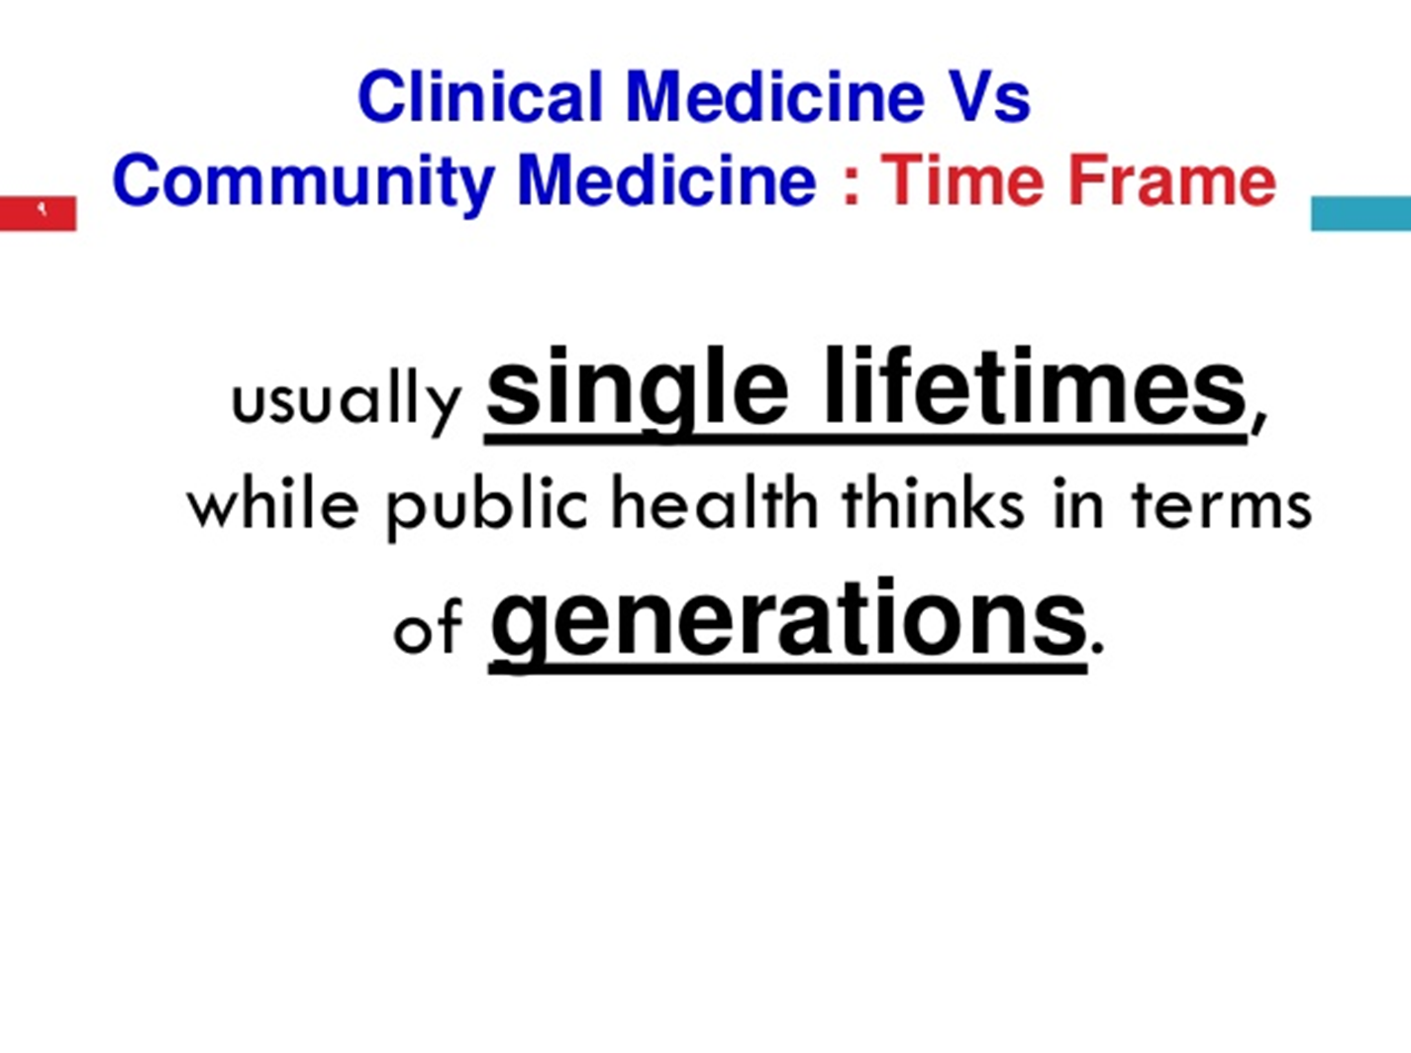

Slide 15
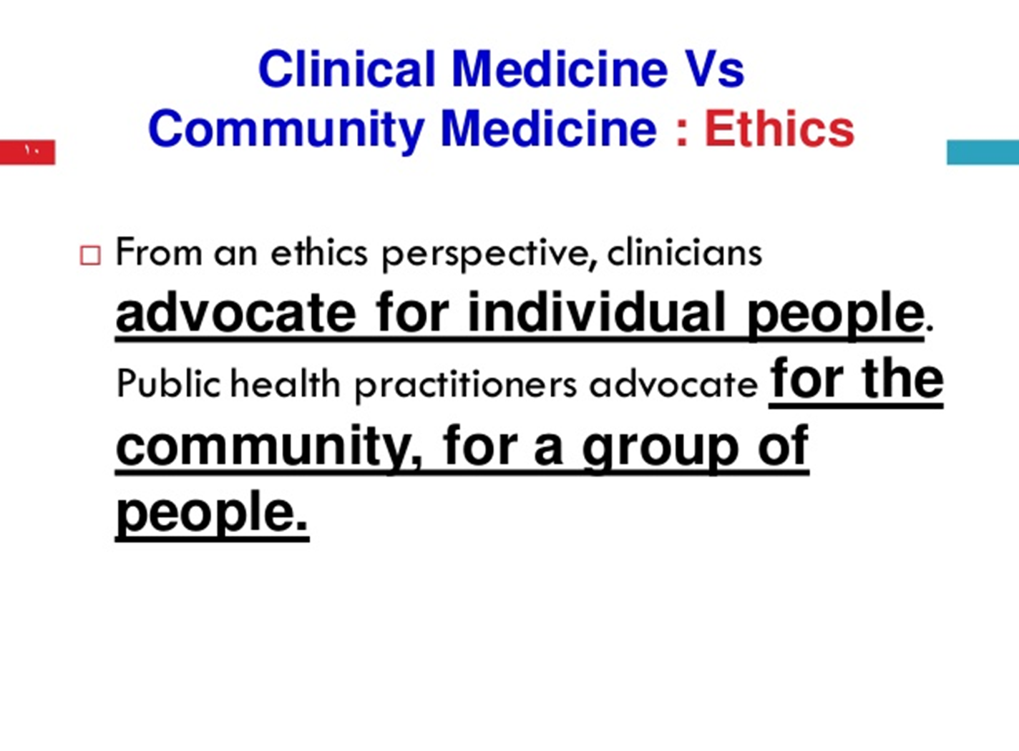

Slide 16
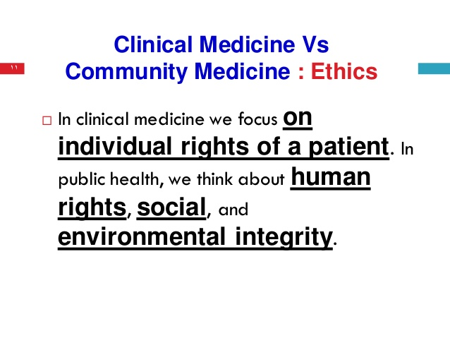
Notes:
integrity

Slide 17
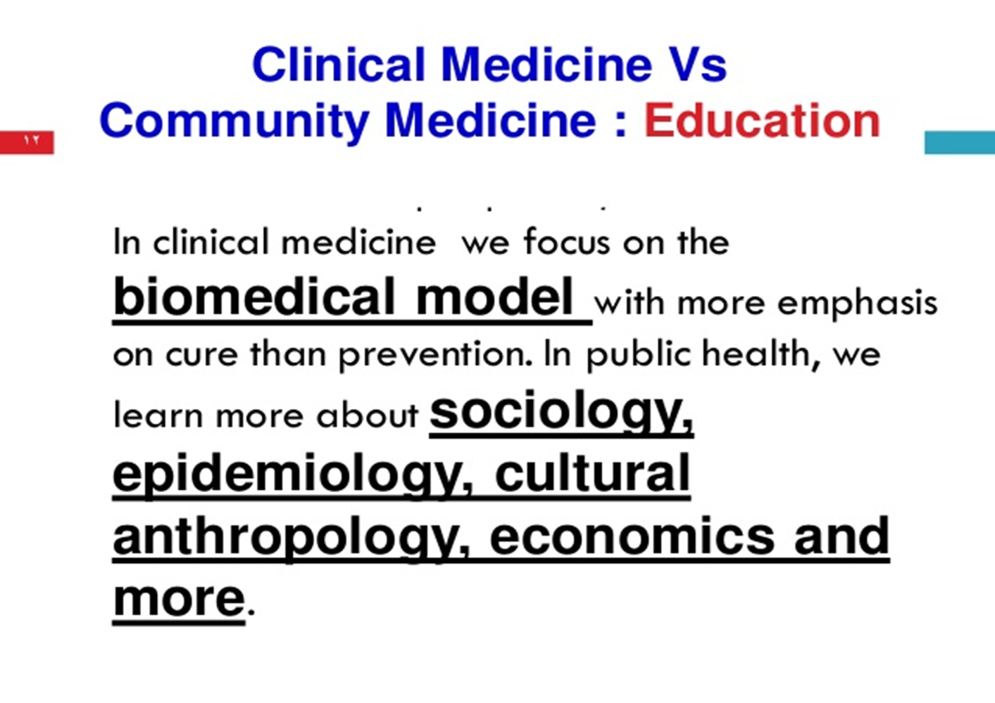

Slide 18


Clinical medicine interested in cases with diseases.
Community medicine concerned with both
"sick" and "healthy"

Slide 19
Clinician is concerned with the - Diagnosis
-Prognosis
-Treatment
Epidemiologist identify - particular source of infection,
- mode of spread
or an etiological factor(s)
in order to determine a future trend and recommend specific control measures.

Slide 20
Clinician uses laboratory reports and
post mortem reports
to diagnose disease
while in epidemiology the subject matter is conceptual and can only be symbolized in the form of tables and graphs.

Slide 21



Clinical medicine patient comes to the doctor Epidemiological epidemiologist goes out into the community
to find persons who have the disease or
experience of the suspected causal factor in
question.

Slide 22

Finally
Clinical medicine and Epidemiology are not antagonistic.
Both are closely related, co-existent and mutually helpful

Slide 23
Differences between clinical and
community medicine
 | Clinical medicine | Community medicine
objectives | Patient care Disease in individual | Health improvement Disease pattern in population
Unit of concern | Case or cases | Population ,population at risk (healthy and sick )
Diagnosis | D/D | Community diagnosis
Investigation | Lab. exam., x-ray ..etc. | Studies and surveys
Resources | Available therapy | Health and health related services
Management | Treatment | Health programmers
Evaluation | Follow up of patient | Assessment of health

Slide 24



Slide 25
Principles of Epidemiology
Dr. Amina Elsaid
Community Medicine

Slide 26
Learning objectives
1-Definition Of Epidemiology
2-Epidemilogical Determinants
3-Pioneer in epidemiology
3-Aims & Objectives Of Epidemiology
4-Epidemiological Approach
5-Uses Of Epidemiology

Slide 27
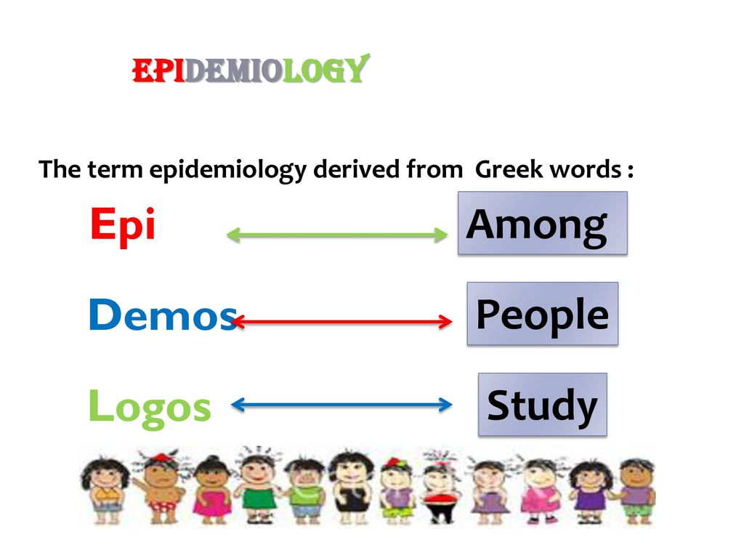

Slide 28
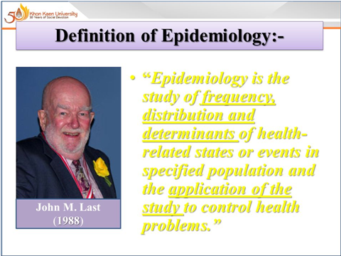

Slide 29
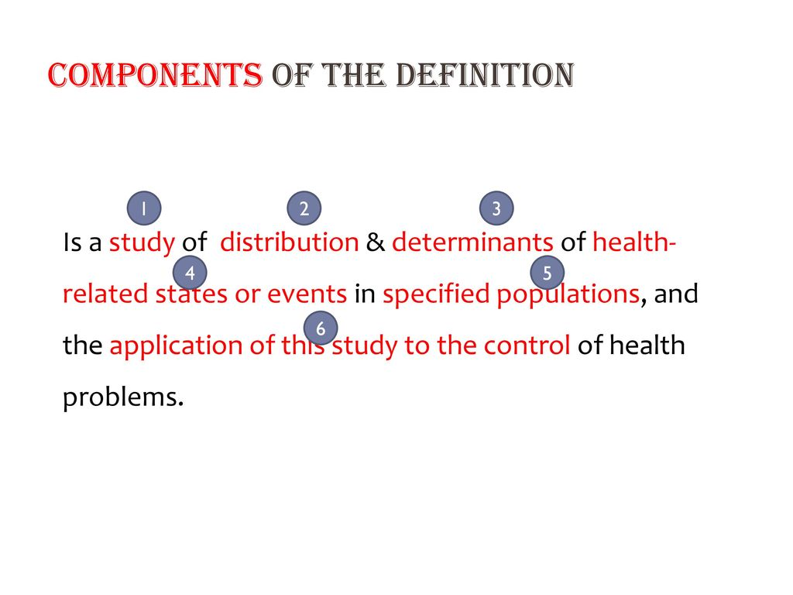

Slide 30
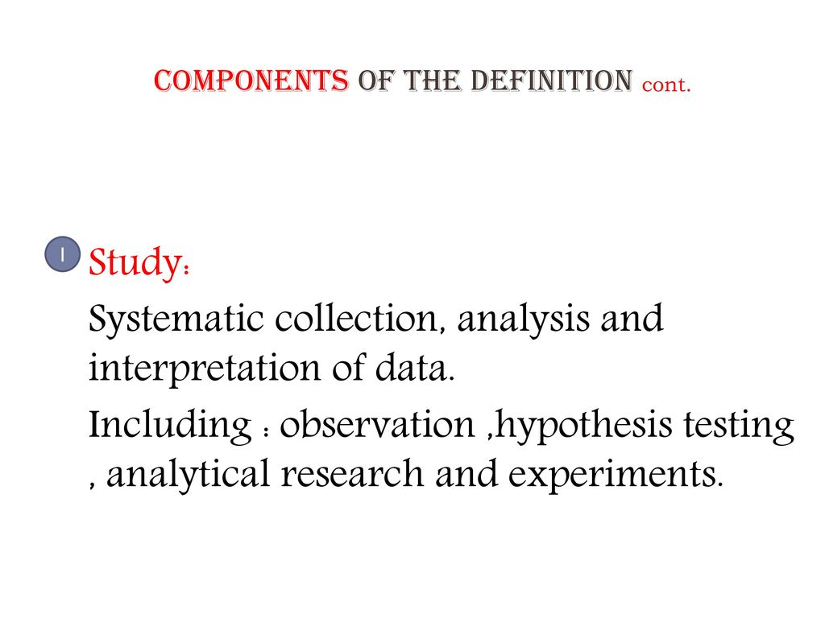

Slide 31
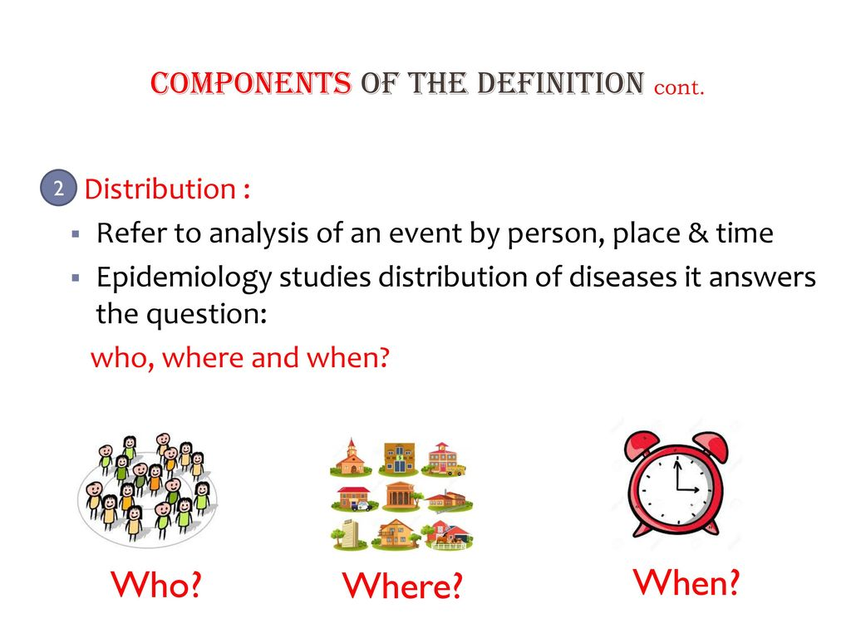

Slide 32
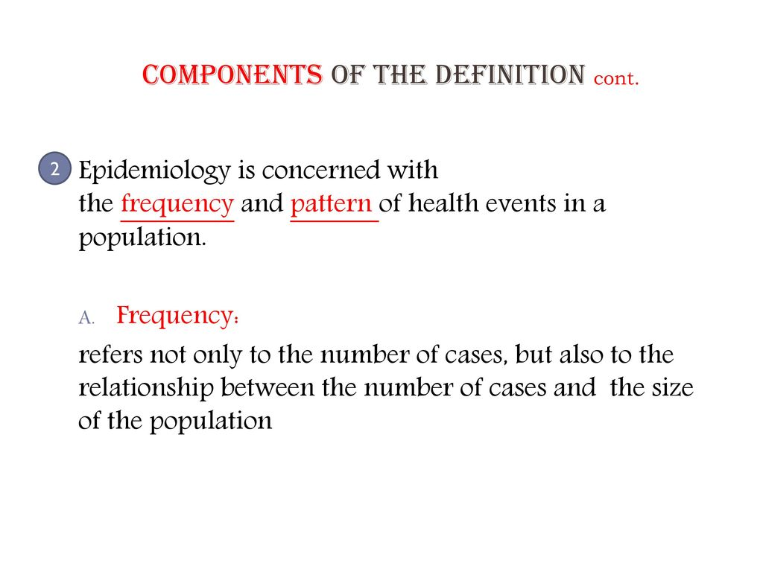

Slide 33
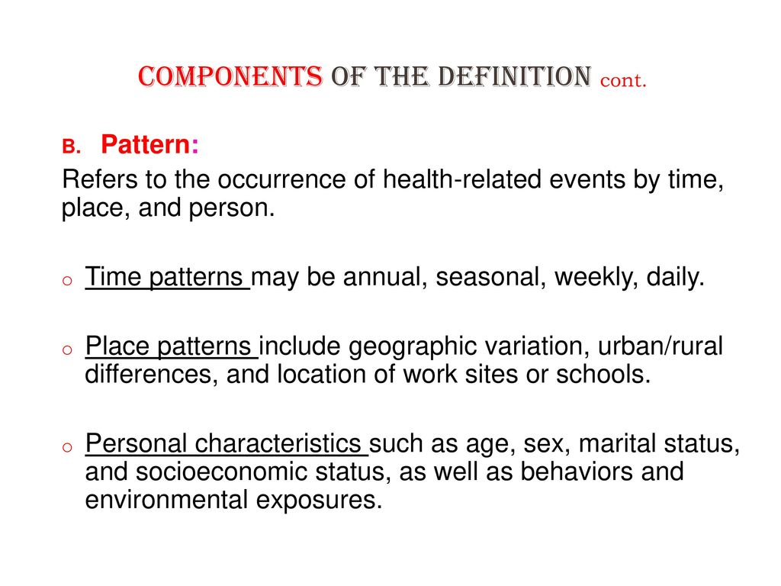

Slide 34
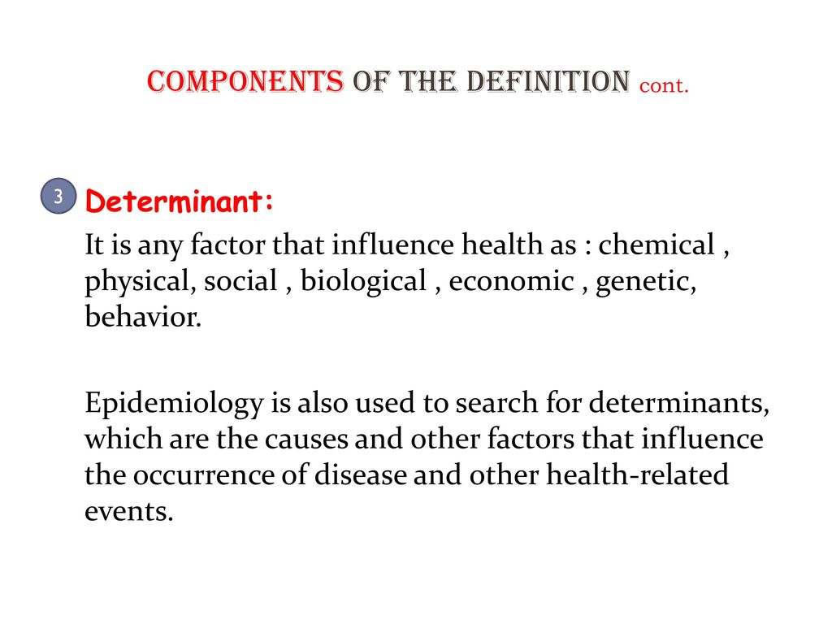

Slide 35
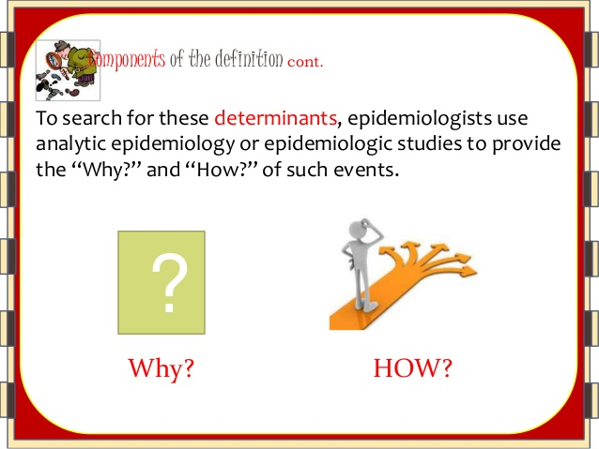

Slide 36
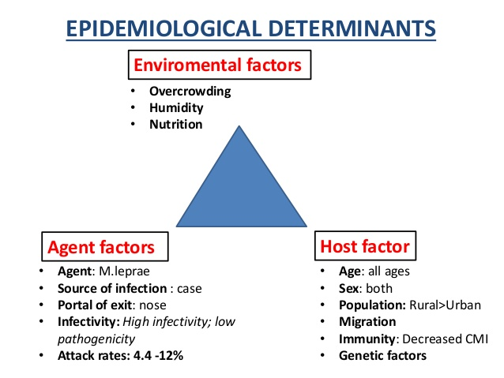

Slide 37
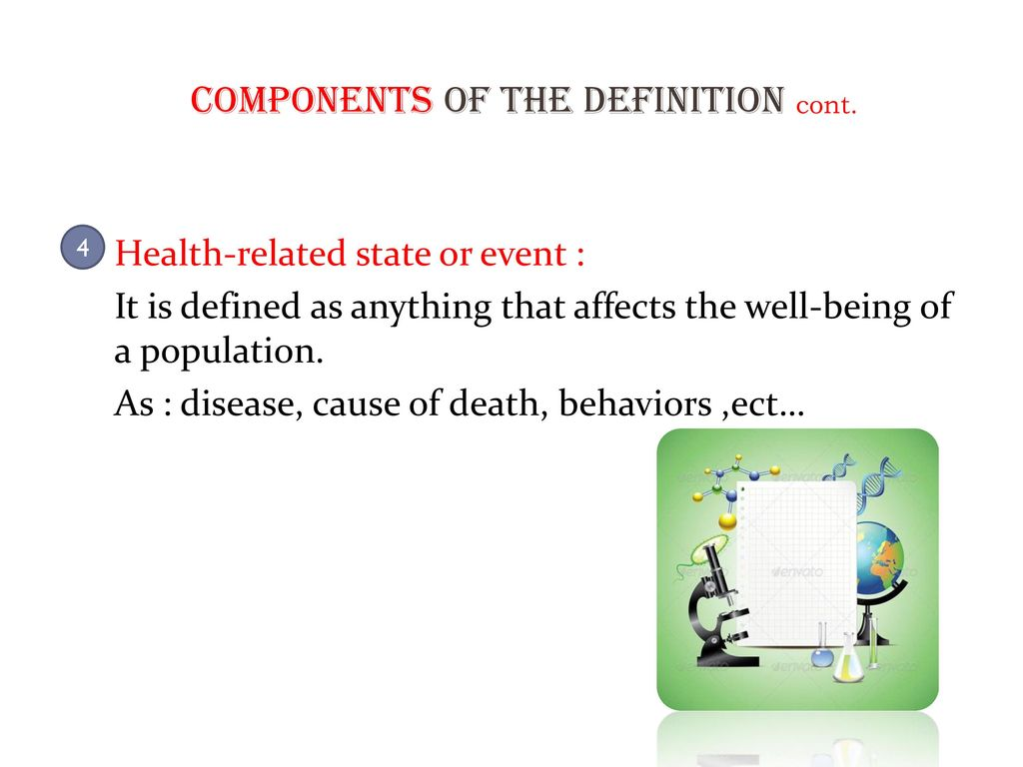

Slide 38
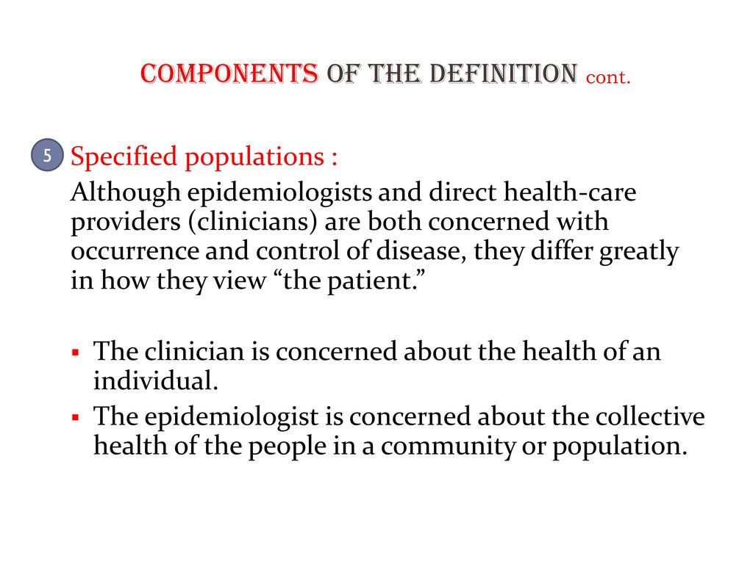

Slide 39
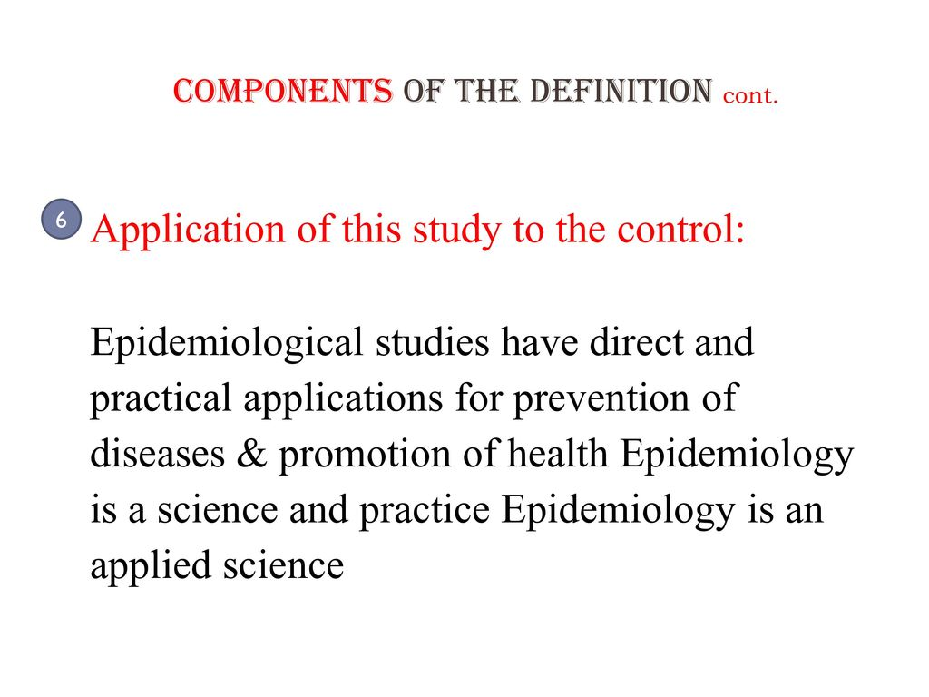

Slide 40
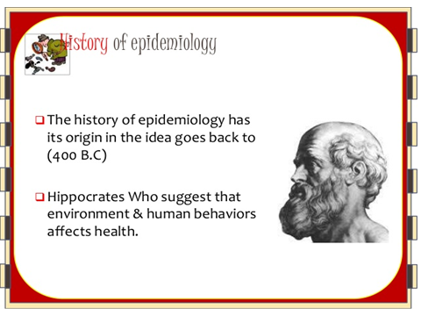
Pioneer in epidemiology

Slide 41
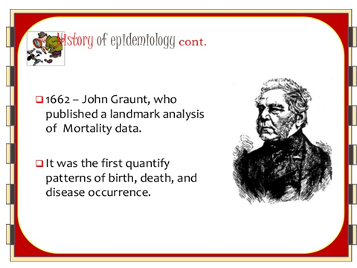

Slide 42
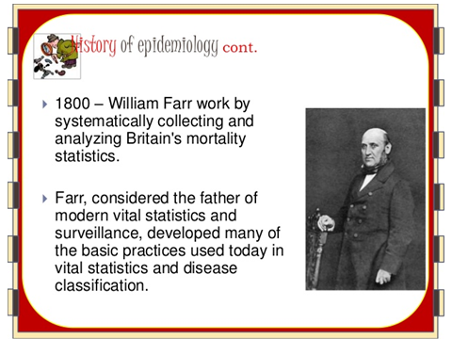

Slide 43
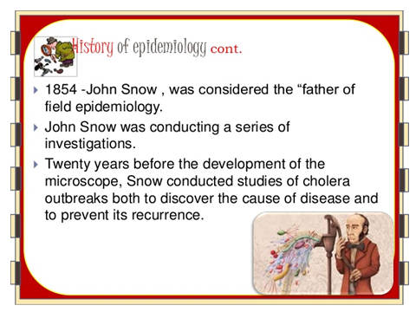

Slide 44
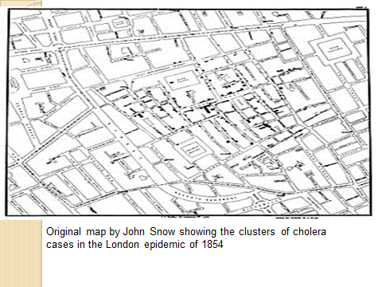

Slide 45
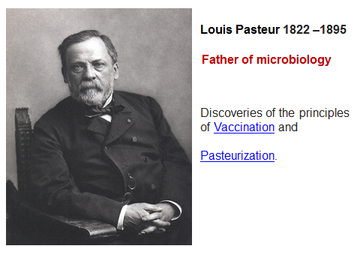

Slide 46
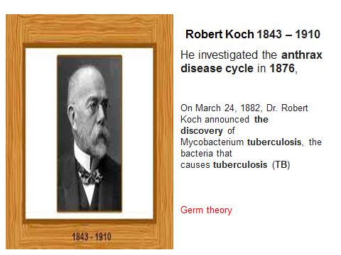

Slide 47
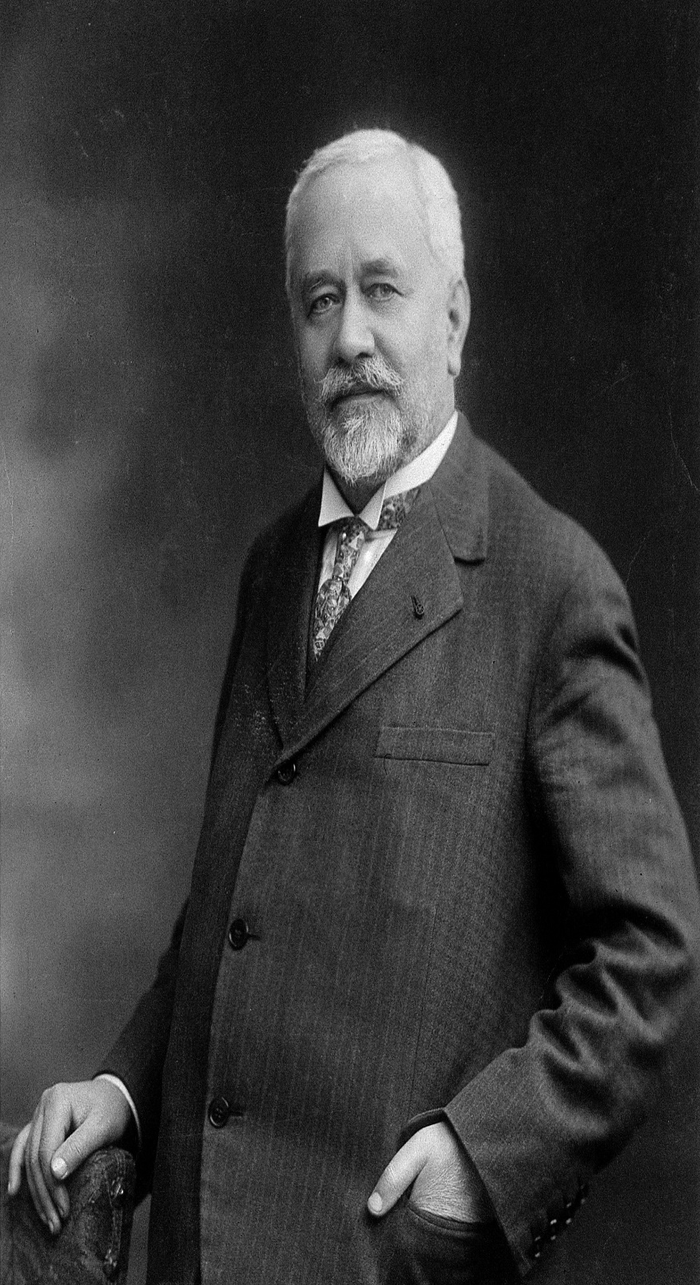
Albert Calmette 1863 –1933
and BCG
French bacteriologists
The vaccine was developed over a period of 13 years, from 1908 to 1921, by French bacteriologists Albert Calmette and Camille Guérin,
who named the product Bacillus Calmette-Guérin, or BCG.

Slide 48
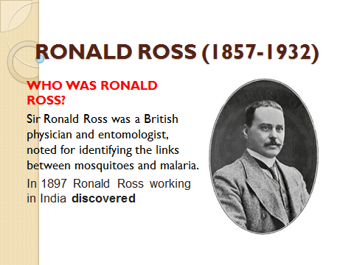

Slide 49
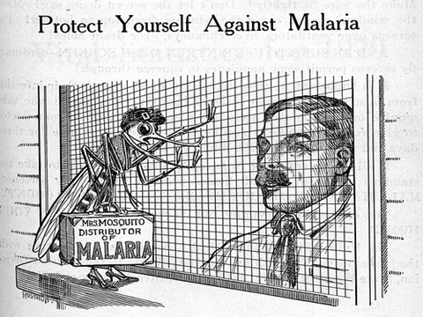

Slide 50
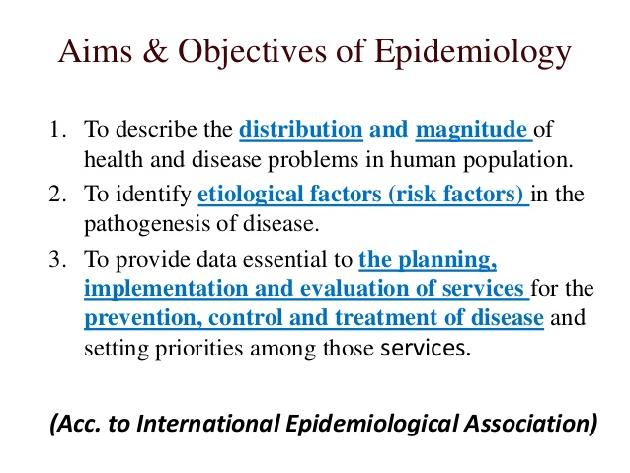

Slide 51
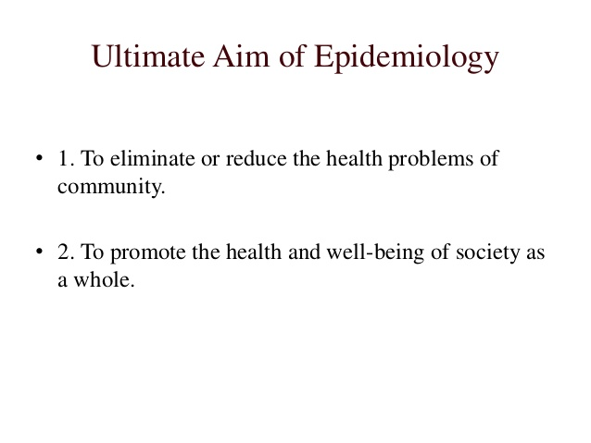

Slide 52
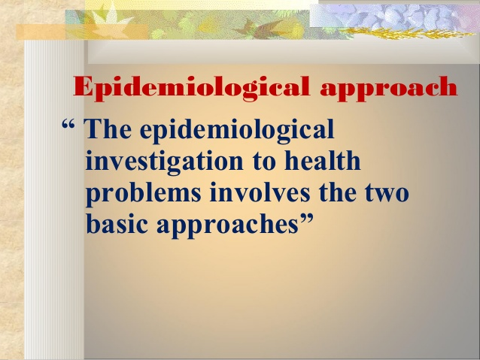

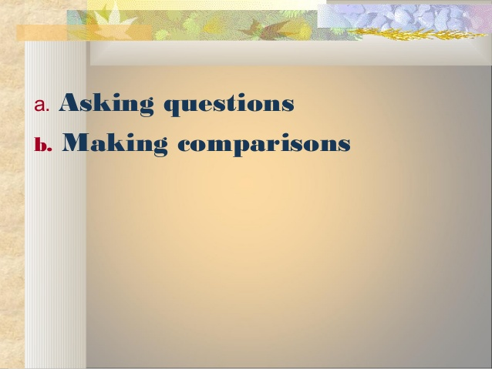

Slide 53
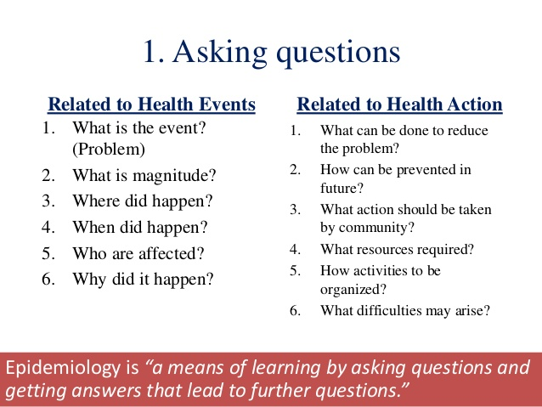

Slide 54
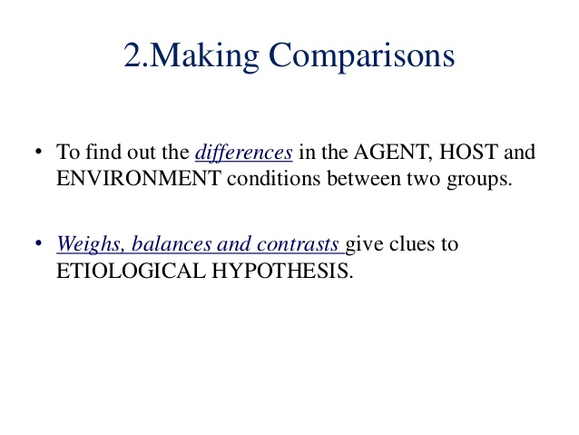
Notes:
Weighs,balances and contrasts

Slide 55
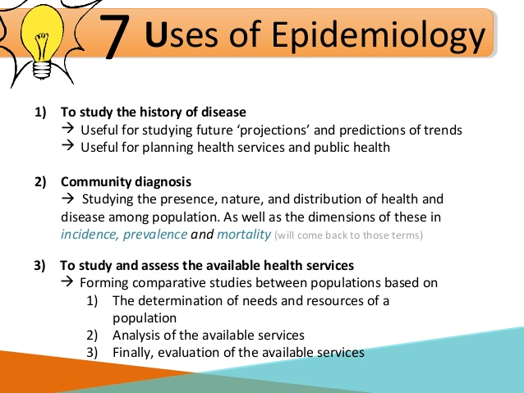

Slide 56
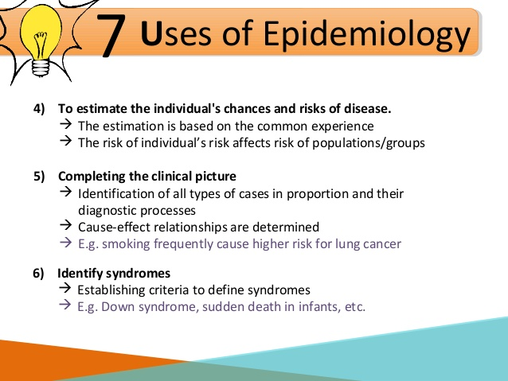

Slide 57
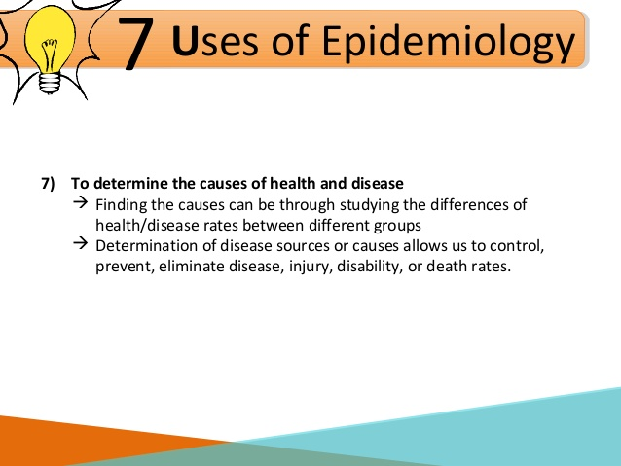

Slide 58

Thank you

Slide 59
Tools of Measurement in Epidemiology
Dr.Amina Elsaid
Community Medicine

Slide 60
Learning objectives
1- Measures of Morbidity
2- Measures of Mortality

Slide 61
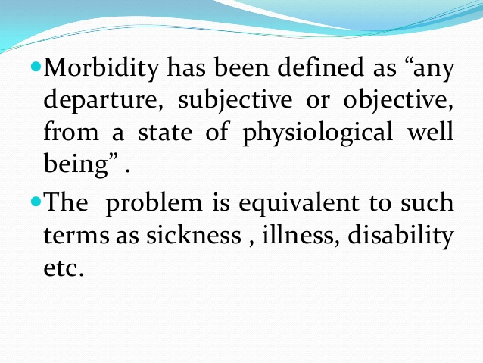
Measures of Morbidity

Slide 62
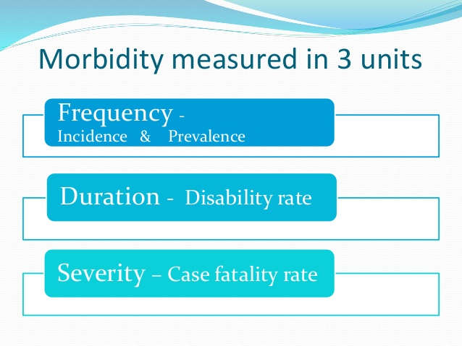

Slide 63
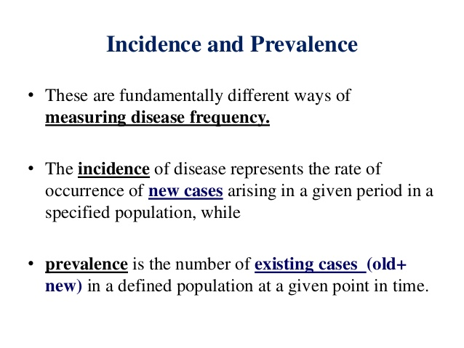

Slide 64
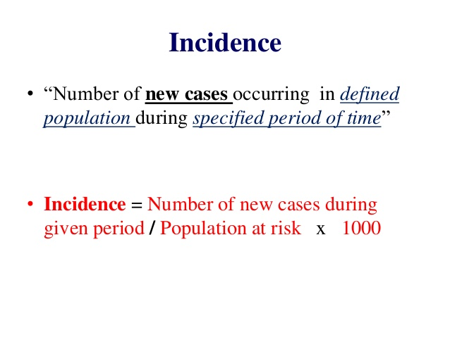

Slide 65
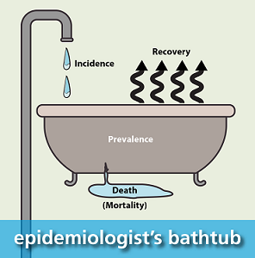
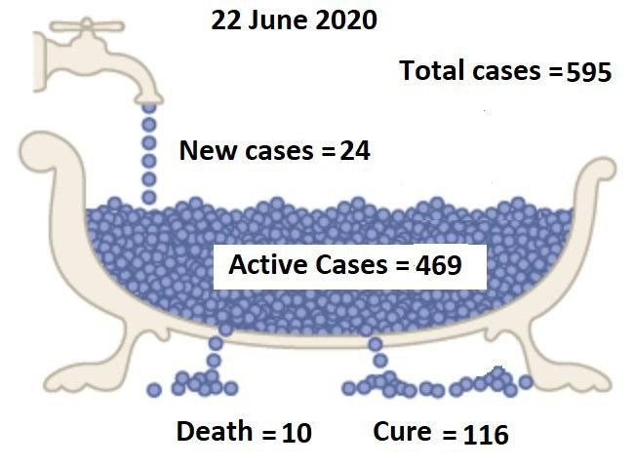

Slide 66
Some applications of incidence rate
A-Attack rate.
B-Secondary attack rate (SAR)
Each type is used in different situation
to measure the occurrence of new cases.

Slide 67
A-Attack rate
It measures the frequency of new cases when the population is exposed to an agent for a limited period of time, such as during an epidemic.
It measures the extent or magnitude of the disease
during an epidemic
(usually used for infectious diseases)
Attack rate = Number of cases of the disease during an epidemic period X 100
Total people at risk of developing the disease during the same
epidemic period

Slide 68
B-Secondary Attack Rate (SAR)
-It is the number of exposed susceptible persons developing the disease within the range of one incubation period following exposure to the primary case.
-SAR is estimated for infectious diseases (measles, influenza) in which primary case is infective
only for a short period of time.
-It also measures the communicability of a disease.

Slide 69
Uses of SAR
1-To measure the spread or communicability of an infection within family or in a closed group
e.g. hostel inmates.
2-To know the communicability of a new disease.
3-To evaluate the control and preventive measures
e.g., vaccination , isolation, etc.

Slide 70
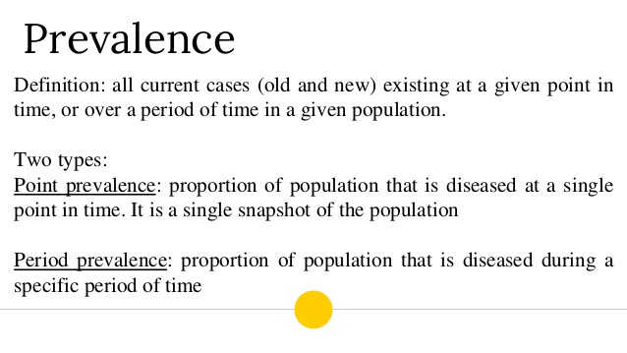

Slide 71
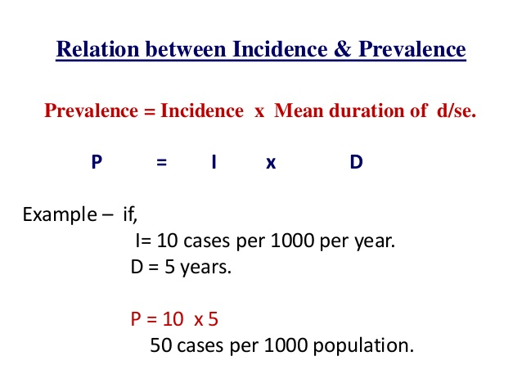

Slide 72
Uses of incidence and prevalence rates
Incidence rate | Prevalence rate
To plan control and preventive measures 2. To evaluate control & preventive measures i.e. if incidence rate of a disease is increasing after application of control and preventive measures, it indicates failure of the measures. There is a need for new measures or present measures needs modification 3. Provides research direction in to a disease | 1-To estimate the total magnitude of a disease in the community 2. To identify potential high risk population 3. Useful for administrative and planning purposes. 4. To plan facilities to deal with the total magnitude of disease e.g. Number of beds, doctors, nurses, required drugs, rehabilitation facilities.

Slide 73

MEASURES OF MORTALITY

Slide 74


Slide 75


Slide 76


Slide 77


Slide 78
Case Fatality Rate (CFR)
“The number of deaths among persons diagnosed with a disease(patients). Case fatality rate is used in acute infectious diseases ( food poisoning, cholera, measles).
Case fatality is expressed in percentage.
It represents the “killing power” of a disease.
Total number of deaths due to a particular disease
CFR = ---------------------------------------------------------- x 100
Total number of cases of the same disease

Slide 79
Standardized Death Rates:
Comparison of death rates of two populations with different age compositions should be done by age adjustment or age standardization as Crude Death rate cannot provide correct comparison.
This removes the confounding effect of different age structures.
Survival Rate:
It is the proportion of survivors in a group studied and followed over a period (usually 5 years). It is a method of describing prognosis in certain disease conditions.
Total number of patients alive after a specific period
Survival rate = ------------------------------------------------------------------- x 100
Total number of patients diagnosed or treated

Slide 80
Thank you

Slide 81
Investigation Of An Epidemic
Dr. Amina Elsaid
Community Medicine

Slide 82
Learning objectives
1- Definition of epidemic
2- Steps in an epidemic Investigation

Slide 83

Epidemic
The unusual occurrence in a community of disease, specific health related behaviors (smoking) or other health related events (accident) clearly in excess of expected occurrence

Slide 84

Epidemic con.
It indicates that some
significant changes have taken place in the existing balance of
AGENT, HOST AND ENVIRONMENT.

Slide 85


Slide 86



1-Verification of diagnosis: It should be done quickly
Clinical examination
laboratory investigation
Notes:
Clinical examination laboratory investigation

Slide 87


2- Confirmation of the existence of an epidemic.
An epidemic is said to exist when the number of cases are in excess of the expected frequency for the specified population during the same period in previous years.

Slide 88

Notes:
dwelling

Slide 89


Slide 90


Slide 91


Slide 92

Search for new cases to be carried out daily till the area is declared free of an epidemic
i.e. twice the incubation period of the disease after the last case or death occurs (epidemic disease).

Slide 93

5. Analysis of data: Data should be analyzed by;
1- Time:- epidemic curve
2- Place:- area specific attack rate can be estimated, (Dot-map or Spot –map).
3- Person:- age, sex, occupation, socio-economic status, exposure to risk factors

Slide 94

Epidemic curve;
Number of cases are shown on Y – axis (vertical) and Time on X-axis (horizontal). It should be done in terms of Time relationship -whether common or propagated source or seasonal/cyclic pattern.

Slide 95


Slide 96


Slide 97


Slide 98


Slide 99


Slide 100
Thank you

