Slide 1
INVESTIGATION OF CARDIOVASCULAR
DISEASE
Dr. Zaki Bettamer
Zikoech@yahoo.com
28/12/2016

Slide 2
Investigation of cardiovascular disease
Electrocardiogram
Cardiac biomarkers
Chest X-ray
Echocardiography (echo)
Computed tomographic imaging
Magnetic resonance imaging
Cardiac catheterisation
Electrophysiology study
Radionuclide imaging

Slide 3
Electrocardiogram
assess cardiac rhythm and conduction.
information about chamber size.
the main test used to assess for myocardial ischaemia and infarction.
The standard 12–lead ECG
Exercise (stress) ECG
Ambulatory ECG

Slide 4
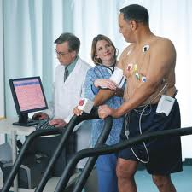
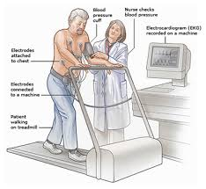
Exercise (stress) ECG

Slide 5
Exercise (stress) ECG
used to detect myocardial ischaemia during physical stress .
helpful in the diagnosis of coronary artery disease.
A 12-lead ECG is recorded during exercise on a treadmill or bicycle ergometer.
The limb electrodes are placed on the shoulders and hips rather than the wrists and ankles.
The Bruce Protocol is the most commonly used for testing.
BP is recorded and symptoms assessed throughout the test.
A test is ‘positive’ if anginal pain occurs, BP falls or fails to increase, or if there are ST segment shifts of more than 1 mm

Slide 6
Exercise (stress) ECG
False-negative results can occur in patients with coronary artery disease,
false-positive with patients a positive test will not have coronary disease .
contraindicated in the presence of acute coronary syndrome, decompensated heart failure, severe AS and severe hypertension.

Slide 7
Indications
To confirm the diagnosis of angina
To evaluate stable angina
To assess prognosis following myocardial infarction
To assess outcome after coronary revascularisation, e.g. coronary angioplasty
To diagnose and evaluate the treatment of exercise-induced arrhythmias

Slide 8
High-risk findings
Low threshold for ischaemia (i.e. within stage1 or 2 of the Bruce Protocol)
Fall in BP on exercise
Widespread, marked or prolonged ischaemic ECG changes
Exercise-induced arrhythmia

Slide 9
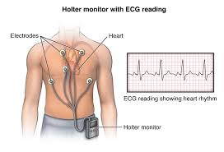
Ambulatory ECG ( Holter monitor )

Slide 10
Ambulatory ECG
Continuous (ambulatory) ECG recordings can be obtained using a portable digital recorder.
These devices usually provide limb lead ECG recordings only.
can record for between 1 and 7 days.
Ambulatory ECG recording is principally used in the investigation of patients with suspected arrhythmia, such as those with intermittent palpitation, dizziness or syncope. For these patients.

Slide 11
Ambulatory ECG
used to assess rate control in patients with atrial fibrillation, and are sometimes used to detect transient myocardial ischaemia using ST segment analysis.
patients with more infrequent symptoms, small, patient-activated ECG recorders can be issued for several weeks until a symptom episode occurs.
The patient places the device on the chest to record the rhythm during the episode. With some devices, the recording can be transmitted to hospital via telephone.
Implantable ‘loop recorders’ resemble a leadless pacemaker and are implanted subcutaneously. They have a lifespan of 1–3 years and are used to investigate patients with infrequent but potentially serious symptoms, such as syncope.

Slide 12
Cardiac biomarkers
Plasma or serum biomarkers can be measured to assess myocardial dysfunction and ischaemia.
Brain natriuretic peptide
. This is a 32-amino acid peptide and is secreted by the LV along with an inactive
76 amino acid N-terminal fragment (NT-proBNP).
. The latter is diagnostically more useful, as it has a longer half-life.
. It is elevated principally in conditions associated with left ventricular systolic
dysfunction, and may aid the diagnosis and assess prognosis and response to therapy
in patients with heart failure

Slide 13
Biochemical Changes in Acute Myocardial Infarction
(mechanism of release of myocardial markers)
ischemia to myocardial muscles (with low O₂ supply)
anaerobic glycolysis
increased accumulation of Lactate
decrease in pH
activate lysosomal enzymes
disintegration of myocardial proteins
cell death & necrosis
clinical manifestations
(chest pain)
release of intracellular contents to blood
BIOCHEMICAL MARKERS
ECG
changes

Slide 14
Cardiac biomarkers
Cardiac troponins
Troponin I and troponin T are structural cardiac muscle proteins that are released during myocyte damage and necrosis, and represent the cornerstone of the diagnosis of acute myocardial infarction.
can detect very low levels in myocardial damage, so are seen in other acute conditions, such as pulmonary embolus, septic shock and acute pulmonary oedema .
cTnI completely specific for the heart
4-6 hours to rise post-infarct, similar to CKMB
6-9 hours to detect pathologic elevations in all patients with infarct
Elevated levels can persist in blood for weeks; the cardiac specificity of troponins thus make them the ideal marker for retrospective diagnosis of infarction

Slide 15
CK-MB: Shortcomings
Concomitant skeletal muscle damage can confuse the issue of diagnosis:
  CPR and defibrillation
  Cardiac and non-cardiac procedures
  Blunt chest trauma
  Cocaine abuse

Slide 16
Myoglobin
Heme protein rapidly released from damaged muscle
Elevations can be seen as early as one hour post-infarct
Much less cardiac specific; meant to be used as a marker protein for early diagnosis in conjunction with troponins

Slide 17
Cardiac Biomarkers in AMI

Slide 18
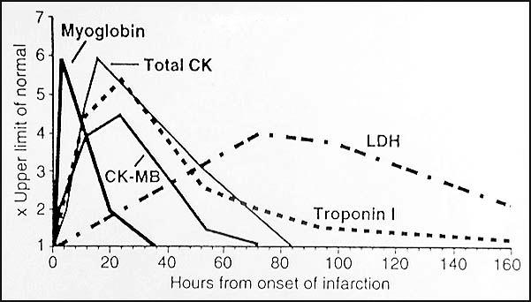
Troponins

Slide 19
Chest X-ray
Different tissues in our body absorb X-rays at different extents:
Bone- high absorption (white)
Tissue- somewhere in the middle absorption (grey)
Air- low absorption (black)

Slide 20
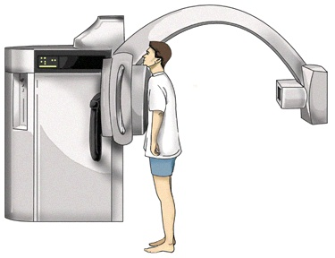
CXR Film Quality
First determine is the film a PA or AP view.
PA- the x-rays penetrate through the back of the patient on to the film
AP-the x-rays penetrate through the front of the patient on to the film.
All x-rays in the ICU are portable and are AP view

Slide 21
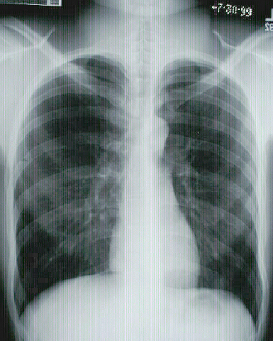

Slide 22
Gastric bubble should be on the left
Verify Right and Left sides

Slide 23
Look at the diaphragm:
for tenting
free air
abnormal elevation
Margins should be sharp
(the right hemidiaphragm is usually slightly higher than
the left)

Slide 24
Check the Heart
Size
Shape
Diameter (>1/2 thoracic diameter is enlarged heart)
Remember: AP views make heart appear larger than it actually is.

Slide 25
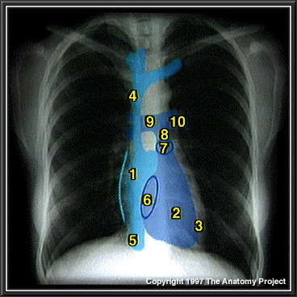
R Atrium
R Ventricle
3. Apex of L Ventricle
Superior Vena Cava
Inferior Vena Cava
6. Tricuspid Valve
Pulmonary Valve
Pulmonary Trunk
9. R PA 10. L PA

Slide 26
Check the costophrenic angles
Remember CXR
Should be done with
Full inspiration

Slide 27
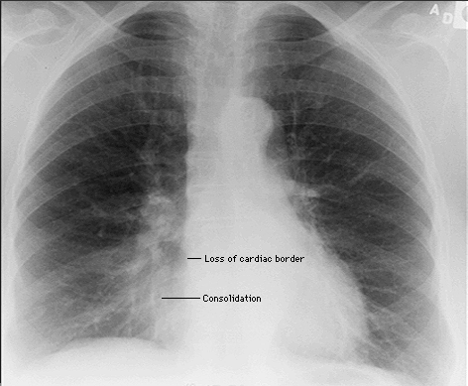
Loss of Sharp Costophrenic Angles

Slide 28
Check the hilar region
The hilar – the large blood vessels going to and from the lung at the root of each lung where it meets the heart.
Check for size and shape of aorta, nodes ,enlarged vessels

Slide 29
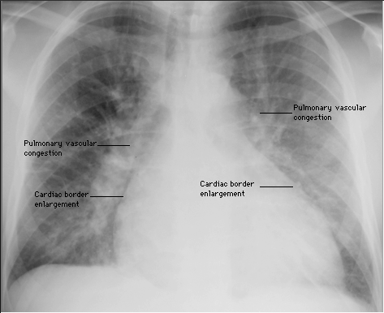

Slide 30
Finally, Check the Lung Fields
Infiltrates
Increased interstitial markings
Masses
Absence of normal margins
Air bronchograms
Increased vascularity

Slide 31
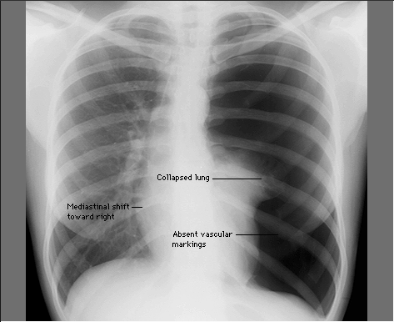

Slide 32
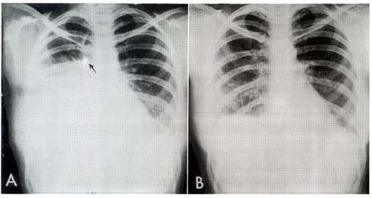
Hemothorax

Slide 33
Chest X-ray
useful for determining the size and shape of the heart.
determining the state of the pulmonary blood vessels and lung fields.
Most information is given by a posteroanterior (PA) projection taken in full inspiration.
Anteroposterior (AP) projections are convenient result in magnification of the cardiac shadow.
heart size can be made by comparing the maximum width of the cardiac outline with the maximum internal transverse diameter of the thoracic cavity.

Slide 34
Chest X-ray
‘Cardiomegaly’ is the term used to describe an enlarged cardiac silhouette where the ‘cardiothoracic ratio’ is greater than 0.5.
caused by chamber dilatation ( esp. LV ) & pericardial effusion.
Lateral or oblique projections may be useful for detecting pericardial calcification in patients with constrictive pericarditis or a calcified thoracic aortic aneurysm
The lung fields on the chest X-ray may show congestion and oedema and Pleural effusions in patients with heart failure.

Slide 35
Pulmounary congestion and oedema

Slide 36
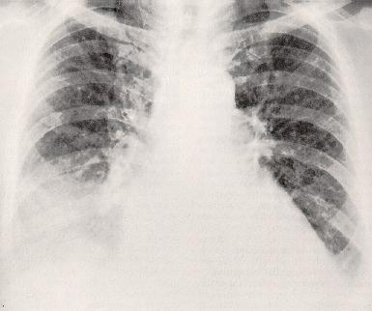
Pulmounary congestion and oedema and Pleural effusions

Slide 37
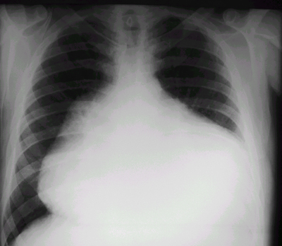
Pericardial effusion

Slide 38
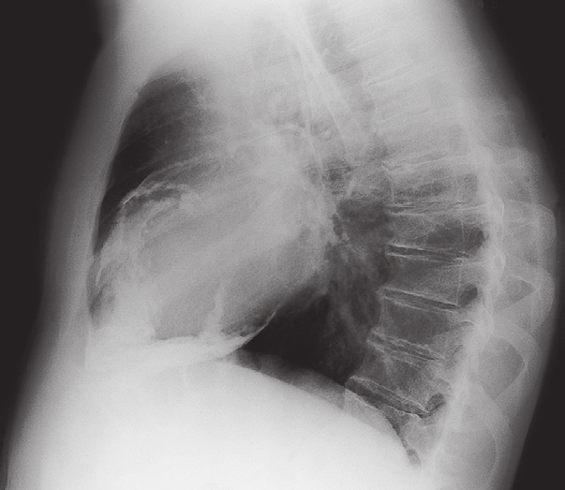
Pericardial calcification constrictive pericarditis

Slide 39
Echocardiography (echo)
Two-dimensional echocardiography
Echocardiography, or cardiac ultrasound, is obtained by placing an ultrasound transducer on the chest wall to image the heart structures as a real-time.
This permits the rapid assessment of cardiac structure and function. Left ventricular wall thickness and ejection fraction can be estimated.
Common indications
Assessment of left ventricular function
Diagnosis and quantification of severity of valve disease
Identification of vegetations in endocarditis
Identification of structural heart disease in atrial fibrillation, cardiomyopathies or congenital heart disease
Detection of pericardial effusion
Identification of structural heart disease or intracardiac thrombus in systemic embolism

Slide 40
Doppler echocardiography
This depends on the Doppler principle that sound waves reflected from moving objects, such as intracardiac red blood cells,
Doppler echocardiography can be used to detect valvular regurgitation.
Advanced techniques include
three-dimensional echocardiography,
intravascular ultrasound (defines vessel wall abnormalities and guides coronary intervention),
intracardiac ultrasound (provides high-resolution images)
tissue Doppler imaging (quantifies myocardial contractility and diastolic function).

Slide 41
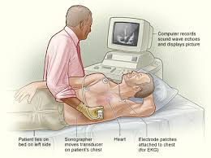

Slide 42
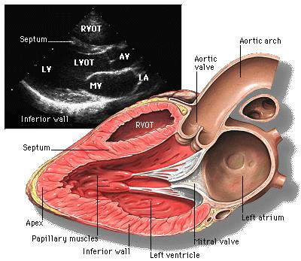

Slide 43
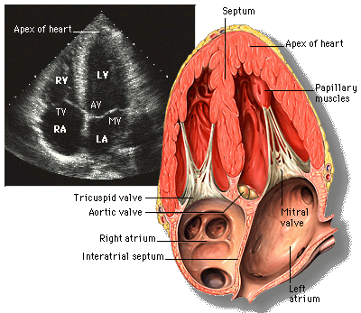

Slide 44
Transoesophageal echocardiography
TTE sometimes produces poor images, especially if the patient is overweight or has obstructive airways disease.
Some structures are difficult to visualise in transthoracic views, such as the left atrial appendage, pulmonary veins, thoracic aorta and interatrial septum.
TOE uses an endoscope-like ultrasound probe which is passed into the oesophagus under light sedation and positioned behind the LA.
This produces high-resolution images, which makes the technique particularly valuable for investigating patients with prosthetic (especially mitral) valve dysfunction, congenital abnormalities (e.g. atrial septal defect), aortic dissection, infective endocarditis (vegetations that are too small to be detected by transthoracic echocardiography) and systemic embolism (intracardiac thrombus or masses).

Slide 45
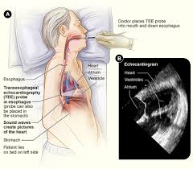

Slide 46
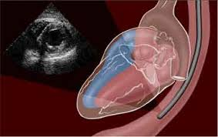

Slide 47
Stress echocardiography
Stress echocardiography is used to investigate patients with suspected coronary artery disease who are unsuitable for exercise stress testing, such as those with mobility problems or pre-existing bundle branch block.
A two-dimensional echo is performed before and after infusion of a moderate to high dose of an inotrope, such as dobutamine. Myocardial segments with poor perfusion become ischaemic and contract poorly under stress, showing as a wall motion abnormality on the scan.
Stress echocardiography is sometimes used to examine myocardial viability in patients with impaired left ventricular function.
Low-dose dobutamine can induce contraction in ‘hibernating’ myocardium; such patients may benefit from bypass surgery or percutaneous coronary intervention.

Slide 48
Computed tomographic imaging
CT is useful for imaging the cardiac chambers, great vessels, pericardium, and mediastinal structures and masses.
Multidetector scanners can acquire up to 320 slices per rotation, allowing very high-resolution imaging.
CT is often performed using a timed injection of X-ray contrast to produce clear images of blood vessels and associated pathologies.
Contrast scans are very useful for imaging the aorta in suspected aortic dissection and the pulmonary arteries and branches in suspected pulmonary embolism .

Slide 49
CT
used for quantification of coronary artery calcification.
modern multidetector scanning allows non-invasive coronary angiography .
CT coronary angiography is particularly useful in the initial elective assessment of patients with chest pain that is, excluding the presence of coronary artery disease.
Modern volume scanners are also able to assess myocardial perfusion, often at the same sitting.

Slide 50
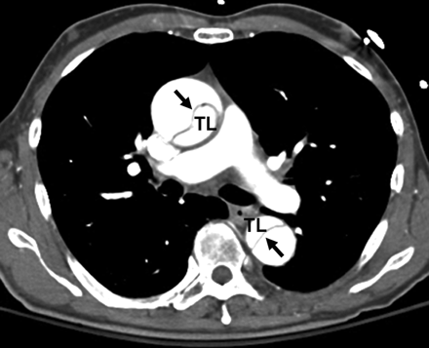
Contrast CT scan
Acute type A AD
Enlargement of the ascending aorta
intimal flap (arrow) in the ascending and descending aorta.
Both the true lumen (TL) and false lumen are opacified with contrast

Slide 51
Magnetic resonance imaging
MRI requires no ionising radiation and can be used to generate cross-sectional images of the heart, lungs and mediastinal structures.
It provides better differentiation of soft tissue structures than CT but is poor at demonstrating calcification.
MRI scans allowing the scanner to produce moving images of the heart and mediastinal structures throughout the cardiac cycle.
MRI is very useful for imaging the aorta, including suspected dissection .
can define the anatomy of the heart and great vessels in patients with congenital heart disease.

Slide 52
MRI
useful for detecting infiltrative conditions affecting the heart.
allows quantification of blood flow across regurgitant or stenotic valves.
analyse regional wall motion in patients with suspected coronary disease or cardiomyopathy.
The RV is difficult to assess using echocardiography because of its retrosternal position but is readily visualised with MRI.
assess myocardial perfusion and viability.
identifying those with myocardial infiltration such as that seen with sarcoid heart disease and right ventricular dysplasia.

Slide 53
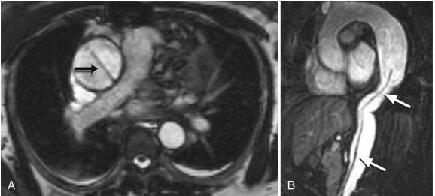
A, MRI demonstrating type A aortic dissection with an intimal flap.
B, MRI of a chronic type B aortic dissection with intimal flap (arrows) and aneurysmal enlargement of the proximal descending aorta.

Slide 54
Cardiac catheterisation
This involves passage of a preshaped catheter via a vein or artery into the heart under X-ray guidance, which allows the measurement of pressure and oxygen saturation in the cardiac chambers and great vessels.
performance of angiograms by injecting contrast media into a chamber or blood vessel.
Left heart catheterisation involves accessing the arterial circulation, usually via the radial artery, to allow catheterisation of the aorta, LV and coronary arteries.
Coronary angiography is the most widely performed procedure, in which the left and right coronary arteries are selectively cannulated and imaged, providing information about the extent and severity of coronary stenoses, thrombus and calcification .

Slide 55
Cardiac catheterisation
This permits planning of percutaneous coronary intervention and coronary artery bypass graft surgery.
Left ventriculography can be performed during the procedure to determine the size and function of the LV and to demonstrate mitral regurgitation.
Aortography defines the size of the aortic root and thoracic aorta, and can help quantify aortic regurgitation.
Left heart catheterisation is a daycase procedure and is relatively safe, with serious complications occurring in fewer than 1 in 1000 cases.

Slide 56
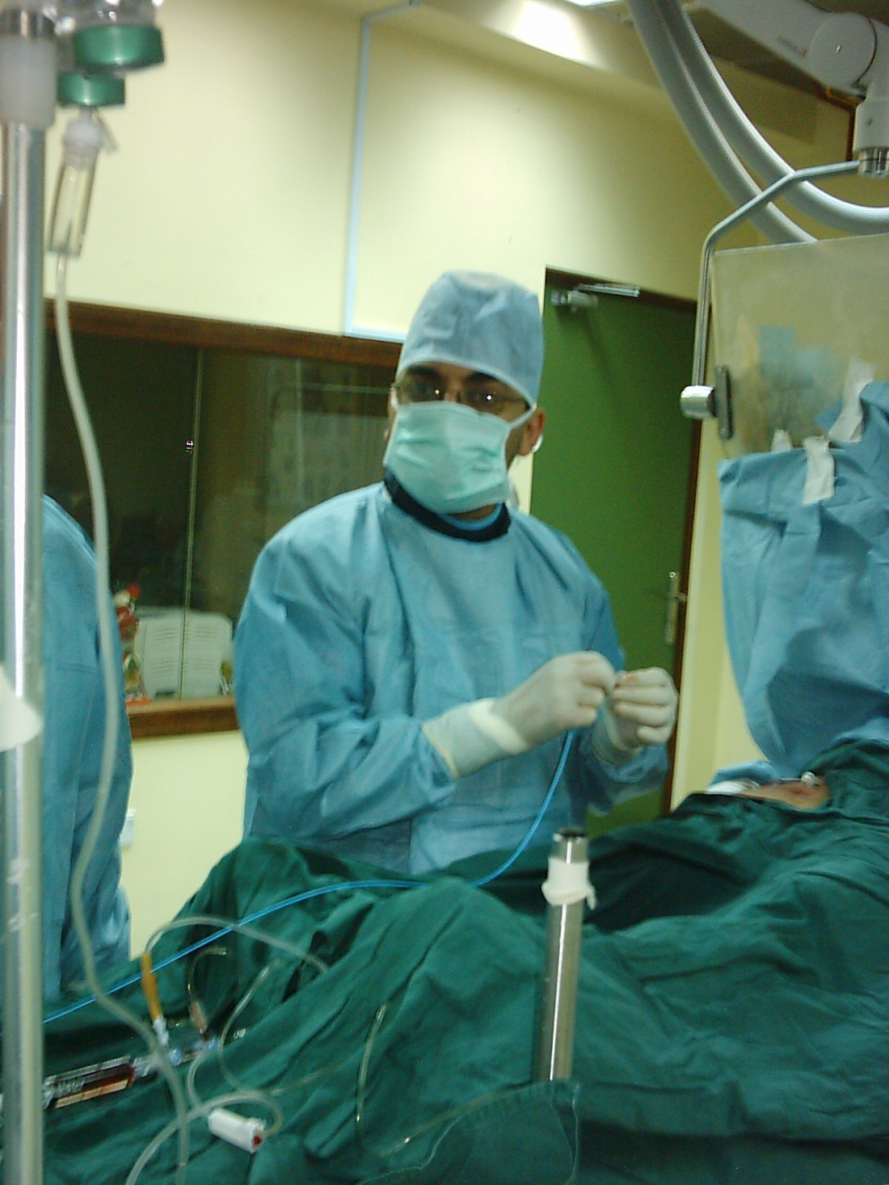
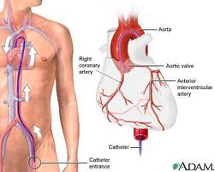
Cardiac Catheterization

Slide 57
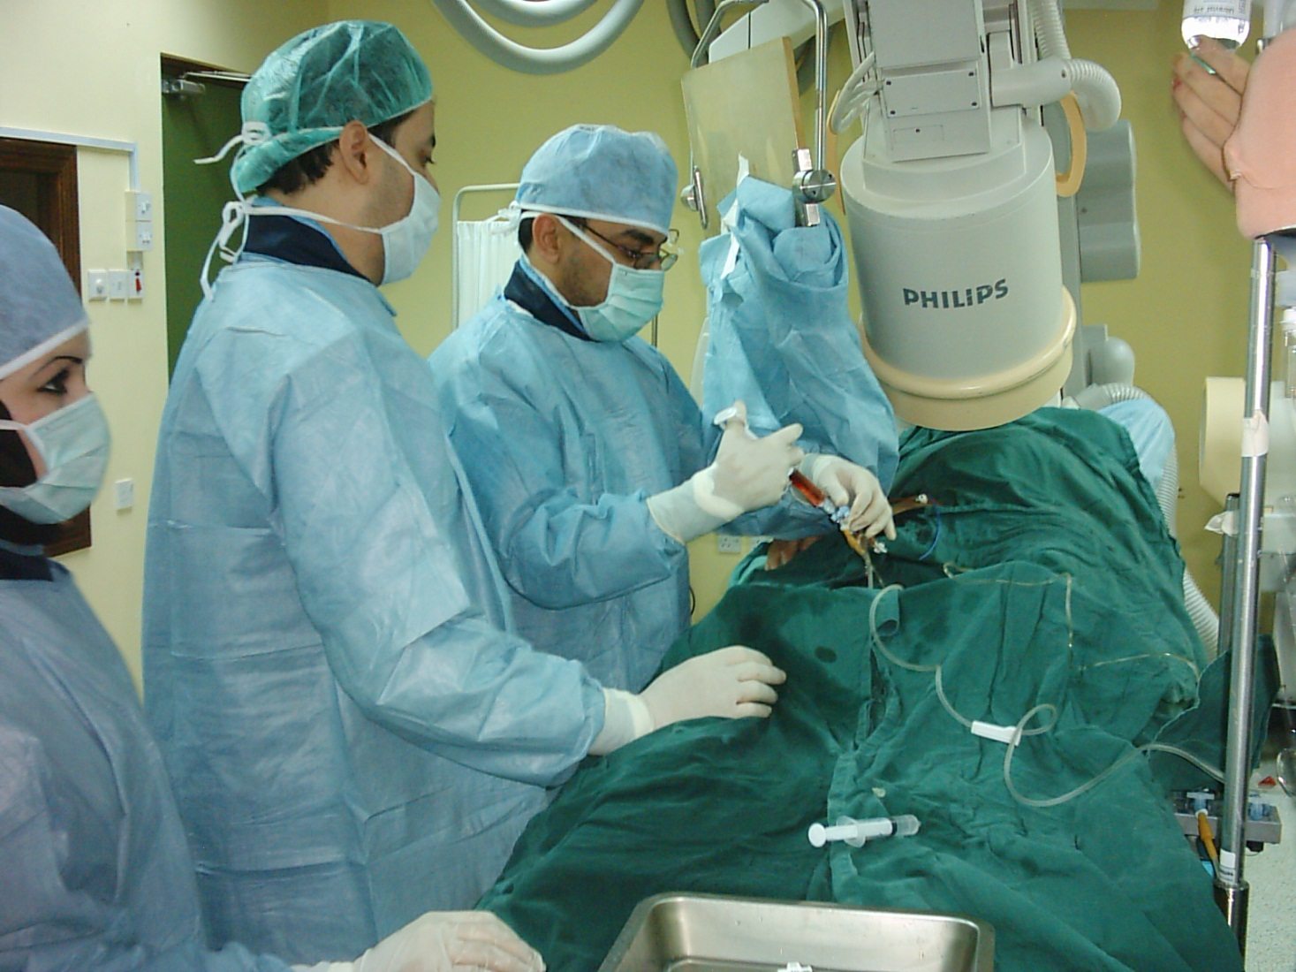

Slide 58
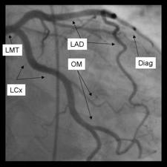
Coronary Angiography
Left Main Trunk
Left Anterior
Descending
Left Circumflex
Diagonal branch

Slide 59
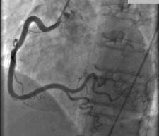
RCA
NORMAL RCA

Slide 60
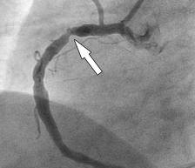
RCA
Stenosis RCA

Slide 61
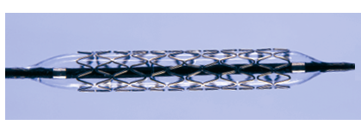

Slide 63
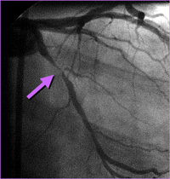
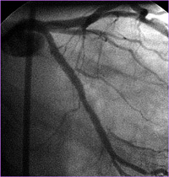
PTCA WITH STENTING
The arrow on the angiogram shows block in the artery.
Opening of the artery after stenting Opening of the artery after stenting

Slide 64
Right heart catheterisation
is used to assess right heart and pulmonary artery pressures, and to detect intracardiac shunts by measuring oxygen saturations in different chambers.
Cardiac output can also be measured using thermodilution techniques.
Left atrial pressure can be measured directly by puncturing the interatrial septum from the RA with a special catheter.

Slide 65
Electrophysiology study
Patients with known or suspected arrhythmia are investigated by percutaneous placement of electrode catheters into the heart via the femoral and neck veins.
Electrophysiology study (EPS) is most commonly performed to evaluate patients for catheter ablation, normally done during the same procedure.
It is occasionally used for risk stratification of patients suspected of being at risk of ventricular arrhythmias

Slide 66
Radionuclide imaging
The availability of gamma-emitting radionuclides with a short half-life has made it possible to study cardiac function non-invasively.
Two techniques are available, although their use is declining due to the availability of equivalent or superior imaging techniques that have lower or no exposure to ionising radiation.
Blood pool imaging
The isotope is injected intravenously and mixes with the circulating blood.
A gamma camera detects the amount of radiation-emitting blood in the heart at different phases of the cardiac cycle, thereby permitting the calculation of ventricular ejection fractions.
It also allows the assessment of the size and ‘shape’ of the cardiac chambers.

Slide 67
Myocardial perfusion imaging
This technique involves obtaining scintiscans of the myocardium at rest and during stress after the administration of an intravenous radioactive isotope, such as 99technetium tetrofosmin .
More sophisticated quantitative information is obtained with positron emission tomography (PET), which can also be used to assess myocardial metabolism, but this is only available in a few centres.

Slide 68
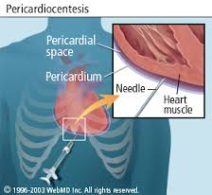
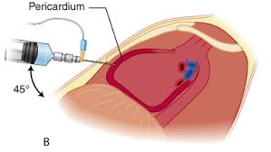
Pericardiocenesis

Slide 69
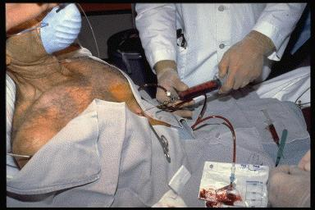

Slide 70
Pericardiocenesis
Indications cardiac tamponade analyze the fluid
Complications Dysrhythmias
Coronary artery puncture or aneurysm
Left internal mammary artery puncture or aneurysm
Hemothorax , Pneumothorax, Pneumopericardium , Hepatic injury
False-negative aspiration – Clotted blood in the pericardium
False-positive aspiration – Intracardiac aspiration
Reaccumulation of pericardial fluid

Slide 71
Jones criteria for the diagnosis of rheumatic fever
Major manifestations
• Carditis
• Polyarthritis
• Chorea
• Erythema marginatum
• Subcutaneous nodules
Minor manifestations
• Fever
• Arthralgia
• Previous rheumatic fever
• Raised ESR or CRP
• Leucocytosis
• First-degree AV block

Slide 72

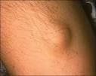
Subcutaneous nodules

Slide 73

Polyarthritis

Slide 74
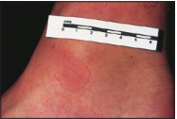
Erythema marginatum

Slide 75
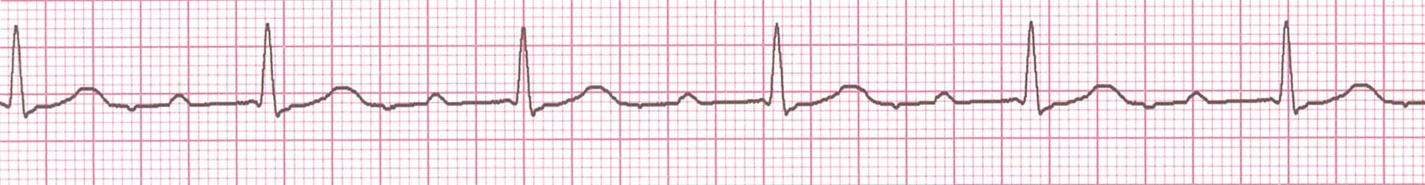
First degree HB

Slide 76

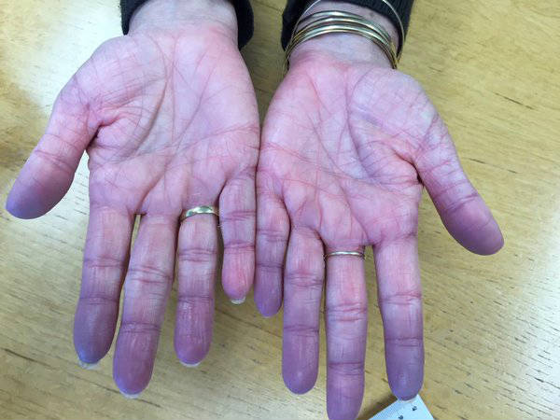
cyanosis

Slide 77
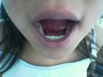


cyanosis

Slide 78
Types of cyanosis
Central
The blood leaves the heart containing
bad quality HB ( reduced HB more
than 5gm %)
* CVS
Congenital cyanotic heart diseases
(F3,F4,Eisenmenger )
* Pulmonary
*COPD
*acute pulmonary edema
*IPF
* pulmonary embolism
*liver cirrhosis
Peripheral
The blood leaves the heart containing normal level of reduced HB but due to its tagnation in the peripheral circulation
Allows more time for O2 extraction by tissues so raising the reduced HB
heart failure
*Cold
*peripheral vascular
disease as Raynauds

Slide 79
cyanosis
All the body including tongue
Warm (hypoxia induced VD)
No effect of warming
Clubbing
Low Po2
Inhalation of O2 improves only pulmonary causes
All except tongue
Cold ( VC)
Cyanosis improves
Absen tof clubbing
Normal Po2
No effect of inhaled O2

Slide 80
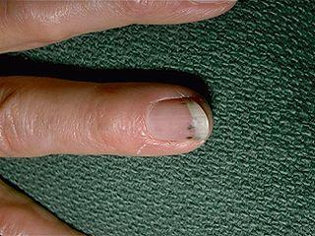
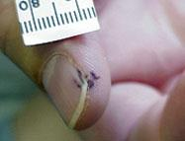
Splinter Hemorrhages
1. Nonspecific
2. Nonblanching
3. Linear reddish-brown lesions found under the nail bed
4. Usually do NOT extend the entire length of the nail

Slide 81
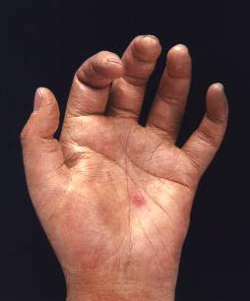
Osler’s Nodes
1. More specific
2. Painful and erythematous nodules
3. Located on pulp of fingers and toes
4. More common in subacute IE

Slide 82
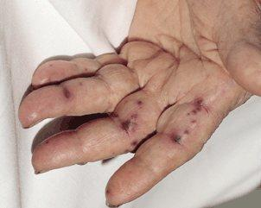
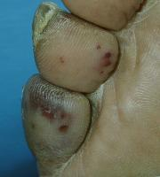
Janeway Lesions
1. More specific
2. Erythematous, blanching macules
3. Painless.
4. Located on palms and soles

Slide 83
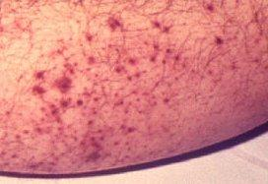
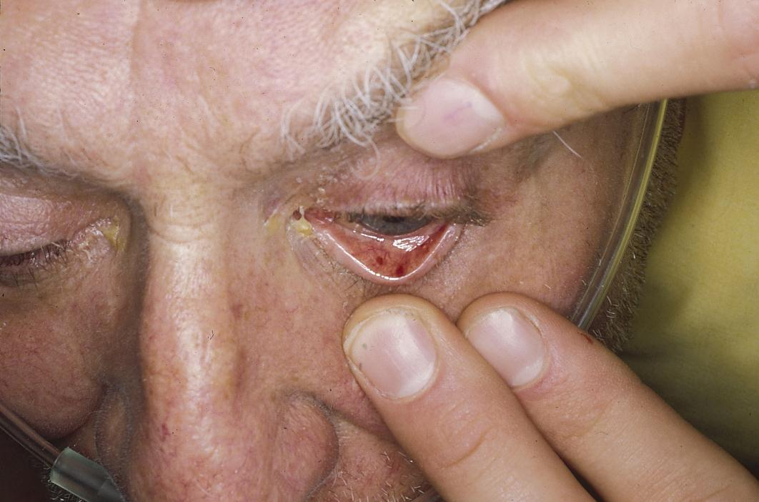
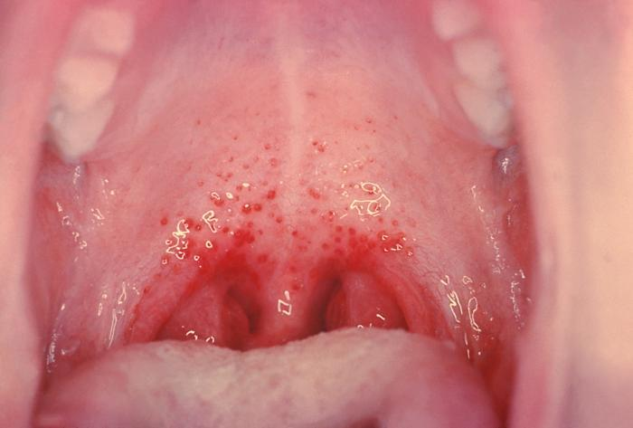
Petechiae
1.Nonspecific
2.Often located on extremities or mucous membranes

Slide 84

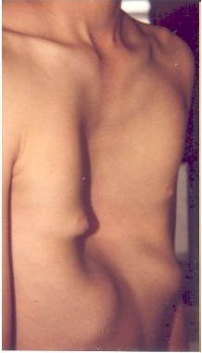
Pectus carinatum & excavatum

Slide 85
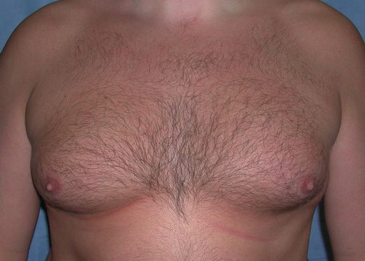
Gynaecomastia
Liver cirrhosis
Hyperthyroidism
Klinefilter syndrome
Testicular tumors
Bronchogenic carcinoma
drugs

Slide 86
Drugs frequently causing gynecomastia
Antiandrogens | Bicalutamide, flutamide, finasteride, dutasteride
Antihypertensive | Spironolactone
Antiretroviral | Protease inhibitors (saquinavir, indinavir, nelfinavir, ritonavir, lopinavir), reverse transcriptase inhibitors (stavudine, zidovudine, lamivudine)
Environmental exposure | Phenothrin (antiparasitical)
Exogenous hormones | Oestrogens, prednisone (male teenagers)
Gastrointestinal drugs | H2 histamine receptor blockers (cimetidine)

Slide 87
Drugs possibly causing gynecomastia
Antifungal | Ketoconazole (prolonged oral use)
Antihypertensive | Calcium channel blockers (amlodipine, diltiazem, felodipine, nifedipine, verapamil)
Antipsychotic (first generation) | Haloperidol, olanzapine, paliperidone (high doses), risperidone (high doses), ziprasidone
Antiretroviral | Efavirenz
Chemotherapy drugs | Methotrexate, cyclophosphamide, carmustine, etoposide, cytarabine, melphalan, bleomycin, cisplatin, vincristine, procarbazine
Exogenous hormones | Androgens (athletes abuse)
Gastrointestinal drugs | Proton pump inhibitors (omeprazole)
Cardiovascular drugs | Phytoestrogens (soya-based products, high quantity)

Slide 88
Drugs rarely or very unlikely causing gynecomastia
Miscellany | Amiodarone, amphetamine, aripiprazole, atorvastatin, captopril, cetirizine, clonidine, cyproterone acetate, dasatinib, diazepam, diethylstilbestrol, digoxin, domperidone, entecavir, ethanol, fenofibrate, fluoxetine, gabapentin, heroin, imatinib, lisinopril, loratadine, marijuana, methadone, metronidazole, misoprostol, MyTosterone®, paroxetine, penicillamine, phthalates, pravastatin, pregabalin, ranitidine, rosuvastatin, sulindac, sulpiride, sunitinib, theophylline, venlafaxine

Slide 89
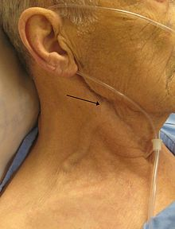
Raised JVP

Slide 90

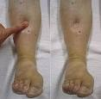

Slide 91


Saphenus graftpost CABG

Slide 92


ICD CRT

Slide 93
How To Measure The Bp:
• The BP cuff bladder should be at least 20% wider than the arm
• The patient should be relaxed and the arm at the level of the heart
• Wrap the cuff at least 2.5cm above the cubital fossa
• Palpate the brachial pulse medial to the biceps tendon and use this area for auscultation
• First assess the systolic BP by palpation of the radial artery to avoid auscultatory gap.
• Auscultate for the SBP by raising the pressure of the sphygnomanometer until the brachial pulse is obliterated then deflate the cuff slowly at a rate of 3 mmHg / sec
• The point at which the sound appears is taken as SBP
• Then continue to deflate till the point of diastolic muffling and the point of diastolic disappearance which is usually recorded as DBP
• Normally the difference between those two points (muffling/disappearance) is less than 10mmHg and if more, the point of muffling is used as the DBP (as in most cases of hyperdynamic circulation and VD e.g. paregnancy, AI, hypoxia , A-V fistula )

Slide 94
THANK YOU

