Slide 1


Libyan International Medical University
Faculty of Business Administration
Target Market
Name : Shatha wail elwerfalli
ID : 3299
Email: shatha_3299@limu.edu.ly
Date :27th /April/ 2022

Slide 2
Objectives
Understand what Target Market is
Get to know more about it
1

Slide 3
Table of Contents
What’s a Target Market
Importance of Target Market
Data points to include your Target Market
Examples
Conclusion
References
2

Slide 4
Target Market
A target market is a group of potential customers that you identify to sell products or services to. Each group can be divided into smaller segments.
Segments are typically grouped by :
-age
- location
- income and lifestyle.
Once you’ve defined your target audience, you’ll find it easier to determine where and how to market your business.
3

Slide 5
Importance of Target Market
Knowing your customers will help you to target customers who are willing to pay for your product or service.
4

Slide 6
Types of Target Market :
-Demographics
-Geographics
-Psychographics
-Behavioral Patterns
5

Slide 7
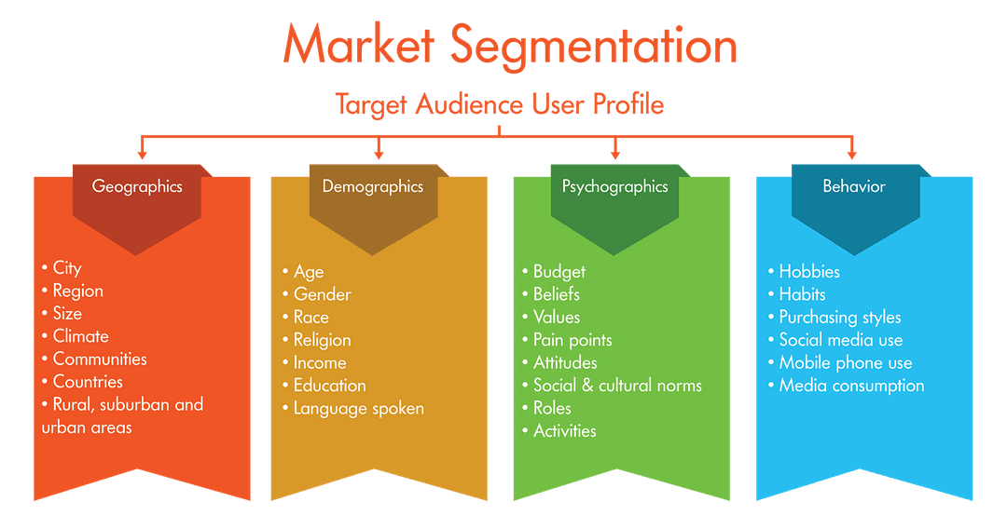
6

Slide 8
Conclusion
Targeted marketing has huge potential, both for the benefit of your business and for consumers in need of your services or product. Like all marketing methods, however, it comes with pros and cons that will change based upon your business, the current market and your own growth potential.
7

Slide 9
References
Identify your target market. Support for businesses in Australia. (n.d.). Retrieved April 27, 2022.
Matson, M. (2022, February 17). Define your Target Market. Types of Target Market . ReferralCandy. Retrieved April 27, 2022.
Understanding Target Market. Toolbox.com. (n.d.). Retrieved April 27, 2022.
8

Slide 10


