Slide 1

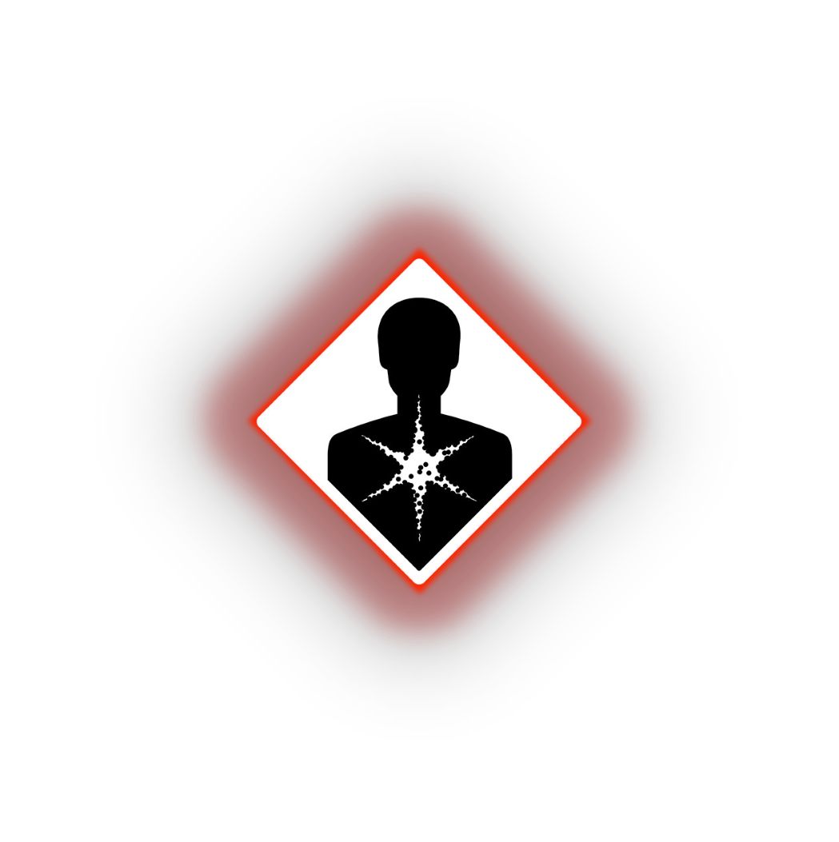

LIBYAN INTERNATIONAL MEDICAL UNIVERSITY
1th YEAR
Carcinogen
Presented by SALMA ALZAEIM 3461
17/5/2022

Slide 2

Objectives:
1
Introduction to carcinogen
2
Mechanism of carcinogen
3
List common carcinogens
4

Slide 3
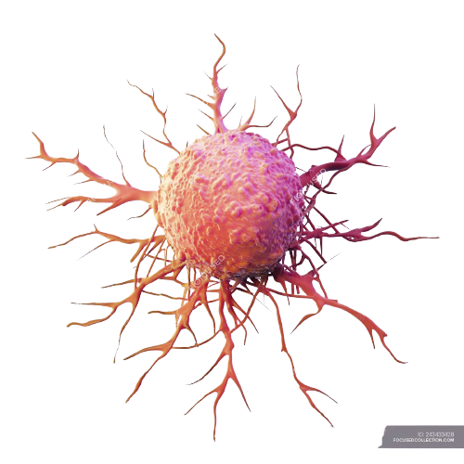
Introduction of carcinogen

Slide 4
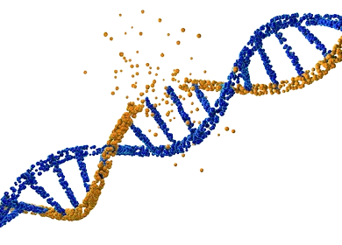
Introduction
A carcinogen is any substance, radionuclide, or radiation that promotes carcinogenesis due to the ability to damage the genome.

Slide 5
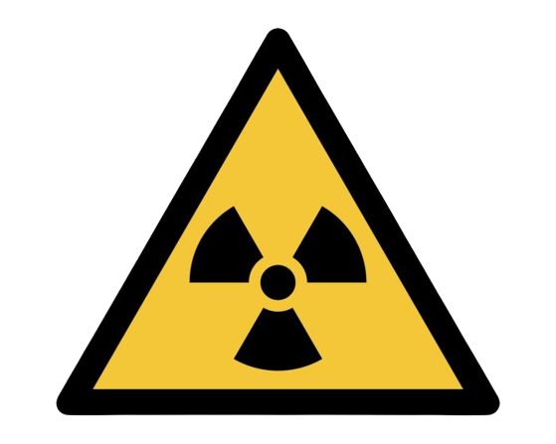
Introduction
Several radioactive substances are considered carcinogens, but their carcinogenic activity is attributed to the radiation, for example gamma rays and alpha particles.

Slide 6
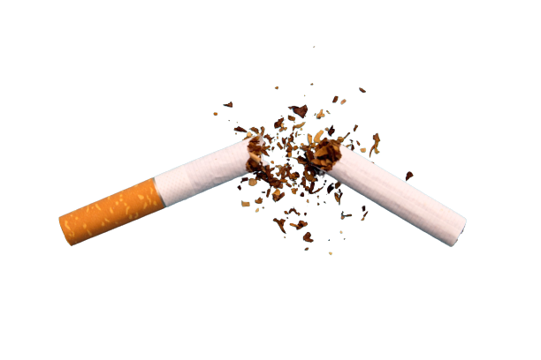
Introduction
Common examples of non-radioactive carcinogens are inhaled asbestos certain dioxins, and tobacco smoke.

Slide 7
Mechanism of carcinogen
Carcinogens can be classified as genotoxic or nongenotoxic.
Genotoxins
cause irreversible genetic damage or mutations by binding to DNA. Genotoxins include chemical agents like N-nitroso-N-methylurea (NMU) or non-chemical agents such as ultraviolet light and ionizing radiation. Certain viruses can also act as carcinogens by interacting with DNA.

Slide 8
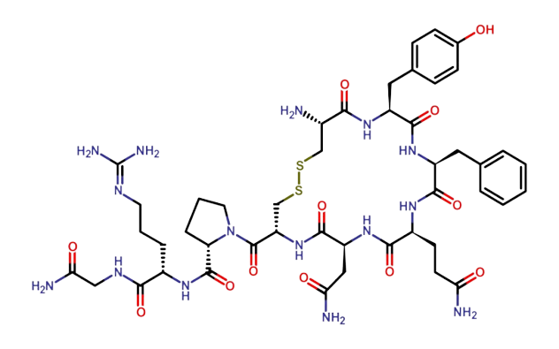
Mechanism of carcinogen
Nongenotoxins do not directly affect DNA but act in other ways to promote growth. These include hormones and some organic compounds

Slide 9
Mechanism of carcinogen
Occupational carcinogens
Occupational carcinogens are agents that pose a risk of cancer in several specific work locations:

Slide 10
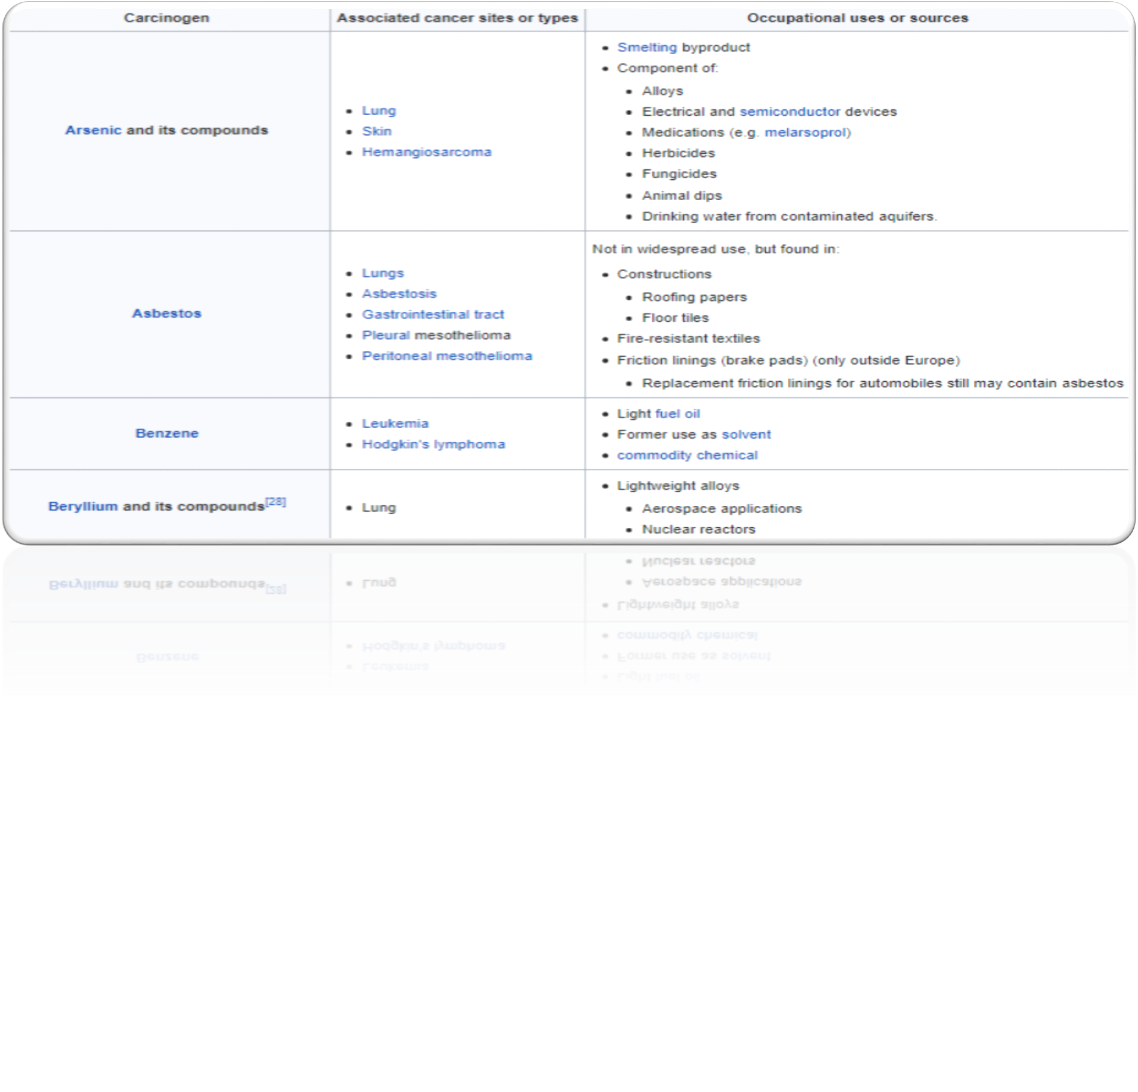

Slide 11
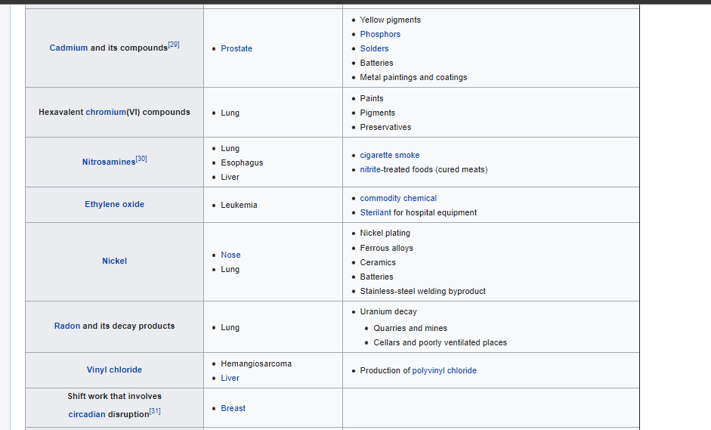

Slide 12
Reference
1- Ames BN, Gold LS (January 2000). "Paracelsus to parascience: the environmental cancer distraction". Mutation Research. 447 (1): 3–13. doi:10.1016/S0027-5107(99)00194-3. PMID 10686303
2- Tricker AR, Preussmann R (1991). "Carcinogenic N-nitrosamines in the diet: occurrence, formation, mechanisms and carcinogenic potential". Mutation Research. 259 (3–4): 277 289. doi:10.1016/0165-1218(91)90123-4. PMID 2017213

