Slide 1
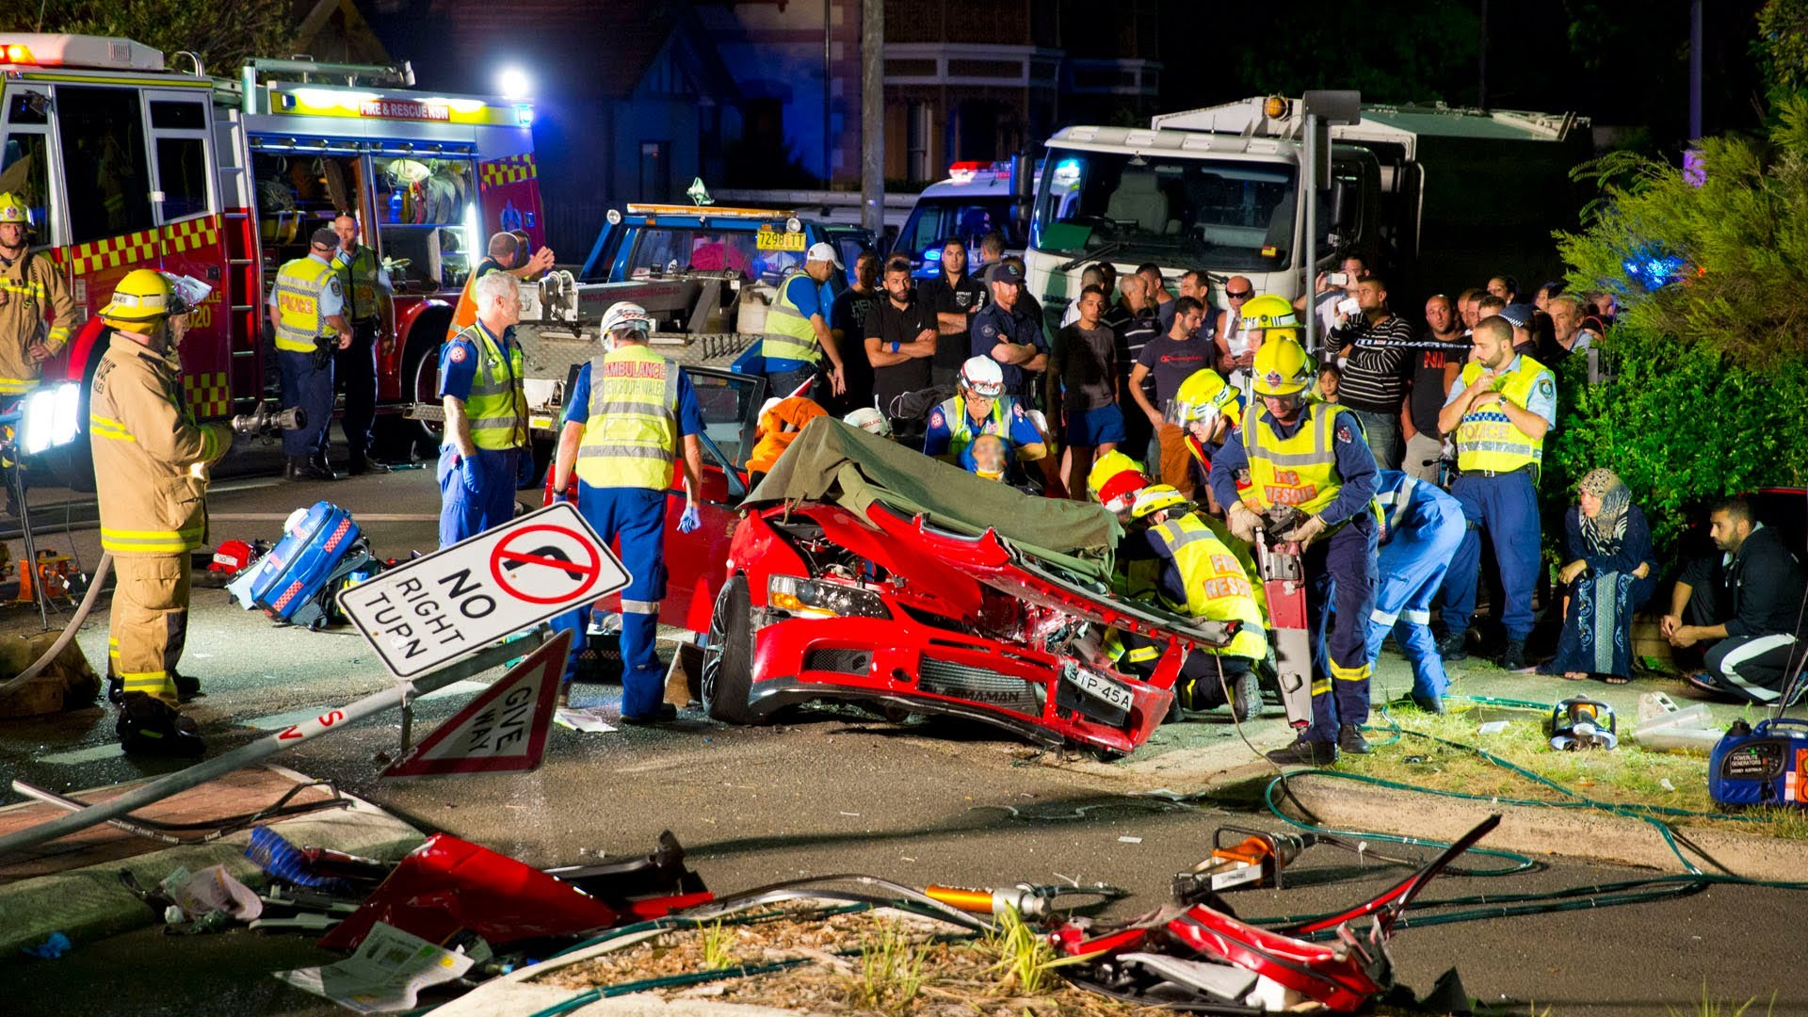
Multiple injured patient
HAITHAM R. ELMEHDAWI

Slide 2


Slide 4
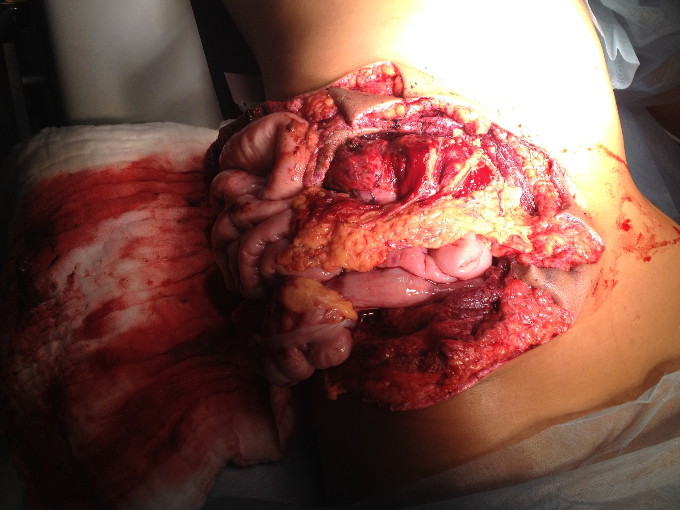

Slide 5
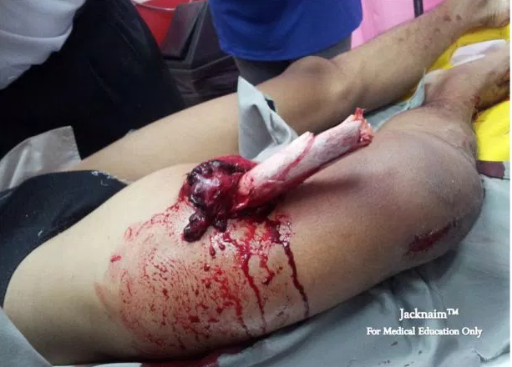

Slide 6
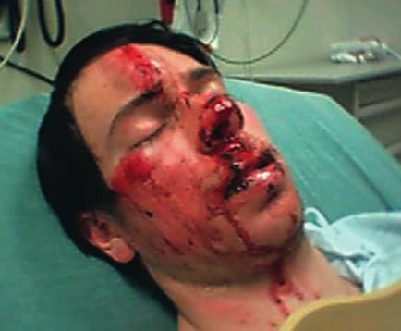

Slide 7


Multiple injured patient
Injury is the commonest cause of death among people in first 4 decades.
WHO data suggests that 1 in 10 deaths worldwide is the result of an injury.
Permanent disability 3 times the mortality rate.
Trauma related dollar costs exceed $400 billion annually in USA

Slide 8
Multiple injured patient
TRAUMA
a Greek word meaning :- a wound
currently defined as a mechanical injury to tissues by an external physical cause.

Slide 9
Multiple injured patient
Multiple trauma | Polytrauma
Injury to more than one body region
No major effect on the body physiology | Altered physiology Threat to life
1 + 1 = 2 | 1+1 ≥2

Slide 10
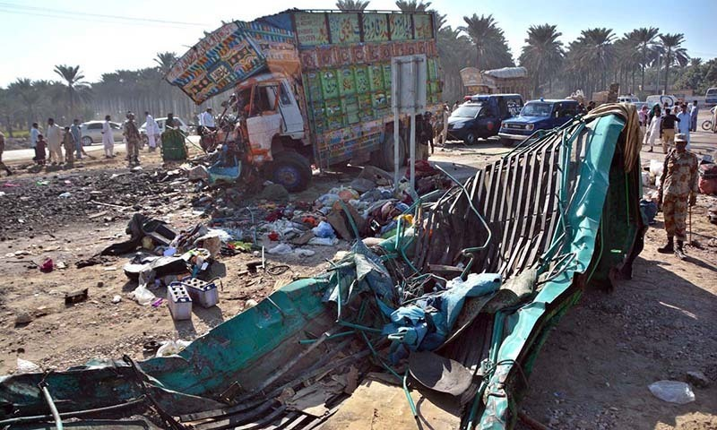
Multiple injured patient
TAYPES OF TRAUMA
Blunt Trauma
Motor vehicle collision
Assaults
Falls

Slide 11
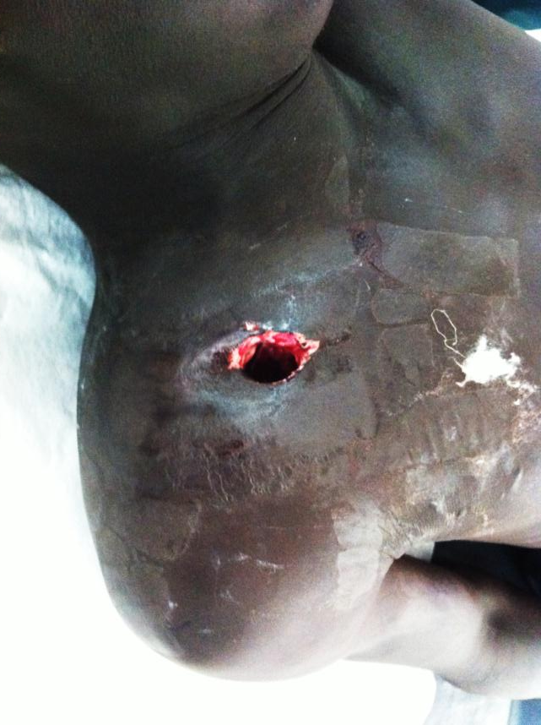
Multiple injured patient
Penetrating injuries
Bullets
Fragments
Bombs / Rockets
Anti-personnel mines
Knife

Slide 12
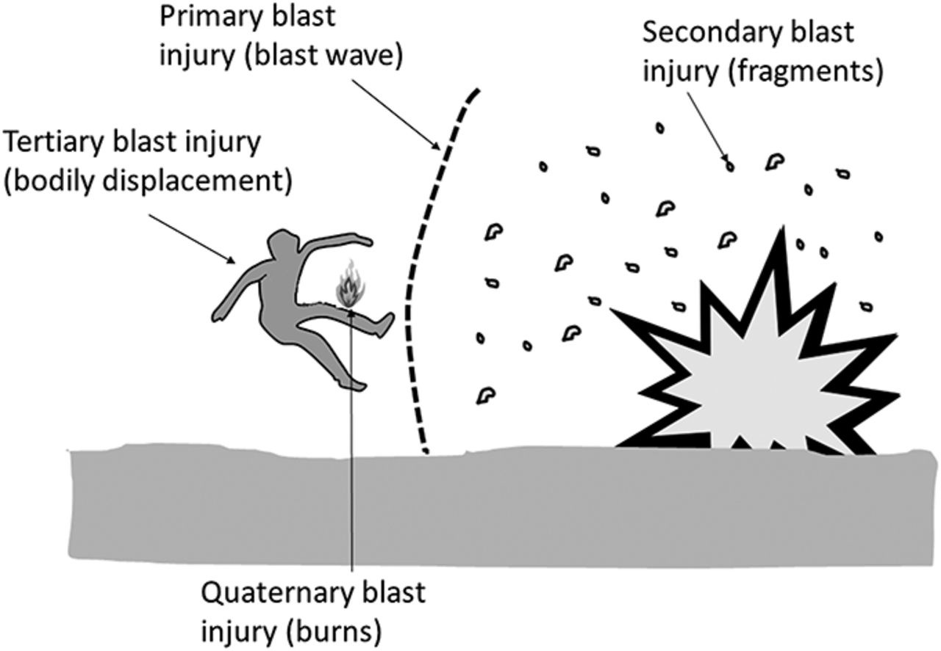
Multiple injured patient
Blast injuries

Slide 13
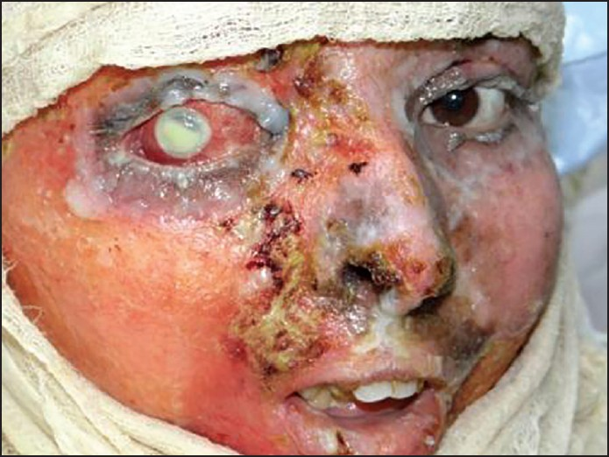
Multiple injured patient
Thermal & chemical injuries

Slide 14
Multiple injured patient
A major trauma is characterized by a series of complex pathophysiological reactions, some directly as a result of the event itself, others as part of a compensatory response.

Slide 15
Multiple injured patient
Systemic inflammatory response syndrome (SIRS) It is clinically recognized by the presence of two or more of the following
Temperature | >38.5ºC or <35ºC
Heart rate | >90 beats/min
Respiratory rate | >20 breaths/min
WBC | >12,000 /mm3, <4000 /mm3

Slide 16
Multiple injured patient
SIRS can result from a variety of conditions, such as autoimmune disorders, pancreatitis, vasculitis, thromboembolism, burns, surgery or multiple injury .

Slide 17
Multiple injured patient
The main features are triggered by:
hypoxia
shock
neurohumoral responses

Slide 18
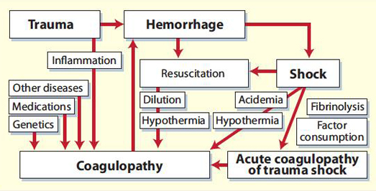
Multiple injured patient

Slide 19
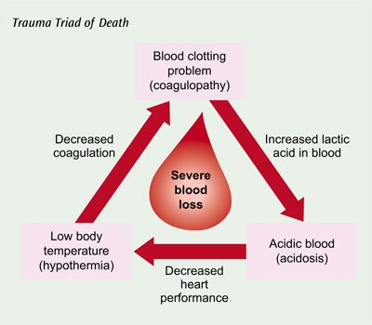
Multiple injured patient

Slide 20
Multiple injured patient
The magnitude of an injury is related to
energy transferred to the victim during the event,
the volume/area of tissue involved and
the time taken for the interaction.

Slide 21
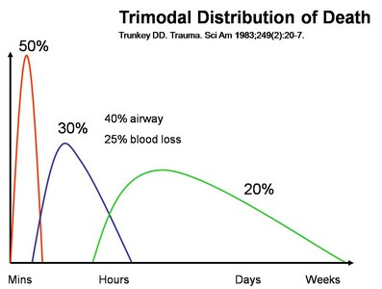
Multiple injured patient

Slide 22
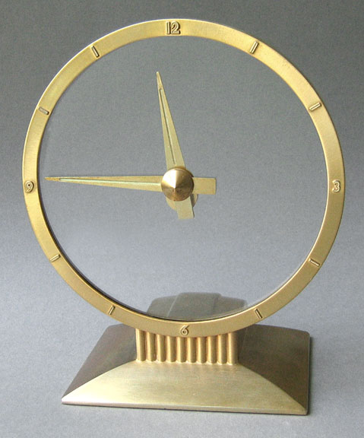
Multiple injured patient
The "Golden Hour" concept, the period of 60 minutes or less following injury when immediate definitive care is crucial to a trauma patient's survival

Slide 23
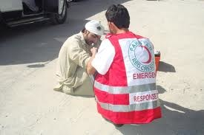
Multiple injured patient
Before arriving at the ER
First aid
Trained staff
Equipment
Transport
Communications
Information to emergency room
platinum 10 minutes

Slide 24
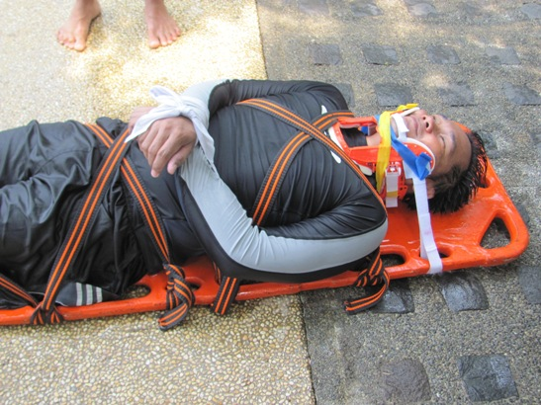
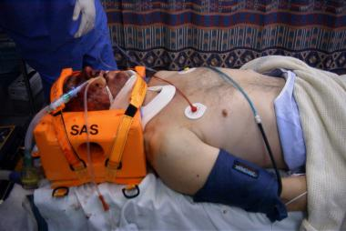
Multiple injured patient

Slide 25
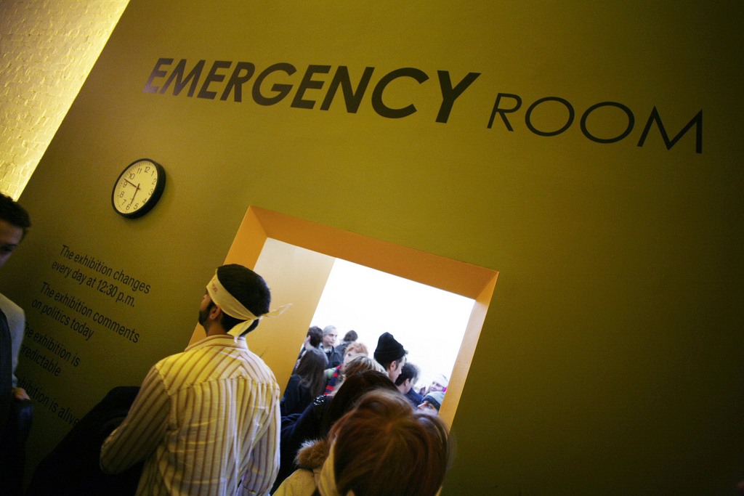
Multiple injured patient
In the Emergency Room
Teamwork
Things can be done simultaneously
Team leader responsible for priorities and team actions

Slide 26
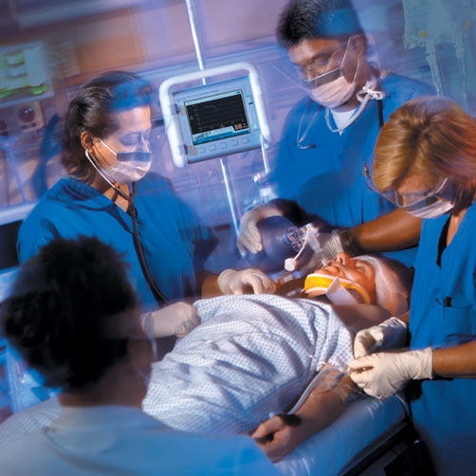

Multiple injured patient
TRAUMA TEAM
ANAESTHESIST
NURSE 1
ANAESTHETIC ASST.
GENERAL SURGEON
ORTHOPEDIC
RADIOGRAPHER
NURSE 2
TEAM LEADER

Slide 27
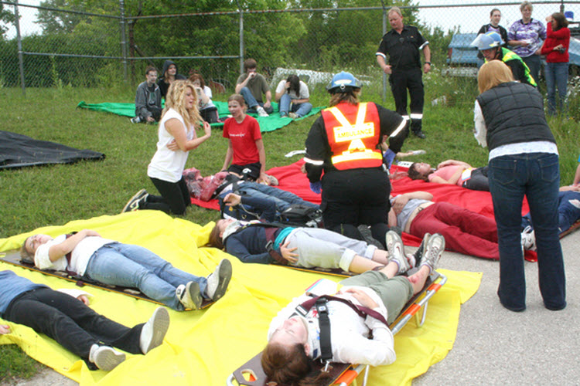
Multiple injured patient
TRIAGE

Slide 28
Multiple injured patient
Triage is a process of prioritizing patients for treatment in situations with massive numbers of wounded

Slide 29
Multiple injured patient
When needs are bigger than resources.
Do the best for the most - not everything for everyone.
Use available resources as efficiently as possible.
Patients with the greatest chance of survival are managed first .

Slide 30
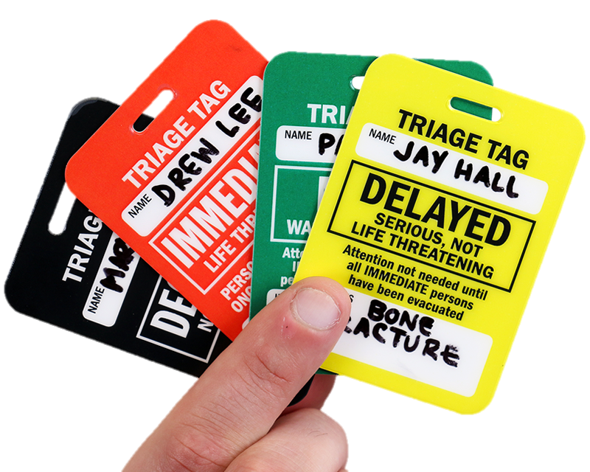
Multiple injured patient

Slide 31
Multiple injured patient
Color Codes Triage Tag
RED : Most critical injury.
YELLOW : Less critical injured.
GREEN : No life threatened injury.
BLACK : Death or obviously fatal injury.

Slide 32
Multiple injured patient
Initial Assessment
Primary survey
Secondary survey
Definitive care
Resuscitation

Slide 33

Multiple injured patient
A standardised way to identify and treat life-threatening conditions

Slide 34
A
AIRWAY
c-spine protection
B
BREATHING
C
CIRCULATION
haemorrhage control
D
DISABILITY
E
EXPOSURE
and hypothermia prevention

Slide 35
Multiple injured patient
Rapid ABC Assessment
Introduce yourself
Ask ”what happened to you ?”
If the patient answers directly you will know that
Airway is clear
Enough ventilation to talk
Enough circulation to the brain to understand

Slide 36
Multiple injured patient
If the patient is not answering you have to act quickly !!!
START WITH “A”

Slide 37

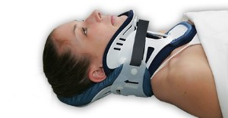
A
AIRWAY
c-spine protection
Multiple injured patient
Assume C-spine injury in all patients

Slide 38
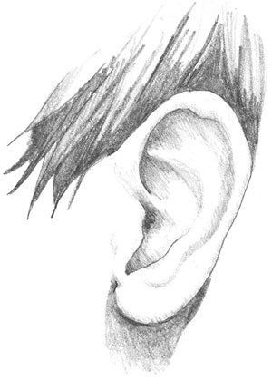
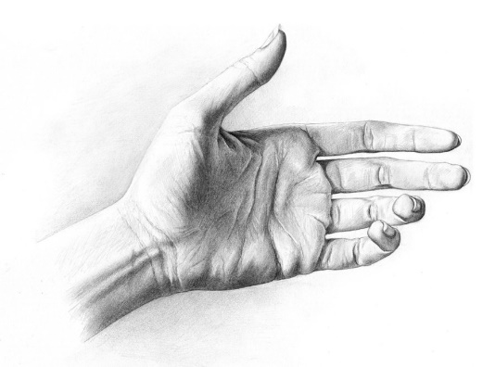
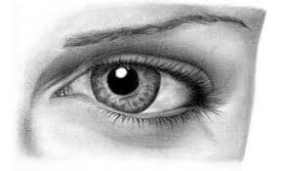
A
AIRWAY
c-spine protection
Multiple injured patient
Assess airway
Look
Listen
Feel

Slide 39
A
AIRWAY
c-spine protection
Multiple injured patient
Clear airway
Give O2
Prevent aspiration ( FB)
Assist ventilation – if necessary

Slide 40
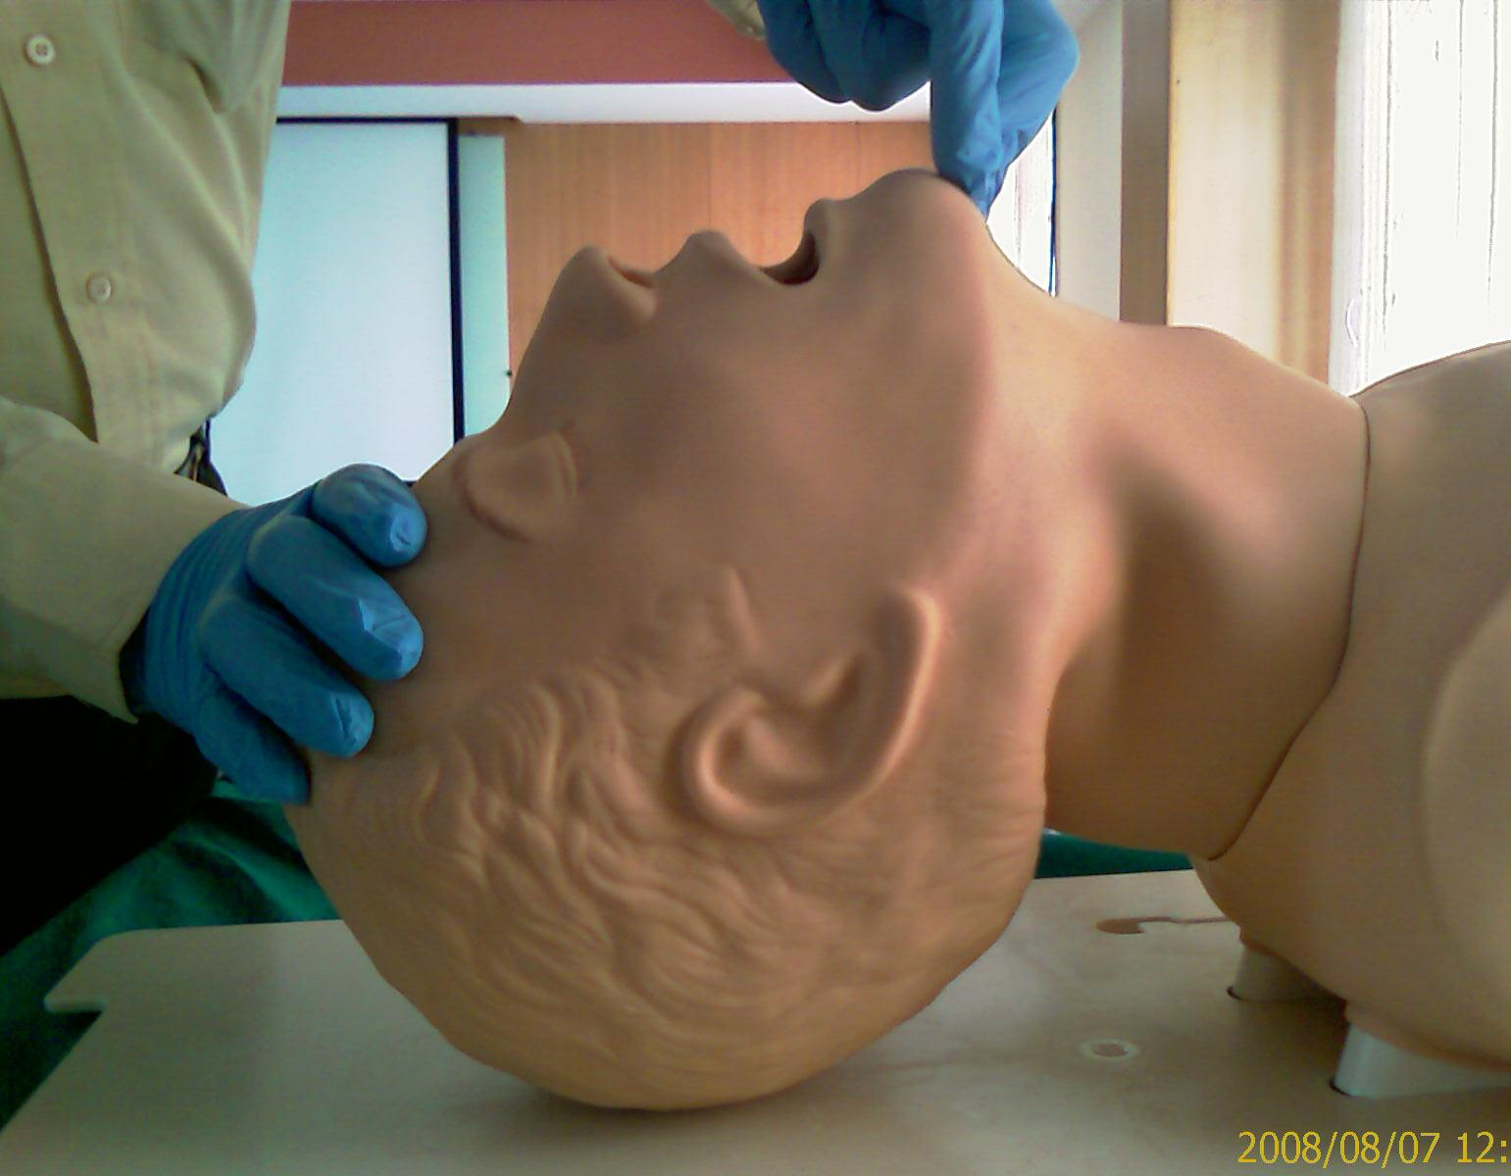
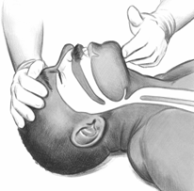
A
AIRWAY
c-spine protection
Multiple injured patient
Basic Airway Maintenance
Chin lift:

Slide 41
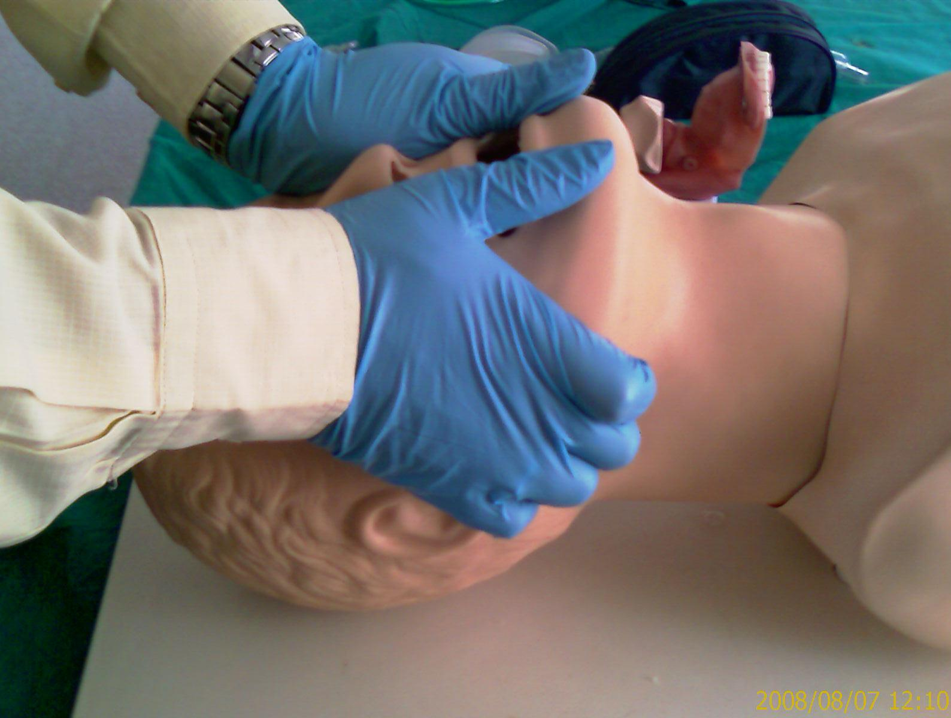
A
AIRWAY
c-spine protection
Multiple injured patient
Basic Airway Maintenance
Jaw thrust:

Slide 42
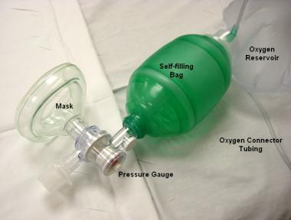
A
AIRWAY
c-spine protection
Multiple injured patient
Basic Airway Maintenance
BAG VALVE MASK AIRWAY

Slide 43
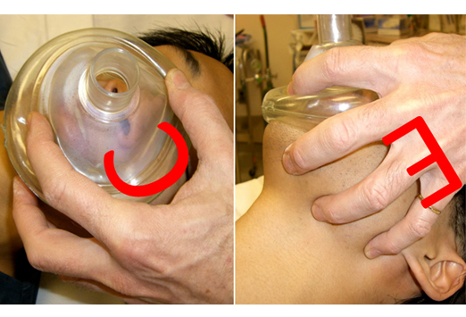
A
AIRWAY
c-spine protection
Multiple injured patient
Basic Airway Maintenance
BAG VALVE MASK AIRWAY

Slide 44
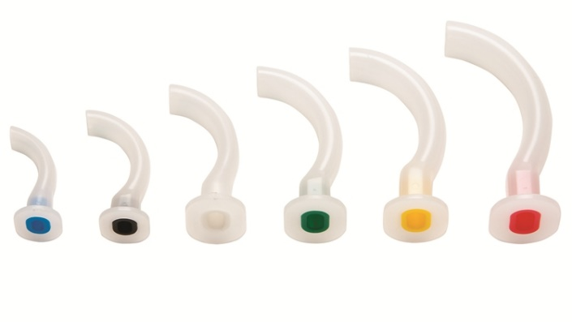
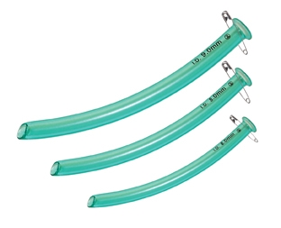
A
AIRWAY
c-spine protection
Multiple injured patient
Basic Airway Maintenance
Oropharyngeal airway
Nasopharyngeal airway

Slide 45
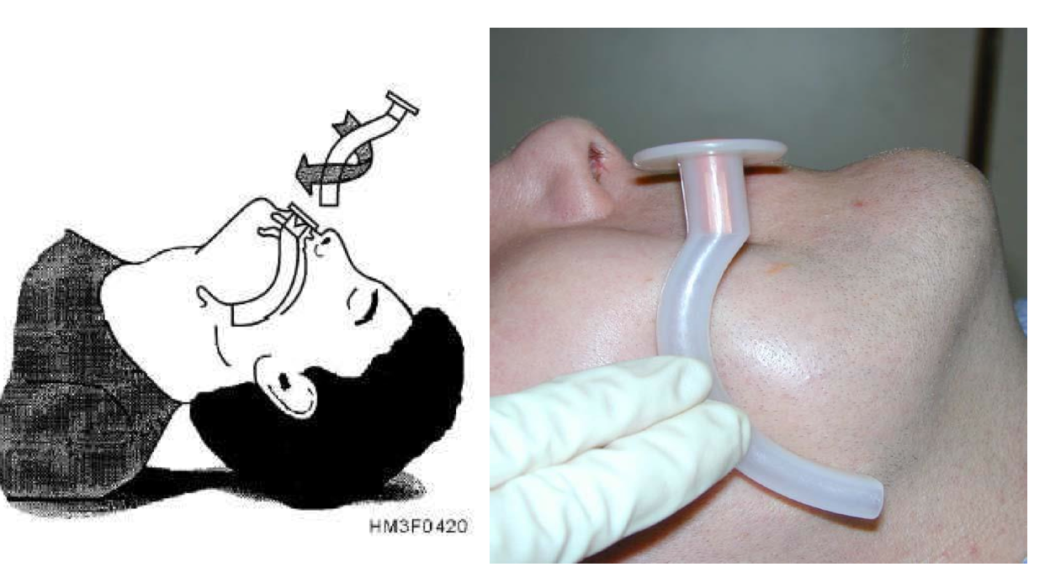
A
AIRWAY
c-spine protection
Multiple injured patient
Basic Airway Maintenance
Oropharyngeal airway

Slide 46
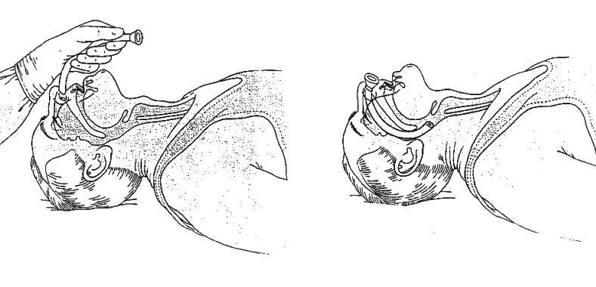
A
AIRWAY
c-spine protection
Multiple injured patient
Basic Airway Maintenance
Nasopharyngeal airway

Slide 47
A
AIRWAY
c-spine protection
Multiple injured patient
Definitive Airway: Indications
Maxillo-facial injury
Aspiration
Upper airway injury
Preventative
Inhalation burn
Coma (GCS < 8)
Secondary brain injury

Slide 48
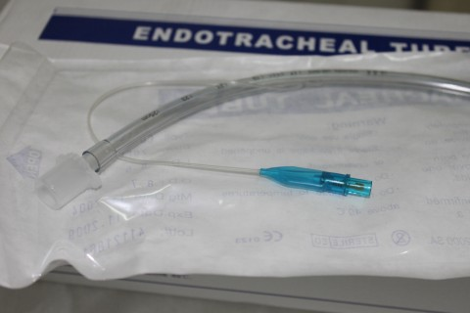
A
AIRWAY
c-spine protection
Multiple injured patient
Advanced Airway
Definitive Airway
Endotracheal tube
ORAL OR NASAL

Slide 49
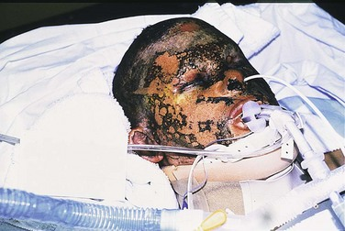
A
AIRWAY
c-spine protection
Multiple injured patient
Advanced Airway
Definitive Airway
Endotracheal tube
ORAL OR NASAL

Slide 50
A
AIRWAY
c-spine protection
Multiple injured patient
Rapid Sequence Induction
Cervical spine protection
Oxygenate / Ventilate
Suction
Give drugs
Intubate
If unable – perform a surgical airway

Slide 51
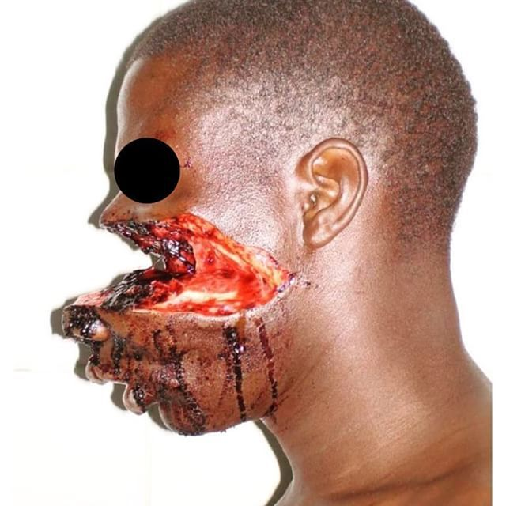
A
AIRWAY
c-spine protection
Multiple injured patient

Slide 52
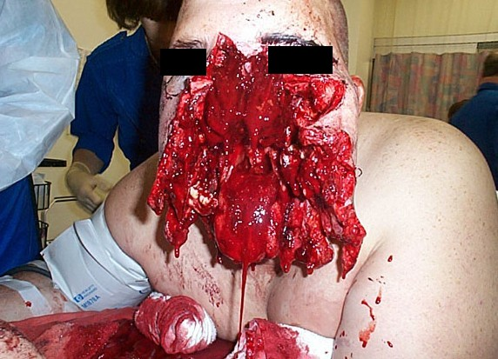
A
AIRWAY
c-spine protection
Multiple injured patient

Slide 53
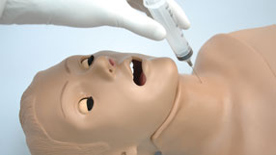
A
AIRWAY
c-spine protection
Multiple injured patient
Needle Cricothyroidotomy
May be life saving
Temporary measure
Good oxygenation
Poor ventilation
Not a definitive airway

Slide 54
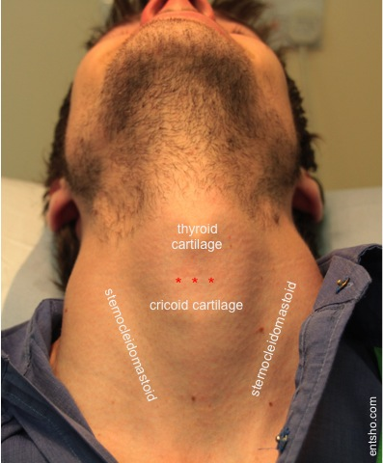
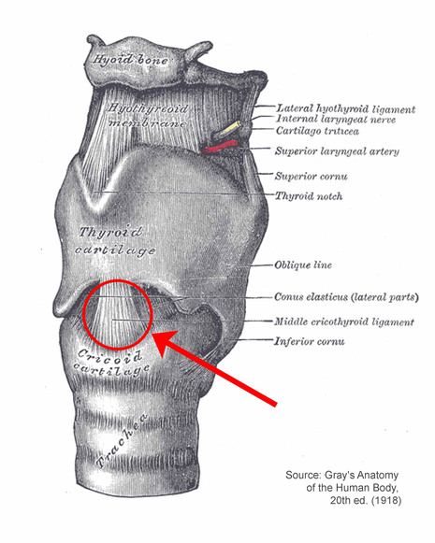
A
AIRWAY
c-spine protection
Multiple injured patient

Slide 55
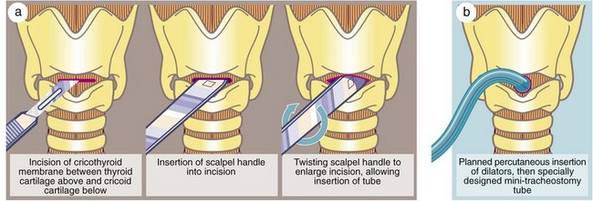
A
AIRWAY
c-spine protection
Multiple injured patient

Slide 56
B
BREATHING
Multiple injured patient
Do not confuse airway problem for ventilation problem
Patent airway does not equal adequate ventilation.
Need good gas exchange
Oxygen in
CO2 out
Rapid assessment of
RR
SPO2
TRACHEA
CHEST EXPANSION
PERCUSSION
AUSCULTATION

Slide 57
B
BREATHING
Multiple injured patient
INSPECT :Equal chest rise, paradoxical chest movements, contusion , sucking chest wound , distended neck veins
PALPATE: Trachea , chest wall tenderness , subcutaneous emphysema ,sternal and rib fracture
PERCUSS: dullness , hyperresonance
AUSCULTATE: equal breath sounds , absence of breath sounds

Slide 58
B
BREATHING
Multiple injured patient
Tension pneumothorax
Open pneumothorax
Flail chest
Massive haemothorax
Cardiac tamponed

Slide 59
B
BREATHING
Multiple injured patient
Tension Pneumothorax
Signs
Massive respiratory distress
Terror – “I am going to die !”
Shock
Distended neck veins (if enough circulating volume)
Absent breath sounds and hyper-resonance
Late signs
Trachea deviated
Cyanosis

Slide 60
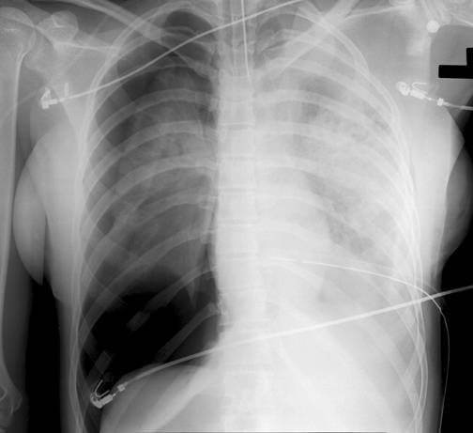
B
BREATHING
Multiple injured patient
Tension Pneumothorax

Slide 61
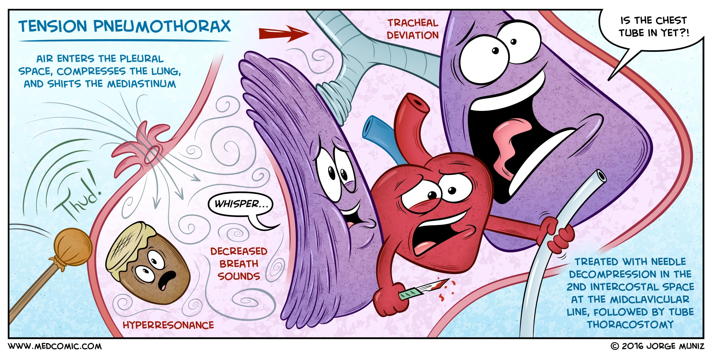
B
BREATHING
Multiple injured patient

Slide 62
B
BREATHING
Multiple injured patient
Tension Pneumothorax
Treatment
Immediate decompression (needle)
Chest tube insertion
Clinical Diagnosis
Don’t wait for X ray

Slide 63
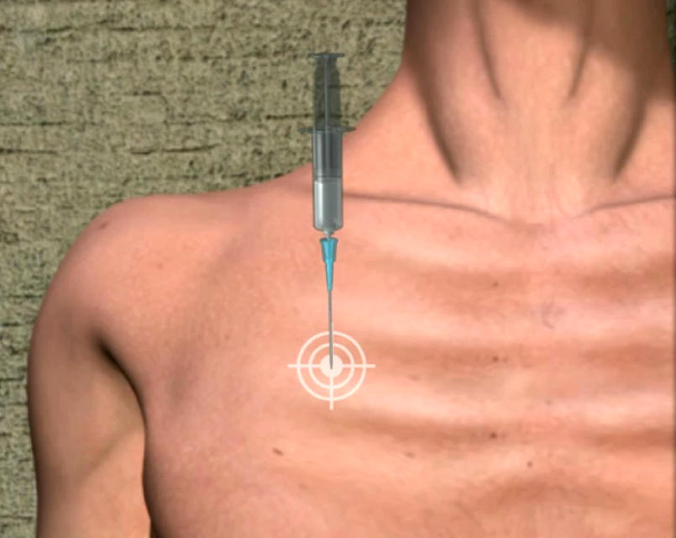
B
BREATHING
Multiple injured patient
Tension Pneumothorax
Needle Decompression
2nd IC space
mid-clavicular line

Slide 64
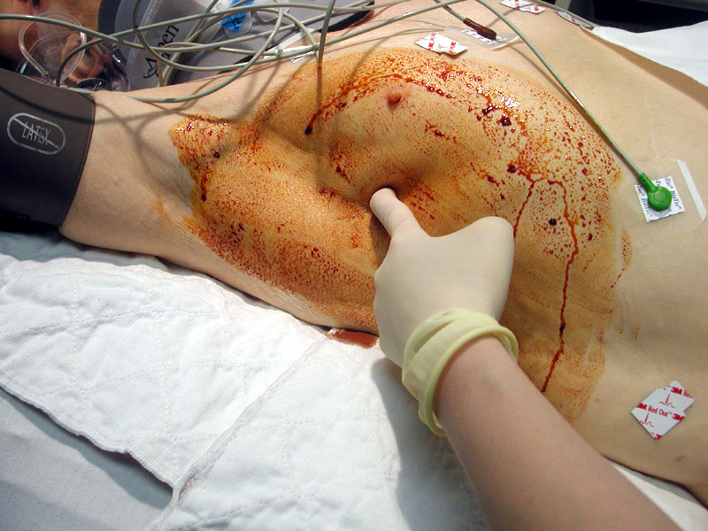
B
BREATHING
Multiple injured patient
Chest Tube

Slide 65
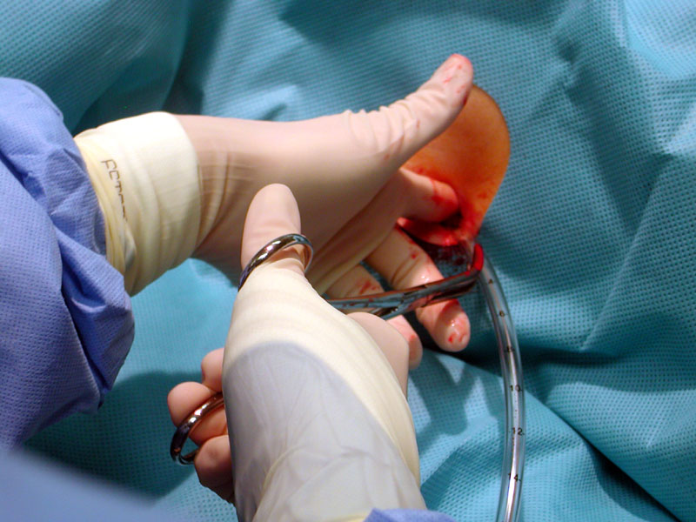
B
BREATHING
Multiple injured patient
Chest Tube
4th / 5th space
between mid-and anterior axillary line
Underwater seal

Slide 66
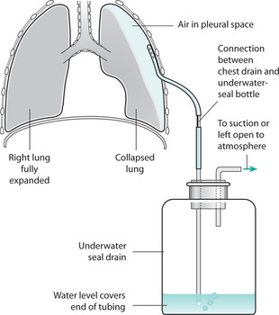
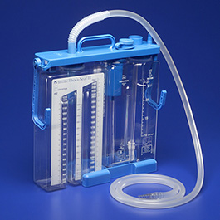
B
BREATHING
Multiple injured patient

Slide 67
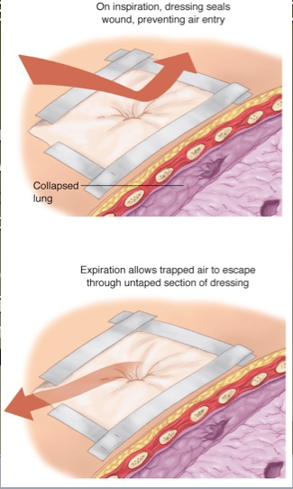
B
BREATHING
Multiple injured patient
Open Pneumothorax
Sucking chest wound
Treatment
Sterile occlusive 3 sided dressing
Chest drain

Slide 68
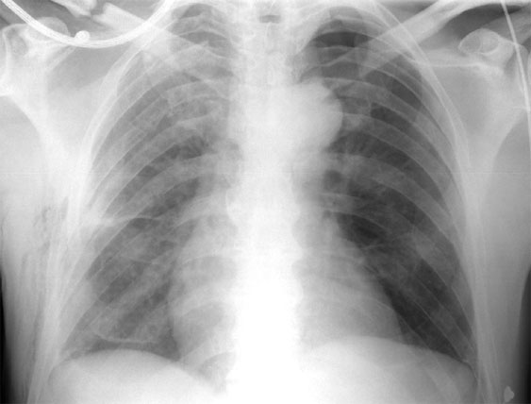
B
BREATHING
Multiple injured patient
Flail Chest

Slide 69
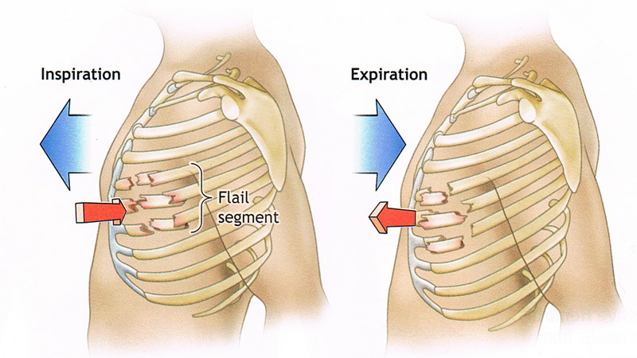
B
BREATHING
Multiple injured patient
Flail Chest
Two or more ribs’
fractured in two or more places
Main problem
pulmonary contusion

Slide 70
B
BREATHING
Multiple injured patient
Flail Chest
O₂
Analgesia
Judicious fluid management
Intubation only if necessary

Slide 71

B
BREATHING
Multiple injured patient
Massive Haemothorax
Signs
Shock
Absence of breath sounds
Dullness to percussion
Treatment
IV support
Chest tube
Thoracotomy

Slide 72
C
CIRCULATION
hemorrhage control
STOP THE BLEEDING !!!

Slide 73
C
CIRCULATION
hemorrhage control
External bleeding
Direct pressure
Dressings
Elevation of limb
Compression of artery
Tourniquet
Internal bleeding
Surgery

Slide 74
C
CIRCULATION
hemorrhage control
Unrecognised bleeding is the major cause of preventable death in trauma

Slide 75
C
CIRCULATION
hemorrhage control
Assess-
Pulse .
Skin Colour And Temperature
Conscious Level(GCS)
Capillary Refill Time
Decreased Urine Output
Hypotension- a Late Sign When≥ 30% Blood Volume Lost

Slide 76
C
CIRCULATION
hemorrhage control
Blood on the Floor
and Four More
Thorax
Abdomen
Retroperitoneum (includes pelvis)
Long bones

Slide 77
C
CIRCULATION
haemorrhage control
Blood loss and symptoms (for 70 Kg pt)
 | Class I | Class II | Class III | Class IV
Blood loss (ml) | Up to 750 | 750 -1500 | 1500 - 2000 | > 2000
Blood loss (% of volume) | Up to 15 % | 15 - 30% | 30 – 40% | > 40%
Pulse rate | < 100 | >100 | >120 | > 140
Blood pressure | Normal | Normal | Decreased | Decreased
Mental status | Normal to slightly anxious | Slightly anxious, restless | Anxious, confused | Confused, lethargic

Slide 78
C
CIRCULATION
haemorrhage control
Shock
Inadequate tissue perfusion
and tissue oxygenation

Slide 79
C
CIRCULATION
hemorrhage control
Management of Shock
Stop the bleeding
Replace the volume
Evaluate the response

Slide 80
C
CIRCULATION
hemorrhage control
Management of Shock
Insert 2 large bore I V cannulas
Send blood for cross match , coagulation screen , Hb , Hct ,biochemistry , blood alcohol level.
Insert urine catheter
Input / output chart
Close observation to vital singe
IVF
FAST SCAN

Slide 81
C
CIRCULATION
hemorrhage control
Pelvic fractures are a C problem
Classified according to anatomy
Compression – stable
Open book – unstable
Shear – massively unstable

Slide 82

C
CIRCULATION
hemorrhage control
Stable

Slide 83

C
CIRCULATION
hemorrhage control
Open book - Unstable

Slide 84

C
CIRCULATION
hemorrhage control
Shear fracture – Unstable – massive blood loss

Slide 85

C
CIRCULATION
hemorrhage control
The binder must always be at the level of the greater trochanters

Slide 86
C
CIRCULATION
hemorrhage control
Assessment
Inspection
Perineal wound
Blood at meatus
Vaginal bleeding
Scrotal haematoma
Palpation
Rectal palpation
High-riding prostate
Blood on glove
X-ray

Slide 87


C
CIRCULATION
hemorrhage control
Dont insert urine catheter if there are sings of pelvic fractures

Slide 88
D
DISABILITY
Neurological Evaluation
Abbreviated neurological exam :
Level of consciousness
Pupil size and reactivity
GCS

Slide 89

D
DISABILITY
Glasgow Coma Scale

Slide 90
D
DISABILITY
Severity of Head Injury
GCS 13 – 15
GCS 9 – 12
GCS < or equal 8
MILD
MODERATE
SEVERE

Slide 91
D
DISABILITY
Signs and Symptoms of
basal skull fractures
CSF leak (nasal or auricular)
Periorbital ecchymosis (raccoon eyes)
Retroauricular ecchymosis (Battle’s sign)
Haemotympanum
Facial nerve injury
Loss of hearing

Slide 92

D
DISABILITY

Slide 93
E
EXPOSURE
and hypothermia prevention
You can’t treat what you don’t find!
If you don’t look, you won’t see!

Slide 94


E
EXPOSURE
and hypothermia prevention

Slide 95

E
EXPOSURE
and hypothermia prevention

Slide 96

E
EXPOSURE
and hypothermia prevention

Slide 97

E
EXPOSURE
and hypothermia prevention
control hypothermia
control hypothermia
control hypothermia
control hypothermia
control hypothermia
control hypothermia
control hypothermia

Slide 98
At the End of the Primary Survey
Assessment and management of:A,B,C,D is completed.
ABG
ECG, pulse oximeter, BP Cuff placed
Urinary catheter and Naso-gastric tube inserted
X rays requested:
AP chest
AP pelvis
Lateral C-spine
Consider system involvement and surgical specialities required.
Consider need for patient transfer

Slide 99

At the End of the Primary Survey

Slide 100


At the End of the Primary Survey
CXR
PELVIS AP
LATERAL C-SPINE
DPL
FAST

Slide 101


Slide 102
At the End of the Primary Survey
Primary survey
Secondary survey
Definitive care
Resuscitation
Surgery
(damage control surgery)
If not respond
If patent respond

Slide 103
SECONDARY SURVEY
The secondary survey does not begin until the primary survey (ABCDEs) is completed, resuscitative efforts are underway, and the normalization of vital functions has been demonstrated.

Slide 104
SECONDARY SURVEY
AMPLE Key terminology
A Allergies
M Medication
P Past illnesses
L Last Meal
E Ethanol/ Drug abuse
.

Slide 105
SECONDARY SURVEY
Head to Toe examination.
reassessment of all vital signs.
If patent needs extra investigation
( Abdominal uss , CT brain , etc. )

Slide 107



Slide 108


THANK YOU

