Slide 1


Libyan international medical university
Faculty of Business Administration
The Marketplace
Name: Heba Elbanka
ID:3788
Email:hibah3788_@limu.edu.ly

Slide 2
0bjectives
Define the marketplace
Providing examples for the marketplace

Slide 3
CONTENTS
Introduction
Define the marketplace
Examples for online marketplace
Conclusion
References
1
1

Slide 4

Introduction
An open square or place in town where market or public sales
2

Slide 5
Define the marketplace
Marketplace is any location where dealings take place between the selling and buying of goods , whose prices are based on decisions
based on two main factors
1. Producer
2. consumer
3

Slide 6
An online marketplace
An online marketplace is site connects seller and buyer and also use it to reach customers who want to purchase their products and services
4

Slide 7

Examples for online marketplace
Amazon is an American e-commerce company, it started selling books and then expanded its products
5

Slide 8





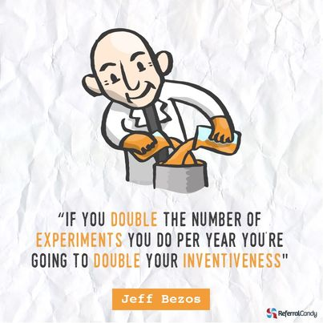
Top tips from Jeff Bezos for success
6

Slide 9
Conclusion
The marketplace is a link between all the people
who are directly connected with the world
7

Slide 10
References
. Retrieved March 30, 2022, from https://www.coursehero.com/tutors-problems/Electrical-Engineering/34576556-httpslmessengercomlphpuhttps3A2F2Fwwwcourseherocom2F/ https://l.messenger.com/l.php?u=https%3A%2F%2Fwww.arimetrics.com%2Fen%2Fdigital-glossary%2Fmarketplace&h=AT2YW2tbwcYNq75uGxaR-YXQkP8q3Y5CZREXcfAv0LejjVSQ4h6uiD9KnY2RofD8Z8ve5W_feRv7Zn5EXCI_214TQkIuGV7OpF1WoMK5hOMUGzyE6twXnZc3afr5XEEnTThPLw
8

Slide 11
Thank you

