Slide 1
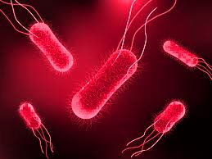
Typhoid fever

Slide 2
TYPHOID FEVER
systemic infection caused by S. Typhi.
S. Para Typhi A&b are relatively infrequent.
Faecal–oral route, are important causes of fever

Slide 3
Salmonella General characteristics
Over 2400 species are available
They are :
*intestinal of man and animal
*Gram negative bacilli
*aerobes .
*non-capsulated and non-spore forming

Slide 4
Classification according to antigenic structure :
1- Somatic(O) antigen :
* heat stable cell wall antigen
2-Flagellar (H) antigen (1,2,3,4,5,)
*heat labile antigen
N.B. :
Vi antigen is a surface antigen on salmonella strains associated with virulence of the strain and carrier status.

Slide 5
Salmonella cause 2 types of diseases in man
1 - Typhoid (enteric ) fever.
2 - Food poisoning.

Slide 6
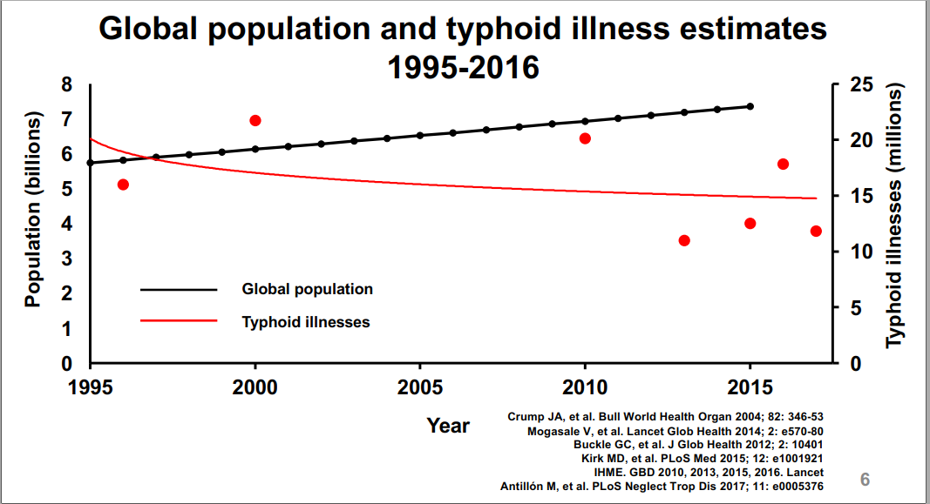
epidemiology

Slide 7
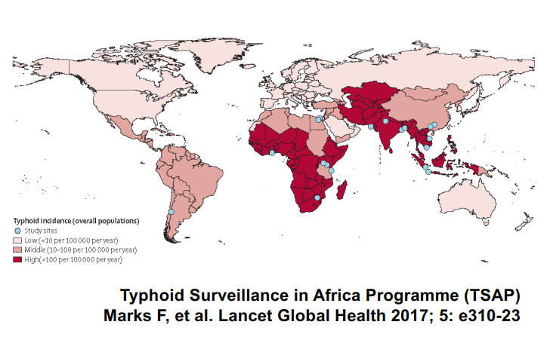
incidence

Slide 8
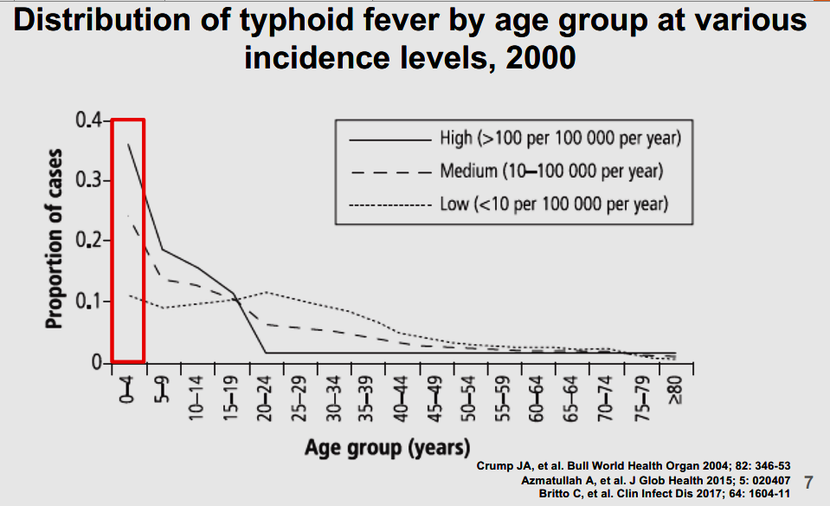
epidimiology

Slide 9
Epidemiology:
SOURCE :Affected cases and carriers are the source of infection.
Pathogens are excreted in feces and gall bladder
Also pass with urine adhered to shistosome eggs leading to contamination of water
OTHER SALMONELLA Organism commonly found in intestine of pigs,cows,goats,sheep,rodents,chicken and ducks

Slide 10
Source :Reservoir of infection
human is the only reservoir
Cases
A case is infectious as
long as bacilli appears
in stools or urine
Carriers
Temporary/incubat or excrete bacilli for 6 to 8
Weeks.
Chronic- excrete bacilli
for more than a year,
organism persist in gall
bladder/biliary tract.

Slide 11
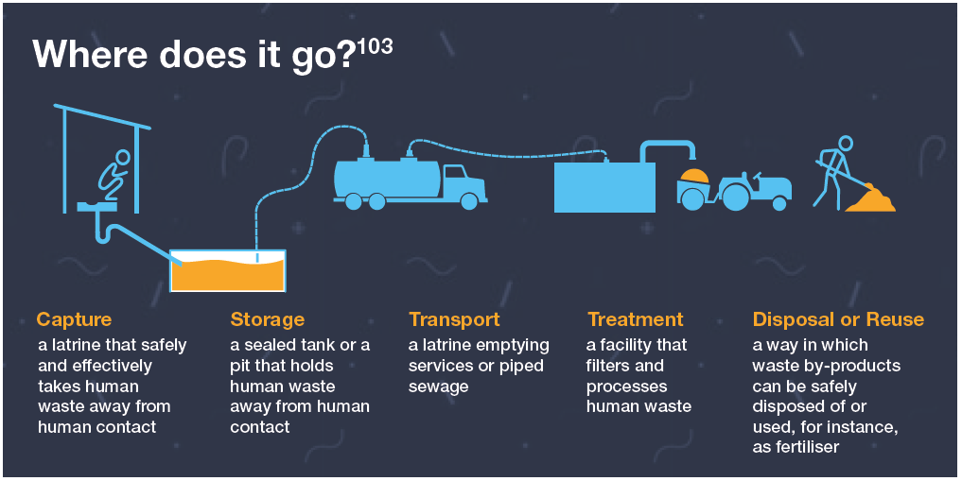

Slide 13
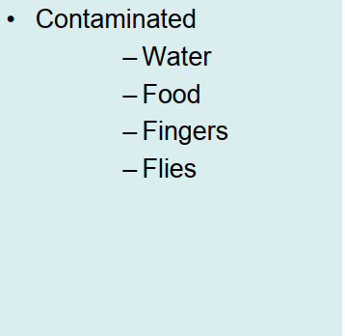
SPREED

Slide 14
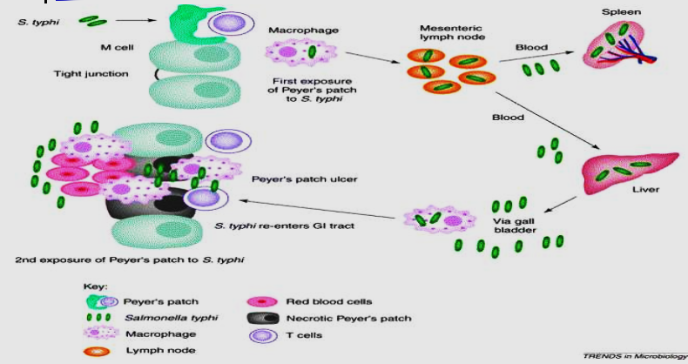
pathogenesis
Salmonella can penetrate ileal mucosa---- mesenteric lymph nodes via lymphatics------- thoracic lymph ducts blood stream
Liver, spleen, kidney, and bone marrow are also affected

Slide 16
relative bradycardia
The pulse is often slower than would be expected from
the height of the temperature.
I e rise Less than
10 beats per minute per one dgree centigrade .

Slide 17
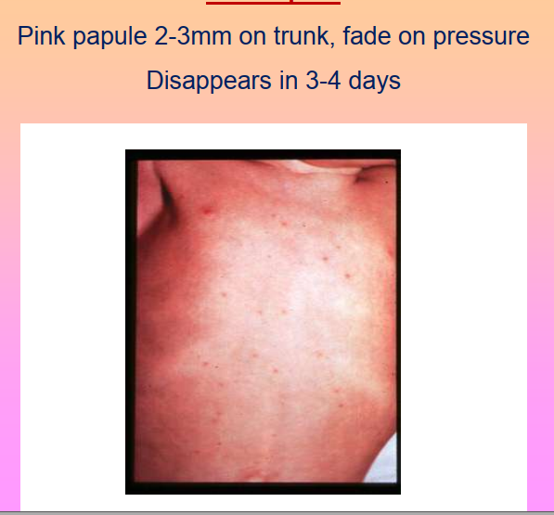
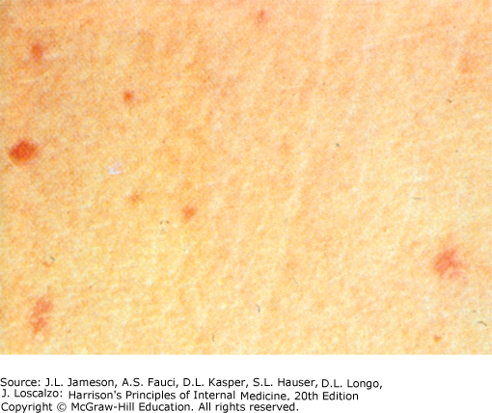
Rose spots

Slide 18
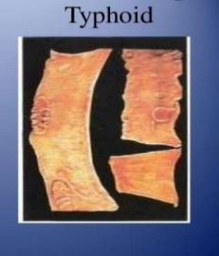
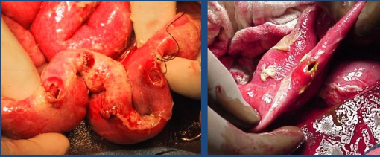
Intestinal perforation

Slide 19
Laboratory diagnosis :
the first week, diagnosis may be difficult because, in this
invasive stage with bacteraemia, the symptoms are those of
generalised infection without localising features.
Typicaly there is a leucopenia
1- direct method :
* isolation of the organism from :
- blood during the first week of infection
-feces and urine after the first week

Slide 20
Blood culture :
Organism is recovered from blood stream at any stage of the illness
Commonly isolated during the first 7-10 days and during relapses
Bone marrow biopsy is recommended in chronic cases or upon use of antibiotics

Slide 21
Blood Cultures are positive in
  1st week in 90%
  2nd week in 75%
  3rd week in 60%

Slide 22
SEROLOGICAL PROCEDURE
FELIX-WIDAL TEST
slide agglutination test *Anti O and *anti H sera
• The Widal test detects antibodies to the O and H antigens but is not specific.
Presence of O-antibodies indicates recent infectio
• Testing a paired sample (7-10days) for raise of antibodies
carries a greater significance

Slide 23
Treatment
Fluoroquinolones
are the drugs of choice (e.g. ciprofloxacin 500 mg twice daily).
for 14 days.
For carriers longer duration of antibiotics and cholycystectomy.

Slide 24
Immunity :
Certain degree of immunity is obtained upon infection with S.typhi or S.paratyphi due to O and Vi antibodies
Relapses may occur
Persons with sickle cell anemia are more susceptible to salmonella infection especialy osteomylitis.

Slide 25
Salmonella causing food poisoning :
S.typhimurium and S.enteritidis are the most important species
Infection is via contamination with the excreta of rats, rodents human carriers
They cause infection to the intestinal epithelium rather than toxicity

Slide 26
Sources of infection: Undercooked food e.g. chicken, eggs and meat; food or water contaminated with faeces from an infected person or animal
Incubation period: 6-48 hours (usually 12-36 hours).
Symptoms: Diarrhoea, abdominal pain, vomiting, nausea and fever lasting 1-7 days.
Organism Survival: Salmonella can survive up to 28 days under refrigeration, even on the surface of vegetables which have become contaminated. Deactivated by heating to 70oC
Treatment: The infection is usually self-limiting although fluid replacement may be required.

Slide 27
Bacilli are destroyed at t 70 C for 15 minutes
Boiling, pasteurization of milk or chlorinated water destroy the bacilli

Slide 28
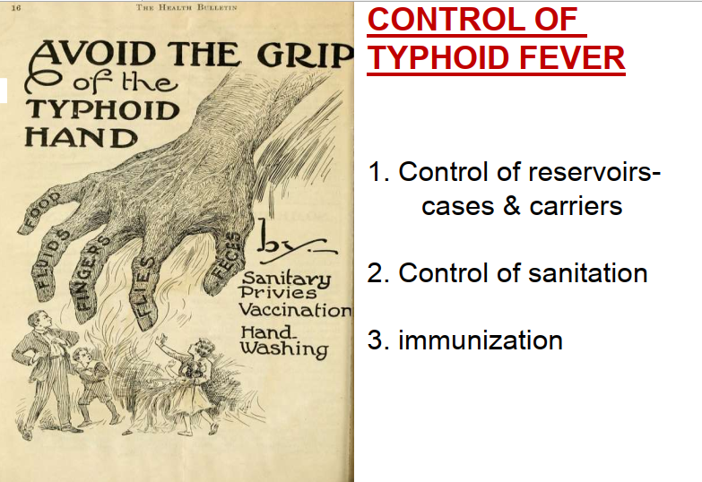

Slide 29
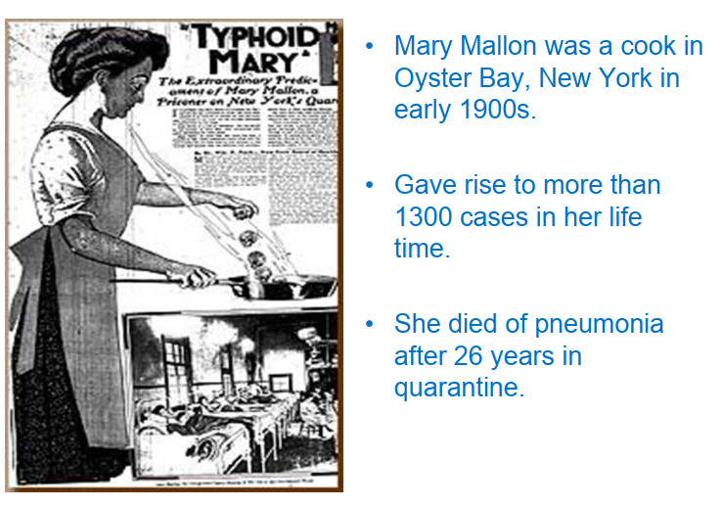

Slide 30
Thank u

