Slide 1


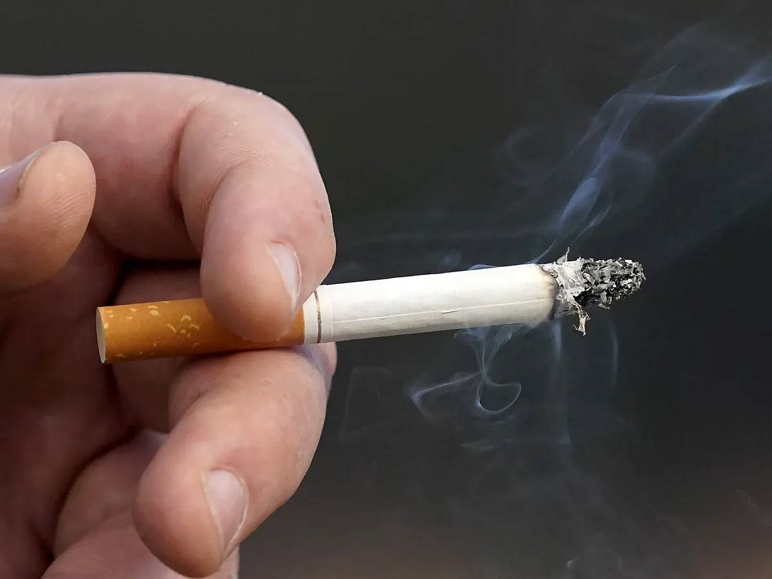

Tobacco epidemic
Prepared by:Abdulrahman ardeiwa
Student number:3261
Block :pts
First year
Date:2022/6/4

Slide 2
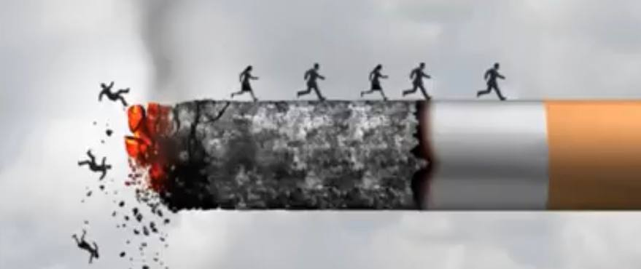
Objective:
Overview of Tobacco epidemic.
Disease caused be tobacco epidemic.
Outline epidemiology.
Disease control and prevention.

Slide 3
Overview of Tobacco epidemic:
Smoking is 1 cause of preventable death in the world
Key facts WHO :
Tobacoo kills up to half of its users.
Tobacco kills more than 8.2 million people each year .
7 million of those result of direct tobacoo use .
Arround 1.2 million are the result of non-smokers being exposed to smoke (Passive smocking).

Slide 4
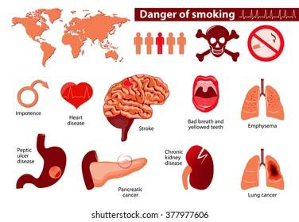
Disease caused by tobacco smoking:

Slide 5
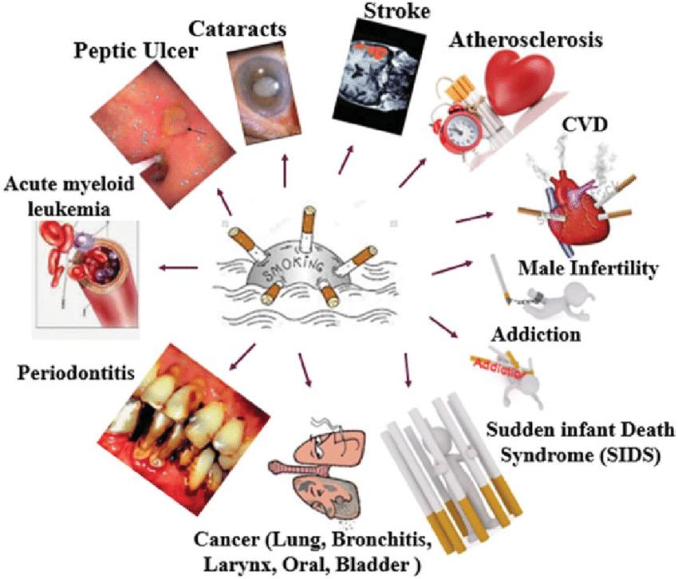

Slide 6
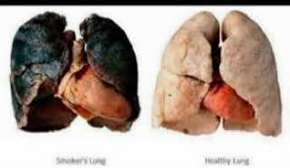
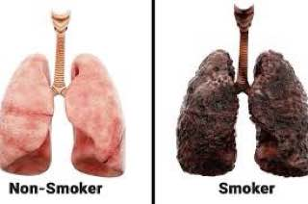

Slide 7
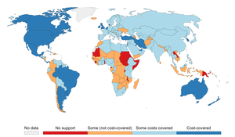
Outline of Tobacco epidemiology World wide:
In 2020 , over 1.1 billion people smoked tobacco
More in males than females .
Even though the prevalence of tobacco smoking is declining worldwide and in many countries , it appears to increase in eastern meditarian region and in African region.
In other region Europian region and Western pacific prevalence and effort must be intensified to reduce it . .

Slide 8
Summary:
Smoking is associated with various diseases of cardiovascular and respiratory systems as well Cancer.
Smoking is the leading cause of preventable death in the world.
There is 1.1 billion users of tobacco smoke in the world and still increasing .
More in man than in women and more in people with a lower educational level.

Slide 9
References:
World Health Organization. (2010). Gender, women, and the tobacco epidemic. World Health Organization.‏
AlMulla, A., Hassan-Yassoub, N., Fu, D., El-Awa, F., Alebshehy, R., Ismail, M., & Fraser, C. P. (2020). Smoking cessation services in the Eastern Mediterranean Region: highlights and findings from the WHO Report on the Global Tobacco Epidemic 2019. Eastern Mediterranean Health Journal, 26(1), 110-115.
Giovino, G. A. (2007). The tobacco epidemic in the United States. American journal of preventive medicine, 33(6), S318-S326.‏

Slide 10


