Slide 1


Executive - Legislative Relations
Libyan International Medical University
Faculty of Business Administration
Name : Nouri Founas
Student ID : 2733
E-mail : nouri_2733@limu.edu.ly
2021-Dec-15

Slide 2
TABLE OF CONTENTS
01
02
Introduction
Aspects of Executive-Legislative Relation
03
04
Conclusion
References
1

Slide 3

INTRODUCTION
2

Slide 4
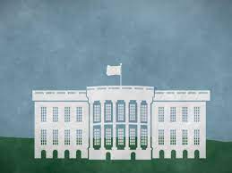

A parliamentary system of government is one in which the members of a legislative body decide on the composition of the cabinet (executive), and any majority of the legislature can vote the cabinet out of office at nearly any moment. The executive branch is in charge of carrying out and managing the public policy that the legislative branch has passed and funded.
History.com Editors. (2017, November 17). Three branches of government. History.com. Retrieved December 15, 2021, from https://www.history.com/topics/us-government/three-branches-of-government
3

Slide 5
02
Aspects of Executive-Legislative Relation
4

Slide 6
1-The extent to which the functions of government are effectively separated between branches is known as separation of powers.
2- The executive branch's ability to govern the legislative branch, or the legislature's ability to control the executive branch (oversight), and the legislative branch's ability to legislate.
3- The ability to remove a chief executive or dissolve the legislature is a major difference between presidential and parliamentary systems.
6

Slide 7
4- The influence of the ruling system on the structures produced by legislative parties; degree of hierarchical control, internal discipline, and latitude for openness to representing local diversity.
5- To preserve control of the executive, party discipline is required, and this requirement differs throughout the three systems.
6- The legislature is a platform for debate on political, economic, and social concerns under parliamentary, presidential, and hybrid systems, and it is essential to legitimize new legislation.
6

Slide 8
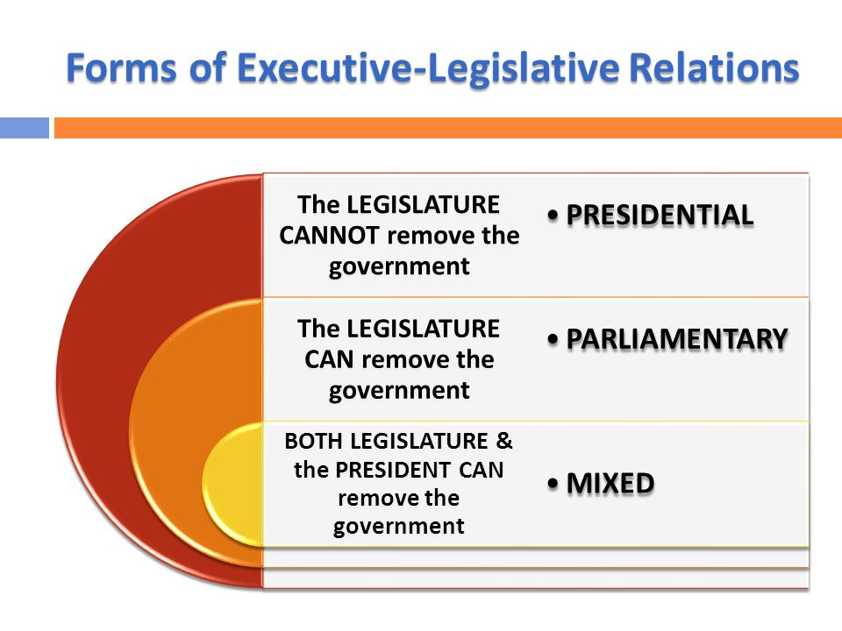
Institutions of the state 3 pub 101 (Week 14). forms of executive-legislative relations. - ppt download. SlidePlayer. (n.d.). Retrieved December 14, 2021, from https://slideplayer.com/slide/10987566
/
7

Slide 9
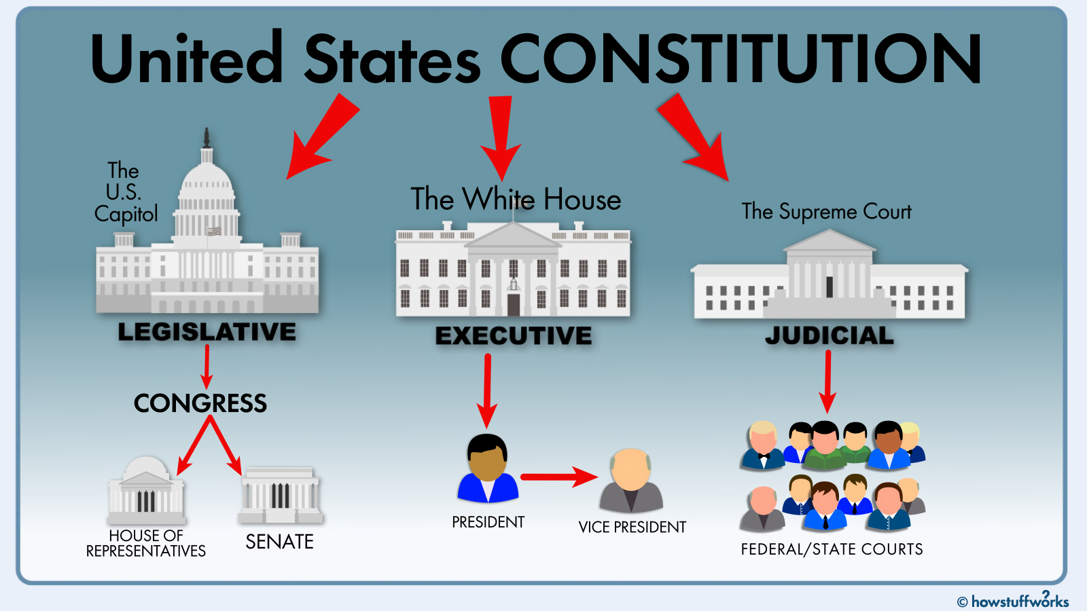
Kiger, P. J. (2020, July 27). What are the three branches of U.S. government and how do they work together?HowStuffWorks. Retrieved December 15, 2021, from https://people.howstuffworks.com/three-branches-government.htm
8

Slide 10
Conclusion
The Legislative Council enacts laws and enforces them with wisdom and full knowledge. These laws are implemented by the Executive Council, and the Legislative Council is the one who puts the executive members through voting.
9

Slide 11
References
(UNDP), U. N. D. P. (2015, September 4). Governing Systems and executive – legislative relations. GSDRC. Retrieved December 14, 2021, from https://gsdrc.org/document-library/governing-systems-and-executive-legislative-relations/
Admin. (2021, July 9). Difference between legislative and executive in India & their comparisons. BYJUS. Retrieved December 14, 2021, from https://byjus.com/free-ias-prep/difference-between-legislative-and-executive/
Institutions of the state 3 pub 101 (Week 14). forms of executive-legislative relations. - ppt download. SlidePlayer. (n.d.). Retrieved December 14, 2021, from https://slideplayer.com/slide/10987566/
Kiger, P. J. (2020, July 27). What are the three branches of U.S. government and how do they work together?HowStuffWorks. Retrieved December 15, 2021, from https://people.howstuffworks.com/three-branches-government.htm
History.com Editors. (2017, November 17). Three branches of government. History.com. Retrieved December 15, 2021, from https://www.history.com/topics/us-government/three-branches-of-government
10

Slide 12
Thanks!
Any questions!
11

