Slide 1


Major Components of an Organizations Internal Environment
LIBYAN INTERNATIONAL MEDICAL UNIVERSTY
FACULTY OF BUSINESS ADMINISTRATION
Name: Ahmed Gargoum
ID Number: 3296
E-mail: ahmed_3296@limu.edu.ly
Date: 30/3/2022

Slide 2
01
02
03
04
Define the Internal Evironment
Introduction
Importance of Internal Environment
Components of an Internal Environment
05
06
THE Internal Environment Definition
Conclusion
02

Slide 3
Introduction
Internal is the environment that has a direct impact on the business.
03

Slide 4

THE INTERNAL ENVIRONMENT DEFINITION
Internal is the environment that has a direct impact on the business. An organization’s internal business environment is composed of the elements within the group, including current employees, management, and particularly business culture.
04

Slide 5
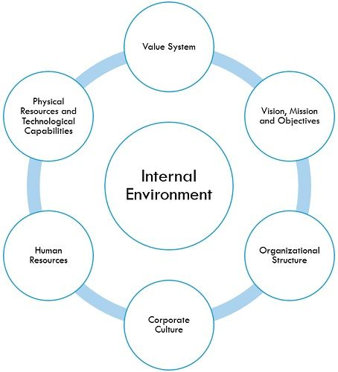
COMPONENTS OF INTERNAL ENVIROMENT
Value system
Mission and vision objective
Management structure and nature
Human resource
Internal power relationships
Company image and brand equity
05

Slide 6
Differences Between internal and external environment
Internal Environment pinpoints in-house factors of the firm, which are often constitutional in nature. On the flip side, External environment is composed of those factors which are exterior to the firm.
06

Slide 7
Importance of Internal Environment
The internal environment not only influences the activities and choices of employees but also affects the behavior of employees within the organization.
07

Slide 8
CONCLUION
Internal refers to the environment that has a direct bearing on the company. The internal business environment of a company is made up of internal aspects such as present personnel, management, and, most importantly, corporate culture.
08

Slide 9
References
Gitman, L. J., McDaniel, C., Shah, A., Reece, M., Koffel, L., Talsma, B., & Hyatt, J. C. (2018, September 18). The role of management. Introduction to Business. Retrieved March 23, 2022, from https://opentextbc.ca/businessopenstax/chapter/the-role-of-management/.
08

Slide 10
THANK YOU FOR YOUR ATTENTION
08

