Slide 1


HIV&TB Co-infection
2nd Year AMS (2021-2022)
Presented by : Reem Khaled
PTS block
1

Slide 2
Objectives
1
2
3
Explain the relation between HIV and TB
Discuss effect of TB on mortality of HIV
Outline the prevention and management of TB in HIV patients
2

Slide 3
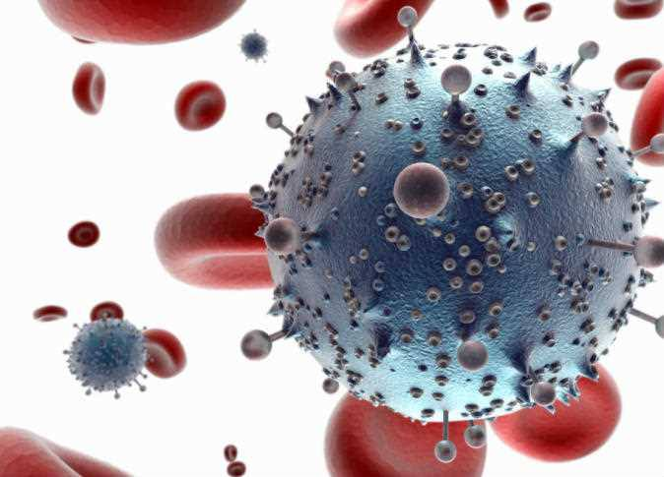
Introduction
3

Slide 4
1
Explain the relation between HIV and TB
4

Slide 5
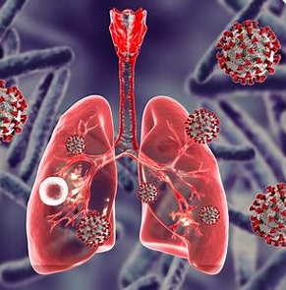
- TB and HIV are public health problems, which have a synergistic effect to each other. In people living with HIV, TB increases HIV replication and viral heterogeneity
HIV and TB
5

Slide 6
- HIV and TB can work together to shorten the life of the person infected. Someone with untreated latent TB infection and HIV infection is much more likely to develop active TB disease during his or her lifetime than someone with HIV infection
HIV and TB
6

Slide 7
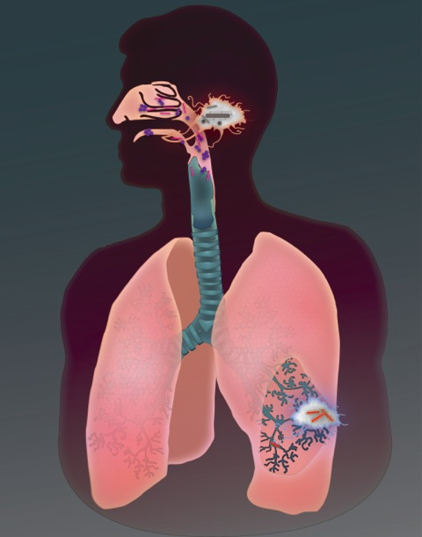
HIV infection is the most powerful known risk factor for Mycobacterium tuberculosis infection and progression to active disease , with 20-fold increase in the probability of latent TB reactivation.
HIV and TB
7

Slide 8
2
Discuss effect of TB on mortality of HIV
8

Slide 9
Study in Tanzania about effect of TB on HIV mortality
Routine data over 6 years from people living with HIV (PLHIV) attending health facilities in three regions of Northern Tanzania were analyzed, showing mortality trends from 2012 to 2017 for HIV and HIV/TB subpopulations.
9

Slide 10
Results
TB
26 per 1000 person-years
PLHIV
57per 1000 person-years
PLHIV
TB
PLHIV with TB co-infection had 40% higher mortality than those without TB
10

Slide 11
Global co-infection mortality
In 2019 208,000 people who had both TB and HIV are estimated to have died. This is in addition to the 1.2 million people who died from TB alone. Those people who have co-infection when they die, are internationally reported as having died of HIV infection. An estimated 690,000 people died of HIV infection in 2019
11

Slide 12
Global co-infection mortality (2019)
Deaths from HIV and TB co-infection: 208,000
Deaths from TB alone: 1,200,000
Deaths from HIV alone: 690,000
12

Slide 13
3
preventing and management TB in HIV patients
13

Slide 14

14

Slide 15
preventing TB in HIV patients
-The WHO currently recommends that all HIV infected persons be screened for TB, and HIV- Infected persons without active TB disease be evaluated for treatment of latent TB infection
15

Slide 16
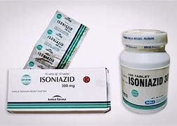
The most widely recommended regimen for TB preventive therapy is isoniazid 300 mg daily for 6 months
16

Slide 17
Conclusion
- TB and HIV are public health problems -also are though completely different infections. If you have HIV infection you will not get infected with TB bacteria - HIV and TB can work together to shorten the life of the person infected
17

Slide 18
Reference
-Annabel, K. TB and HIV - co-infection , diagnosis & treatment - TBFacts, GHE, (2022). pubmed [ Retrieved 2022 ] -Pawlowski A, Jansson M, Sköld M, Rottenberg ME, Källenius G. Tuberculosis and HIV co-infection. PLoS Pathog . (2012) doi: 10.1371/journal.ppat.1002464.2012 Feb 16. -Mollel, E. W., Todd, J., Mahande, M. J., & Msuya, S. E. Effect of tuberculosis infection on mortality of HIV-infected patients in Northern Tanzania. (2020).Tropical medicine and health, 27 Apr. 2020 doi.org/10.1186/s41182-020-00212-z
18

Slide 19
Thank you
19

