Slide 1


Injury and violence
Presented by: Aseel buhalfaya
Student number:2724
Year 2 AMS
Block: PTS

Slide 2
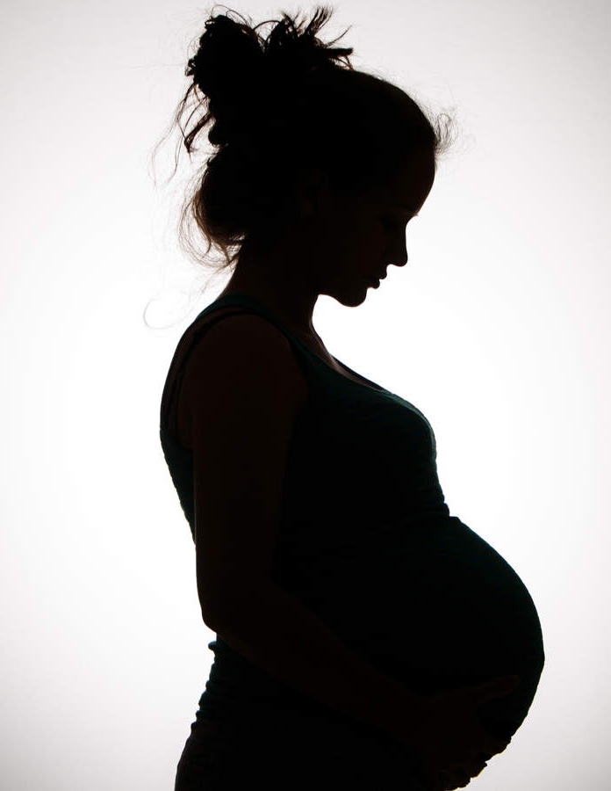
Intimate partner violence on maternal and neonatal

Slide 3
Lois capps
"Pregnant women are more likely to die from homicide by domestic violence than any other cause of death"

Slide 4
Objectives
1
Outline the types of violence used
2
Discuss the effect of IPV on maternal mental health
3
Outline maternal complications and birth outcomes
4
Discuss the cycle of overlapping violence

Slide 5


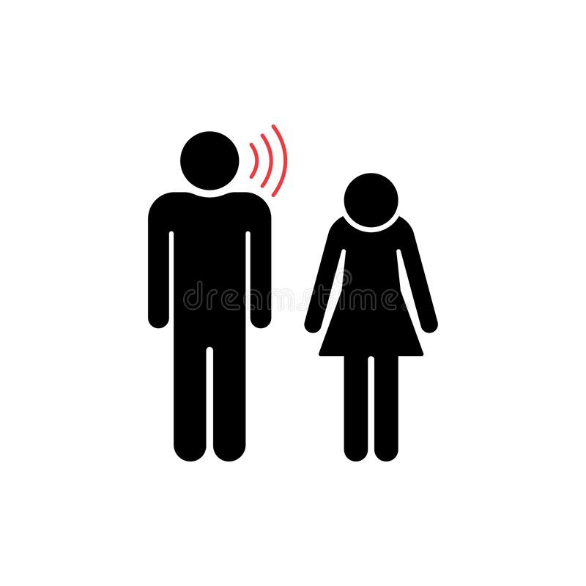

Types of violence used
Physical abuse
Emotional abuse
Sexual abuse
Social abuse

Slide 6
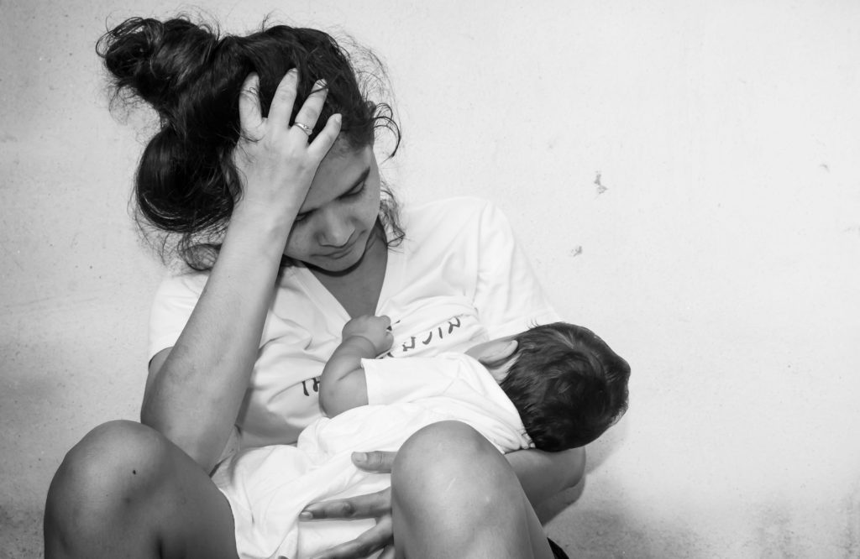
The effect of IPV on maternal mental health
Depression
Depression has been identified as the most common consequences of IPV.
With nearly 40% of abused women reporting depressive symptomology
Venus has a beautiful name and is the second planet from the Sun

Slide 7
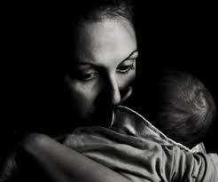
The effect of IPV on maternal mental health
Post-traumatic stress disorder
PTSD is also referred to a common consequences of IPV with reported rates of PTSD ranging from 19% to 80%

Slide 8

The effect of IPV on maternal mental health
Alcohol abuse and smoking
It is found that women who experienced IPV had higher rates of smoking and alcohol abuse before pregnancy and less likely to quite during pregnancy than those women who didn’t experience IPV

Slide 9
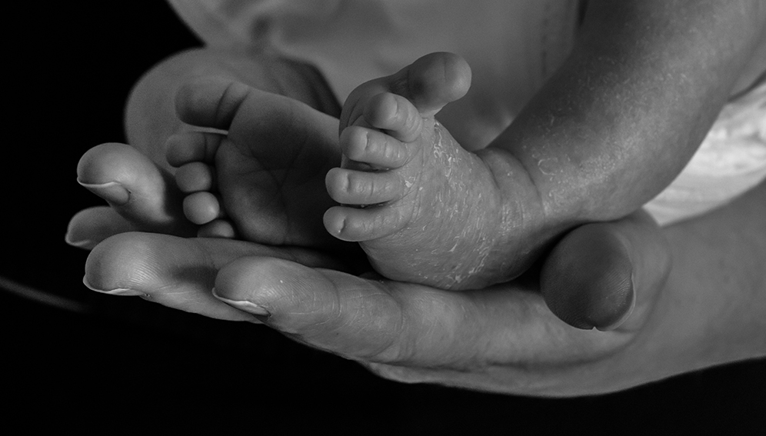
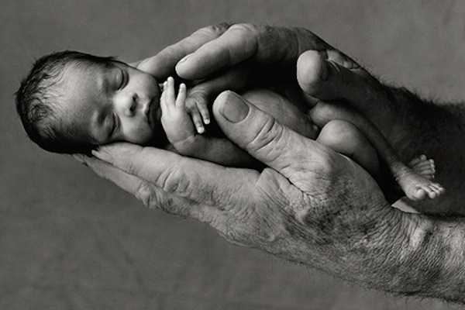
Maternal complications and Birth outcomes
Low birth weight
The normal weight of a healthy new born is 3.3kg.
The researches supports the role of IPV in low birth weights and increases the rates of preterm birth

Slide 10
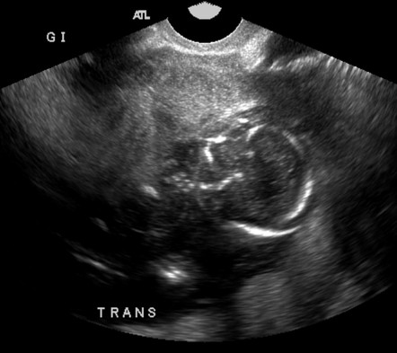
Maternal complications and Birth outcomes
Perinatal death
The physical or sexual trauma to the mother abuse during pregnancy increases the risk of perinatal death because of negative maternal coping behaviors such as poor maternal nutrition

Slide 11
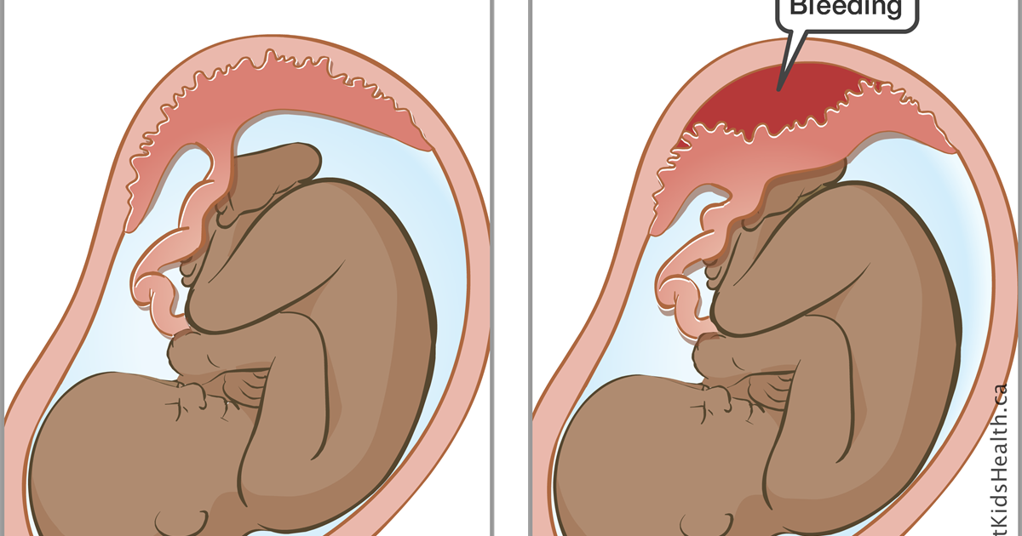
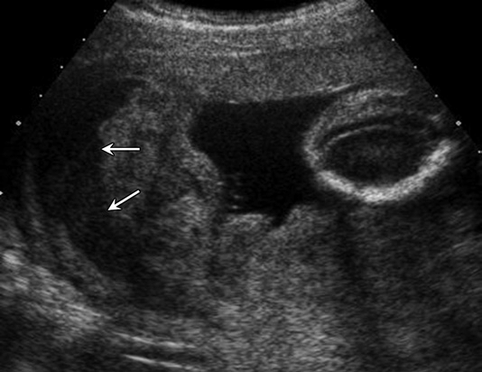
Maternal complications and birth outcomes
Placenta abruption
Placenta is the structure that provides nutrients and oxygen for the fetus
Placenta abruption is a consequence of IPV
The common risk factors of placenta abruption include hypertension trauma and substance use which these risk factors have been associated with IPV.
Violence and assault such as blunt force to the abdomen by a partner is one of causes of placenta abruption.

Slide 12
What can trigger domestic violence and abuse during pregnancy?
Unplanned pregnancy
Responsibility
Jealousy

Slide 13
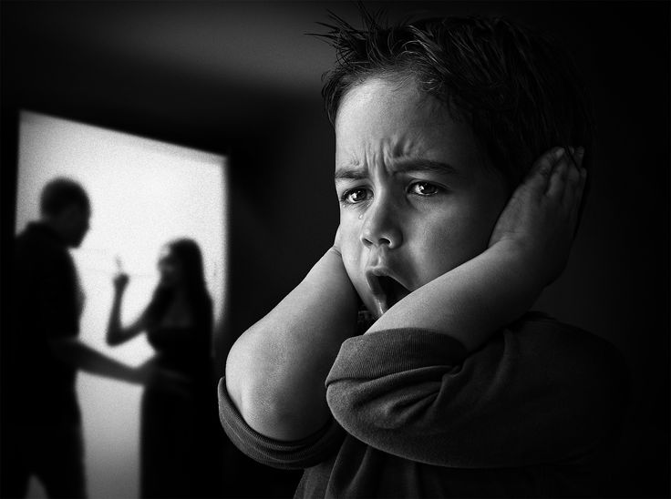
Did you know?
Children who witness domestic violence are 3 times more likely to repeat the cycle in adulthood

Slide 14
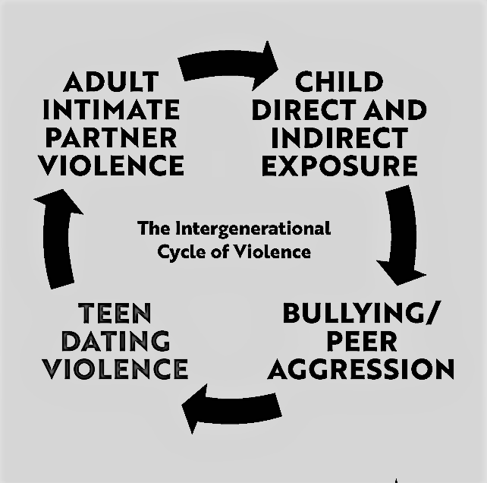
The cycle of overlapping violence

Slide 15
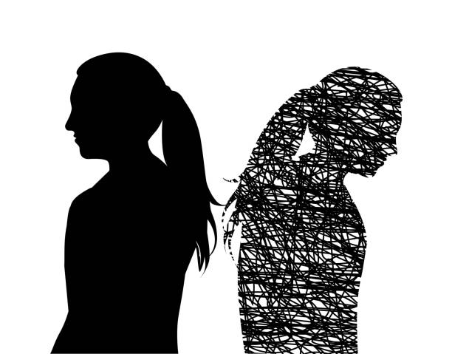
Why does the victim stay ?
Fear: the threats and emotional harm is powerful and abusers use this to control and keep women trapped .
Distorted thoughts : being controlled is traumatizing and it leads to confusion, doubt and self-blame.
Women shared " I believed I deserved it" or
" I was ashamed, embarrassed and blamed myself because I thought I triggered him "

Slide 16
"I do this for my baby "
Children : mothers put their children first for sacrificing their own safety..
" I was afraid if he wasn’t beating me he would beat his kids"
" I stayed for 20 years protected our children all the while I was being abused"
Staying for the benefit of the children : " I wanted my son to have a father "
Mental health

Slide 17
References:
1. Domestic Violence in Pregnancy: How Abuse Affects Your Pregnancy [Internet]. What to Expect. 2022 [cited 2 April 2022]. Available from: https://www.whattoexpect.com/pregnancy/domestic-abuse/
2. 1. Intimate Partner Violence | ATrain Education [Internet]. Atrainceu.com. 2022 [cited 2 April 2022]. Available from: https://www.atrainceu.com/content/1-intimate-partner-violence-0
3. Eight Reasons Women Stay in Abusive Relationships [Internet]. Institute for Family Studies. 2022 [cited 2 April 2022]. Available from: https://ifstudies.org/blog/eight-reasons-women-stay-in-abusive-relationships

Slide 18


