Slide 1


The Impact of the Natural and Technological Environments in Marketing
The Libyan International Medical University
The Faculty Of Business
Rabeia Elmansoury
3483
Rabeia_3483@limu.edu.ly

Slide 2
TABLE OF CONTANT :-
Intended learning outcomes:-
INTRODUCTION:-
THE TYPES OF MARKTING ENVIRMENTS.
CONCLUSION:-
References:-

Slide 3
Intended learning outcomes:-
      At the end of this presentation you will be able to:-
KNOW Meaning of Marketing Environment.
know the types of the unviroment.

Slide 4
INTRODUCTION:-
marketing environment is a combination of internal and external environmental forces and factors that influences the business operation of a business and its ability to serve its customers.

Slide 5

THE TYPES OF MARKTING ENVIRMENTS:-

Slide 6
Micro Environnent:-
Micro environment refers to the environment, which is closely linked to the organization, and directly affects organizational activities.

Slide 7
The Micro Environment can be divided into :-
supply side environment
demand side environment

Slide 8
Macro Environnent:-
A macro environment consists of conditions that exist across the world’s economy in general, rather than in a specific industry or region.

Slide 9
Natural Environment

Slide 10
The following natural factors have a huge impact on an organization's marketing activities:

Slide 11

Natural Resources:
a. Natural Resources: It is used as a raw material in the production of a wide range of products.

Slide 12
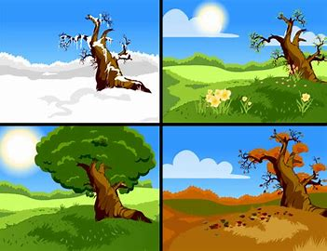
Weather:
It leads to opportunities or threats for the organizations. For example The marketing environment is greatly influenced by the weather conditions of a country.

Slide 13
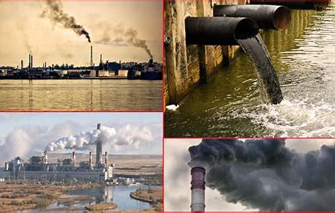
Pollution:
It includes pollution of the air, water, all of which result in environmental degradation. Organizations nowadays focus on promoting environmentally friendly items through their marketing effort.

Slide 14


Slide 15

Technological Environment:
Technology aids in a country's economic development. It has become an unavoidable part of everyday life.

Slide 16
Following points explain the technological trends that affect the marketing environment:

Slide 17

Pace of Technological Change:
It has a dramatic effect on product expiration.

Slide 18

Research and Development:
It helps in the increase of an organization's growth opportunities. To bring innovation to their products.

Slide 19
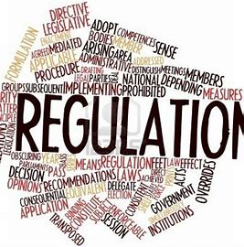
Increased Regulation:
It refers to government laws that banned the sale of dangerous goods.

Slide 20

CONCLUSION:-
The marketer must know how different external forces influence the organization's decision. Marketers and organizations who identify, plan, and implement ways to counter this environmental shift are successful.

Slide 21
References:-
Art of Marketing - Learn the Art of Marketing from the Experts! 2017|5|16https://www.artofmarketing.org/marketing-environment-2/marketing-environment-meaning-features-types-and-importance/135
investopedia September 03, 2021 https://www.investopedia.com/terms/m/macro-environment.asp#:~:text=The%20macro-environment%20refers%20to%20the%20broader%20condition%20of,on%20things%20such%20as%20spending%2C%20borrowing%2C%20and%20investing.
https://www.bing.com/th?id=OIP.Nfe-9ckdwIHmgJ5fboY_eQHaHA&w=181&h=170&c=8&rs=1&qlt=90&o=6&dpr=1.5&pid=3.1&rm=2
https://th.bing.com/th/id/OIP.R9m72UcRQEMfufgdEZF9wAHaFr?w=234&h=180&c=7&r=0&o=5&dpr=1.5&pid=1.7
https://th.bing.com/th/id/OIP.hfs3Osf3hYTIkO_bID9BIwHaEK?w=283&h=180&c=7&r=0&o=5&dpr=1.5&pid=1.7

