Slide 1


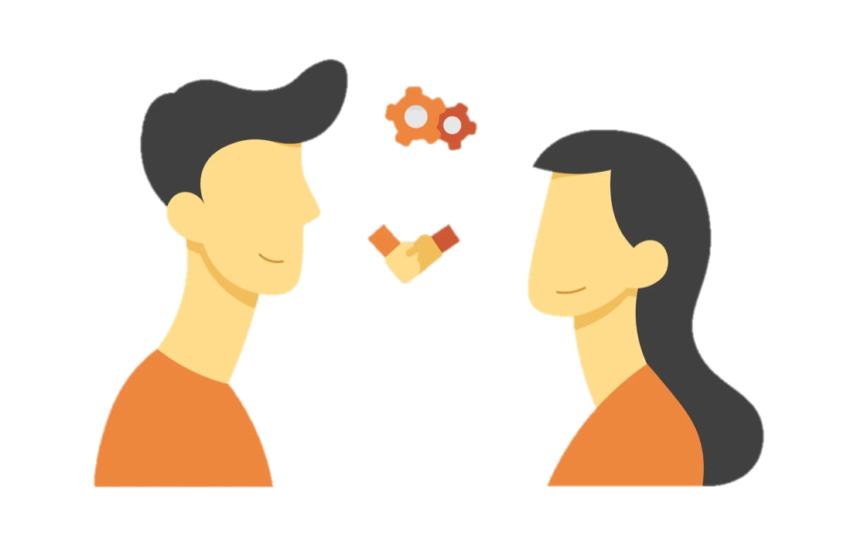
The Major Theories That Explain Relationship Development, Deterioration, Repair
Libyan International Medical University
Faculty of Business Administration
Name: nahawand elhammali
Id: 2752
Email: nahawand_2752@limu.edu.ly

Slide 2

Table of Contents:
01
02
03
04
05
06
Introduction
Theories of Relationship Development
Skills of Interpersonal Communication
Types of Relationships
Conclusion
References
1

Slide 3

Introduction
The relationships rules theory asserts that relationships are held together by the observance of definite rules, and when these rules are not complied with, our connections might weaken or end.
2

Slide 4

The Theories Of Relationship Development
Given this variety of factors, several theories and models have been proposed to predict how relationships evolve, including
Filter theory
Social exchange theories
Resource theory
Equity theory
Interdependence theory
Social penetration theory
Uncertainty reduction theory
Predicted outcome value theory
3

Slide 5

What Skills That You Need To Make Effective Interpersonal Communication?
4

Slide 6
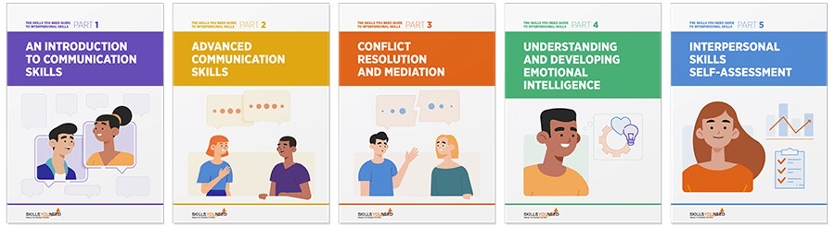
They include a wide range of skills, but particularly communication skills, You can improve your interpersonal skills by developing your awareness of how you interact with others and practising your skills.
5

Slide 7
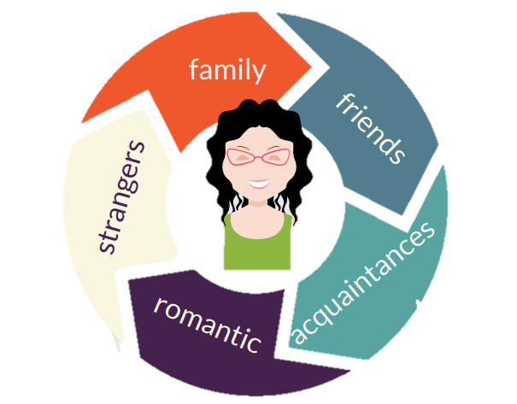
There Are 5 Types Of Relationships.
Competitive/Controlling.
Active/Passive.
Aggressive/Accommodating.
Disconnected/Parallel Lives.
Accepting/Balanced.
6

Slide 8

Conclusion
Relationships are held together by the adherence of definite rules, according to the relationships rules hypothesis.
7

Slide 9
References
Fox, J. (2015, December 1). Models of relationship development. Wiley Online Library. Retrieved December 13, 2021, from https://onlinelibrary.wiley.com/doi/abs/10.1002/9781118540190.wbeic028.
Wikimedia Foundation. (2021, October 19). Relationship maintenance. Wikipedia. Retrieved December 13, 2021, from https://en.wikipedia.org/wiki/Relationship_maintenance.
2011-2021, (c) C. skillsyouneed.com. (n.d.). Interpersonal skills. SkillsYouNeed. Retrieved December 14, 2021, from https://www.skillsyouneed.com/interpersonal-skills.html
8

Slide 10

9

