Slide 1


Libyan International Medical University
Faculty of Business Administration
Classify The Key Changes in The Political and Cultural Environments in The Libyan Market and abroad
By : Nazeeha Amrouni
ID number : 2763
E-mail : nazeehah_2763@limu.edu.ly

Slide 2
Contents
2
Defining the political environment.
Defining the cultural environment.
The impact of cultural and political environments in market.
Classify the key changes in those environments in the market.
Conclusion.
References.

Slide 3
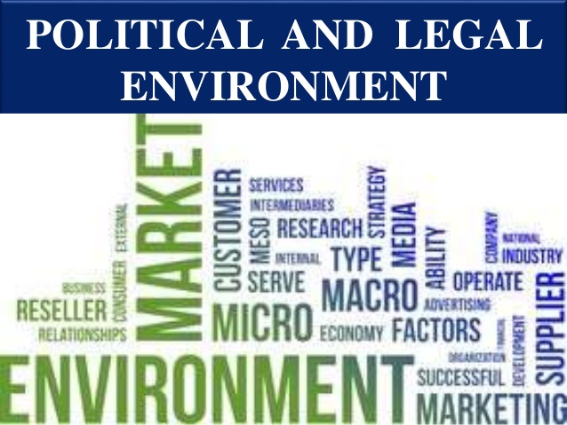
Defining the political environment
3
The political environment refers to the laws and institutions that influence or restrict marketing practices. They are all aspects that have a good or negative impact on marketing effort.

Slide 4
4
Increased legislation controlling business, strong government agency enforcement, and a stronger emphasis on ethics and socially responsible acts have all influenced marketing around the world.

Slide 5
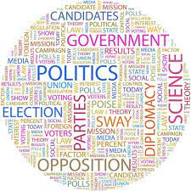

Slide 6

Defining the cultural environment
6
Institutions and influences that influence a society's beliefs, perceptions, preferences, and behaviors make up the cultural environment. The environment reflects tendencies toward new technology-enabled communication, a decline in trust in institutions, rising patriotism, a deeper respect for nature, shifting spiritualism, and the desire for more significant and long-lasting values.

Slide 7
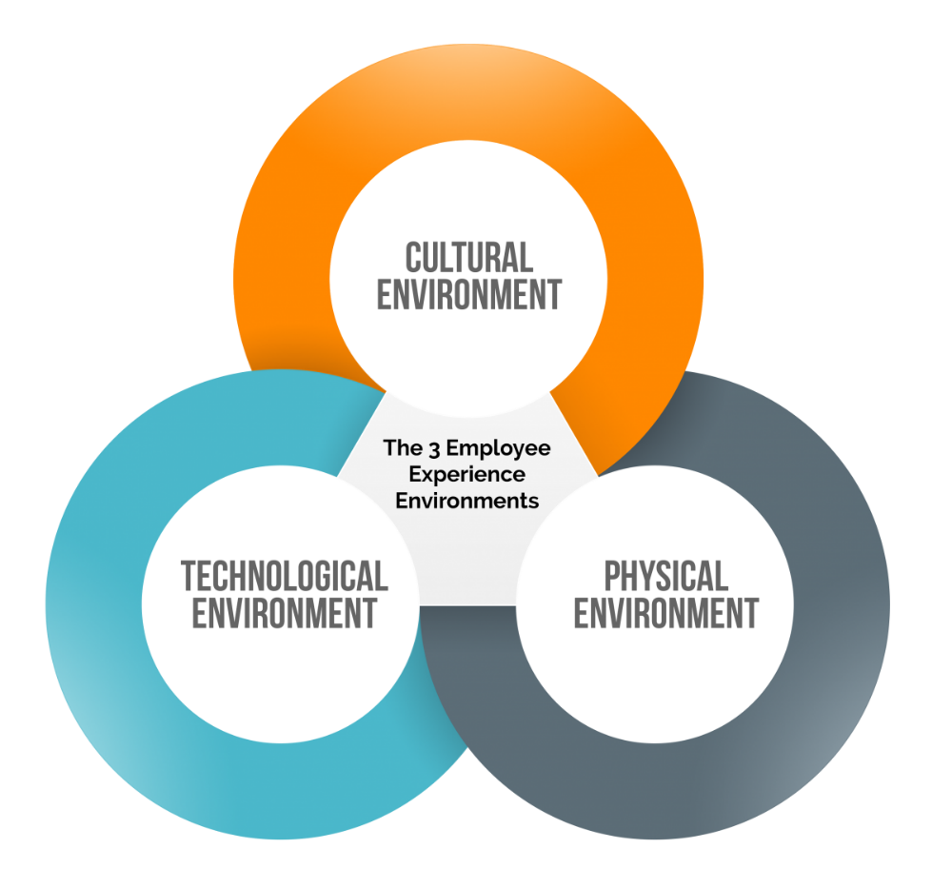

Slide 8
The impact of cultural and political environments in market :
9
Political environment :
Political concerns that affect business are frequently given a lot of weight. Several components of government policy can have an impact on the economy. All businesses must abide with the law. Managers must determine how upcoming laws will impact their operations.
Cultural environment:
Cultural considerations have a significant impact on business. Employees' values and priorities have an impact on how they are managed. It also has an impact on the marketing, sales, and distribution departments. It can have an impact on how a company analyzes and decides how to join a new market.

Slide 9
Classify the changes in cultural and political environments :
10
1-Political environment:
Political stability:
International firms withdrew from some nations due to political instability, pushing them to seek other markets.
Changing governance and changing the role of the state and politics in the market :
Changes in government result in changes in the state's role and meddling in economic life. One of the most essential elements analyzed by multinational business companies is the amount of the state's interference in the economic system.

Slide 10


Slide 11
Conclusion:
13
When considering a new project, you should research the market's political and cultural context because it is one of the most crucial parts of the project's success.

Slide 12
References:
14
(n.d.). Retrieved April 14, 2021, from https://www.hartehanks.com/insights/our-insights/2017/10/02/Blast-from-the-Past-What-Has-Changed-In-Marketing-from-5-Years-Ago-
Tracy, B. (n.d.). Marketing (the Brian TRACY Success library). Retrieved April 14, 2021, from https://www.oreilly.com/library/view/marketing-the-brian/9780814434215/xhtml/summary.html
7 major importance of Marketing: Marketing management. (2014, February 17). Retrieved April 14, 2021, from https://www.yourarticlelibrary.com/marketing/7-major-importance-of-marketing-marketing-management/25857
What is MARKETING?: INTANDEM COMMUNICATIONS. (2019, November 15). Retrieved April 14, 2021, from https://www.intandemcommunications.co.uk/article/what-is-marketing/
Hardy, J., Onukogu, G., Stoller, L., Adewale, A., Ward, G., Holmes, S., & Ashley. (2020, June 16). The history of Marketing: From trade to tech. Retrieved April14, 2021, from https://historycooperative.org/the-evolution-of-marketing-from-trade-to-tech/

Slide 13


