Slide 1

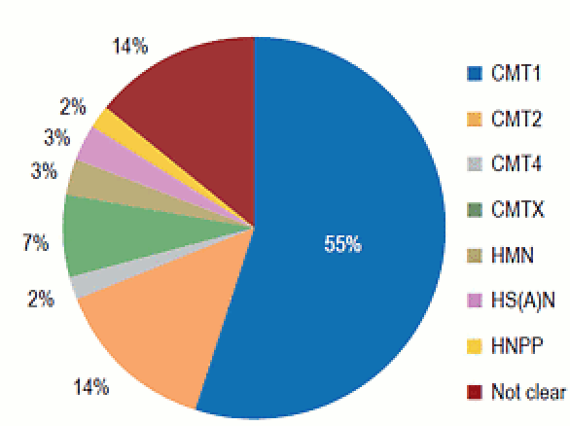
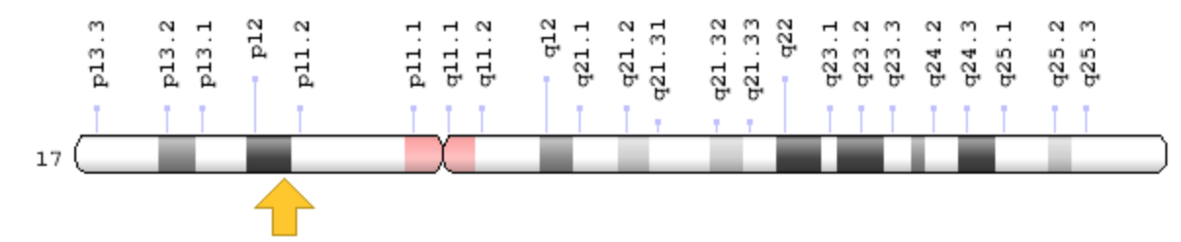
Hereditary Neuropathy With Liability To Pressure Palsies
Libyan International Medical University
Faculty of Basic Medical Science
Mohammed Omar. 2nd Year Medical Student.
Introduction
Discussion
Conclusion
Caused by the deletion of one copy of the peripheral myelin protein 22 (PMP22) gene.
The PMP22 protein is a component of myelin, a protective substance that covers nerves and promotes the efficient transmission of nerve impulses (Figure 2).
Studies suggest that the PMP22 protein is particularly important in protecting nerves from physical pressure, helping them restore their structure after compression.
A shortage of PMP22 protein appears to make nerves less able to recover from compression, which impairs the transmission of nerve impulses, causing the signs and symptoms of HNPP.
-The HNPP is rare disease caused by deletion on chromosome 17.
-The symptoms occur in childhood period, the PMP22 gene mutation is the main cause of this condition
by affected myelin sheath in peripheral nerves
the main symptoms is numbness and pain in the affected nerves.
-Surgical decompression of nerves is not beneficial and may cause harm, the PMP22 gene mutation can cause other conditions such as , the PMP22 gene mutation can cause other conditions such as :
Charcot-Marie-Tooth disease, and Yuan-Harel-Lupski syndrome.
-physical thereby also used to helps muscles function.
HNPP is disorder that affects peripheral nerves.
Which estimated to occur in 2 to 5 per 100,000 individuals(Figure 1).
People with this disorder, the peripheral nerves are usually sensitive to pressure Such as :
When carrying heavy grocery bags, leaning on an elbow, or siting without changing position.
The most common problem sites involve nerves in the wrist, elbows and knees.
The fingers, shoulders, hands, feet, scalp can also be affected.
The aim of the study to describe the symptoms and the genetic mutation.
Chromosomal location:-
Cytogenetic Location: 17p12, which is the short (p) arm of chromosome 17 .(Figure 3)
Health conditions related to genetic changes:-
1- Charcot-Marie-Tooth disease.
2- HNPP.
3- Yuan-Harel-Lupski syndrome.
Symptoms
References
The symptoms develop in anytime from childhood to late adulthood .
Recurrent episodes of numbness, tingling, and loss of muscle function, associated with ( arm, hand, leg, or foot ).
An episode can last from several minutes to several months, but recovery is usually complete.
Many people with this disorder experience carpal tunnel syndrome .
An episode of nerve compression in the knee can lead to a condition called foot drop.
An episode in the hand may affect fine motor activities such as writing, opening jars, and fastening buttons.
Does not affect life expectancy.
1] HNPP | Genetic and Rare Diseases Information Center (GARD) – an NCATS Program.
2] Yilmaz, U., Bird, T. T., Carter, G. T., Wang, L. H., & Weiss, M. D. (2015). Pain in hereditary neuropathy with liability to pressure palsy: an association with fibromyalgia syndrome?. Muscle & nerve, 51(3), 385-390.
3] Potulska‐Chromik, A., Sinkiewicz‐Darol, E., Ryniewicz, B., Lipowska, M., Kabzińska, D., Kochański, A., & Kostera‐Pruszczyk, A. (2014). Clinical, electrophysiological, and molecular findings in early onset hereditary neuropathy with liability to pressure palsy. Muscle & nerve, 50(6), 914-918.
4] Ferraro, D. F., Carantini, D. F. I., & Baietta, C. " La mobilizzazione del sistema nervoso nel dolore della persona con Charcot-Marie-Tooth.
5] electrophysiological, and molecular findings in early onset hereditary neuropathy with liability to pressure palsy. Muscle Nerve. 2014 Dec;50(6):914-8. doi: 10.1002/mus.24250. Epub 2014 Oct 30. citation on pubmed
Fig.1 frequency distribution of hereditary neuropathies in 1652 cases.
Fig.2 parts-of a neuron.
Fig.3

