Slide 1


Ethical Issues Related with The Consumer
Libyan International Medical University
Faculty of Business Administration
Name: Roua El.frgani
ID: 3169
Roui_3169@limu.edu.ly

Slide 2
Table Of Contents
01
02
03
Introduction
Ethical in product policy
Ethical in marketing communications
04
05
Ethical in pricing
Conclusion
06
References
2

Slide 3
Objectives!
Understand ethical relation with customer.
3

Slide 4
Introduction
The relationship between business ethics and customer relations depend on the manner in which the management of various businesses apply the principles of ethics in their interaction with customers, now the organizations to succeed by outperforming their competitors in providing super value to their customer.
4

Slide 5
Ethical issues in product policy
In most countries, businesses are legally obligated to provide products and services that are safe, effective, and fit for their intended use, many commonly purchase and used goods have the potential to damage, harm, or even kill people if used incorrectly.
Not just including alcoholic drinks and cigarettes, but also to cars, bicycles, tools, medicines, public transportation, financial services, and catering services.
5

Slide 6
Ethical issues in marketing communications
Marketing Communications is the sharing of information concepts receiver about products and services and the organizations that sells them.
There are different manner of communicating to consumers: personal selling, sales promotion, direct marketing, public relations, and advertising.
6

Slide 7

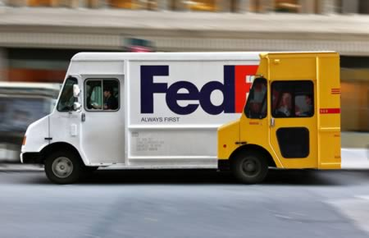
Unhealthy Brand Comparisons Unhealthy brand comparisons and bad-mouthing the products of rival brands is a common concept so that the customers can shift allegiance to their brand.
For instant: DHL
One of advertising tools:
8

Slide 8
Ethical issues in pricing
Pricing a product ethically is a major decision for any business.
Businesses who use ethical pricing strategies to sell their products and earn a profit are gain more respected.
9

Slide 9
the concept of a fair price is open to a number of different views, but typically is thought of as the result of a mutual agreement by the buyer and seller under competitive conditions.
Types of pricing practices where ethical problems are likely to arise..
Excessive pricing.
Price fixing.
10

Slide 10
Conclusion
As a business owner to get loyalty in your product you have to know every tannic that will impact on your customers relations, without satisfying your customer you can not ruin your business.
11

Slide 11
Reference
Contributor, C. (2020, October 26). Ethics in marketing communication. Small Business - Chron.com. Retrieved December 7, 2021,
Guo, V. (2021, September 6). Pricing ethics: 5 ethical issues in pricing strategies [+avoiding them]. Pricing Ethics: 5 Ethical Issues in Pricing Strategies [+Avoiding Them]. Retrieved December 7, 2021,
12

Slide 12
Thank you
Does anyone have any question?

