Slide 1
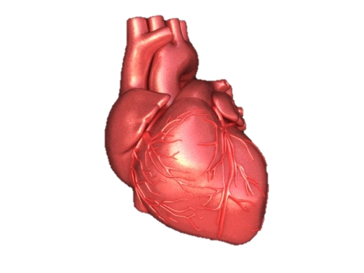
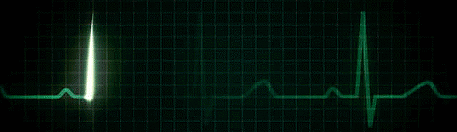
ECG
Dr. Zaki Bettamer,MD
Zikoecho @yahoo.com

Slide 2
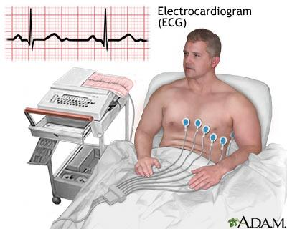

Slide 3
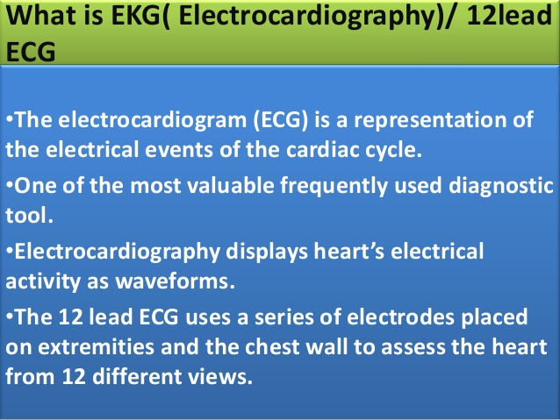

Slide 4
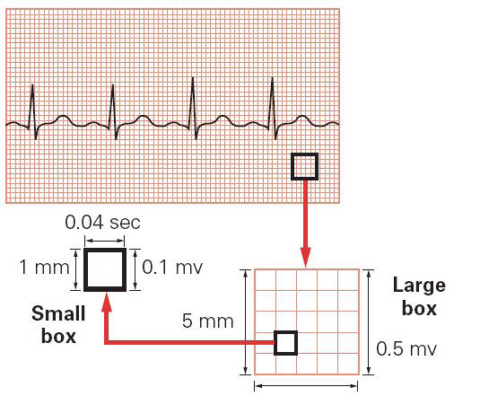

Slide 5
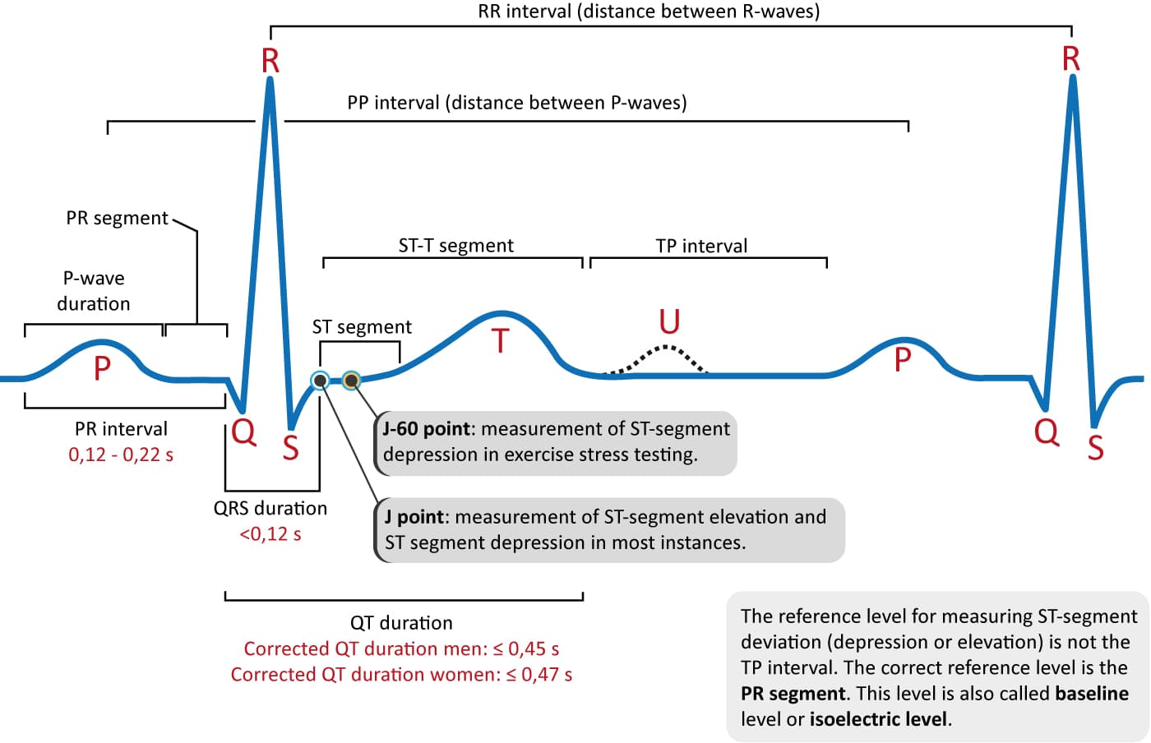

Slide 6
ECG leads
• To ascertain the direction of a wavefront, the
ECG is recorded from different sites called lead
Recording 12 lead ECG:
• 6 horizontal bipolar leads( I,II, III, aVR, aVL,
aVF).
• 6 frontal leads unipolar leads(V1 – V6).

Slide 7
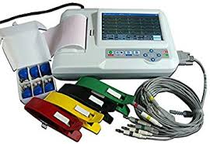

Slide 8
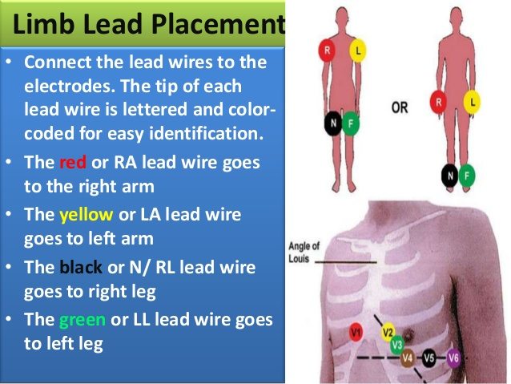

Slide 9

The vertical plane - the six limb leads
Lead I
Lead aVR
Lead aVL
-
+
+
-
-
+
-
-
Lead II
Lead III
Lead aVF
-
-
-
-
+
+
+
7.4
Notes:
The vertical plane - the six limb leads
The three electrodes are placed on the right (R) and left arms (L) and the left leg (F) with the neutral lead on the right leg, usually on the wrists and ankles.
Lead I is obtained by connecting L to the positive terminal and R to the negative terminal.
Lead II records with the left leg connected to the positive and the right arm to the negative.
Lead III records with the left foot connected to the positive and the left arm to the negative.
aVR, aVL, and aVF are considered to look at the heart from the right arm, left arm and left leg.
Leads I and aVL give most information about the lateral border, leads II, III, and aVF obtain most information about the inferior (or posterior) and the precordial leads give information about the anterior aspect of the heart.

Slide 10
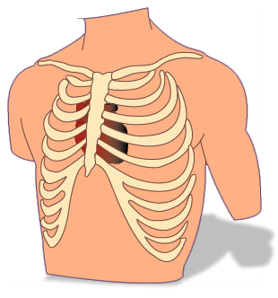
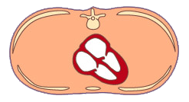
Horizontal plane - the six chest leads
LA
RA
LV
V1
V2
RV
V6
V3
V4
V5
V6
V5
V4
V1
V2
V3
7.5
Notes:
Horizontal plane - the six chest leads
Each of the six chest leads has a fixed position. In order to place the precordial leads correctly the fourth intercostal space needs to be identified. The ribs form convenient horizontal landmarks. In order to count them, feel for the ridge with marks the junction of the manubrium and the body of the sternum. When this has been found, run the finger outwards until it reaches the second costal cartilage, which articulates with the sternum at this level. The space immediately above this is the first intercostal space. The spaces should then be counted downwards, well away from the sternum, as they are more easily felt here.
V₁ right sternal margin at fourth intercostal space
V₂ left sternal margin at fourth intercostal space
V₃ midway between V₂ and V₄
V₄ intersection of left midclavicular line and fifth intercostal space
V₅ intersection of left anterior axillary line with a horizontal line through V₄
V₆ intersection of mid-axillary line with a horizontal line through V₄ and V₅.
V₁ and V₂ face and lie close to the free wall of the right ventricle, V₃ and V₄ lie near to the interventricular septum with V₄ usually at the cardiac apex, and V₅ and V₆ face the free wall of the left ventricle but are separated from it by a substantial distance.
Together the chest leads observe changes in the anterior and lateral aspects of the heart, giving detailed information about the myocardium of the area they lie over.

Slide 11
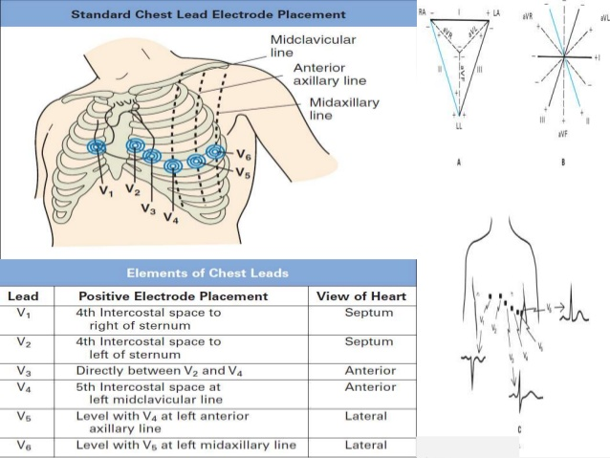

Slide 12
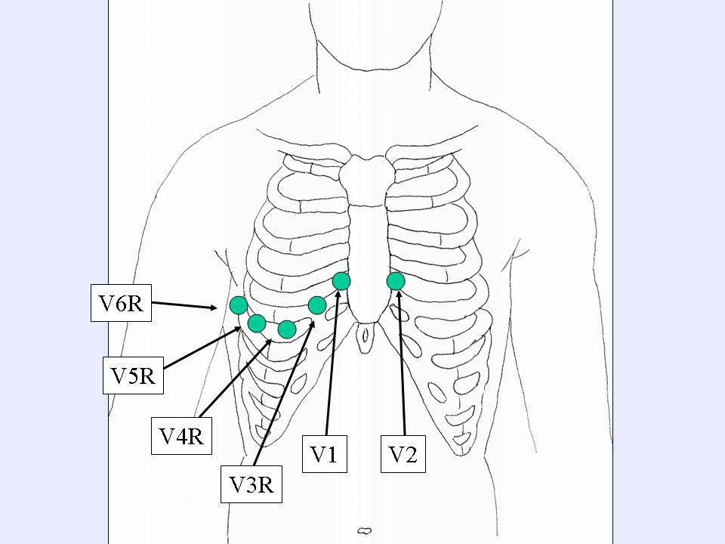
RT sided ECG.

Slide 13
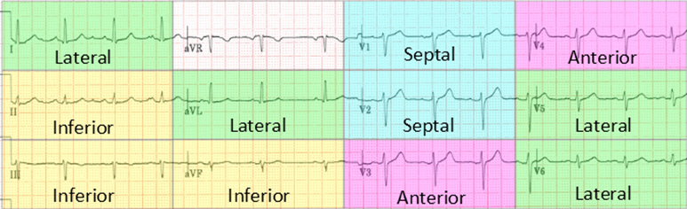

Slide 14
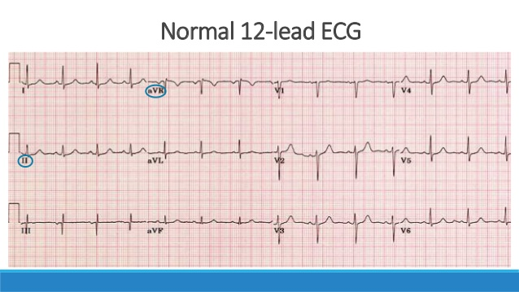

Slide 15
Reading normal ECG

Slide 16
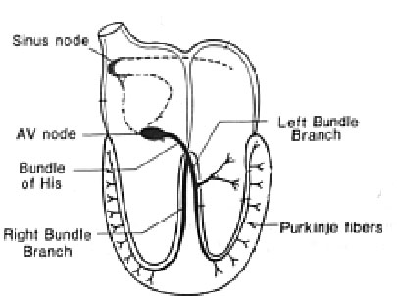
Normal Impulse Conduction
Sinoatrial node
AV node
Bundle of His
Bundle Branches
Purkinje fibers

Slide 17
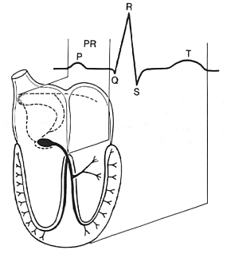
Impulse Conduction & the ECG
Sinoatrial node
AV node
Bundle of His
Bundle Branches
Purkinje fibers

Slide 18
The “PQRST”
P wave - Atrial depolarization
QRS - Ventricular depolarization
T wave - Ventricular repolarization

Slide 19
The PR Interval
Atrial depolarization
+
delay in AV junction
(AV node/Bundle of His)
(delay allows time for the atria to contract before the ventricles contract)

Slide 20
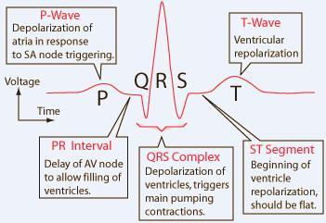
Anatomy of Heart and ECG signal

Slide 21
Pacemakers of the Heart
SA Node - Dominant pacemaker with an intrinsic rate of 60 - 100 beats/minute.
AV Node - Back-up pacemaker with an intrinsic rate of 40 - 60 beats/minute.
Ventricular cells - Back-up pacemaker with an intrinsic rate of 20 - 45 bpm.

Slide 22
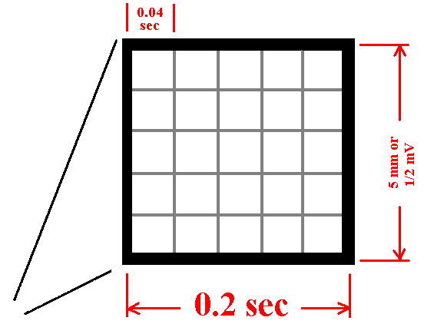
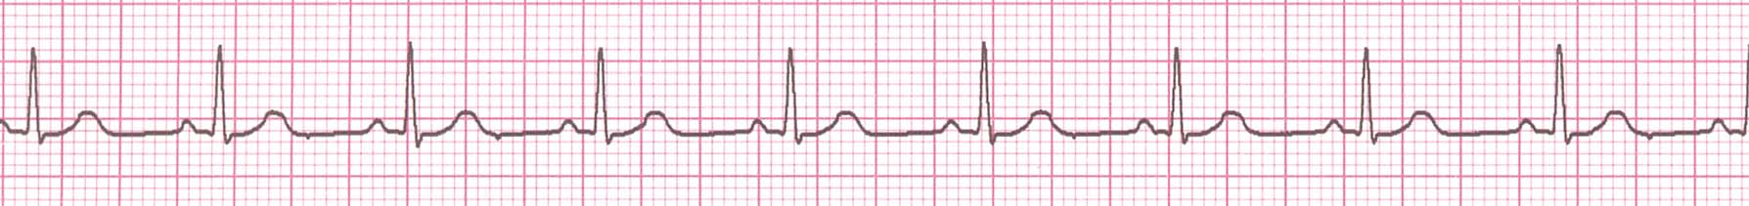
The ECG Paper
Horizontally
  One small box - 0.04 s
  One large box - 0.20 s
Vertically
  One large box - 0.5 mV

Slide 23
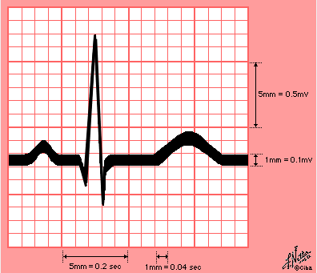

Slide 24
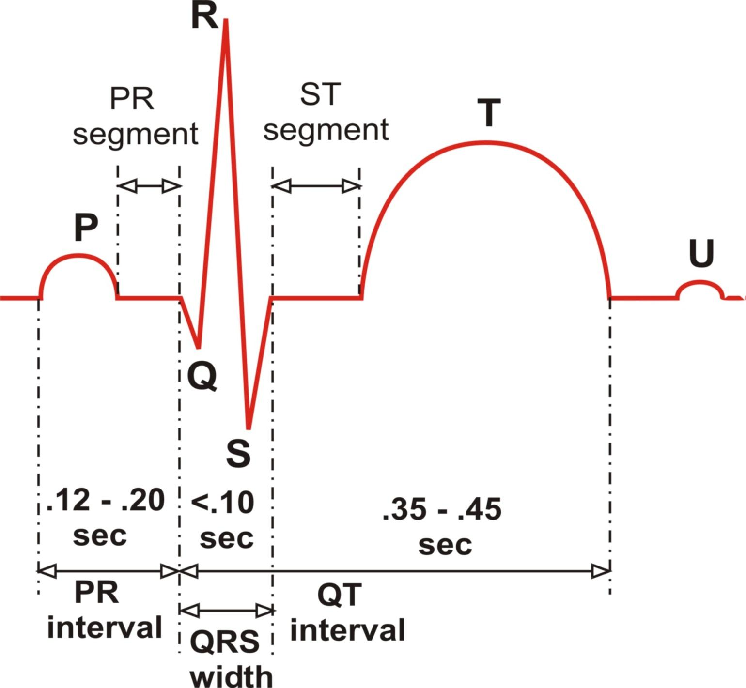
The ECG Complex with Interval and Segment Measurements

Slide 25
Remember This 3, 3, 3 and 5
P duration = 3 small sqs = 0.12 sec.
P height = 3 small sqs = 0.12 sec.
QRS duration = 3 small sq = 0.12 sec.
P-R interval = 5 small sqs = 0.2 sec.

Slide 26
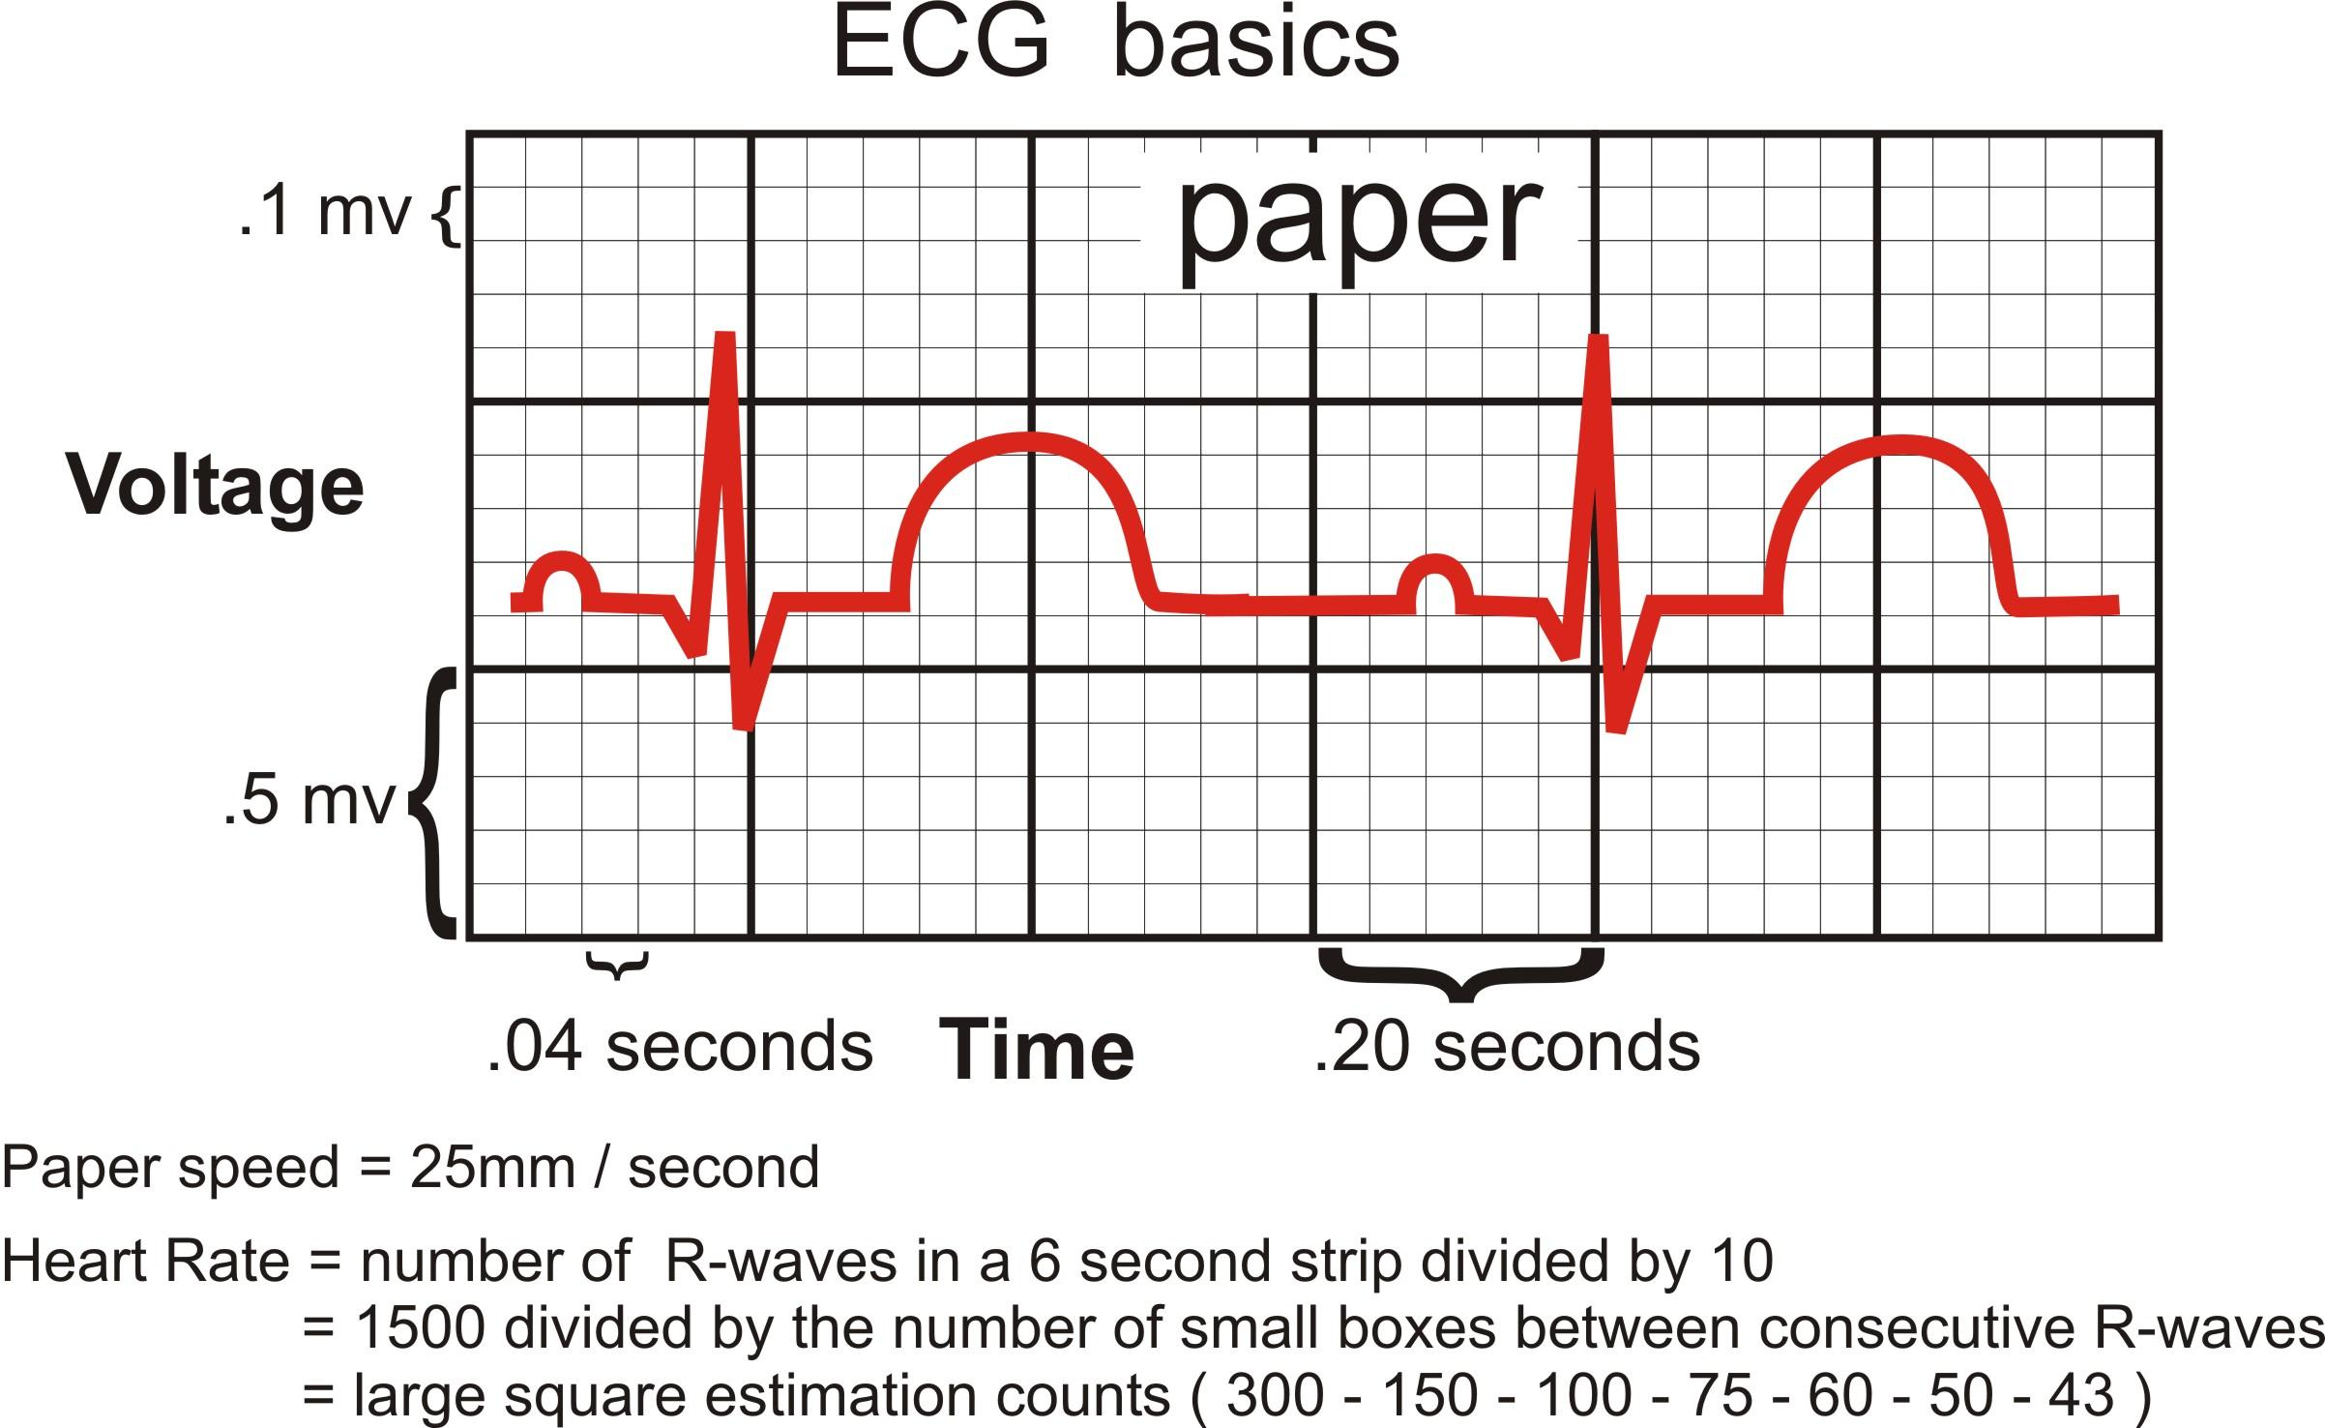
ECG Paper and related Heart Rate & Voltage Computations

Slide 27
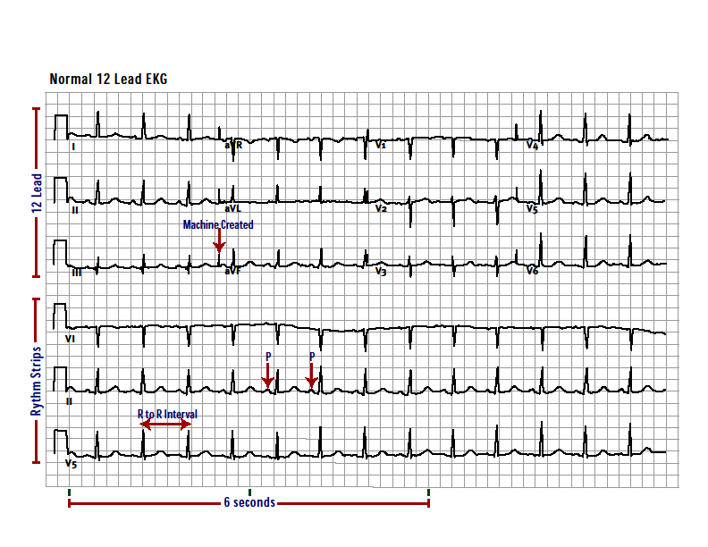

Slide 28
Rhythm Analysis
Step 1: Calculate rate.
Step 2: Determine regularity.
Step 3: Assess the P waves.
Step 4: Determine PR interval.
Step 5: Determine QRS duration.

Slide 29
The ECG Paper (cont)
3 sec
3 sec
Every 3 seconds (15 large boxes) is marked by a vertical line.
This helps when calculating the heart rate.

Slide 30
Step 1: Calculate Rate
3 sec
3 sec
Option 1
  Count the # of R waves in a 6 second rhythm strip, then multiply by 10.
Interpretation?
9 x 10 = 90 bpm

Slide 31
Step 1: Calculate Rate
300
150
100
75
60
50
Option 2 (cont)
  Memorize the sequence:
  300 - 150 - 100 - 75 - 60 - 50
Interpretation?
  Approx. 1 box less than 100 = 95 bpm

Slide 32
Rate:
If regular : Divide 300/ number of large squares between 2 Rs = HR
If irregular: Count number of complexes in 6 sec. and multiply by 10
RATE may be: P = Sinus
Normal 60 -100 No P = Non sinus
Bradycardia < 60
Tachycardia > 100

Slide 33
Step 2: Determine regularity
R
R
Look at the R-R distances (using a caliper or markings on a pen or paper).
Regular (are they equidistant apart)? Occasionally irregular? Regularly irregular? Irregularly irregular?
Interpretation?
Regular

Slide 34
Step 3: Assess the P waves
Are there P waves?
Do the P waves all look alike?
Do the P waves occur at a regular rate?
Is there one P wave before each QRS?
Interpretation?
Normal P waves with 1 P wave for every QRS

Slide 35
Step 4: Determine PR interval
Normal: 0.12 - 0.20 seconds.
(3 - 5 boxes)
Interpretation?
0.12 seconds

Slide 36
Step 5: QRS duration
Normal: 0.04 - 0.12 seconds.
(1 - 3 boxes)
Interpretation?
0.08 seconds

Slide 37
Rhythm Summary
Rate 90-95 bpm
Regularity regular
P waves normal
PR interval 0.12 s
QRS duration 0.08 s
Interpretation?
Normal Sinus Rhythm

Slide 38
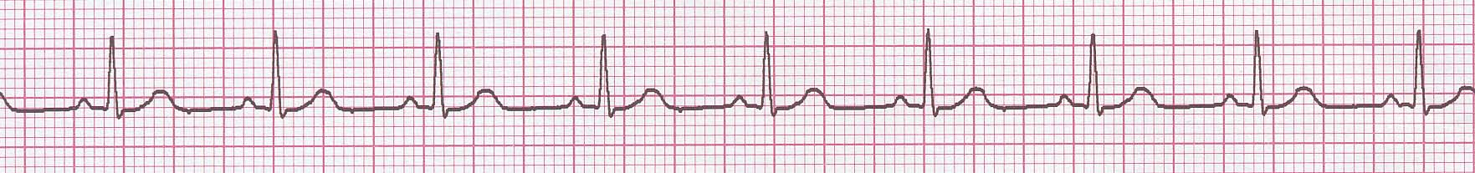
NSR Parameters
Rate 60 - 100 bpm
Regularity regular
P waves normal
PR interval 0.12 - 0.20 s
QRS duration 0.04 - 0.12 s
Any deviation from above is sinus tachycardia, sinus bradycardia or an arrhythmia

Slide 39
The QRS Axis
The QRS axis represents the net overall direction of the heart’s electrical activity.
Abnormalities of axis can hint at:
Ventricular enlargement
Conduction blocks (i.e. hemiblocks)

Slide 40
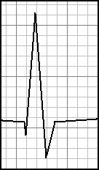
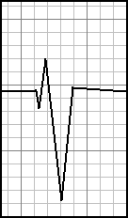
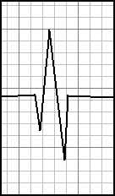
Determining the Axis
Predominantly Positive
Predominantly Negative
Equiphasic

Slide 41
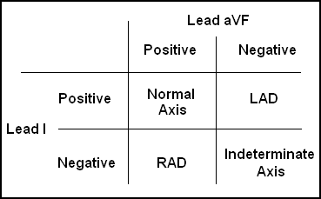
The Quadrant Approach
1. Examine the QRS complex in leads I and aVF to determine if they are predominantly positive or predominantly negative. The combination should place the axis into one of the 4 quadrants below.

Slide 42
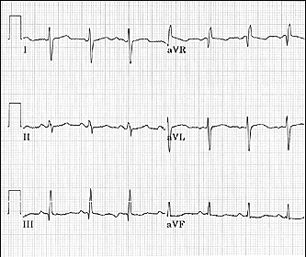
Quadrant Approach: Example 1
The Alan E. Lindsay ECG Learning Center http://medstat.med.utah.edu/kw/ecg/
Negative in I, positive in aVF → RAD

Slide 43
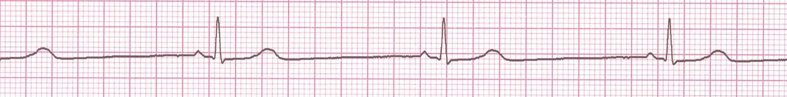
Rate?
30 bpm
Regularity?
regular
P waves?
normal
PR interval?
0.12 s
QRS duration?
0.10 s
Interpretation?
Sinus Bradycardia

Slide 44
Sinus Bradycardia
Deviation from NSR
- Rate < 60 bpm

Slide 45

Rate?
130 bpm
Regularity?
regular
P waves?
normal
PR interval?
0.16 s
QRS duration?
0.08 s
Interpretation?
Sinus Tachycardia

Slide 46
Sinus Tachycardia
Deviation from NSR
- Rate > 100 bpm

Slide 47
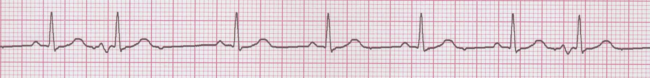
Rate?
70 bpm
Regularity?
occasionally irreg.
P waves?
2/7 different contour
PR interval?
0.14 s (except 2/7)
QRS duration?
0.08 s
Interpretation?
NSR with Premature Atrial Contractions

Slide 48
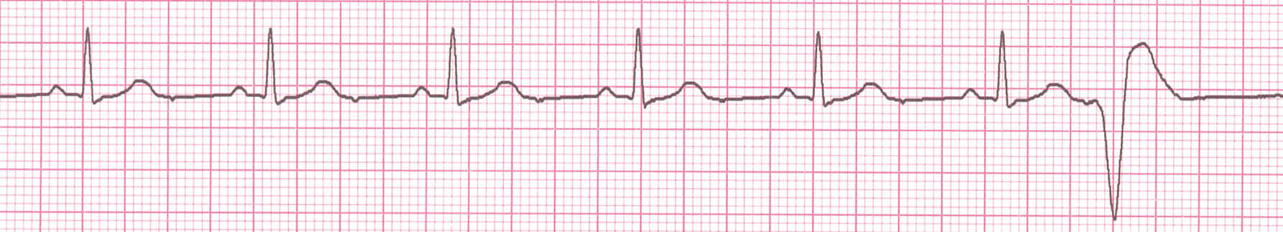
Rate?
60 bpm
Regularity?
occasionally irreg.
P waves?
none for 7th QRS
PR interval?
0.14 s
QRS duration?
0.08 s (7th wide)
Interpretation?
Sinus Rhythm with 1 PVC

Slide 49
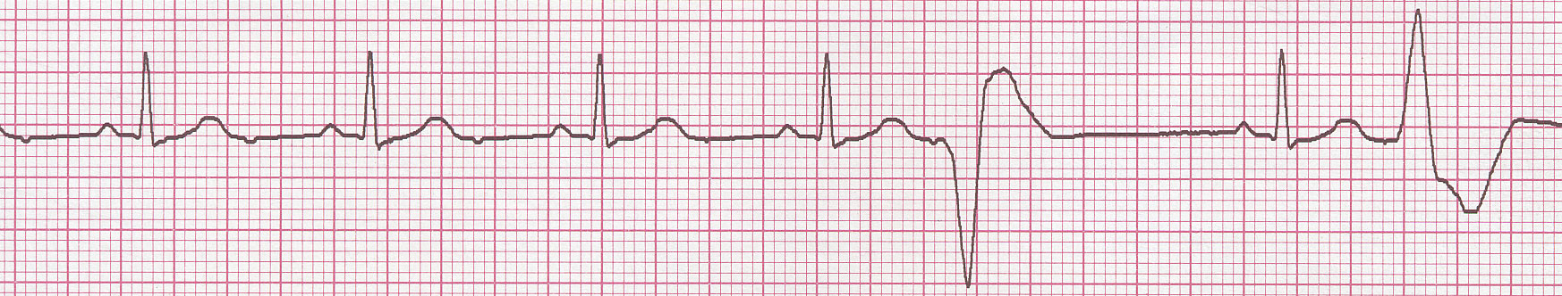
Teaching Moment
When an impulse originates in a ventricle, conduction through the ventricles will be inefficient and the QRS will be wide and bizarre.

Slide 50
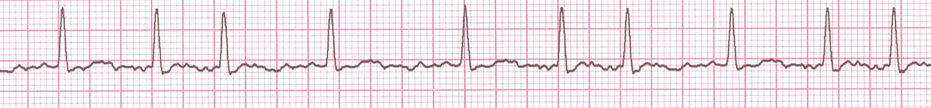
Rate?
100 bpm
Regularity?
irregularly irregular
P waves?
none
PR interval?
none
QRS duration?
0.06 s
Interpretation?
Atrial Fibrillation

Slide 51
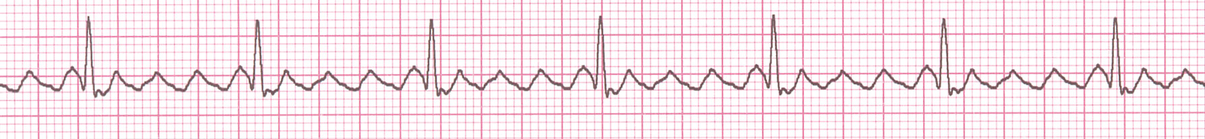
Rate?
70 bpm
Regularity?
regular
P waves?
flutter waves
PR interval?
none
QRS duration?
0.06 s
Interpretation?
Atrial Flutter

Slide 52
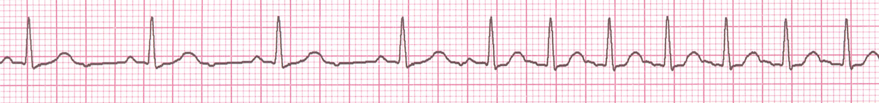
Rate?
74 →148 bpm
Regularity?
Regular → regular
P waves?
Normal → none
PR interval?
0.16 s → none
QRS duration?
0.08 s
Interpretation?
Paroxysmal Supraventricular Tachycardia (PSVT)

Slide 53
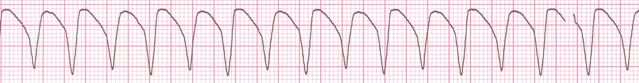
Rate?
160 bpm
Regularity?
regular
P waves?
none
PR interval?
none
QRS duration?
wide (> 0.12 sec)
Interpretation?
Ventricular Tachycardia

Slide 54
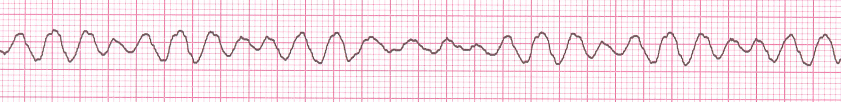
Rate?
none
Regularity?
irregularly irreg.
P waves?
none
PR interval?
none
QRS duration?
wide, if recognizable
Interpretation?
Ventricular Fibrillation

Slide 55
AV Nodal Blocks
1st Degree AV Block
2nd Degree AV Block, Type I
2nd Degree AV Block, Type II
3rd Degree AV Block

Slide 56
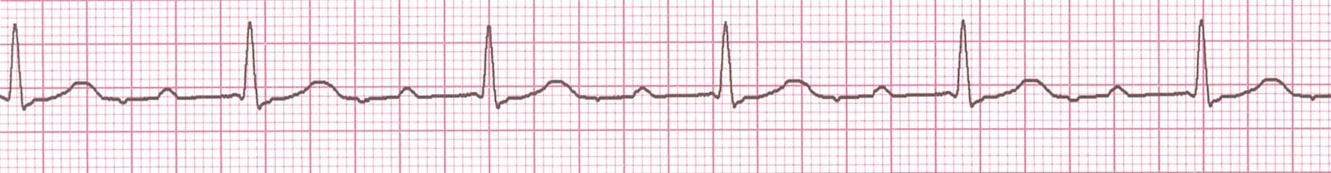
Rate? 60 BPM
Regularity? Regular
P waves? Normal
PR interval? 0.36 s
QRS duration? 0.08 s
Interpretation? 1st Degree AV Block

Slide 57
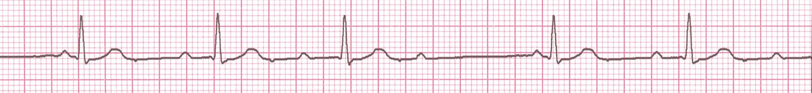
• Rate? 50 bpm
• Regularity? regularly irregular
P waves? nl, but 4th no QRS
• PR interval? Lengthens
QRS duration? 0.08 s
Interpretation? 2nd Degree AV Block, Type I
(Wenckebach, Mobitz type I)
PR interval progressively lengthens, then the impulse is completely blocked (P wave not followed by QRS)

Slide 58
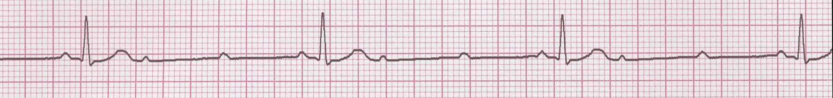
• Rate? 40 bpm
• Regularity? Regular
• P waves? nl, 2 of 3 no QRS
• PR interval? 0.14 s
• QRS duration? 0.08 s
Interpretation? 2nd Degree AV Block, Type II
Occasional P waves are completely blocked (P wave not followed by QRS).

Slide 59
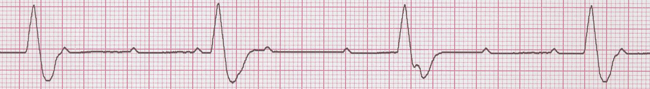
↑
↑
↑
↑
↑
↑
↑
↑
↑
• Rate? 40 bpm
• Regularity? regular
• P waves? no relation to QRS
• PR interval? None
• QRS duration? wide (> 0.12 s)
Interpretation? 3rd Degree AV Block

Slide 60
Acute Myocardial Infarction

Slide 61
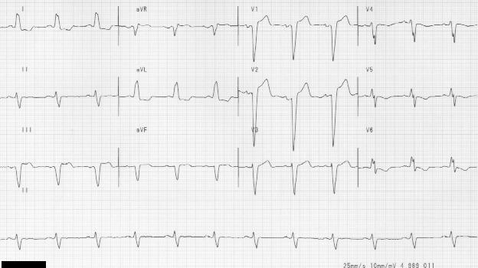
Diagnosing a MI
To diagnose a myocardial infarction you need to go beyond looking at a rhythm strip and obtain a 12-Lead ECG.
12-Lead ECG
Rhythm Strip

Slide 62
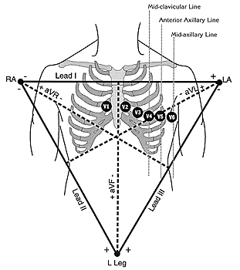
The 12-Leads
The 12-leads include:
  3 Limb leads (I, II, III)
  3 Augmented leads (aVR, aVL, aVF)
  6 Precordial leads (V₁- V₆)

Slide 63
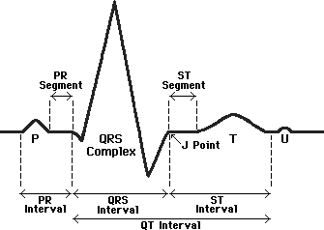
ST Elevation
One way to diagnose an acute MI is to look for elevation of the ST segment.

Slide 64
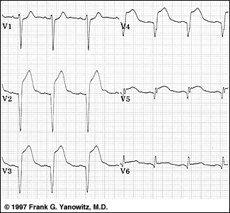
ST Elevation (cont)
Elevation of the ST segment (greater than 1 small box) in 2 leads is consistent with a myocardial infarction.

Slide 65
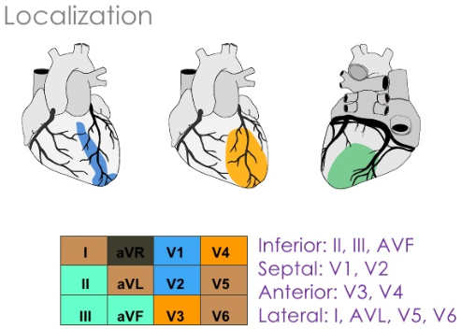
What part of the heart is affected ?
• II, III, aVF = Inferior Wall
Leads V1, V2, V3, and V4 = Anterior Wall MI
I, aVL, V5 and V6 Lateral wall of left ventricle

Slide 66
Putting it all Together
Do you think this person is having a myocardial infarction. If so, where?

Slide 67
Interpretation
Yes, this person is having an acute anterior wall myocardial infarction.

Slide 68
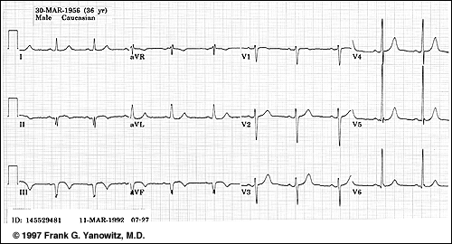
Putting it all Together
Now, where do you think this person is having a myocardial infarction?

Slide 69
Inferior Wall MI
This is an inferior MI. Note the ST elevation in leads II, III and aVF.

Slide 70
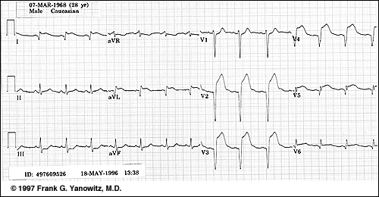
Putting it all Together
How about now?

Slide 71
Anterolateral MI
This person’s MI involves both the anterior wall (V₂-V₄) and the lateral wall (V₅-V₆, I, and aVL)!

Slide 72
Right Bundle Branch Block (RBBB)
Diagnostic criteria for right bundle branch block
  QRS duration >0.12 s
  A secondary R wave (R') in V1 or V2
  Wide slurred S wave in leads I, V5, and V6
Associated feature
  ST segment depression and T wave inversion in the right precordial leads

Slide 73
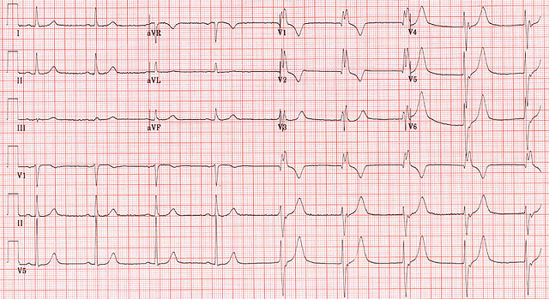
Right Bundle Branch Block (RBBB)

Slide 74
Left Bundle Branch Block (LBBB)
Diagnostic criteria for left bundle branch block
  QRS duration of >0.12 s
  Broad monophasic R wave in leads 1, V5, and V6
  Absence of Q waves in leads V5 and V6
  Associated features
    Displacement of ST segment and T wave in an opposite direction to the dominant deflection of the QRS complex (appropriatediscordance)
    Poor R wave progression in the chest leads
    RS complex, rather than monophasic complex, in leads V5 and V6
    Left axis deviation—common but not invariable finding

Slide 75

Left Bundle Branch Block (LBBB)

Slide 76


Slide 77


Slide 78


Slide 79


Slide 80


Slide 81


Slide 82


Slide 83
Q & A
Thanks

