Slide 1
Pancreatitis

Slide 2
Objectives
Definition of Acute Pancreatitis
Causes , Pathogenesis & Clinical features of Acute Pancreatitis
Complications & Prognosis of Acute Pancreatitis
Diagnosis & Management of Acute Pancreatitis
Definition , Causes , Clinical features & Complications of Chronic Pancreatitis
Diagnosis , Management & Prognosis of Chronic Pancreatitis.

Slide 3
Acute Pancreatitis
1
Anas Nagem

Slide 4
Acute pancreatitis : is the sudden inflammation of the pancreas due to autodigestion by pancreatic enzymes .

Slide 5
Important facts of acute pancreatitis
Most commonly ( 90% ) caused by gallstones , alcoholism , Post-ERCP , idiopathic
It is relatively common , incidence rate in Western countries is 10 to 20 cases per 100,000 people.
The male-to-female ratio is 1 : 3 in the group with biliary tract disease and 6 : 1 in those with alcoholism.

Slide 6
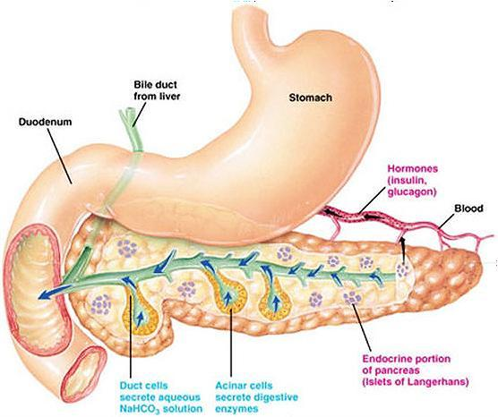
Why does autodigestion occur ?
Normally Trypsinogen a proenzyme produced in the pancreas is activated in the duodenum by enteropeptidase , if trypsinogen is prematurely activated to trypsin autodigestion occurs , since trypsin activates both prophospholipase and proelastase , in addition the release of the already active lipase enzyme also contributes to the autodigestion .

Slide 7
Mechanical
Metabolic
Causes of Acute pancreatitis
1- obstruction ( gallstones , ampullary neoplasm , Choledochoceles , parasites ) .
2- Trauma .
3- Iatrogenic injury ( ERCP ) .
1- Alcoholism .
2- Hyperlipoprteinemia .
3- Hypercalemia .
5- Hypertriglyceridemia .
6- Hyperparathyroidism .
7- Drugs ( azathioprine ) .
Vascular
Genetic
Infectious
1- Vasculitis .
2- Atheroembolism .
3- Shock .
1- PRSS1 and SPINK1 Gene mutation
1-Mumps infection

Slide 8
I GET SMASHED
1- Idiopathic
2- Gallstone
3- Ethanol ( alcohol )
4- Trauma
5- Steroids ( anabolic )
6- Mumps .
7- Auto-immune disease
8- Scorpion bite
9- Hypertriglyceridemia / Hypercalcemia
10-ERCP ( endoscopic retrograde cholangiopancreatography )
11- Drugs

Slide 9
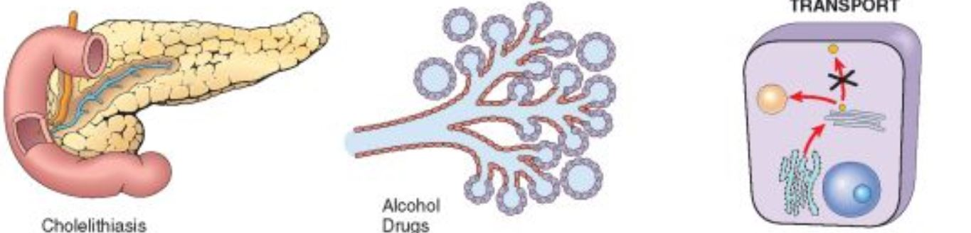

Acute pancreatitis etiopathogenesis
Pancreatic duct obstruction
Primary acinar cell injury
Defective intracellular transport
No matter what the mechanism of acute pancreatitis , all lead to inappropriate activation of proenzymes ( zymogens ) by proteases ( trypsin ) into active enzymes leading to autodigestion

Slide 10
causes of acinar cell injury
Gallstones , Pancreatic secretion plugs , ampullary neoplasms
Trauma , alcoholism , drugs , mumps , ischemia
Development is unclear but is associated with pancreatic duct obstruction and alcoholism
Primary acinar cell injury
Defective intracellular transport
Pancreatic duct obstruction
Activation of both extra and intracellular pro-enzymes ( trypsinogen ) due to release of lysosomal hydrolase
Interstitial edema , blood flow impairment and ischemia
Activation of only intracellular enzymes

Slide 11
Increase pancreatic juice secretion leading to obstructive plugs
Role of alcoholism in acute pancreatitis
Pancreatic duct distention due to obstruction , can lead fusion between zymogen granules and lysosomal granules
Stimulate acinar cells to release cytokines which recruit neutrophils leading to inflammation

Slide 12
Consequences of trypsinogen activation to Trypsin
Trypsin ( protease )
Factor XII activation
Proelastase
Prophospholipase
Phospholipase + Lipase ( already active )
Elastase
Thrombus formation
proteolysis
Hemorrhage
Fat necrosis

Slide 13
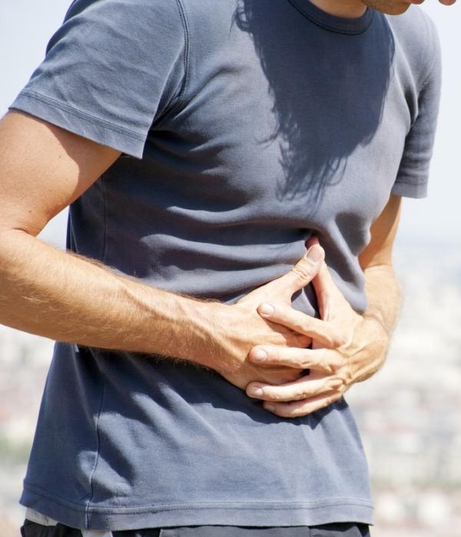
Acute pancreatitis symptoms
Epigastric abdominal pain
Onset : sudden
Course : progressive
Duration : 15-60 min
Radiation : usually to the upper back , and occasionally to left shoulder
Severity : mild to severe
Associated symptoms : nausea , vomiting , loss of appetite

Slide 14
Important signs of acute pancreatitis
1- guarding and rebound tenderness
Absence on examination since the inflammation is principally retroperitoneal
2-Skin discoloration due to severe pancreatitis with hemorrhage , on flanks ( Grey turner’s sign ) , on periumbilicus ( Cullen’s sign )

Slide 15
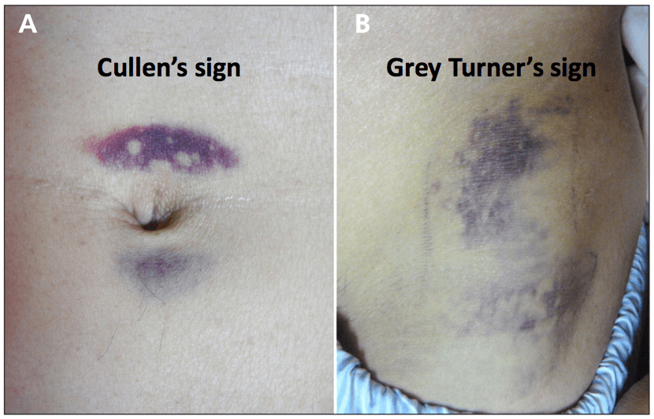

Slide 16
Complications & Prognosis of Acute Pancreatitis
Kariman Ashraf

Slide 17
-Complication Of Acute Pancreatitis:
A-Systemic Complication:
1-Shock.
2-ARDS.
3-Renal failure.
4-Pleural & pericardial effusion.
5-Acute gastroduodenal stress ulceration.
6-Tetany.
7-Lt. sectorial portal hypertension.
8-DIC

Slide 18
-Local Complication:
1-Pseudopancreatic cyst.
2-Pancreatic abscess.
3-Chronic pancreatitis.
-Gastrointestinal Complication:
1-Upper GI bleeding.
2-Duodenal obstruction.
3-Obstructive jaundice.

Slide 19
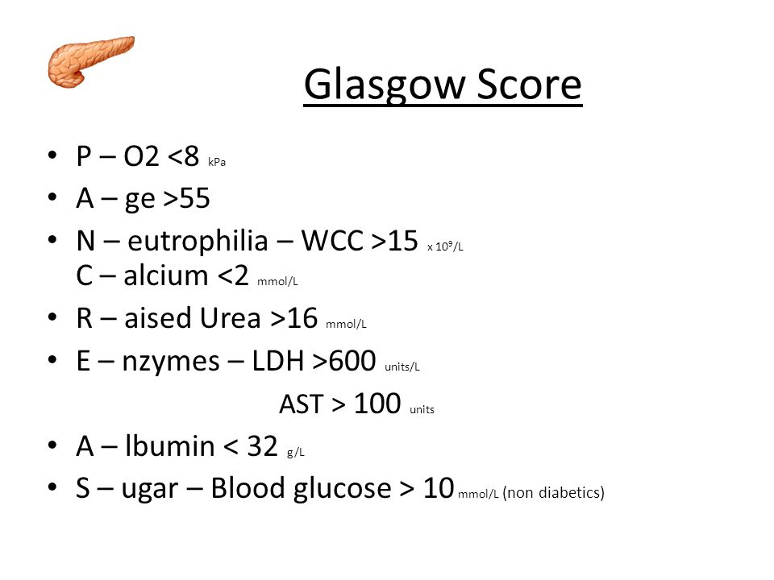
-Prognosis Of Acute Pancreatitis:
.

Slide 20
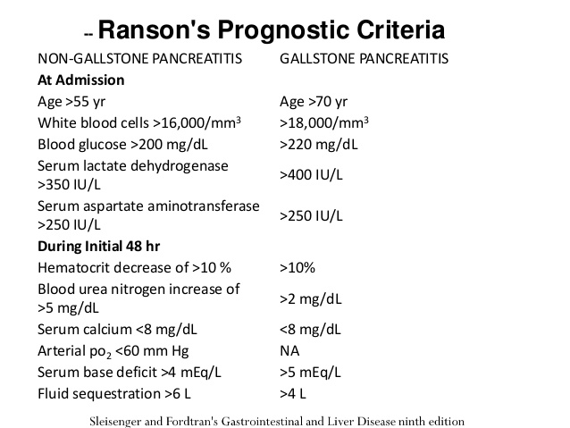

Slide 21
Diagnosis & Management of Acute Pancreatitis
3
Marwa Al Ferjani

Slide 22
Diagnosis
Routine blood : CBC/Blood glucose /LFT/RFT
Serum amylase : Amylase diagnostic of acute pancreatitis if 3x the upper limit of normal and it can return back to normal if measured 24-48 hours after the onset of pancreatitis.
Also raised in bowel perforation, ectopic pregnancy, mesenteric ischaemia, and DKA
Serum lipase :A raised serum lipase is more accurate for acute pancreatitis (as it remains elevated longer than amylase), yet it is not available or routinely performed at every hospital
Ultrasound : confirms diagnosis however in earlier stages the gland may not be grossly swollen (shows gallstones or pseudocyst formation).
A contrast-enhanced CT scan :If performed after 48hrs from initial presentation, it will often show areas of pancreatic oedema and swelling, as well as any potential complications that may have developed.

Slide 23
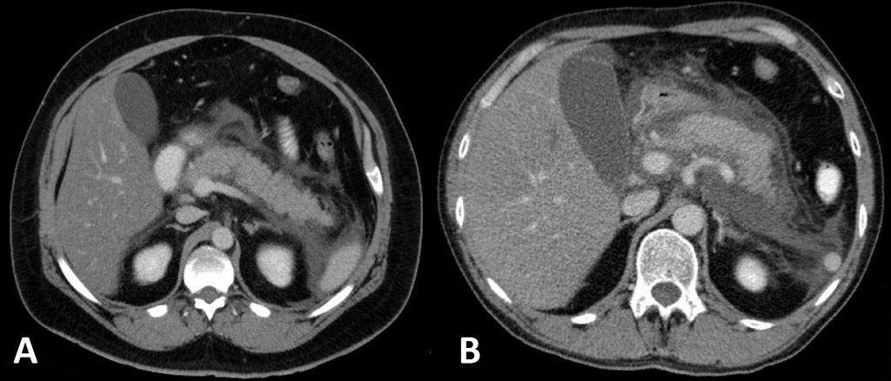
Imaging
Pancreatitis on Axial CT Scan : (A) Localised oedema around the pancreas
(B) Extensive fluid collections around the pancreas

Slide 24
Management
Related steps of management:
Assessing disease severity
Early treatment according to whether the disease is mild or severe
Detection and treatment of complications
Treating the underlying cause (specifically gallstones)

Slide 25
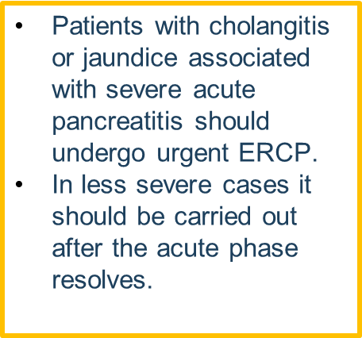
Initial treatment
With supportive care 90% of cases resolve spontaneously.
IV fluid (crystalloid plus colloid if needed) and the patients are made NPO.
Nasogastric tube , antiemetic drug and Analgesics if needed.
broad-spectrum IV antibiotics
Catheterization to accurately monitor urine output and start a fluid chart (due to the potential for rapid third space losses)
Prophylaxis of thromboembolism with low-dose subcutaneous heparin and may improve outcome in severe cases.

Slide 26
Chronic Pancreatitis
4
Hadeel Al Shaqaabi

Slide 27
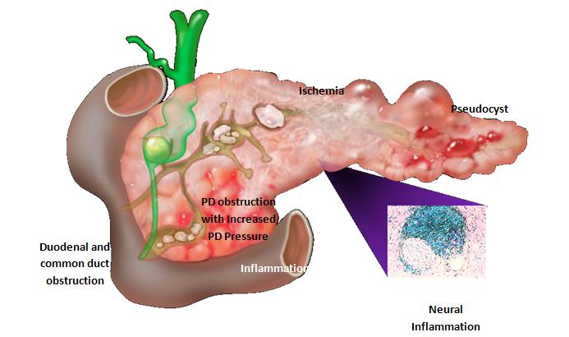
Chronic Pancreatitis
Chronic pancreatitis is a long term progressive inflammatory disease of the pancreas in which at this stage there’s irreversible progressive destruction of pancreatic tissue with permanent loss of the endocrine and exocrine functions.
Its more frequent in men (6:1) at the age of 40

Slide 28
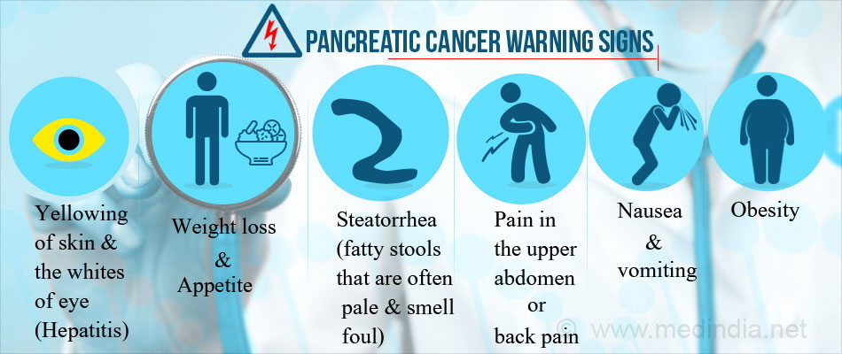
Symptoms & clinical presention Of Chronic Pancreatitis
Chronic Pancreatitis usually manifested as :-
Severe upper abdominal pain that sometimes radiate along the back and is more intense following a meal.
Nausea and vomiting , more commonly experienced during episodes of pain
Smelly and greasy stools ,diarrhea, bloating , abdominal cramps & flatulence.
Thirst , frequent urination , intense hunger , weight loss , tiredness , blurred vision.
Swelling and scarring of the pancreas may damage other local structures , if the bile duct is narrowed , the patient may develop jaundice

Slide 29
Its usually a complication of recurrent episodes of acute pancreatitis …
Alcohol Abuse
Gallstones
Both trigger the activation of trypsin inside the pancreas leading to development of recurrent acute pancreatitis and eventually chronic pancreatitis.
Idiopathic Chronic Pancreatitis
Most cases in people aged 10-20 years and those over 50.
Autoimmune Chronic Pancreatitis
Heredity Pancreatitis
Cystic Fibrosis
Hyperlipidemia & Hyperparathyrodism
Drug Abuse
Causes of Chronic Pancreatitis

Slide 30
Pseudocyst
Caused by leakage of digestive fluids out from a faulty pancreatic duct , if become infected can cause blockage to the intestine or may rupture and cause internal bleeding.
Diabetes
Due to the damage of the insulin producing cells.
Malnutrition
Bile duct or Duodenal obstruction
Pancreatic Ascitis and Pleural Effusion
Pancreatic Fistula
Pseudoaneurysms
Splenic Vein Thrombosis
Pancreatic Cancer
Complications Of Chronic Pancreatitis

Slide 31
Diagnosis and Management of Chronic Pancreatitis
5
Hadil Al Tlhe

Slide 32
Investigation
Test of pancreatic function
Fecal elastase: < 200 mcg per g of stool is abnormal.
Fecal fat estimation : > 7 g of fat per day is abnormal
Serum trypsinogen:< 20 ng per mL is abnormal
Secretin stimulation : Peak bicarbonate concentration < 80 mmol per L in duodenal secretion, best test for diagnosing pancreatic exocrine insufficiency.
Pancreolauryl test .
Oral glucose tolerance test

Slide 33
Test to established the diagnosis:
Abdominal X-ray (may show calcification ).
ERCP (will identify the presence of biliary obstruction and the state of the pancreatic duct )
Endoscopic ultrasonography(Useful in evaluation of early chronic pancreatitis, pancreatic mass, and cystic lesions; can be combined with fine-needle aspiration biopsy).
Test of anatomy prior to surgery
MRCP (Noninvasive and nonionizing radiation or contrast media, less sensitive than ERCP )

Slide 34
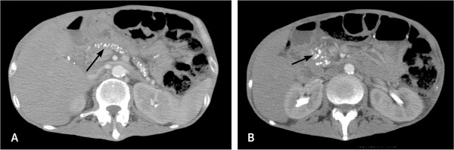
Contrast-enhanced CT (Initial radiologic test of choice for evaluation of suspected chronic pancreatitis).

Slide 35
other
Complete blood count | Elevated with infection, abscess
Serum amylase and lipase | Nonspecific for chronic pancreatitis
Total bilirubin, alkaline phosphatase, and hepatic transaminase | Elevated in biliary pancreatitis and ductal obstruction by strictures or mass
Calcium | Hyperparathyroidism is a rare cause of chronic pancreatitis
Immunoglobulin G4 serum antibody, antinuclear antibody, rheumatoid factor, erythrocyte sedimentation rate | Abnormality may indicate autoimmune pancreatitis

Slide 36

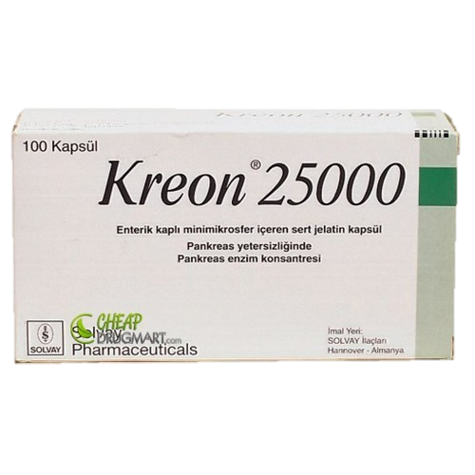
Management
1. Treat the addiction….stop alcohol consumption and tobacco smoking
2.Nutritional and pharmacological measures:
  Diet : low fat high in protein and carbohydrates ,Small frequent feeding.
  Drugs:
    Relief of pain morphine –nitroglycerine or antispasmodic(dicyclomine, propantheline bromide
    Pancreatic enzyme supplementation (lipase, eg creon & Insulin )with proton pump inhibitors or histamine H₂ blockers
    Correct malabsorption of the fat-soluble vitamins (a, d, e, k) and vitamin b12.
    Medium-chain triglycerides in patients with severe fat malabsorption
    Steroids (only in autoimmune pancreatitis, for relief of symptoms).

Slide 37
THANKS!
Any questions?

