Slide 1
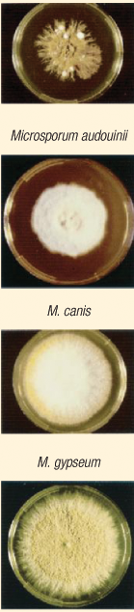
Fungal Skin Diseases
Ali M. Gargoom
MB,ChB., MSc., MD
Professor of Dermatology
Faculty of Medicine
Benghazi University
LIMU

Slide 2
Fungal Skin Diseases
Pityriasis versicolor.
Dermatophytosis (Tinea).
Candidiasis.

Slide 3
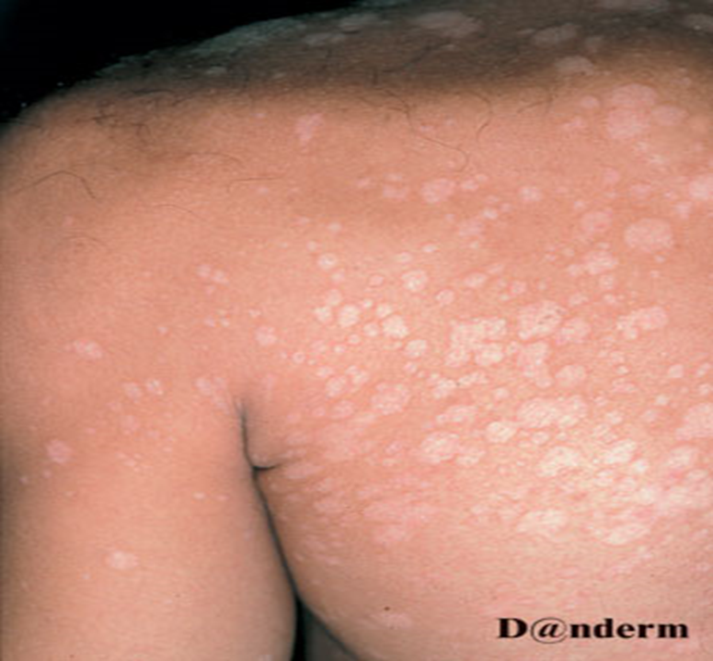
Pityriasis versicolor
A common superficial fungal infection of the skin affecting young adults
Etiology:
Malassezia furfur.
M. furfur is a dimorphic fungi.
The yeast (spore) form is a normal flora of human skin
Transform to pathological mycelial (hyphae) form in certain circumstances.

Slide 4
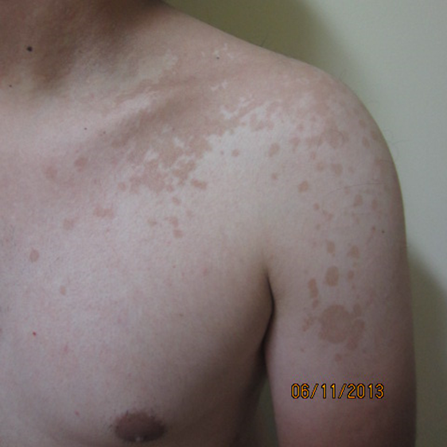
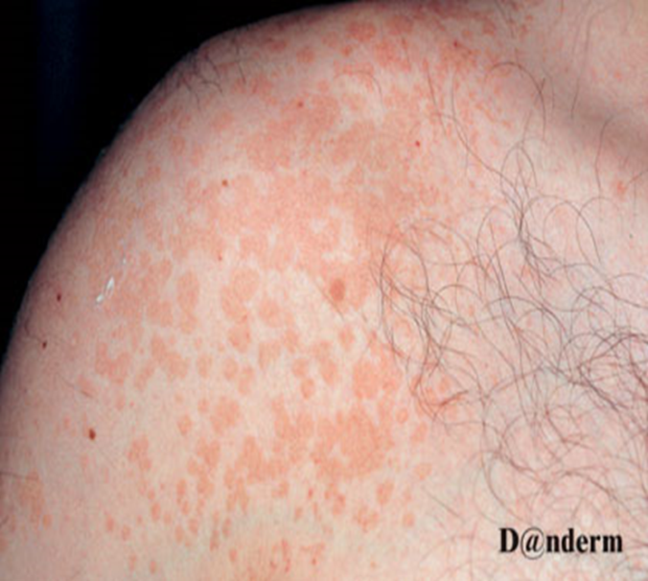

Predisposing Factors:
•Hot climates e.g. summer.
•Excessive sweating and humidity.
•Pregnancy and oral contraceptive.
•Prolonged use of topical or systemic steroids.
Clinical Picture:
•Well-defined hypopigmented (hyperpigmented)macules and patches.
•May be covered by fine scales.
•Affected age group: Young adults. Rarely children and old people.
•Affected site: Upper trunk, shoulder & neck. Rarely abdomen & extremities.

Slide 5
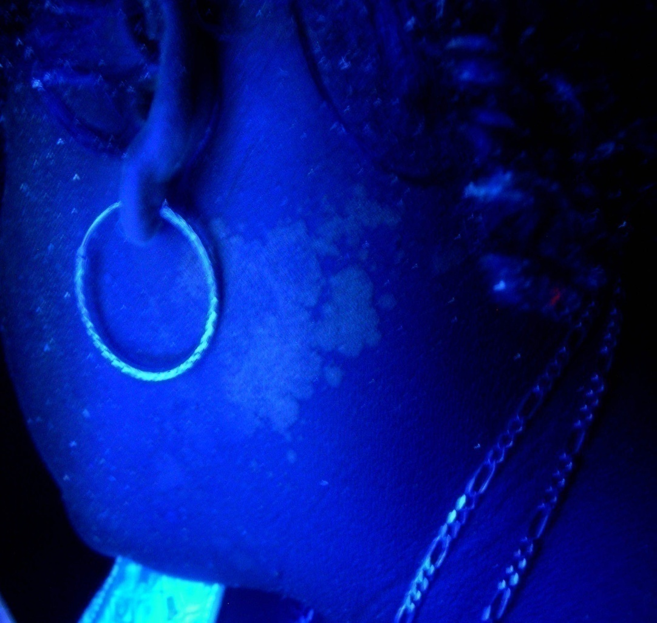
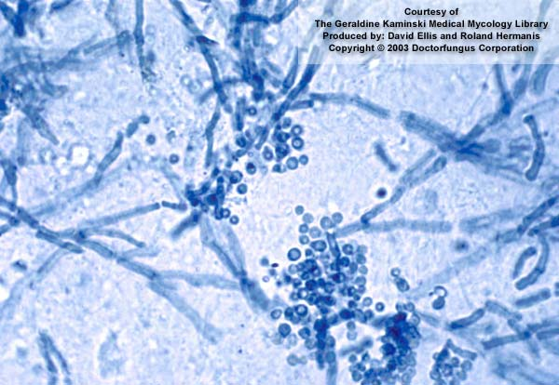
Diagnosis ?
Wood’s Lamp
Yellow fluorescence
KOH examination
Spaghetti & meat balls

Slide 6
Rx. of Pityriasis versicolor
A- Topical Rx
Imidazols deravatives.
Ketoconazol. (Nizoral)
Miconazol, Econazol, Clotimazol
Selenium sulphide (Selsun shampo).
Zinc pyrithion (Head & Shoulder Shampoo).
B- Systemic treatments.
Itraconazol 200 mg for 1 week.
Fluconazole 300mg once.
Grisofulvin and terbinafine are ineffective.

Slide 7
Dermatophytosis

Slide 8
Dermatophytosis (Tinea)
Dermatophytosis (Tinea) are a group of superficial fungal infections caused by a family of fungi known as dermatophytes
Dermatophytes Dermatophytosis (Tinea)

Slide 9
Dermatophytes
Group of fungi that are capable to invade the keratinized epithelium, therefore the infection is limited to the skin, hairs and nails.
Dermatophytes Genera
Trichophyton
Microsporum
Epidermophyton

Slide 10
Ecology of Dermatophytes
To determine the source of infection
Anthropophilic Species
Zoophilic Species
Geophilic Species

Slide 11








Classification of Dermatophytosis ( Tinea )
Tinea capitis
Tinea barbea.
Tinea faciai.
Tinea corporis.
Tinea cruris.
Tinea pedis.
Tinea manum.
Tinea ungum.

Slide 12
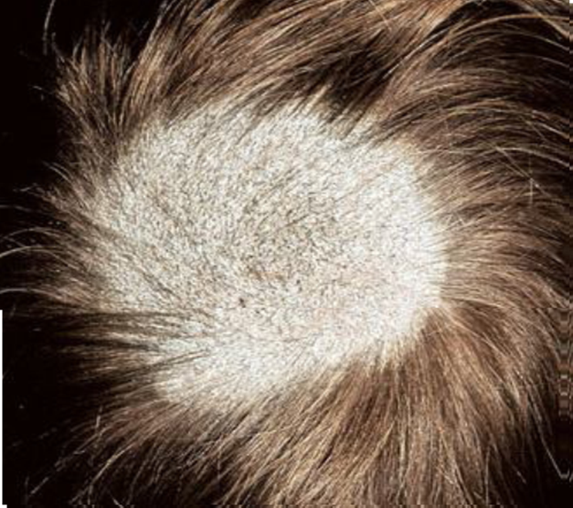
Tinea capitis
• Dermatophytic infection of the scalp hair.
• Affect school-aged children. Rare in adult.
• Classified into inflammatory
and non-inflammatory type.
• In each clinical type there are
two subtypes.

Slide 13
Tinea capitis
Inflammatory type
Non-inflammatory type
Favus
Black Dots
Gray Scaly Patch
Kerion

Slide 14

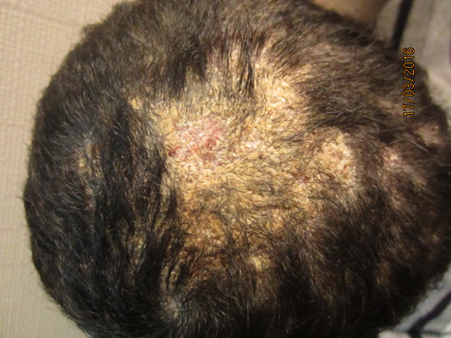
Gray Scaly Patch Tinea Capitis:
This type present with single or multiple well-defined scaly patch(s).
Some hairs in the affected patch is broken off while other remained not affected.
Gary scaly type heals without scarring.

Slide 15
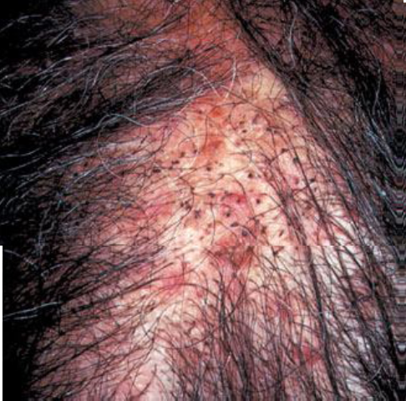
Black Dots Tinea Capitis:
In this clinical type the affected hair is broken off at the point of their emergence from the scalp giving the appearance of black dots on the scalp.

Slide 16
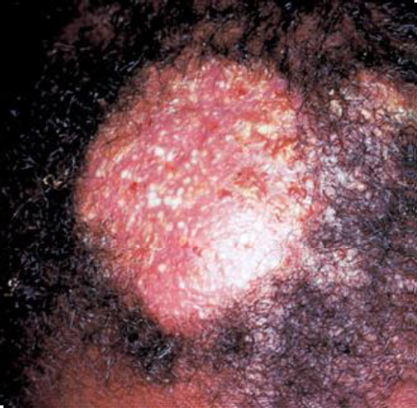
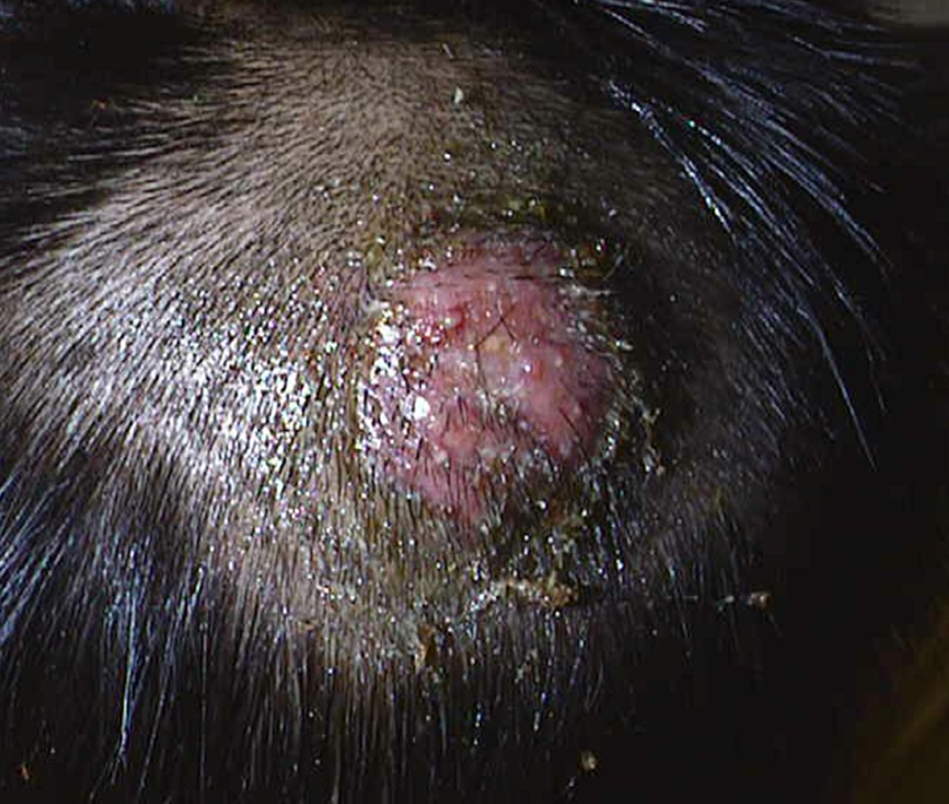
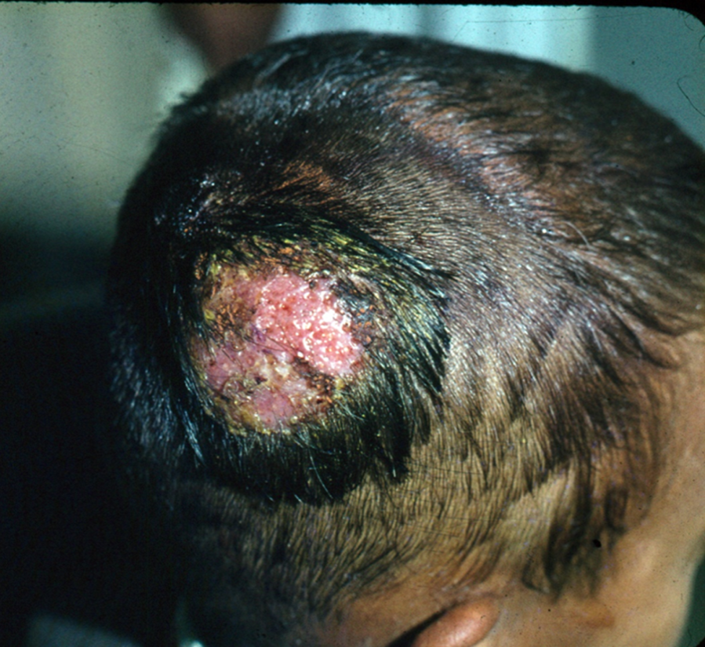
Kerion
Kerion present with inflammatory single or multiple swelling (boggy swelling) studded with pustules and crusting.
The hairs can be easily pulled without pain.
If not diagnosed early and treated properly will heal with permanent scarring alopecia.

Slide 17
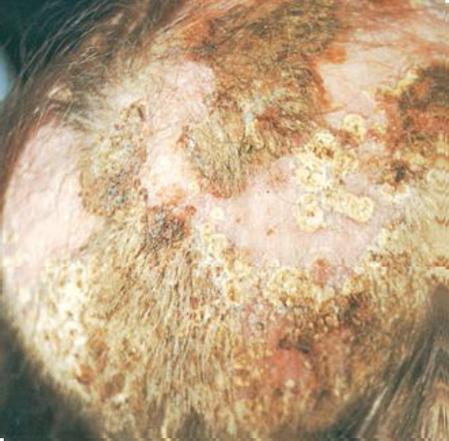
Favus:
This type may be seen in children and adults.
In favus there is diffuse involvement of the scalp and the affected hair is characterized by presence
of yellowish cup-shaped crust which is known as (scutula).
Favus heals with cicatriacial alopecia.

Slide 18
Tinea capitis

Slide 19
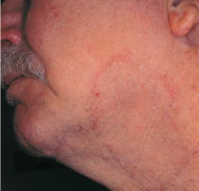
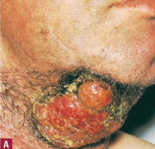
Tinea barbae
Dermatophtic fungal infection of the beard and mustache region

Slide 20
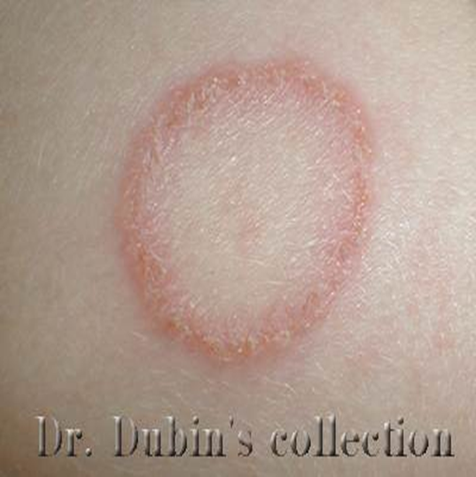
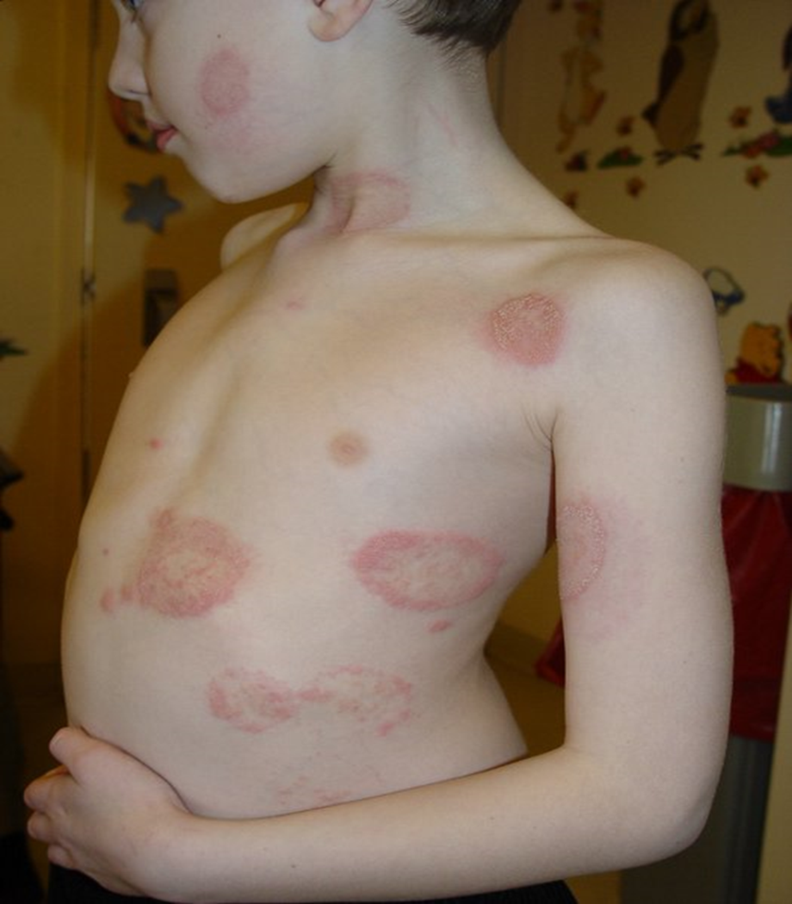
Tinea corporis (circinate):
Skin of the trunk and extremities.
Presents with annular plaque with active border and clear center.
Usually single lesion but multiple lesions my be.

Slide 21
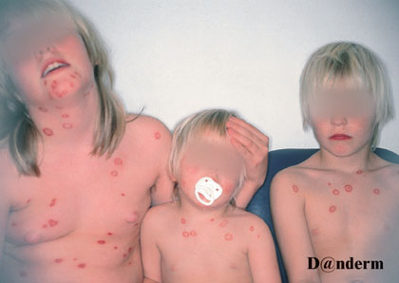

Slide 22
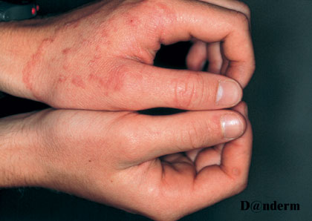
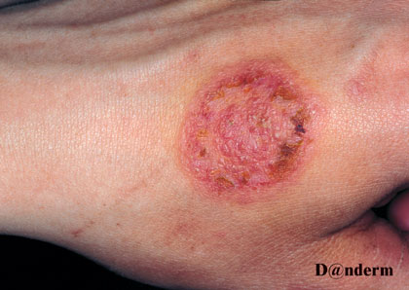
Tinea manuum
Dermatophytic fungal infection of one or both sides of the hands.
Tinea manum presents with clinical picture similar to tinea corporis.

Slide 23
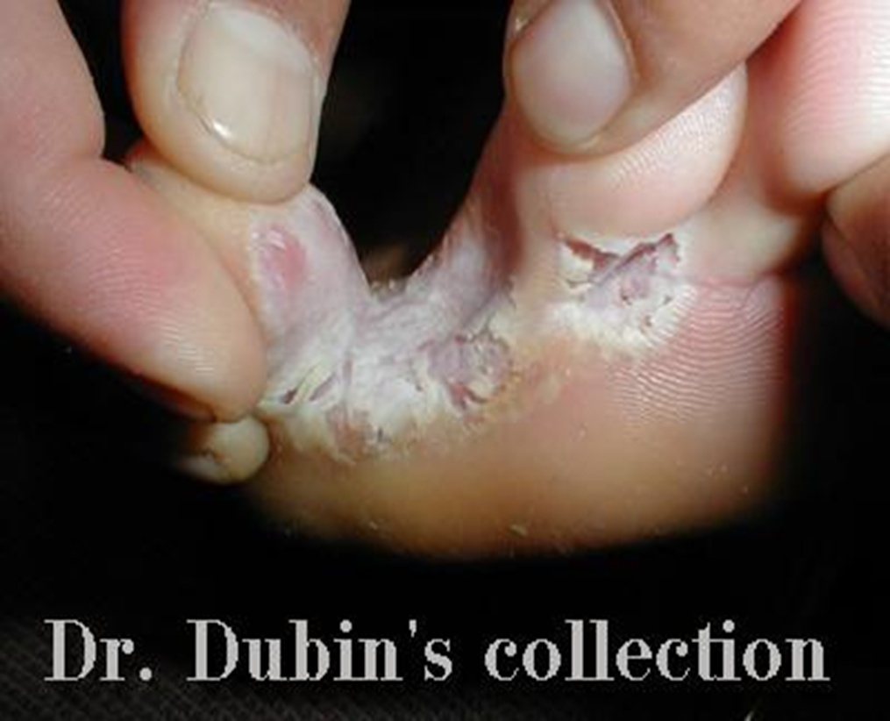
Tinea pedis
Dermatophyte fungal infection of the feet.
The most common dermatophytic infection in the developed countries.
Predisposing factors includes:
Hot, humid weather.
Hyperhidrosis.
Occlusive footwear.
Diabetes
Clinical presentation
Peeling, maceration and fissuing of the toe clefts ( usually between the 4th & 5th toes).

