Slide 1


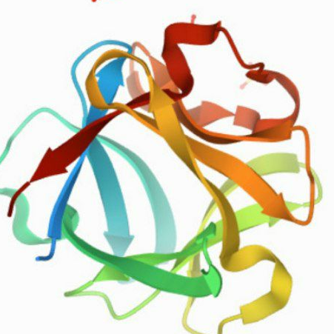


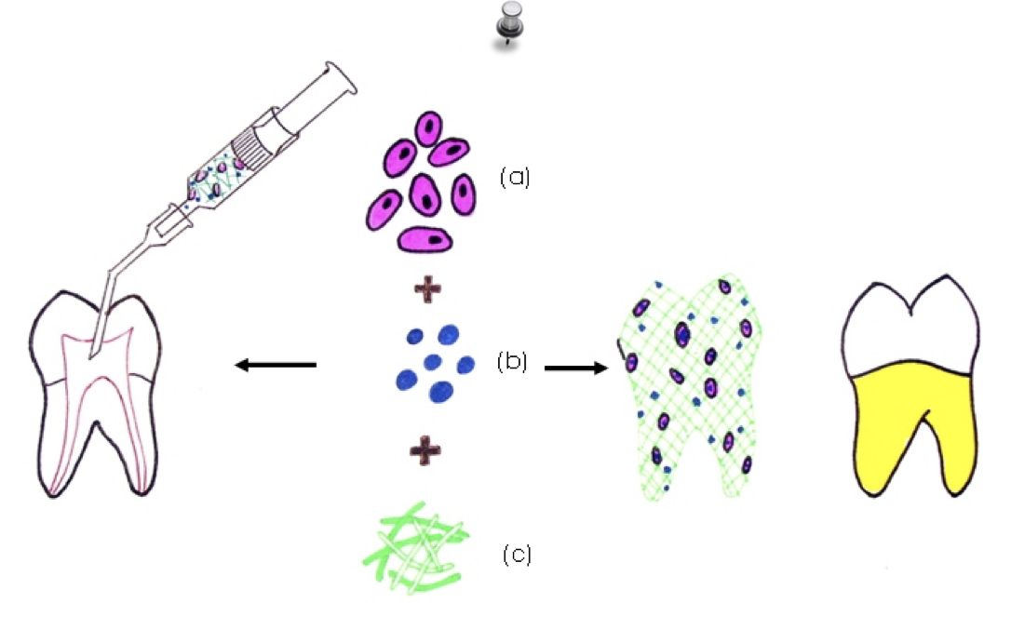

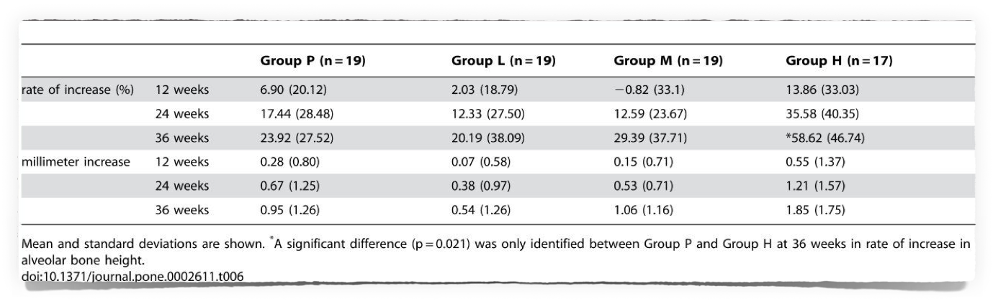


periodontal regeneration
[ Role of growth factor in dental tissue regeneration]
Sanad salem ahmed - 3081
Supervised By : Dr. Asmaa AlBargahthi
Introduction
Methodology
Periodontitis, evoked by the bacterial biofilm (dental plaque) that forms around teeth, progressively destroys the periodontal tissue supporting the teeth, including the periodontal ligament, cementum, alveolar bone and gingiva. Ultimately, this chronic inflammatory disease can lead to loss of the affected teeth [1]–[ Some success has been achieved in suppressing progression of periodontitis by mechanically removing bacterial biofilm, the very cause of the disease. However, removal of the cause, bacterial plaque, with conventional periodontal and/or surgical treatments can, at best, reduce pocket depth and diminish inflammation in the affected region. No such treatment can ever regenerate lost periodontal tissue or normal structure and functionality.
To regenerate periodontal tissue destroyed by periodontitis, the chain of events requires stimulation of cementoblasts and osteoblasts into differentiation on the dental root and alveolar bone surfaces facing the region of periodontal tissue defect, followed by regeneration of the cementum and alveolar bone.
We used recombinant human FGF-2 with 3% hydroxypropylcellulose (HPC) as vehicle and conducted a randomized double-blinded controlled trial involving 13 facilities. Subjects comprised 74 patients displaying a 2- or 3-walled vertical bone defect as measured ≥3 mm apical to the bone crest. Patients were randomly assigned to 4 groups: Group P, given HPC with no FGF-2; Group L, given HPC containing 0.03% FGF-2; Group M, given HPC containing 0.1% FGF-2; and Group H, given HPC containing 0.3% FGF-2. Each patient underwent flap operation during which we administered 200 µL of the appropriate investigational drug to the bone defect. Before and for 36 weeks following administration, patients underwent periodontal tissue inspections and standardized radiography of the region under investigation. As a result, a significant difference (p = 0.021) in rate of increase in alveolar bone height was identified between Group P (23.92%) and Group H (58.62%) at 36 weeks. The linear increase in alveolar bone height at 36 weeks in Group P and H was 0.95 mm and 1.85 mm, respectively (p = 0.132). No serious adverse events attributable to the investigational drug were identified.
Results
Rate of increase in alveolar bone height at 12, 24 and 36 weeks after FGF-2 administration are shown in Table A significant difference (p = 0.021) was only identified between Group P and Group H at 36 weeks.
were noted for gains in clinical attachment level and alveolar bone gain for FGF-2 groups versus Group P, the significant difference in rate of increase in alveolar bone height (p = 0.021) between Groups P and H at 36 weeks suggests that some efficacy could be expected from FGF-2 in stimulating regeneration of periodontal tissue in patients with periodontitis
Conclusion
References
Although no statistically significant differences were noted for gains in clinical attachment level and alveolar bone gain for FGF-2 groups versus Group P, the significant difference in rate of increase in alveolar bone height (p = 0.021) between Groups P and H at 36 weeks suggests that some efficacy could be expected from FGF-2 in stimulating regeneration of periodontal tissue in patients with periodontitis.
1. Nishihara T, Koseki T (2016) Microbial etiology of periodontitis. Periodontology 2000 36: 14–26.
2. Socransky SS, Haffajee AD (2018) Dental biofilms: difficult therapeutic targets. Periodontology 2000 28(1): 12–55.
◦ View Article
3.Ezzo PJ, Cutler CW (2019) Microorganisms as risk indicators for periodontal disease. Periodontology 2000 32(1): 24–35.

