Slide 1

Stages of Perception
Interpersonal Communication (7027)
BY:
Sarah Jamal Aebeed (2184 )
Sarah_2184@limu.edu.com
Submitted To:
Mr. Farag Elmegresi
2021/10/26
1

Slide 2
Contents
Introduction
Stages of Perception
Conclusion
Reference
2

Slide 3


Slide 4
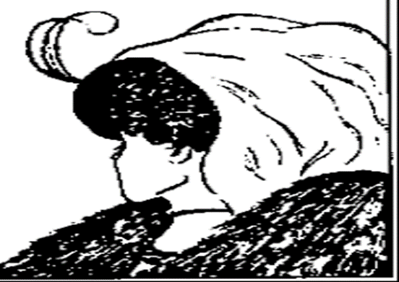

Slide 5

perception is the process by which you become aware of objects, events, and especially people through your senses: sight, smell, taste, touch, and hearing.
Perception is an active, not a passive, process.
Your perceptions result both from what exists in the outside world and from your own experiences, desires, needs and wants, loves and hatreds.
3

Slide 6
Stage One: Stimulation
At this first stage of perception, your sense organs are stimulated—
you hear a new CD,
see a friend,
smell someone’s perfume,
taste an orange,
receive an instant message,
feel another’s sweaty palm.
Change and newness seem to be particularly stimulating and often get your attention.
selective perception, a general term that includes selective attention and selective exposure:
• In selective attention, you attend to those things that you anticipate will fulfill your needs or will prove enjoyable.
Through selective exposure, you expose yourself to people or messages that confirm your existing beliefs, contribute to your objectives, or prove satisfying in some way.
4

Slide 7
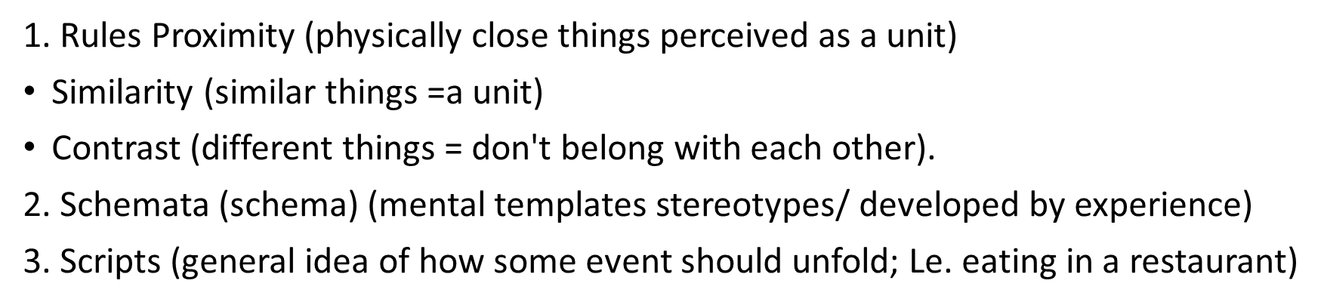
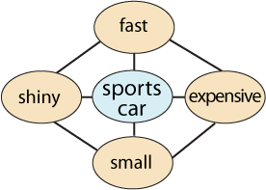
Stage Two: Organization
Organization BY rules In the organization of perceptions by rules,
5

Slide 8
Stage THREE : Interpretation–Evaluation
The interpretation–evaluation step in perception
(a combined term because the two processes cannot be separated)
is greatly influenced by your experiences; needs; wants; values; beliefs about the way things are or should be; expectations; physical and emotional state; and so on. Your interpretation–evaluation are influenced by your rules, schemata, and scripts as well as by your gender.
6

Slide 9
Stage Four : Memory
Your perceptions and their interpretations–evaluations are put into memory; they’re stored so that you may retrieve them at some later time
7

Slide 10
Stage Five : Recall
The recall stage of perception involves accessing the information you have stored in memory.
8

Slide 11
Conclusion
Each individual has differences.
There are differences in culture, beliefs, knowledge and experience
People should never judge a person, but analyze their perceptions, revealing positive rather than negative information.
We should avoid attempting to read minds, and avoid trying to deduce the thoughts and feelings from the behavior that they present to us. We choose what we perceive..
9

Slide 12
Reference
DiFonzo, N. (2011, April 22). The echo-chamber effect. The New York Times. Retrieved from http://www.nytimes.com/roomfordebate/2011/04/21/barack-obama-and-the-psychology-of-the-birther-myth/the-echo-chamber-effect
Hamilton, J. (2013, March 6). Hear that? In a din of voices, our brains can tune in to one. National Public Radio, Retrieved from http://www.npr.org/blogs/health/2013/03/07/173613681/hear-that-in-a-din-of-voices-our-brains-can-tune-to-one.
Harrington, R. (2002, November 24). His musical notes have become TV landmarks. Washington Post. p. Y06. Retrieved from http://player.interactual.com/news/McCartney.htm
McLoed, S. (2008). Asch experiment. Simply Psychology. Retrieved from http://www.simplypsychology.org/asch-conformity.html
Psyblog (2007). The halo effect: when your own mind is a mystery. Retrieved from http://www.spring.org.uk/2007/10/halo-effect-when-your-own-mind-is.php
10

Slide 13

11

