Slide 1


The Growing Cost of Cash During Covid
Libyan International Medical University
Faculty of Business Administration
Name: Nada Elsaiti
ID: 3036
Instructor: Mr. Mohamed Zuwawi
Date: 31.12.2021

Slide 2
Table of contents
01
02
Introduction
The Impacts
03
04
Conclusion
References

Slide 3
Introduction

Slide 4
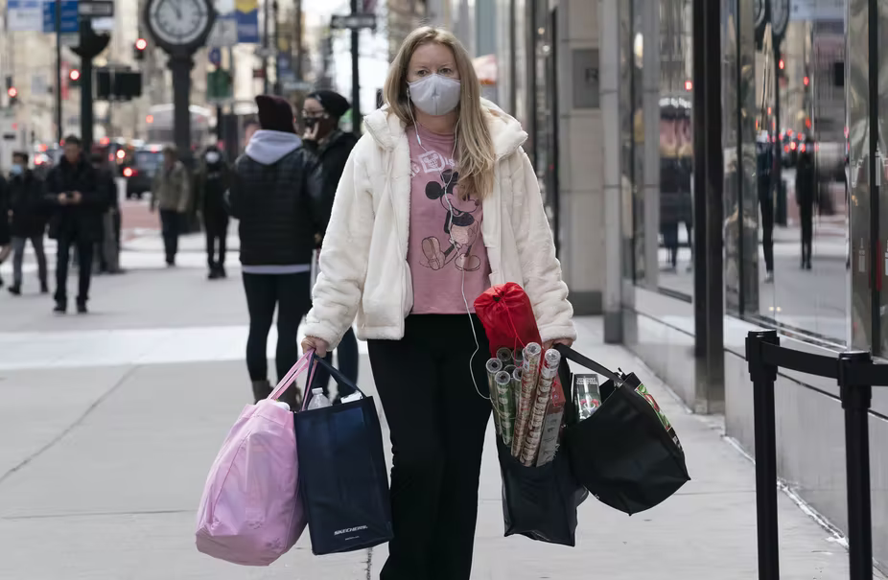
Consumer prices soared in october 2021 are now up to 6.2% from a year earlier. Higher than most economists’ estimates and the fastest increase in more than three decades.
At this point it may be no surprise to most People who are seeing higher prices while shopping for shoes and steaks, dining at restaurants and pumping fuel in their cars.

Slide 5

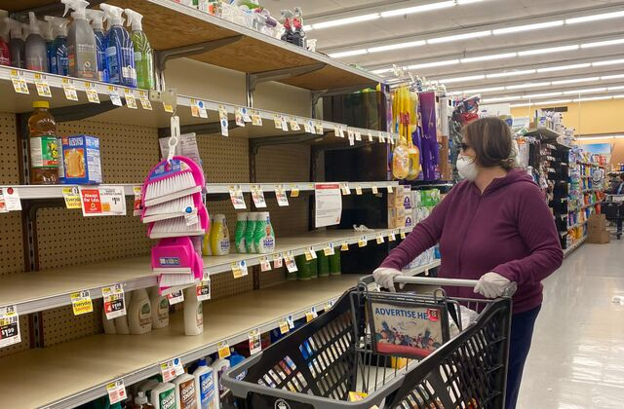
Is this temporary?

Slide 6
The Impacts

Slide 7

Demand is up
Early in the pandemic consumer demands dropped as people hunkered down during lockdowns and unemployment skyrocketed. It has risen over the past year and not for services like restaurants and travel, but for goods, mostly ordered online.

Slide 8
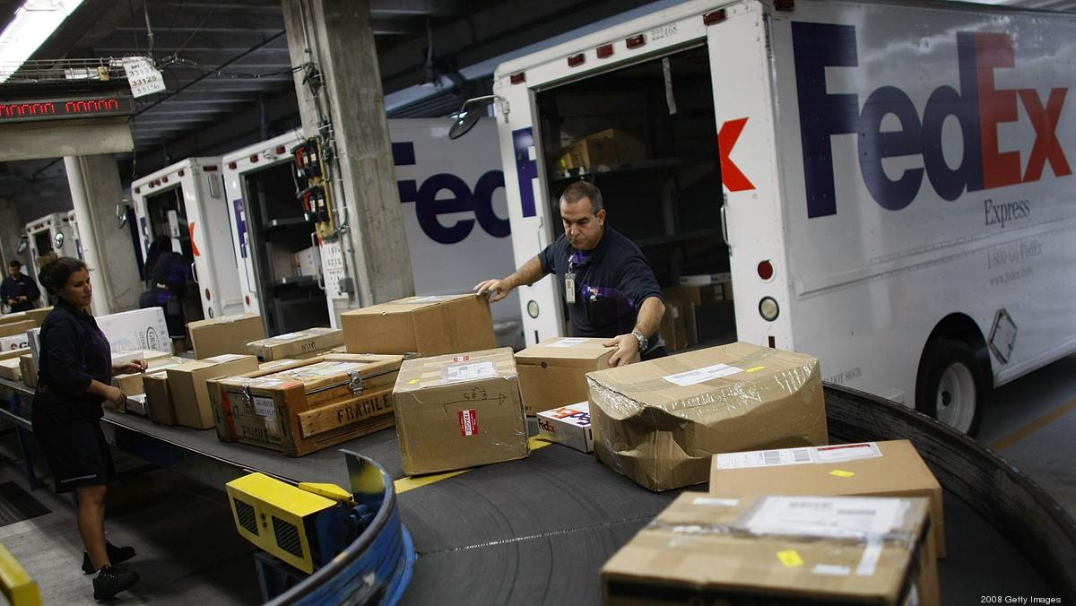
Supply is down
At the same time, supply chains remain a mess and are only getting worse.
Barriers have bottled up all across Asia, putting great stains on the capacity of supply chains to deliver in time. And severe global shortages of drivers and other workers are making it difficult to to expand capacity or fix other problems taunting the supply chains.

Slide 9
Conclusion
There is no end to supply chain problems. Consumer demand is only going to increase through the holiday season and beyond.
Regardless, consumers should get used to the higher prices.
It’s the new normal.

Slide 10
References
Austin, C. (2021, November 10). Why are prices so high? Blame the supply chain – and that’s the reason inflation is here to stay. The Conversation. Retrieved December 30, 2021, from https://theconversation.com/why-are-prices-so-high-blame-the-supply-chain-and-thats-the-reason-inflation-is-here-to-stay-169441

Slide 11
Thank You :)

