Slide 1

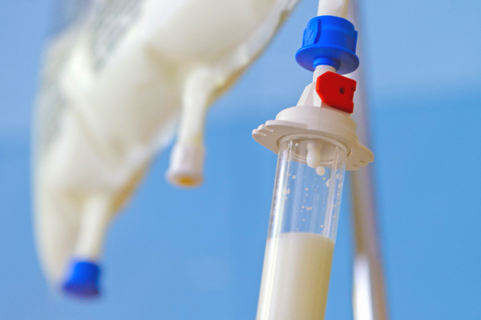
Surgical Nutrition
Haitham R. Elmehdawi
2020

Slide 2
CONTENTS
01
Energy Sources
Nutrition Requirements
02
METABOLIC CHANGES DURING STRESS
03
NUTRITIONAL ASSESSMENT
History, Examination, Laboratory , Score
04
ROUTES & METHODS OF FEEDING
Entral, parentrai .
05
REFEEDING SYNDROME
MONITOR

Slide 3
Aim of nutrition support is to identify
patients at risk for malnutrition and to
meet their nutritional requirements.

Slide 4
Malnutrition has high risk of complications plus mortality

Slide 5
ENERGY SOURCES
Calories provided mainly by carbohydrate and fat
Fat = 9 kcal/ g
Carbohydrate = 4 kcal/ g
Protein = 4 kcal/ g

Slide 6
NUTRITION REQUIREMENTS
An average adult needs 30-35 KCal/Kg/day

Slide 7
NUTRITION REQUIREMENTS
Metabolic stress associated with sepsis, trauma, surgery or ventilation lead to
increase energy requirement (35-40kcal/kg/day)

Slide 8
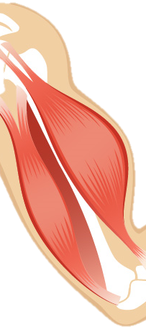

METABOLIC CHANGES DURING STRESS
Lipolysis
↑ fatty acids
Ketones
Fuel for brain
Tissue repair
Wound healing
Trauma
Sepsis
Burn
Surgery
Critical illness
Muscle
Breakdown
Protein synthesis
Amino
acids
Gluconeogenesis
Urea
Glycolysis
Utilization
Fuel for
brain, RBC
and kidneys
↑↑↑ Glucose

Slide 9
STEPS IN NUTRITION SUPPORT
Assessment of Nutrition
Resuscitation
Fluid & electrolytes derangements
Nutritional Requirements
Caloric goal – start with 10-15kcal/kg/d and increased slowly up to 30- 35kcal/kg/day
Routes & Methods of Feeding
Enteral
parenteral
combinations
Monitoring
Adequacy
complications

Slide 10
NUTRITIONAL ASSESSMENT
History
Physical examination
Laboratory investigation
Nutritional assessment score

Slide 11
NUTRITIONAL ASSESSMENT
History
Presenting Complaints
Vomiting, dysphagia, diarrhea
Weight loos
Comorbidities
Malignancy, IBD
Social & Dietary History
Socio economic background
Intake
Amount

Slide 12
NUTRITIONAL ASSESSMENT
Physical Examination
Anthropometric Measurements
o Weight, height & BMI
BMI = weight(kg)/height²
BMI > 18.5 nutritional impairment
BMI > 15 high mortality
o Skin-fold thickness ( biceps & triceps )
o Mid-arm circumference
Signs of Malnutrition
o Hair – easy pluckability
o Muscle bulk – temporalis, thenar eminence, lumbricals
o Skin – increased fold, hyperkeratosis, non healing ulcers
o Limbs – dependent edema

Slide 13
NUTRITIONAL ASSESSMENT
Laboratory
CBC – Hemoglobin ( anemia), Total LC
LFT – Serum albumin
Electrolytes
Others
Nitrogen balance
creatinine

Slide 14
NUTRITIONAL ASSESSMENT
Nutritional assessment score
History and physical examination
Malnutrition Universal Screening Tool
BMI
MUST WT LOSS IN 3-6 MTHS
ACUTE DISEASE
Well nourished
Moderately malnourished
Severely malnourished

Slide 15
Routes & methods of feeding
Any patient who has sustained 5–7 days of
inadequate intake
or who is anticipated to have no intake for this
period should be considered for nutritional support.

Slide 16
Routes & methods of feeding
Enteral
parenteral
combination

Slide 17
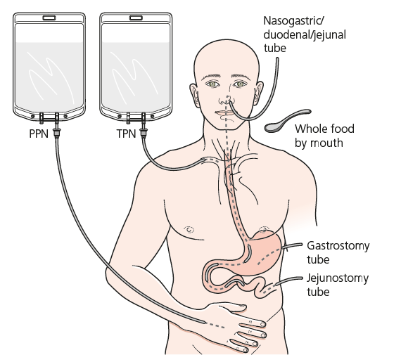
Routes & methods of feeding
parenteral Nutrition
Enteral Nutrition

Slide 18
Routes & methods of feeding
Patient is at risk of malnourishment
Safe
Swallow
Unsafe
Swallow
GIT non functional
Or perforated
GIT intact
Oral nutritional
support
Enteral feeding
Parenteral
Feeding

Slide 19
Routes & methods of feeding
ENTERAL NUTRITION
Delivery of nutrient into healthy and functioning GI tract
Most preferred and more physiological
Advantages
Maintain gut mucosal integrity
Maintain normal gut flora & pH
Cheap & easily available
Less complication

Slide 20
Routes & methods of feeding
Enteral Nutrition

Slide 21
Routes & methods of feeding
Oral
Nasogastric
Nasoenteric
Gastrostomy
PEG (percutaneous endoscopic gastrostomy)
RIG ( radiological inserted gastrostomy )
Surgical gastrostomy
Jejunostomy
RIJ
Surgical jejunostomy
Distal feeding

Slide 22
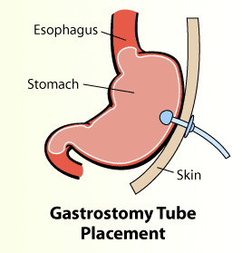
Routes & methods of feeding

Slide 23
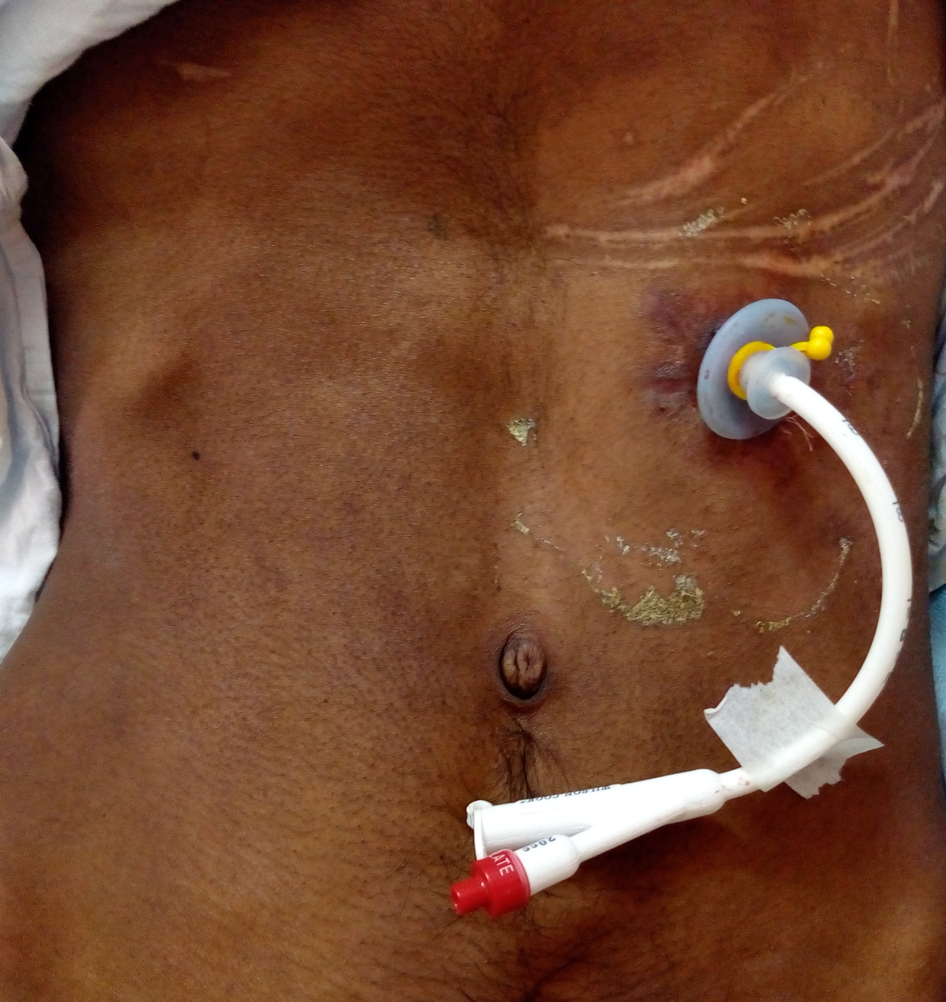
Routes & methods of feeding

Slide 24
Routes & methods of feeding
Indications
Oral intake < 50% of required need for the previous 7-10 days.
Dysphagia /chewing problem ( strokes, brain tumor head injuries).
Major burns.
Low output GIT fistulas (< 500 ml/day).

Slide 25
Routes & methods of feeding
Contraindications
Mechanical obstruction of GIT
Prolonged ileus
Severe GI hemorrhage
Severe diarrhea
Intractable vomiting
High output GIT fistula (>500ml/day)

Slide 26
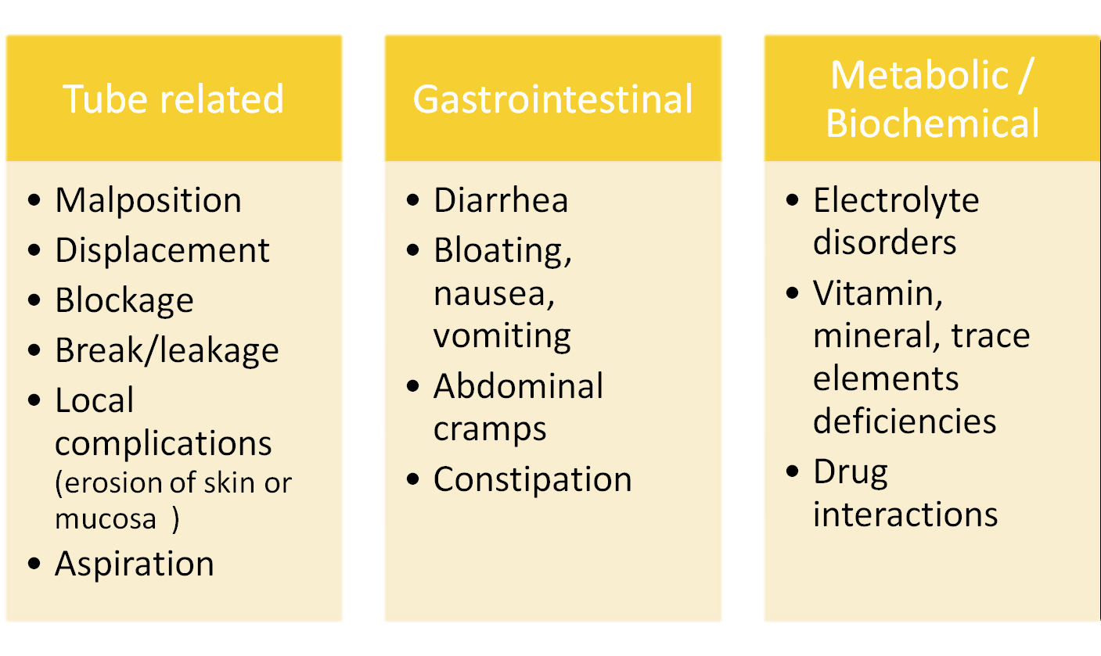
Routes & methods of feeding
COMPLICATIONS

Slide 27

ROUTES & METHODS OF FEEDING
PARENTERAL FEEDING
Delivery of all nutritional requirements by IV route without use of GIT (bypass GIT)
Sterile liquid chemical formula contains all the carbohydrates, protein, fat, vitamins, minerals, and other nutrients needed.
May be delivered via :
Central line
Peripheral line

Slide 28
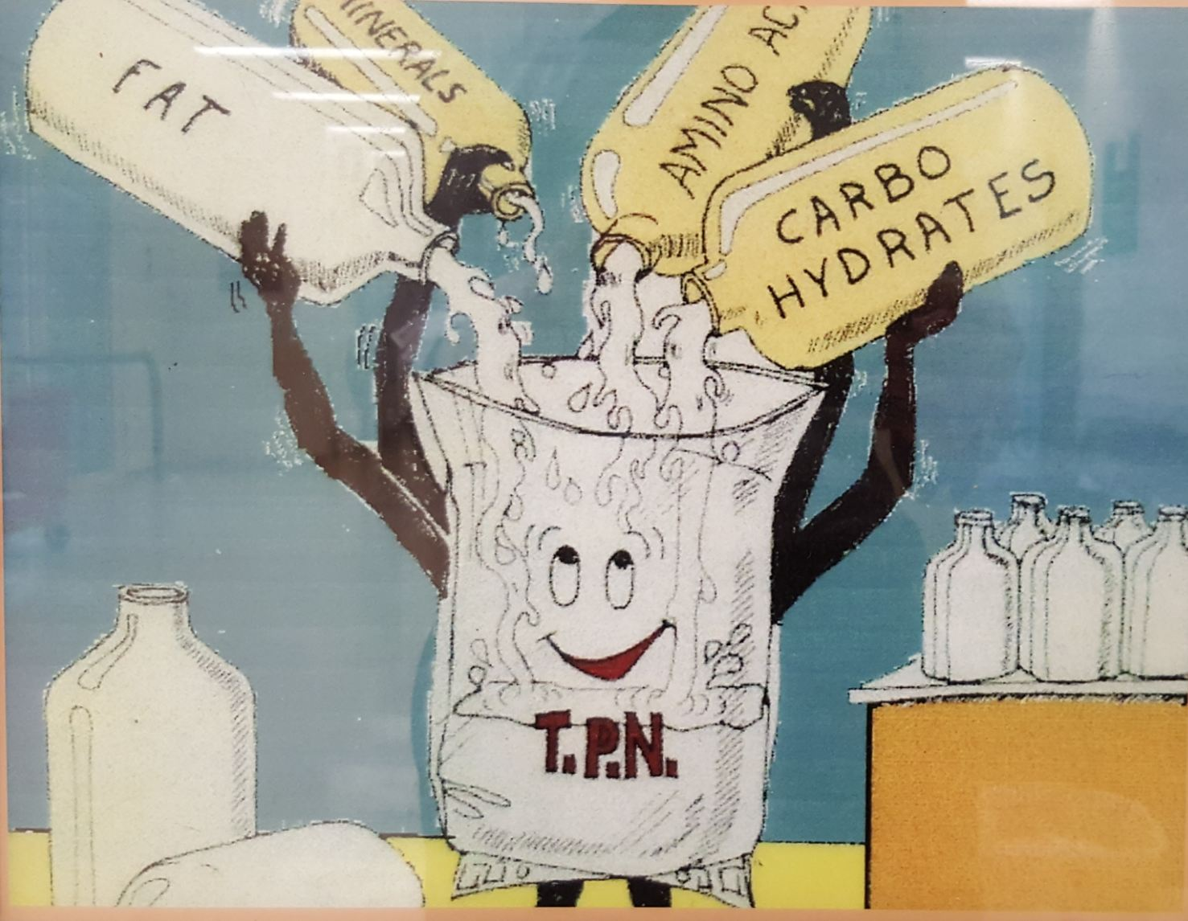
ROUTES & METHODS OF FEEDING

Slide 29
ROUTES & METHODS OF FEEDING
Components of TPN formulations
Macro :
Calorie : Dextrose 20% , 50%
Intralipid 10% , 20%
Protein : Amino acids 5% , 10%
Micro :
Electrolytes ( Na , K, Mg, Ca , PO4 )
Trace elements ( Zn, Cu, Cr, Mn , Se )

Slide 30
ROUTES & METHODS OF FEEDING
Indications
GIT Malfunction
OBSTRUCTED - Ca esophagus/stomach, stricture
FISTULATED - post op enterocutaneous fistula, high output fistulas
INFLAMMED - crohn’s disease, acute severe pancreatitis
TOO SHORT - massive resection, short gut syndrome

Slide 31
ROUTES & METHODS OF FEEDING
Indications
Pre operative : build up of malnourished patient
Failure enteral feeding to meet caloric requirement
- major polytrauma, major burns
Cancer : complication of chemotherapy, radiotherapy
Newborns
- GIT anomalies

Slide 32
ROUTES & METHODS OF FEEDING
TPN (total parenteral nutrition)
Supplies all daily nutritional requirement
High glucose concentration (25% dextrose )
Provides a hyperosmolar formulation (1300-1800 mOsm/L)
Must be delivered into a large-diameter vein through central line.
Long term support (>10 days)

Slide 33
ROUTES & METHODS OF FEEDING
PPN (peripheral parenteral nutrition)
Only part of the daily nutritional requirements supplied , (50-70% of patient’s energy needs)
Similar nutrient components as TPN, but lower concentration (5%-10% dextrose concentration)
Osmolarity < 900 mOsm/L
tolerated by a peripheral veins
Short term support (10-14 days)

Slide 34
ROUTES & METHODS OF FEEDING
Parenteral Access Devices
Peripheral venous access
Catheter placed percutaneously into a peripheral vessel
Central venous access
Percutaneous jugular, femoral, or subclavian catheter
Implanted ports (surgically placed)
PICC (peripherally inserted central catheter)

Slide 35
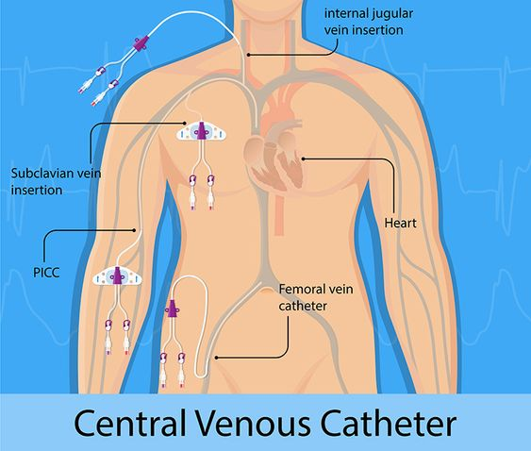
ROUTES & METHODS OF FEEDING

Slide 36
ROUTES & METHODS OF FEEDING
Complications
First 48 hours:
• Mechanical
Malposition, hemothorax, pneumothorax, air embolism, bleeding
• Metabolic
Fluid overload, hyperglycemia,hypophosphatemia, hypokalemia,
Hypomagnesemia, refeeding syndrome .

Slide 37
ROUTES & METHODS OF FEEDING
Complications
First two weeks
• Mechanical
Catheter displacement, catheter thrombosis,
Catheter occlusion
• Metabolic
hyperglycemia coma, acid base Imbalance, electrolyte imbalance
• Infection
catheter site infection

Slide 38
ROUTES & METHODS OF FEEDING
Complications
1 – 2 months
• Mechanical
Tear of catheter, catheter thrombosis, blood loss,
Air embolism
• Metabolic
Essential fatty acid deficiency, vitamin or trace element Deficiency
Metabolic Bone disease, liver diseases, GBS
• Infection
Tunnel infection, sepsis

Slide 39
REFEEDING SYNDROME
Metabolic complication in severely malnourished patients
Potentially fatal condition, may be successfully managed if detected early.
Hypophosphatemia, Hyperglycemia
Fluid retention
ECG changes, hypotension, arrhythmia, cardiac arrest
Weakness, paralysis
Respiratory depression
Ketoacidosis / metabolic acidosis

Slide 40
REFEEDING SYNDROME
Pathophysiology
Metabolism shifts : catabolic -> anabolic state
Insulin is released - triggering cellular uptake of K+, PO4, Mg
Profound depletion those electrolyte extracelullarly
Hypophosphatemia, hypomagnesaemia, hypokalemia ,
hypocalcaemia
-multiorgan dysfunction

Slide 41
REFEEDING SYNDROME
Prevention and Therapy
Correct electrolyte abnormalities before starting nutrition support
Continue to monitor serum electrolytes after nutrition support begins and replete aggressively
• Initiate nutrition support at low rate/concentration (50% of estimated needs) and advance to goal slowly in patients who are at high risk

Slide 42
MONITOR
• No single criteria
• Chest X ray to check for placement
• Clinical monitoring – Vital signs / 4 hr
• Weight (daily)
• Site care and dressing change
• I/o charting

Slide 43
MONITOR
Daily
Electrolytes (Na+, K+, Cl-)
Glucose
Acid-base status
BUN
Urine for glycosuria
• 2 times/week
Ca+, P, Mg
LFT, S.CREAT, ALBUMIN
• weekly
Hb
TLC
INR

Slide 44
Summary
Malnutrition leads to prolong stay &
prolong recovery period
Normal caloric requirement = 30-35kcal/kg/day
Use enteral feeding unless contraindicated
Low osmolarity PN given via peripheral line
We should start with low calories

Slide 45
THANK YOU

