Slide 1
Anatomy of the Musculoskeletal
System
The Extremities
Dr.Nadeia Elbagermi

Slide 2
Normal Imaging Anatomy in the Extremities

Slide 3
What are the parts of a long bone?
Terms you will need to know:
  Cortex
  Medullary cavity (marrow)
  Diaphysis
  Metaphysis
  Epiphysis

Slide 4
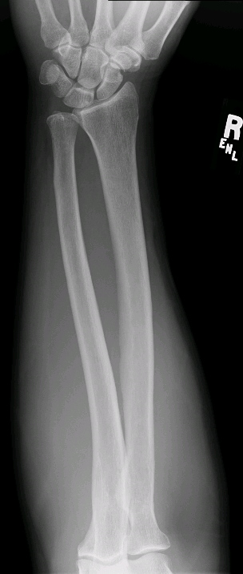
At each end of a long bone is the _________
The tapered part of the bone
is the __________
Medullary cavity (marrow)
cortex
The shaft of the long
bone is the ________
Diaphysis
Metaphysis
Epiphysis

Slide 5
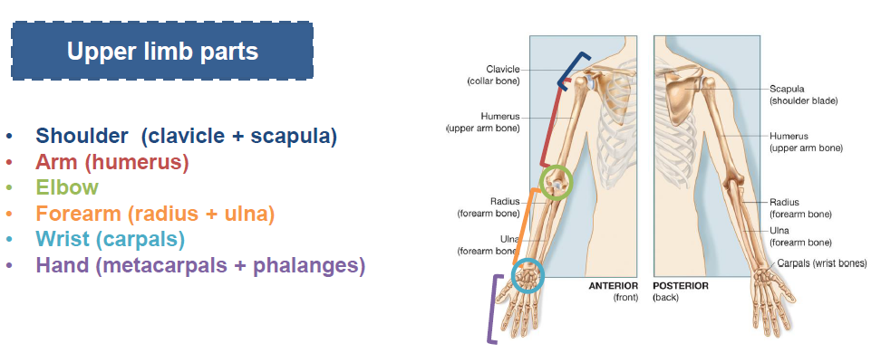

Slide 6
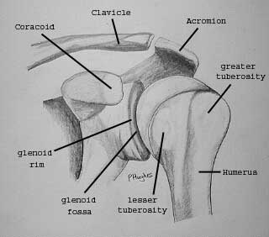

Slide 7
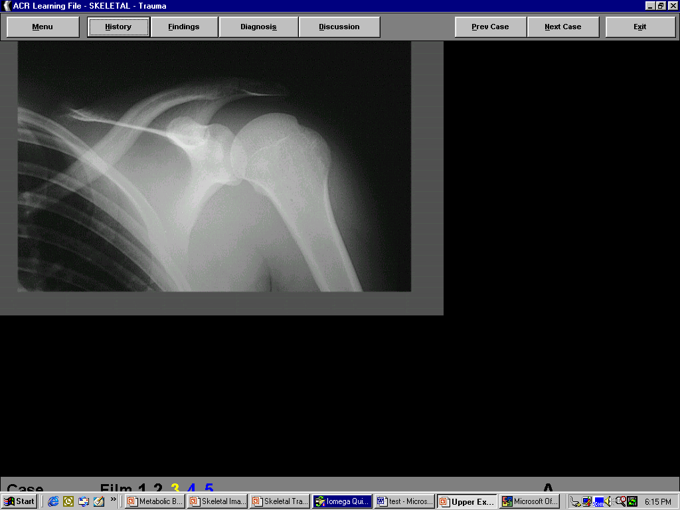
corocoid
acromion
greater tuberosity
clavicle
lesser tuberosity
glenoid fossa
Notes:
7
7

Slide 8
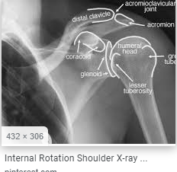
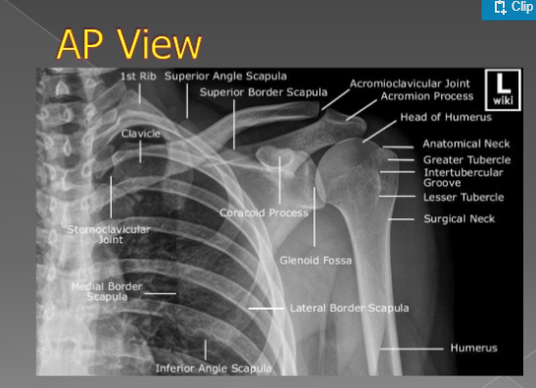

Slide 9
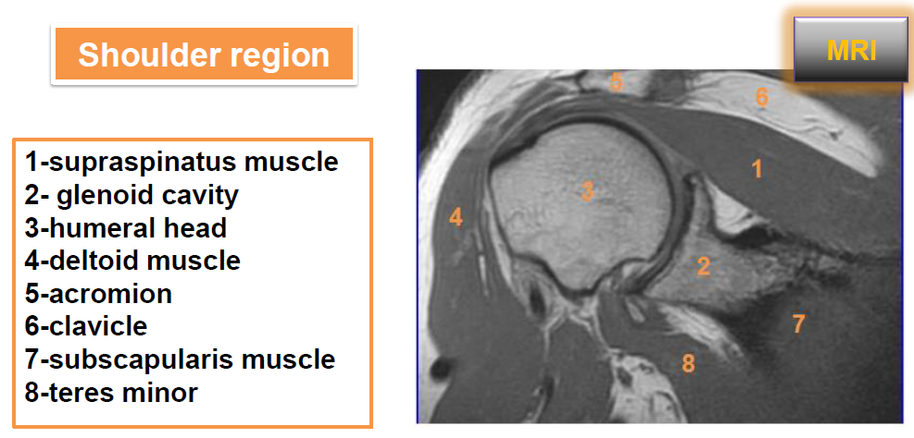

Slide 10
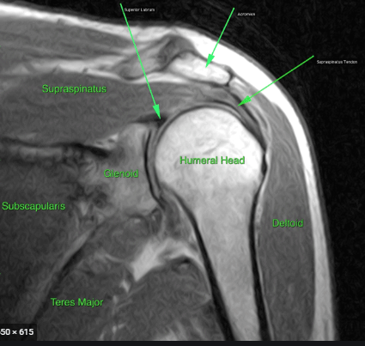

Slide 11
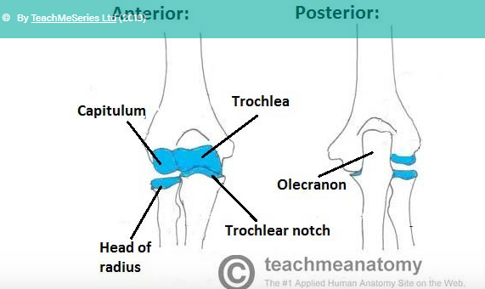
Elbow joint :
Trochlear notch of the ulna and the trochlea of the humerus
Head of the radius and the capitulum of the humerus
Elbow joint

Slide 12
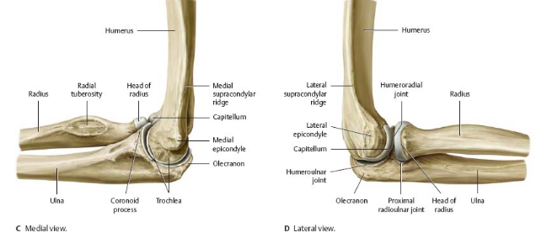

Slide 13
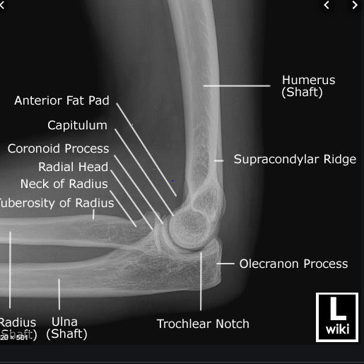

Slide 14
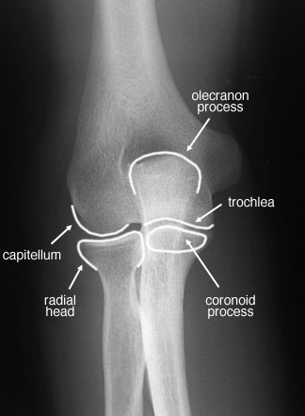
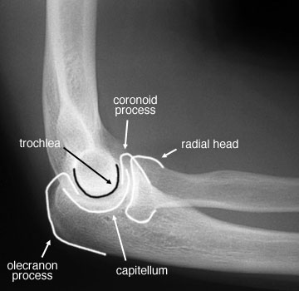

Slide 15
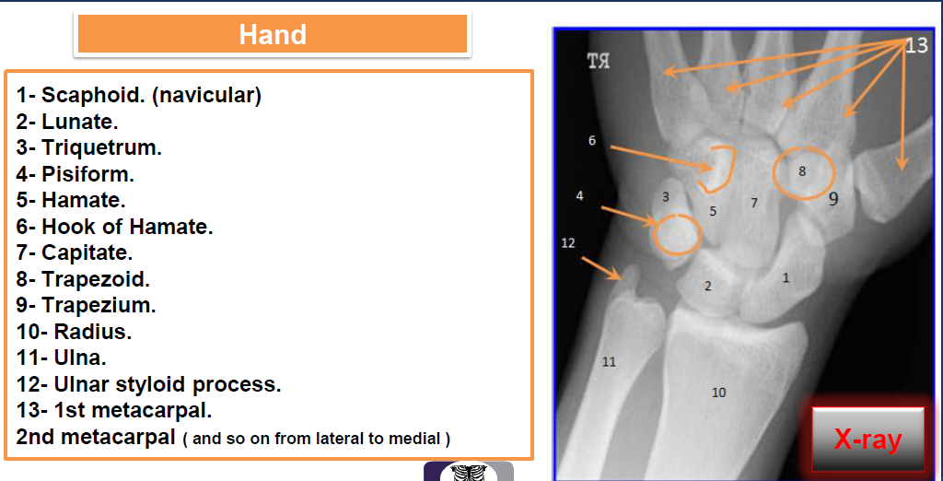

Slide 16
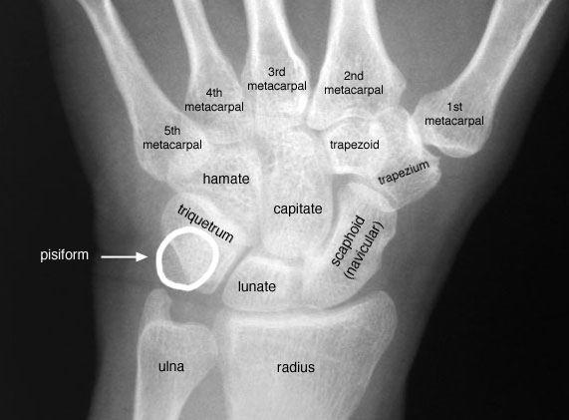
Wrist

Slide 17
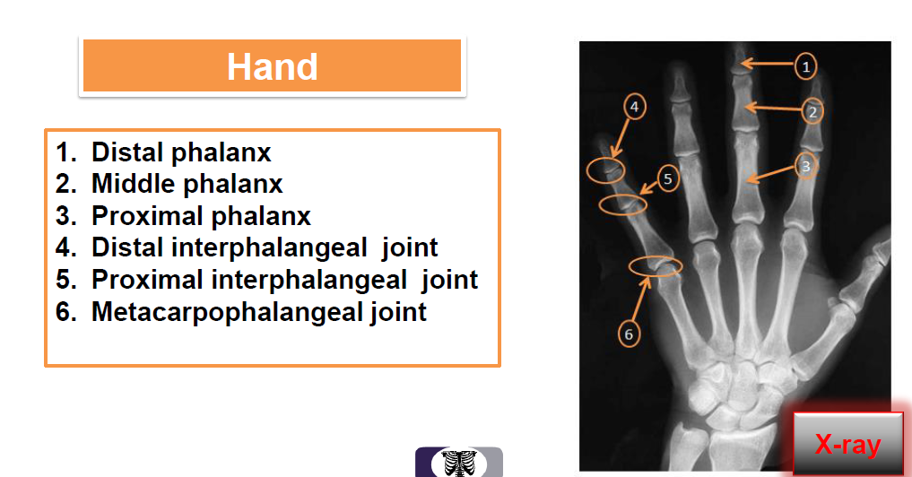

Slide 18
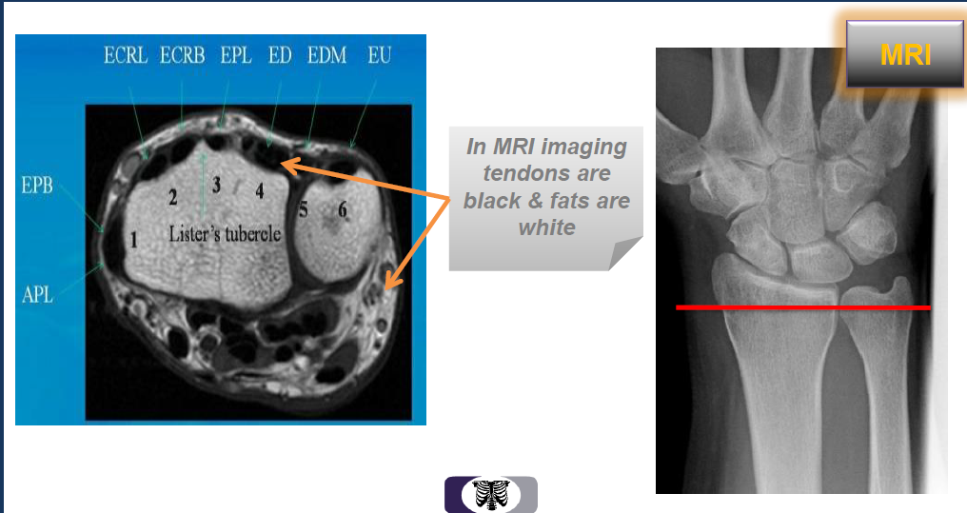
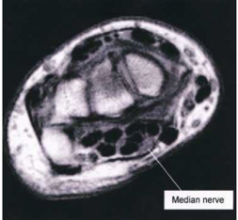

Slide 20
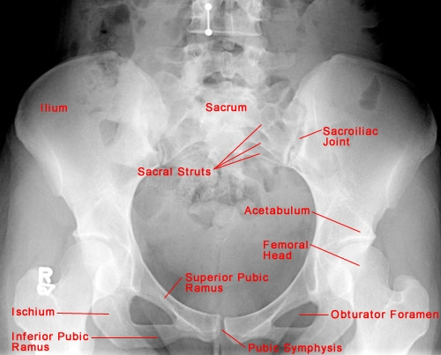

Slide 21
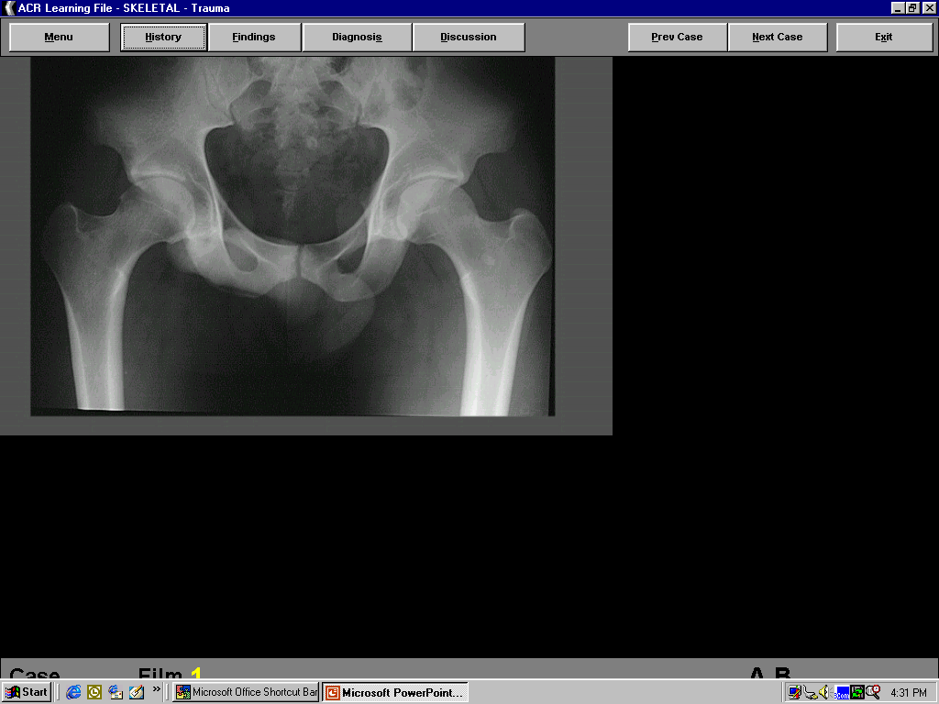
int. iliac spine
acetabulum
greater trochanter
SI joint
symphysis pubis
Notes:
21
21

Slide 22
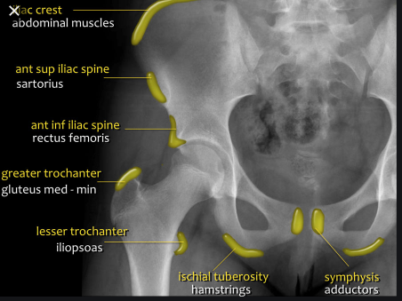

Slide 23
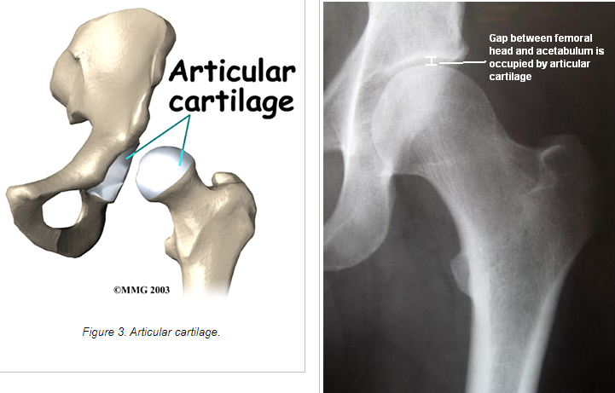

Slide 24
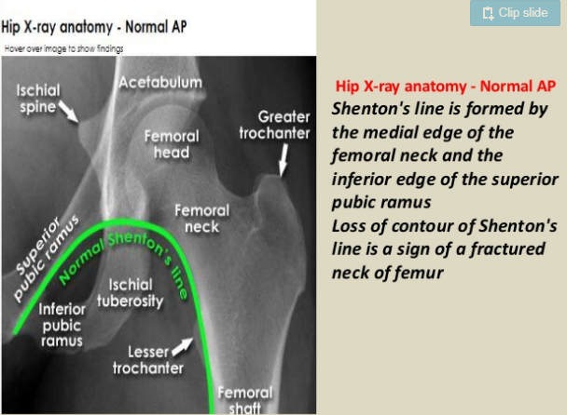
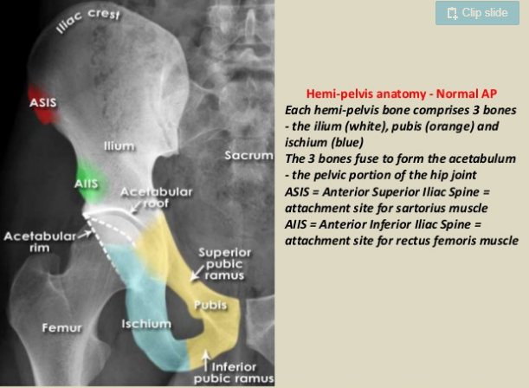

Slide 25
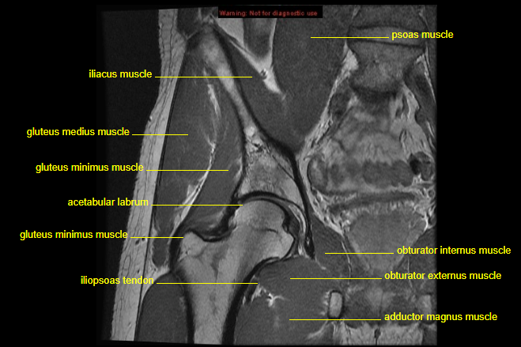

Slide 26
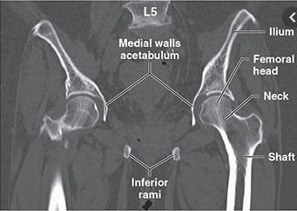
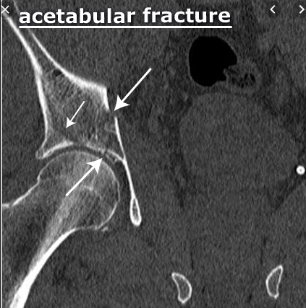

Slide 27
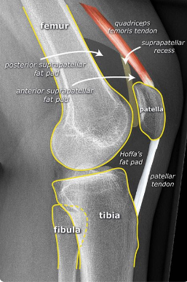
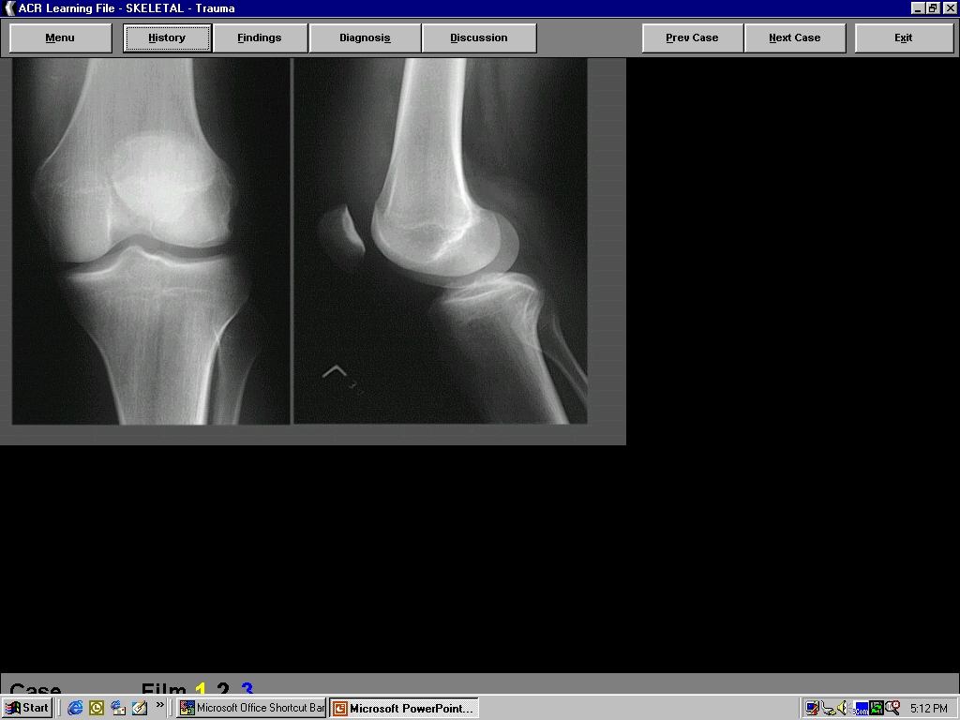
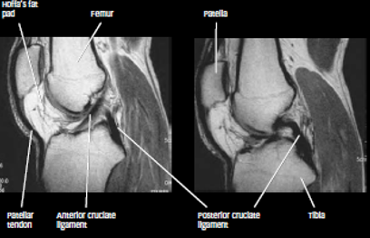
Patella
condyle
Notes:
27
27

Slide 28
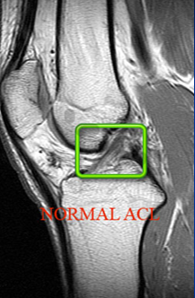
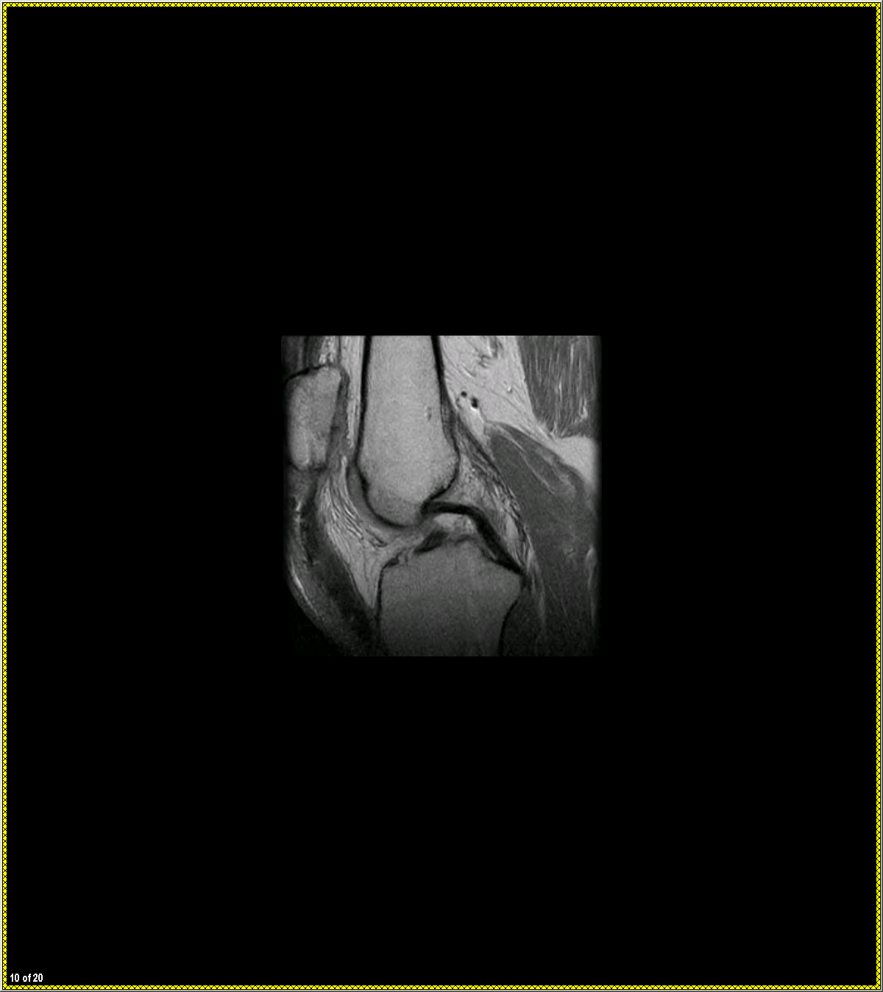
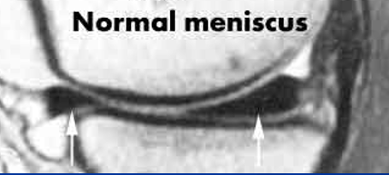
This is an MRI of the knee
There is no radiation used

Slide 29
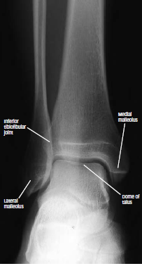
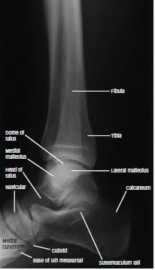
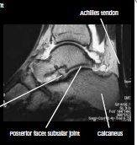

Slide 30
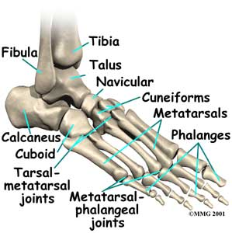
Ankle and Foot

Slide 31
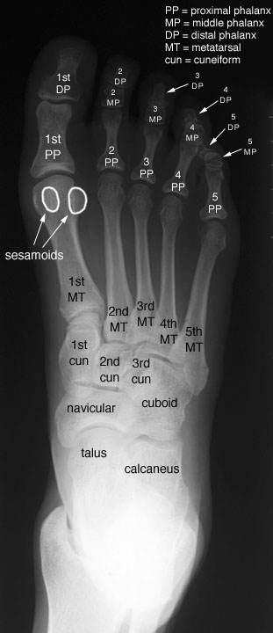

Slide 32
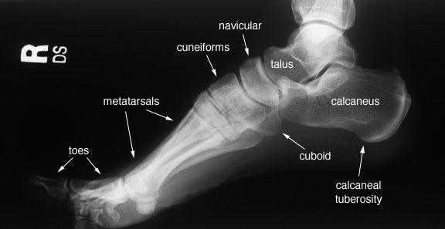

Slide 33
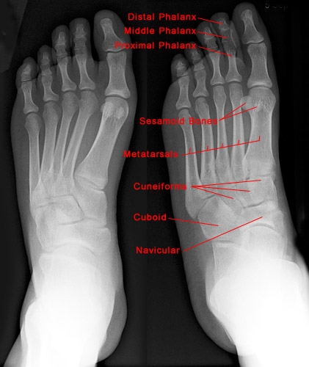

Slide 34
THANK YOU

