Slide 1

A Story of Science Success in Medicine
By Abdulrahman Araibi
YEAR 1
STUNDENT NO. 3438
23/5/2022

Slide 2
Objectives
What is cervical cancer
How has cervical cancer affected the world
What is the cause and risk factors of cervical cancer
Advances in diagnosis and treatment of cervical cancer.
Early detection and prevention of cervical cancer.

Slide 3
What is cancer?
Cancer is uncontrolled cell division
Difficult to diagnose
No cause, no prevention
Once diagnosed difficult to deal with
Decreases quality of life

Slide 4
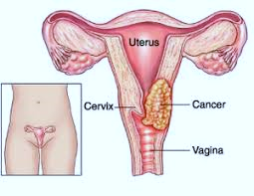
What is cervical cancer
It is cancer which affects the cervix
It affects women at young ages (40’s)
Develops slowly

Slide 5
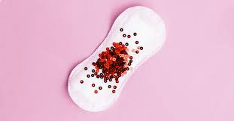
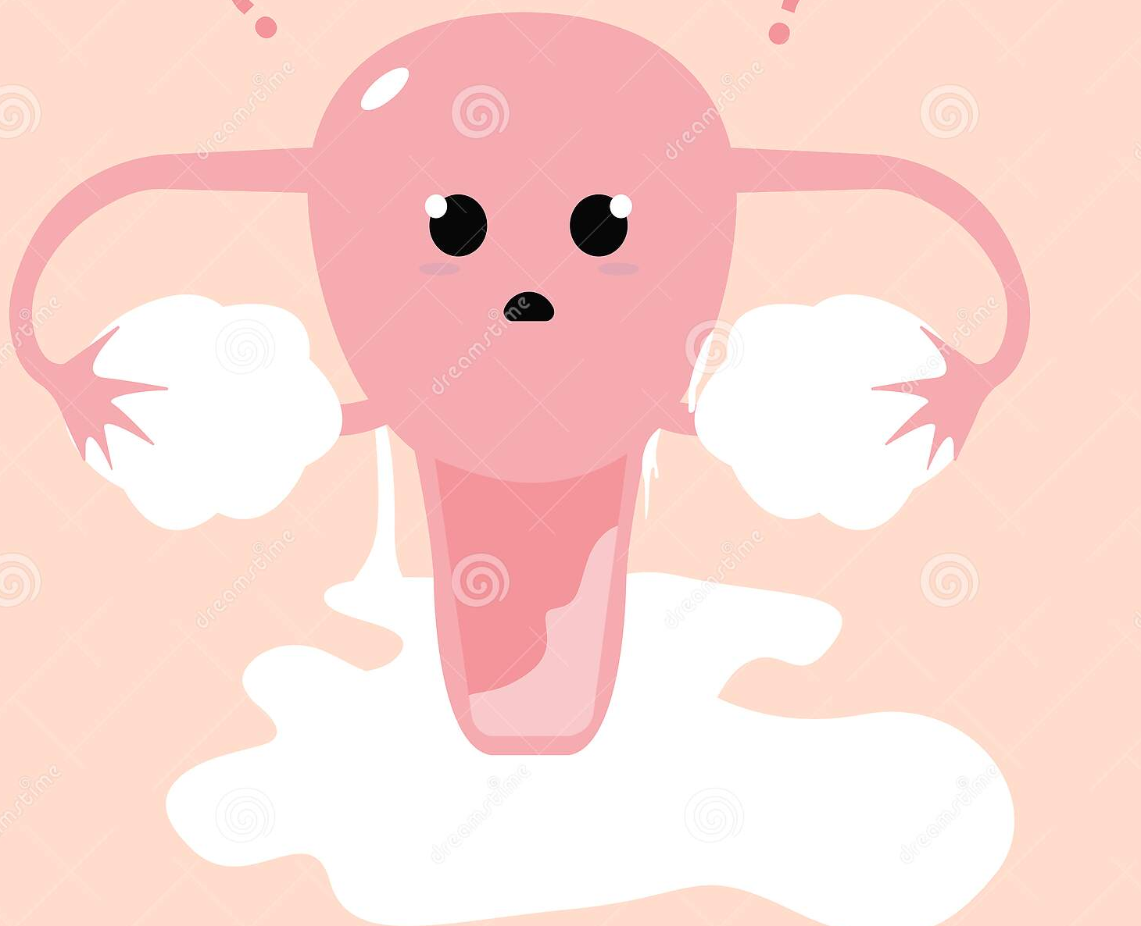

Symptoms are
Abnormal vaginal bleeding
Offensive vaginal discharge
Pain
Asymptomatic

Slide 6
How Does Cervical Cancer Affect The World
Yearly almost 604,000 women are diagnosed
342,000 fatalities
262,000 survived
An average global cost of $118,000 per patient for treatment with the cervical cancer.
It affects women in their quality of life, fertility, role of motherhood and society’s contribution .

Slide 7
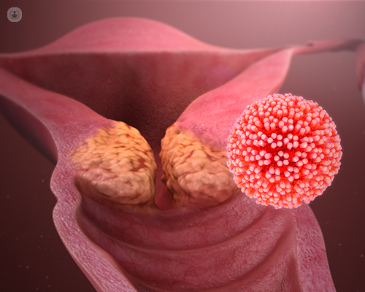
What is the cause and risk factors of cervical cancer
HPV (human papilloma virus) is 97% the cause of cervical cancer.

Slide 8
Risk factors
Multiple sexual partners
Other sexually transmitted infections
Smoking
Oral contraceptive
Obesity

Slide 9
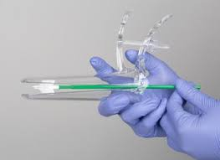
Advances in diagnosis and treatment of cervical cancer.
Diagnosis
Regular cervical smear allows prevention and early detection.
See & treat clinic using Colposcopy and loop excision .
MRI

Slide 10
Treatment
Laparoscopy and robotic approach.
Radiotherapy advances : internal radiotherapy, interstitial modulated radiotherapy & 3D radiotherapy reduce its side effects
Chemoradiotherapy is more effective .
Fertility sparing

Slide 11
Early detection and prevention of cervical cancer.
Cervical cancer is proceeded with precancer stage: cervical intraepithelial neoplasia (C.I.N)
Cervical screening test (cervical smear ) has proven to be effective in reducing cervical cancer incidences.
Cervical smear test is sensitive, easy to do, cost effective way for early detection and prevention

Slide 12
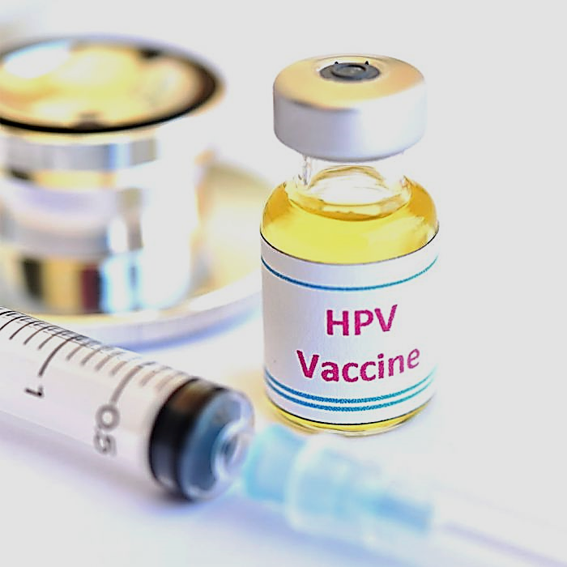
Vaccines
This noble discovery of the HPV vaccine has given us the hope to eradicate cervical cancer in the future.
Gardasil 4
Gardasil 9
Cervarix
HPV vaccines doesn’t cover every high risk virus.

Slide 13
Conclusion
We have learned what cervical cancer is and also how life-threatening it can be. Having found the solution to its prevention gives us hope for the future that cervical cancer will be eradicated.

Slide 14
Any questions?

Slide 15
Reference
Mwaka AD, Orach CG, Were EM, Lyratzopoulos G, Wabinga H, Roland M. Awareness of cervical cancer risk factors and symptoms: cross-sectional community survey in post-conflict northern Uganda. Health Expect. 2016;19(4):854-867. doi:10.1111/hex.12382
Li, H., Wu, X., & Cheng, X. (2016). Advances in diagnosis and treatment of metastatic cervical cancer. Journal of Gynecologic Oncology, 27(4). https://doi.org/10.3802/jgo.2016.27.e43
Tsikouras, P., Zervoudis, S., Manav, B., Tomara, E., Iatrakis, G., Romanidis, C., Bothou, A., & Galazios, G. (2016). Cervical cancer: screening, diagnosis and staging. Journal of B.U.ON.: Official Journal of the Balkan Union of Oncology, 21(2), 320–325. https://pubmed.ncbi.nlm.nih.gov/27273940/
‌
‌

Slide 16
Thank you

