Slide 1


0
2
3
1
1

Slide 2


Maternal fetal transmission of HIV
Name :Rodina Nasser
SN : 2179
Date : 2022/5/24
Block :PTS
2

Slide 3
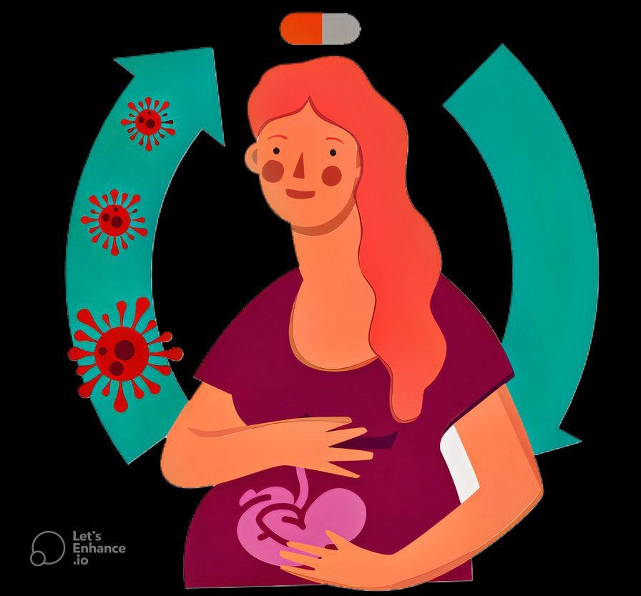
introduction
3

Slide 4
1. Describe the Mother to Child transmission of HIV
Objectives
2. Mention the factor effecting
Mother To child transmission of HIV
3. Outline the prevention and management of Mother To child transmission of HIV
4

Slide 5
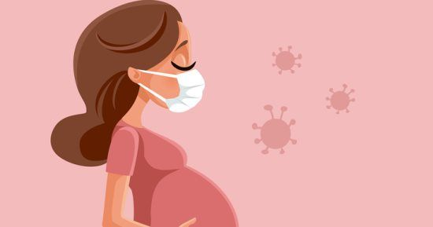
1. Describe the Mother to Child transmission of HIV
5

Slide 6
-Mother to Child transmission of HIV
Mother-to-child transmission (MTCT) remains the most important route of pediatric HIV acquisition and, transmission via three distinct routes:
-in utero, intrapartum, and in the postnatal period through breastfeeding.
-In Utero Transmission :
- Transmission of HIV in utero is the least efficient route of MTCT, accounting for an estimated absolute rate of 5-10% of MTCT for women not receiving antiretroviral therapy (ART)
- The major risk factors for in utero transmission are high maternal viral loads and placental inflammation The mechanisms of in utero HIV transmission are incompletely understood
6

Slide 7
-Intrapartum Transmission
- The most common route of HIV MTCT occurs during labor and delivery, accounting for an absolute rate of 10-20% of infections in children born to women not receiving ART
- A major risk factor for intrapartum transmission is again maternal viral load
- Postpartum Transmission :
-Breastfeeding contributes of pediatric HIV infections accounting for an estimated absolute rate of 5-15% of MTCT for women not receiving ART
7

Slide 8

2. Mention the factor effecting Mother To child transmission of HIV
8

Slide 9
Factors affecting mother-to-child transmission of HIV-1
VIRAL
Viral load
Viral genotype and phenotype
MATERNAL
Maternal immunological status
Maternal nutritional factors
OBSTETRICAL
Obstetrical procedures
Mode of delivery
FETAL
genetic
Prematurity
INFANT
Breastfeeding
gastrointestinal tract factor
9

Slide 10
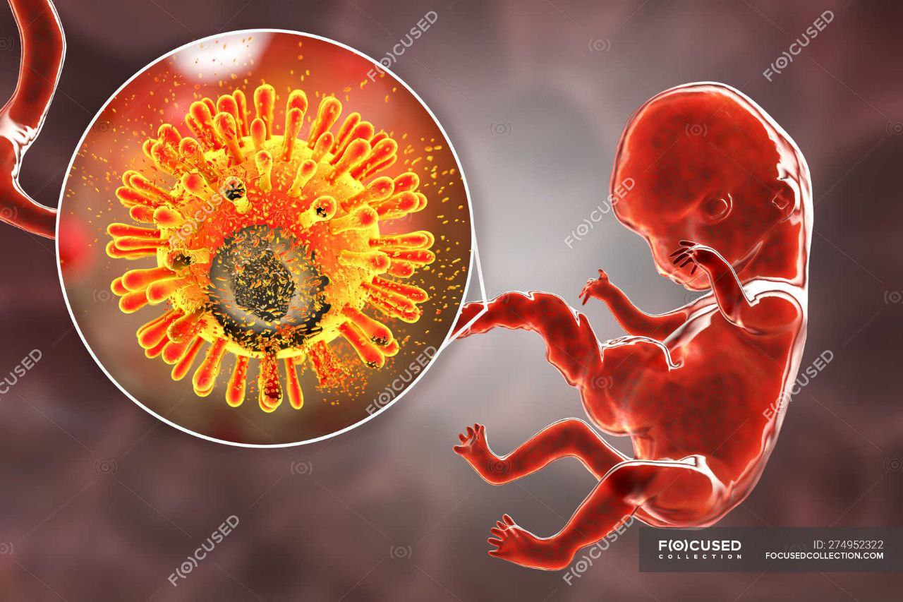
Viral factor
Viral load
*Transmission is increased in the presence of high levels of maternal viraemia.
*The local viral load in cervicovaginal secretions and in breast milk may also be an important determinant of transmission risk intrapartum and through breastfeeding
10

Slide 11
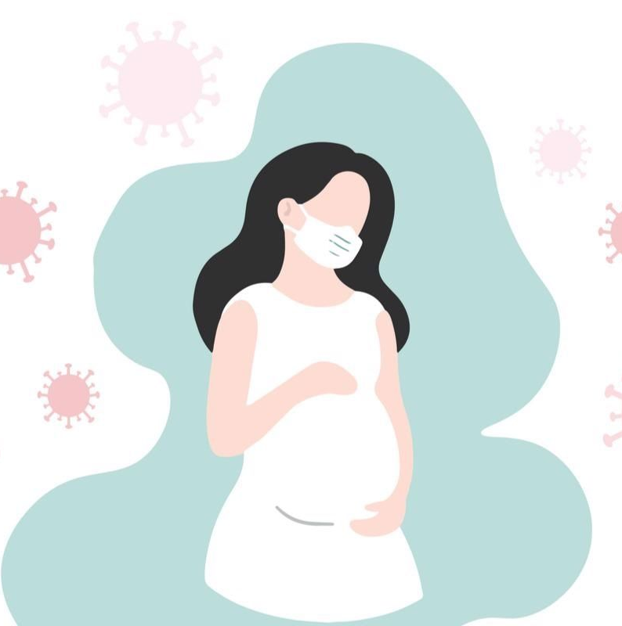
Maternal factor
Maternal immunological status
*Transmission from mother to child is more likely with decreased maternal immune status, reflected by low CD4
12

Slide 12
Maternal nutritional factors
*Serum vitamin A levels in HIV-1 positive mothers have been correlated with the risk of transmission in a Malawi study.
*The mechanism of vitamin A effect is uncertain, but the influence of vitamin A on the integrity of the vaginal mucosa or placenta and the immune stimulatory properties of the vitamin have been suggested
13

Slide 13
Behavioral factors
*Several behavioral factors have been associated with an increased rate of transmission from mother to child. These include cigarette smoking and maternal hard drug use
*Unprotected sexual intercourse during pregnancy has been linked to an increased risk of mother to-child transmission.
14

Slide 14

Obstetric factors
Obstetric factors
*With the majority of mother-to-child transmission occurring at the time of labor and delivery, obstetric factors are important determinants of transmission
15

Slide 15
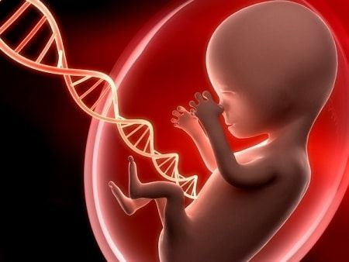
Fetal factors
Fetal factors
*Fetal genetic factors may play a part in transmission. Little is known yet about the role of genetic factors such as the CCR-5 delta32 deletion and HLA compatibility of mother and infant in the determination of transmission risk
16

Slide 16
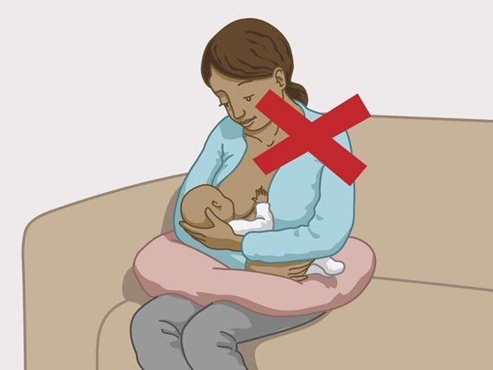
Infant factors
Infant factors
*Breastfeeding is responsible for a high proportion of mother-to-child transmission in developing countries, This is less common in the developed world, where most HIV-positive women will not breast feed.
*Breast milk contains both cell associated and free virus, the amount of which may be related to the immune suppression of the mother and vitamin A levels
17

Slide 17

3. Outline the prevention and management of Mother To child transmission of HIV
18

Slide 18
-Termination of pregnancy
-Behavioral interventions
1-Reduction in the frequency of unprotected sexual intercourse during pregnancy
2-Reduction in the number of sexual partners during pregnancy
3-Lifestyle changes, including avoidance of drug use and smoking in pregnancy
-Therapeutic interventions
1-Antiretroviral therapy: zidovudine alone or combination, long- or short-course
2-Vitamin A and other micronutrients
3-Immunotherapy
4-Treatment of STD
19

Slide 19
-Obstetric interventions
1-Birth canal cleansing
2-Caesarean section delivery
-Modification of infant feeding practice
1-Avoidance of breastfeeding
2-Early cessation of breastfeeding
20

Slide 20
conclusion
-The prevention of new infections in women of reproductive age remains an important component
-This includes the reduction of women’s to HIV-1 infection through the improvement of women’s status in society,
-the provision of information about HIV/AIDS and its prevention, the promotion of safer sex including the use of barrier methods, and the adequate treatment of sexually transmitted diseases .
21

Slide 21
References
Amin, O., Powers, J., Bricker, K. M., & Chahroudi, A. (1AD, January 1). Understanding viral and immune interplay during vertical transmission of HIV: Implications for cure. Frontiers. from https://www.frontiersin.org/articles/10.3389/fimmu.2021.757400/full
https://www.unaids.org/sites/default/files/media_asset/jc151-hiv-in-pregnancy_en_1.pdf
Knott, D., 2022. Management of HIV in Pregnancy Information Leaflet. [online] Patient.info. Available at: <https://patient.info/doctor/management-of-hiv-in-pregnancy>
22

Slide 22
Special Thanks
23

