Slide 1


Types 1 diabetes
فراس منير الصابر : Student name
Student number : 3444
Year 1 - AMS
04/06/2022

Slide 2
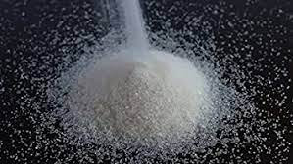
Objectives
Define diabetes.
Define type 1 diabetes.
Outline the causes of type 1 diabetes.
List symptoms and risk factors of type 1 diabetes.
Discuss treatment of diabetes.

Slide 3
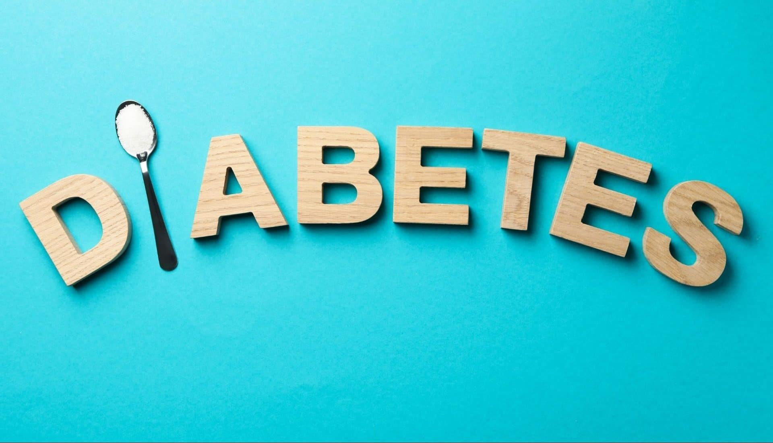
Diabetes

Slide 4
Diabetes
Your body either does not make enough insulin or can not use the insulin it makes as well as it should
When there is not enough insulin or cells stop responding to insulin, too much blood sugar stays in your bloodstream
Over the time, can cause serious health problems, such as heart disease, vision loss, and kidney disease

Slide 5
Type 1 diabetes
Type 1 diabetes usually develops in children, teens, and young adult, but it can happen at any age.
Type 1 diabetes is less common than type 2, about 5-10% of people with diabetes have type 1 , currently , no one knows how to prevent type 1 diabetes .

Slide 6
Prevalence of types of diabetes

Slide 7
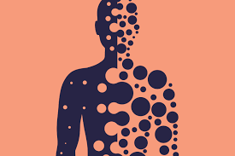


What cause type 1 diabetes ?
Autoimmune reaction.
Genetic factors.
Some viruses.

Slide 8
Symptoms and risk factors
It can take months or years before it noticed.
Some type 1 diabetes symptoms are similar to symptoms of other health condition.
Risk factors for type 1 diabetes are not as clear as for prediabetes and type 2 diabetes.

Slide 9
The treatment
It can be treated successfully by :
Following your doctor’s recommendations for living a healthy lifestyle.
Managing your blood sugar.
Getting regular health checkups.
Getting diabetes self-management education and support

Slide 10
summary
Prevention is better than cure
A healthy life and healthy food is always one of the reasons for treatment

Slide 11
Reference
Type 1 Diabetes [Internet]. CDC. 2022 [cited 18 May 2022]. Available from: https://www.cdc.gov/diabetes/basics/what-is-type-1-diabetes.html

Slide 12


