Slide 1
Primary biliary cirrhosis
dr .nadia ezzawi
Gastroenterology department
Bmc

Slide 2
Primary biliary cirrhosis
It is an autoimmune disease of the liver marked by:
the slow progressive destruction of the small bile ducts (bile canaliculi) within the liver.
when these ducts are damaged, bile builds up in the liver (cholestasis) and over time damages the tissue.
this can lead to scarring, fibrosis and cirrhosis.

Slide 3
Epidemiology:
Female:male ratio of 9:1
Most common during middle age
Presentation similar between genders, races, and sexes
Prevalence: 19-150 cases/million
Incidence: 4-15 cases/million/yr
First-degree relatives may have as much as a 500 times increase in prevalence

Slide 4
Clinical features
Fatigue (common) -
Pruritus -
Jaundice -
-Hepatosplenomegaly
RUQ pain -
-Hyperpigmentation
-Xanthomas and xanthelasmas
-Dyslipidemia
-Extrahepatic autoimmune diseases
-Complications
Portal hypertension
Chronic cholestasis

Slide 5
PBC Differential Diagnosis
-Biliary stones or strictures
-Pancreaticobiliary .malignancies
.-PSC
.-Autoimmune hepatitis
.-Alcoholic hepatitis
-Viral hepatitis
-Sarcoidosis
-Autoimmune .cholangiopathy
.-Medications
.-Granulomatous hepatitis

Slide 6
Diagnosis
Biochemical tests
high
-Alkaline phosphatase
-GGT
-5’ nucleotidase
-AST and ALT
-Bilirubin
-Total cholesterol
-Serum IgM
-Prothrombin time-
low
*Albumin
Serology
*AMA (95%)
*ANA (50%) (prognostic).
*ASMA (50%)
*Anti-centromere
*Anti-thyroid
Medical imaging
*Ultrasound
*CT (to rule out blockage to the bile ducts).
*MR or MRCP

Slide 7
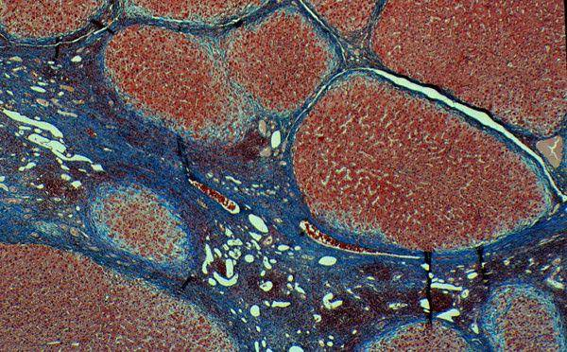
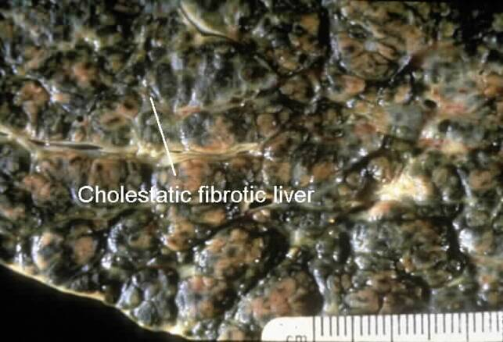
Liver biopsy:
A liver biopsy is necessary to determine the stage of disease.
Now most patients are diagnosed without invasive investigation the combination of AMA and typical (cholestatic) liver function tests are considered diagnostic

Slide 8
stages of the disease
Stage 1 - Portal Stage: Normal sized triads; portal inflammation, subtle bile duct damage. Granulomas are often detected in this stage.
Stage 2 - Periportal Stage: Enlarged triads; periportal fibrosis and/or inflammation. Typically characterized by the finding of a proliferation of small bile ducts.
Stage 3 - Septal Stage: Active and/or passive fibrous septa.
Stage 4 - Biliary Cirrhosis: Nodules present; garland or jigsaw pattern.

Slide 9
management
No known cure.
- Goals of treatment
. .Slow disease progression
.Treat complications.
.Improve clinical symptoms and signs of disease
.Improve liver function tests
. Reduce or eliminate bile duct injury
.Improve patient survival free of transplantation

Slide 10
ursodeoxycholic acid (Ursodiol)
is the most frequently used treatment of pruritis.
helps: reduce the cholestasis .
improves liver function tests .
Improvement in transplant free survival.
Methotrexate
Dose: 7.5-15 mg/week orally
Of : Helps in Improvement
Symptoms
LFTs
Histology?
Survival?
(limited). Because of its Side effects long-term use
-to relieve itching caused by bile acids in circulation, which would normally be removed by the liver,
cholestyramine
(a bile acid sequestrant) may be prescribed to absorb bile acids in the gut and be eliminated, rather than re-enter the blood stream.

Slide 11
Combination therapy
UDCA and corticosteroids
Improvement in LFTs
Variable improvement in histology
UDCA and colchicine
No significant benefit
UDCA and methotrexate
Improvement in LFTs ?
Additional studies warranted.
Liver transplantation :if successful, results in a favourable prognosis.

Slide 12
PBC Complications
Chronic cholestasis
-Osteopenia.
-Malabsorption.
-Steatorrhea.d/t:
.Bile salt deficiency
.Pancreatic disease
.Celiac disease
-Vitamin A, D, E, K deficiency
Portal hypertension
-Esophageal and gastric varices
-Ascites
-Encephalopathy
-SBP
-HRS or HPS
-Hepatocellular carcinoma

Slide 13
PBC Associated Diseases
*Thyroid disease
Hashimoto’s thyroiditis
Grave’s disease
*Scleroderma
*CREST syndrome
*Sjogren’s syndrome
*Arthritis
*Raynaud’s phenomenon
*Celiac disease
*Renal tubular acidosis
Proximal
Distal
*Gallstones
*Hematologic disorders
*Inflammatory bowel disease (rare)
*Pulmonary interstitial fibrosis (rare

Slide 14
PBC Natural History and Prognosis
PBC progresses over 15-20 yrs
Median survival
Asymptomatic disease: 10-16 yrs
Symptomatic disease: 7.5-10 yrs
Bili. (8-10 mg/dL): 2 yrs
40-100% of asymptomatic patients develop symptoms within 2-4 yrs

Slide 15
Summary
-PBC is an important cause of chronic cholestatic liver disease.
- Middle-aged females predominate.
- Immune pathogenesis favored.
- Other autoimmune diseases frequently coexist.
- PBC progresses in most patients.

Slide 16
Summary
- Complications of portal hypertension and chronic cholestasis associated with progressive disease.
- UDCA is standard medical therapy for all patients.
-Transplantation reserved for patients with marginal liver reserve and complications.
- Prognostic models predict disease severity and need for transplantation.

Slide 17
Autoimmune hepatitis

Slide 18
Autoimmun Hepatitis
- self-perpetuating hepatocellular inflammation
unknown cause
characterization:
- histologic features of interface hepatitis .
- Hypergammaglobulinemia.
- serum autoantibodies.
affects all ages, may be asymptomatic, frequently has an acute onset, and can also present as fulminant
hepatitis.
Autoimmune hepatitis has an incidence of 1-2 per 100,000 per year, and a prevalence of 10-20/100,000. As with most other autoimmune diseases, it affects women much more often than men (70%).

Slide 19
Clinical features
Symptoms:
Fatigue
Jaundice
Upper abdominal discomfort
Prurites
Anorexia
Polymyalgias
Diarrhea
Fever.
Signs:
Hepatosplenomegaly
Jaundice
Spider angioma
Ascites
Encephalopathy
Concurrent immune diseases
Laboratory findings:
High AST, ALT & GGT.
High IgG .
High bilirubin.
High alkaline phosphatase.
Immunological:
ANA , ASMA , ALKMA1 ,
ANCA.
Liver tissue examination
Liver bx is essential to establish diagnosis and assess disease severity to determine need for treatment
Picture of interface hepatitis is ahallmark of the disease

Slide 20
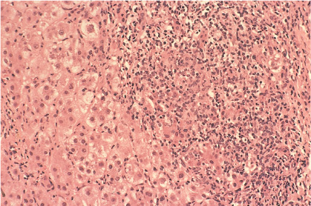
Interface hepatitis
Here you can see the limiting plate of the portal tract, demarcating the hepatocyte boundary, is disrupted by a lymphoplasmacytic infiltrate.
This histological pattern is the hallmark of autoimmune hepatitis, but it is not disease specific.
Notes:
Interface hepatitis. Here you can see the limiting plate of the portal tract, demarcating the hepatocyte boundary, is disrupted by a lymphoplasmacytic infiltrate. This histologic pattern is the hallmark of autoimmune hepatitis, but it is not disease specific.
Hematoxylin and eosin, *200.
Extra notes:
Acute onset AIH pattern: panancinar hepatitis that resembles an acute viral or drug-induced hepatitis.
Centrilobular or pervenular (rappaprot zone 3) hepaitits that resembles an acute toxic injury.

Slide 21
Treatment
- Prednisone, Azathioprine.
- Liver transplantation .
- Presence of ascites or hepatic encephalopathy identifies pts with a poor prognosis.
- 13-20% of patients can have spontaneous resolution regardless of disease activity.

Slide 22
Thank you

