Slide 1


COVID-19 Vaccine
Presented by: Mohamed Baayou
Roll Num. 3036
Second year Med student
May 24th 2022
1

Slide 2

Outline types of COVID-19 vaccines .
Objective
Discuss the mechanism of vaccines.
Explain how vaccine stimulate an immune response .
Outline the side effect of vaccines.
2

Slide 3
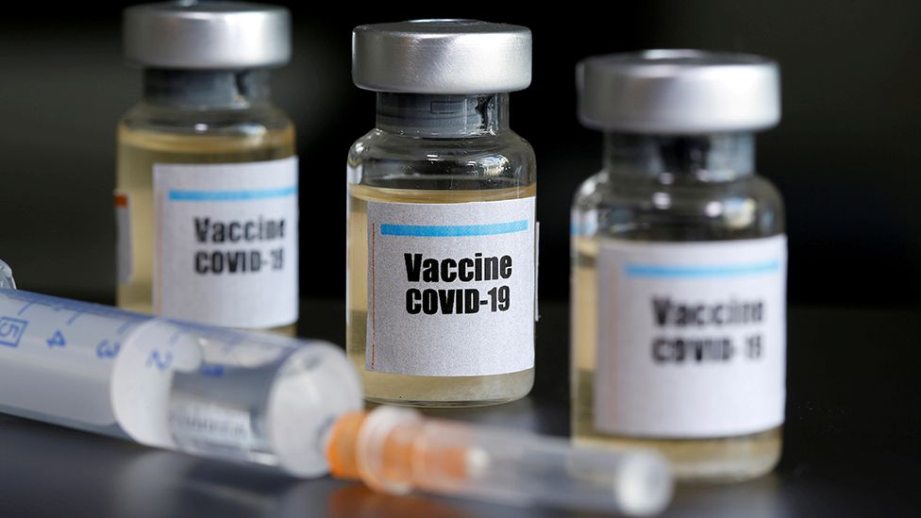
Introduction
Vaccines prevent diseases that can be dangerous, or even deadly. They work with your body’s natural defenses to safely develop protection from a disease.
3

Slide 4
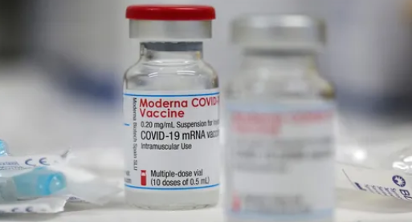
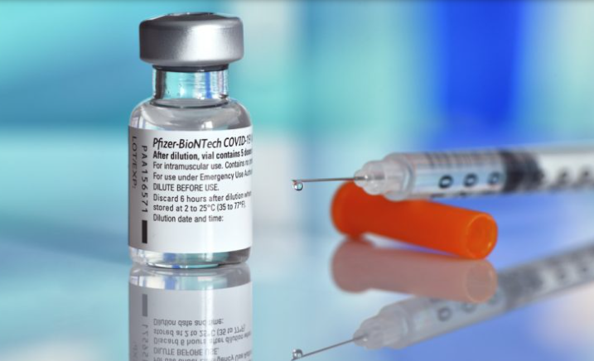
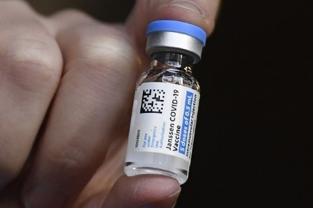
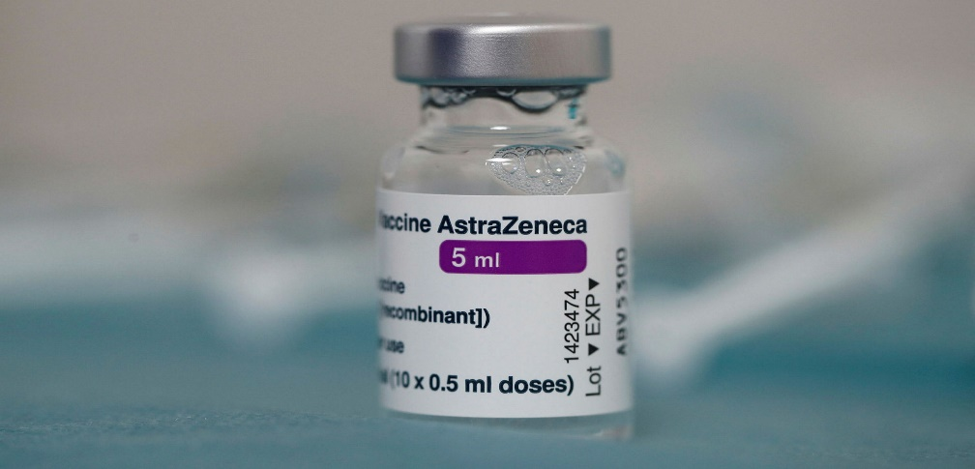

Types of COVID-19 vaccines
Moderna vaccine
BioNTech/Pfizer
Johnson & Johnson
AstraZeneca

Slide 5

Moderna:
mRNA vaccine.
Two doses - 4 weeks apart (28 days).
94.5% effective.
Authorized for 18+.
Stored at extreme cold temperature
between: 2°C and 8°C.
5

Slide 6
Johnson & Johnson:
Non-replicating viral vector vaccine.
One dose.
72% effective in preventing moderate to severe/critical COVID-19 occurring 28 days after vaccination.
Stored at extreme cold temperatures
between: 2°C- 8 °C.
6

Slide 7
BioNTech/Pfizer:
mRNA vaccine.
Two doses -3 weeks apart (21 days).
95% effective.
Authorized for 16+.
Stored at extreme cold temperature
between: 2°C and 8°C.
7

Slide 8

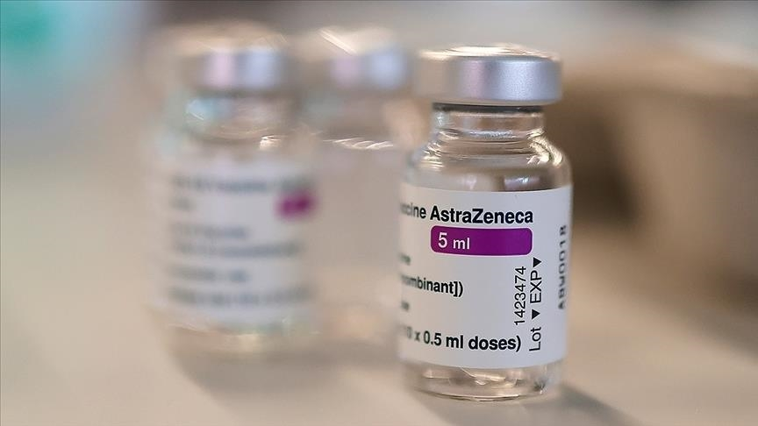
Oxford/AstraZeneca:
Non-replicating viral vector vaccine.
Two doses - 4 weeks apart (28 days).
76% effective.
Stored at extreme cold temperatures
between: 2°C- 8 °C.
8

Slide 9
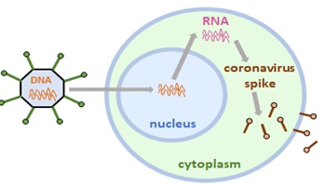

The mechanism of vaccines
Johnson & Johnson/AstraZeneca vaccine.

Slide 10
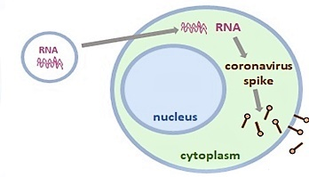
The mechanism of vaccines
2. BioNTech Pfizer/Moderna vaccines.
10

Slide 11
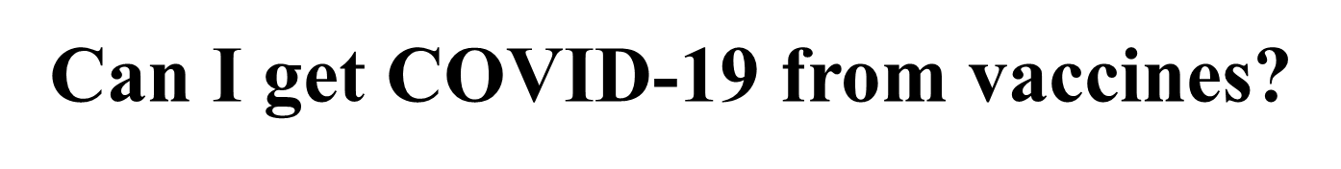
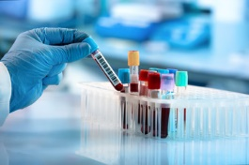
11

Slide 12
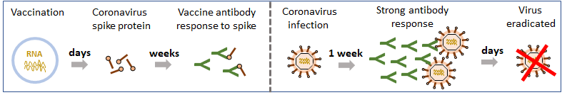
Stimulation of immune response
Vaccine makes coronavirus spike protein in cells, which is presented to immune system.
Immune cells detect spike protein and make antibodies specific for spike protein.
12

Slide 13
Stimulation of immune response
During infection, antibodies bind spike protein on real virus and protect against infection and/or disease.
● Antibodies speed up elimination of the coronavirus from the body.
13

Slide 14
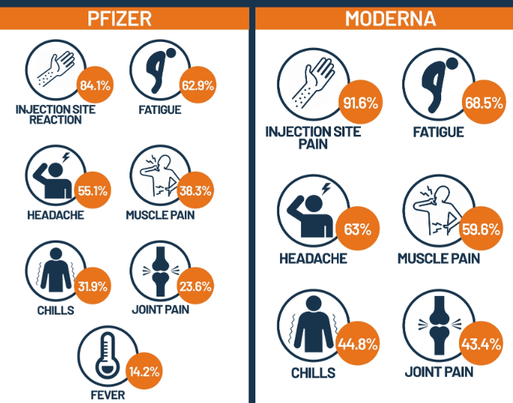
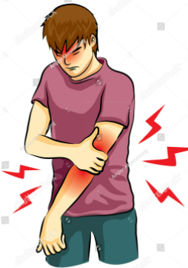
The side effect of vaccines
Pfizer and Moderna vaccine side effects:
• Local side effects: – Sore arm
• Systemic side effects
14

Slide 15
Johnson & Johnson / AstraZeneca side effects
Local reactions:
Systemic reactions:
Pain at the injection site
Redness
Swelling
Fatigue
Headache
Myalgia
15

Slide 16
What We Know and What We are Still Learning?
We know that…
COVID-19 vaccines are effective at preventing COVID-19 disease, Especially severe illness and death.
Other prevention steps help stop the spread of COVID-19, And that these steps are still important, even as vaccines are being distributed.
We are still learning…
How effective the vaccines are against variants of the virus that causes COVID-19?
How well COVID-19 vaccines keep people from spreading the disease?
How long COVID-19 vaccines can protect people?
16

Slide 17
Conclusion
● COVID-19 vaccination will help keep you from getting sick from COVID-19.
● All COVID-19 vaccines available in Libya have been shown to be very effective.
● The combination of getting vaccinated and following CDC’s recommendations to protect yourself and others will offer the best protection from COVID-19.
● The more people who get vaccinated, the faster we can get back to our normal lives.
17

Slide 18
References
1- Thompson MG, Burgess JL, Naleway AL, Tyner HL, Yoon SK, Meece J, Olsho LE, Caban-Martinez AJ, Fowlkes A, Lutrick K, Kuntz JL. Interim estimates of vaccine effectiveness of BNT162b2 and mRNA-1273 COVID-19 vaccines in preventing SARS-CoV-2 infection among health care personnel, first responders, and other essential and frontline workers—eight US locations, December 2020–March 2021. Morbidity and Mortality Weekly Report. 2021 Apr 2;70(13):495.
2- Anzola AM, Trives L, Martínez-Barrio J, Pinilla B, Álvaro-Gracia JM, Molina-Collada J. New-onset following COVID-19 mRNA (BioNTech/Pfizer) vaccine: a double-edged sword?. Clinical Rheumatology. 2022 Feb 3:1-3.
3- U.S. Food and Drug Administration. 2022. Janssen COVID-19 Vaccine Frequently Asked Questions.
4- Emanuel EJ, Luna F, Schaefer GO, Tan KC, Wolff J. Enhancing the WHO’s proposed framework for distributing COVID-19 vaccines among countries. American Journal of Public Health. 2021 Mar;111(3):371-3.
5- Teijaro JR, Farber DL. COVID-19 vaccines: modes of immune activation and future challenges. Nature Reviews Immunology. 2021 Apr;21(4):195-7.
6- Klugar M, Riad A, Mekhemar M, Conrad J, Buchbender M, Howaldt HP, Attia S. Side effects of mRNA-based and viral vector-based COVID-19 vaccines among German healthcare workers. Biology. 2021 Aug;10(8):752.
18

Slide 19

19
18

