Slide 1


Organizational Structure
Libyan International Medical University
Faculty of Business Adminstration
Name: Rudena Bettamer
ID: 2886
Rudena_2886@limu.edu.ly

Slide 2
Table of Contents
01
02
03
Introduction
Organizational Structure
Types of Organizational Structure
04
05
Conclusion
Reflection
06
References
2

Slide 3
Introduction
An organizational structure is a set of rules, roles, relationships and responsibilities that determine how a company’s activities should be directed to achieve its goals. It also governs the flow of information through levels of the company and outlines the reporting relationship among midlevel staff, senior management, executives and owners.
3

Slide 4
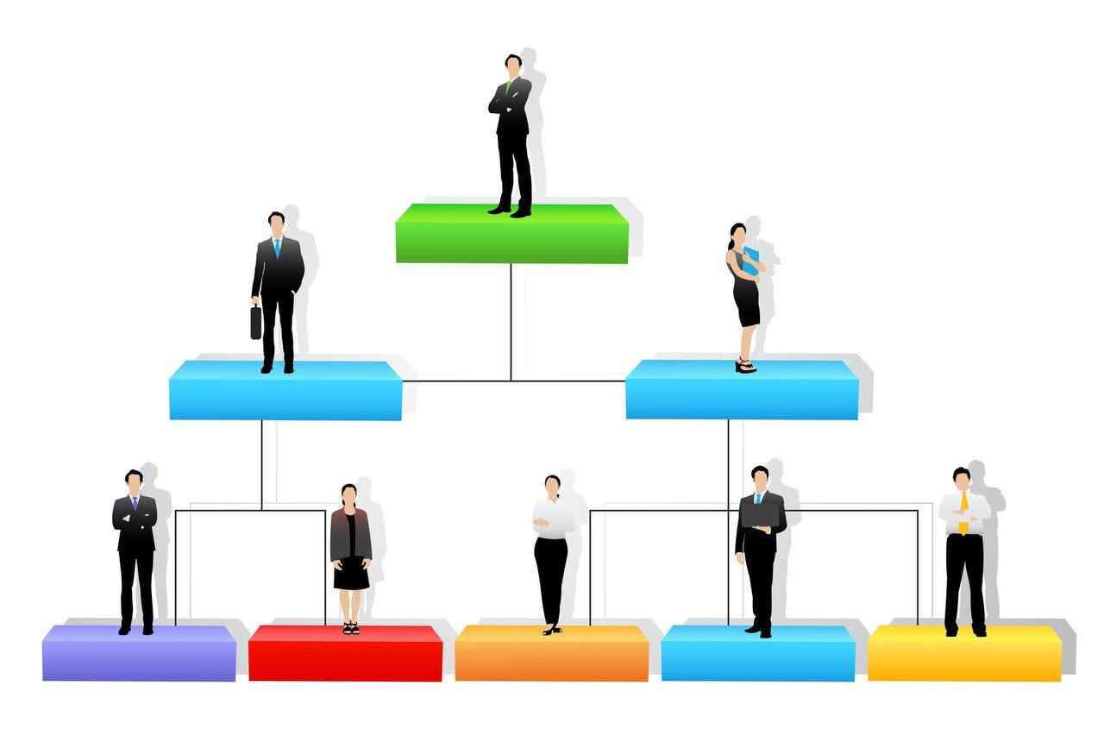
Organizational structure:
Organizational structure is the framework of the relations on jobs, systems, operating process, people and groups making efforts to achieve the goals. Organizational structure is a set of methods dividing the task to determined duties and coordinates them.
4

Slide 5

Types of Organizational Structure:
1_Functional structure.
2_Divisional structure.
3_ Flatarchy structure.
4_ Matrix structure.
5

Slide 6
Conclusion
The organizational structure defines how information, responsibilities and approval flow within your company.
The four types of organizational structures are functional, divisional, flatarchy, and matrix structures.
6

Slide 7
Reflection
The organizational structure applied can be very beneficial to the company. The structure not only determines the company's hierarchy, but also allows the company to plan the wage structure for its employees.
7

Slide 8
Reference
American InterContinental University. (2020, October 22). The four functions of management: What managers need to know. American Intercontinental University - A member of the American InterContinental University System. Retrieved March 22, 2022, from https://www.aiuniv.edu/degrees/business/articles/functions-of-management
Anastasia, C. by. (2021, May 3). How to succeed with planning in management and why it is important. RingCentral UK Blog. Retrieved April 11, 2022, from https://www.ringcentral.co.uk/gb/en/blog/planning-in-management/
Carolina VargasConsultora en marketing digital. Tengo más de 10 años de experiencia en el área de gerencia de marketing y de marketing digital. Ayudo a empresarios a construir y potenciar sus marcas online. Generando visibilidad y nuevos prospectos de neg, Arteaga, A., &amp; Vargas, C. (2019, December 4). 5 stages of the&nbsp;consumer buying decision process • imagine hub. Imagine Hub. Retrieved April 13, 2022, from https://imagine-hub.com/en/blog/consumer-buying-decision-process/
Daniels, R., &amp; Richard DanielsAuthor at Business Study NotesHello everyone! This is Richard Daniels. (2021, March 30). Business buying process in marketing: Steps and details. Business Study Notes. Retrieved April 21, 2022, from https://www.businessstudynotes.com/marketing/principle-of-marketing/business-buying-process/
Hamidzay, A. (2018, March 28). Ethics in business research. LinkedIn. Retrieved April 19, 2022, from https://www.linkedin.com/pulse/ethics-business-research-abdulmarof-hamidzay
Ketchen, D., Short, J., Try, D., &amp; Edwards, J. (2014, September 12). Evaluating the general environment. Mastering Strategic Management 1st Canadian Edition. Retrieved March 29, 2022, from https://opentextbc.ca/strategicmanagement/chapter/evaluating-the-general-environment/
Smyth, D. (2022, March 25).
8

Slide 9
Thank you
Does anyone have any question?

