Slide 1



Environmental movements
Libyan International Medical University Faculty Of Business Administration
Environmentalism and
By: Aisha Elshaare
E-mail: aishaelshaare@yahoo.com
ID: 2869
26th Nov 2020

Slide 2

1] WHAT IS AN ENVIRONMENT
CONTENT
2] The definition of Environmentalism
3] Environmental Movements
4] conclusion
5] References

Slide 3

Introduction
WHAT iS AN Environment?
-The term 'environment' means, simply, ‘nature’.
-To be more scientific, an environment is all interactions on the planet, including our surroundings and activities that affect our environment.

Slide 4



What is environmentalism?
According to Wikipedia, Environmentalism or environmental rights is a broad philosophy, ideology, and social movement regarding concerns for environmental protection and improvement of the health of the environment.

Slide 5
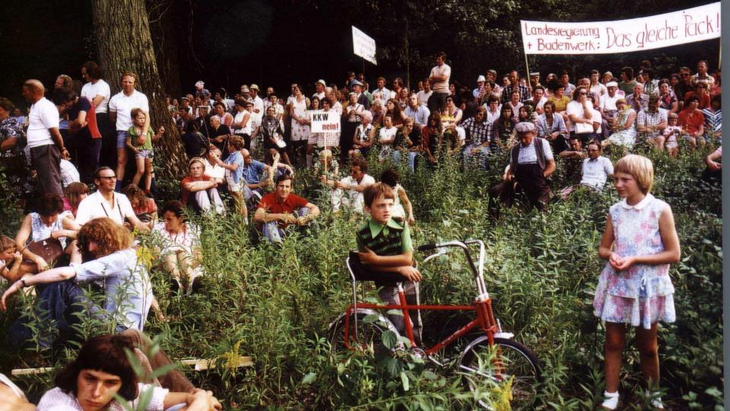
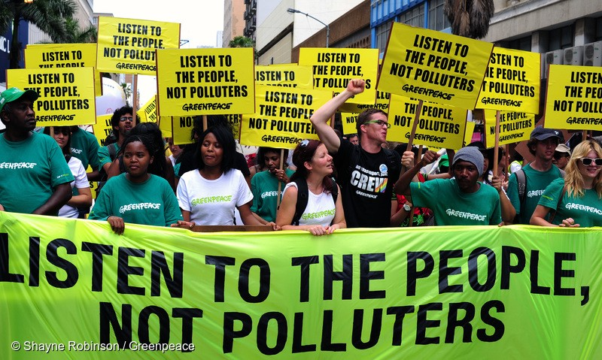

sometimes referred to as the ecology movement including conservation and green politics.
The environmental movement is an international movement, represented by a range of organizations.
It is also a political movement for addressing environmental issues.
environmental movementS:
EXAMPLES…
Conservation movement
Environmental conservation
Anti-nuclear movement

Slide 6
conclusion
The purpose of Environmental movements is to protect the natural Resources of our planet and to balance human activity and its relation with the natural non-human elements and systems.
Most common environmental manifestation is opposition to global warming and climate change.

Slide 7
referenceS
Environmental movement. (2020, November 02). Retrieved December 03, 2020, from https://en.wikipedia.org/wiki/Environmental_movement
English Interactive. (n.d.). Retrieved December 03, 2020, from https://www.english-interactive.com/a-quality-essay-sample-on-the-essence-of-environmentalism
English Interactive. (n.d.). Retrieved December 03, 2020, from https://www.english-interactive.com/a-quality-essay-sample-on-the-essence-of-environmentalism
Environmental movement. (2020, November 02). Retrieved December 03, 2020, from https://en.wikipedia.org/wiki/Environmental_movement
Global Environmental Movements. (1970, January 01). Retrieved December 03, 2020, from http://www.environmentandsociety.org/arcadia/collection/global-environmental-movements

Slide 8

Fin.
Thank you:)

