Slide 1


Benefits of Information Technology
Libyan International Medical University
Faculty of Business Administration
By: sanad Nagem
ID: 2232

Slide 2
Content:
1
Introduction
Uses of Information Technology
Benefits of Information Technology
Conclusion

Slide 3

Introduction:
2
Information technology (IT) is the use of computers to store, retrieve, transmit, and manipulate data or information. IT is typically used within the context of business operations as opposed to personal or entertainment technologies.

Slide 4
Some uses of Information Technology:
3
Accounting
Architecture Software
Artificial Software
Communication Tools
Designing Tools

Slide 5
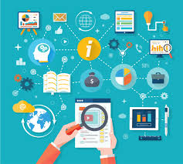
Benefits Of Information Technology:
4
Communication
Globalization and cultural gap
Availability
Creation of new jobs
Cost effectiveness, and productivity

Slide 6
Conclusion:
Information technology made many jobs a lot easier and more efficient. Not to mention it made jobs more reliable since the computer doesn’t make mistakes like an employee would do, it prevents losses from happening.

Slide 7
Reference
5
“Information Technology.” Wikipedia, Wikimedia Foundation, 31 Mar. 2020, en.wikipedia.org/wiki/Information_technology.
77 Types of Information Technology. (n.d.). Retrieved April 1, 2020, from https://simplicable.com/new/types-of-information-technology
Muhsinzoda, M., Campo, P., Jdjd, Ohlsone, App, F., Fekara, … School Software. (n.d.). Inicio. Retrieved April 2, 2020, from https://blogs.deusto.es/master-informatica/advantages-and-disadvantages-of-information-systems

Slide 8
6
Thank You

