Slide 1



Child Marriage
Name: Tamim Suliman Meelad
Student number: 2721
Topic: Adolescent safety
Date: 13/3/2022
Block: PTS
Academic Year: Year 2
Notes:
Hello everyone my name is tamim and today I am going to talk about child marriage

Slide 2

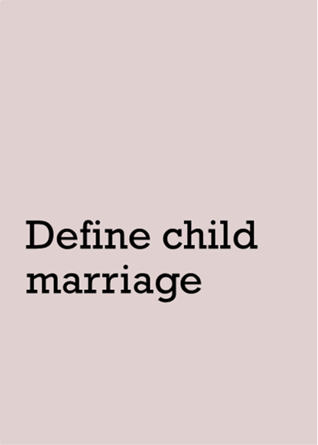
Learning objectives
1
2
3
4
List the causes of child marriage
Discuss the complications of child marriage
List ways to prevent child marriage
Notes:
Our learning objicteves for today will be to
1- Define child marriage
2- List the causes of child marriage
3- Discuss the complications of child marriage
4- List ways to prevent child marriage

Slide 3
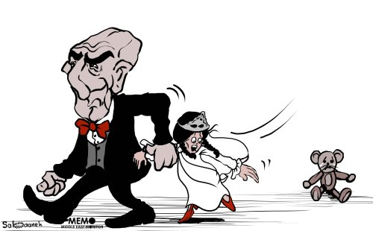

Introduction
Notes:
For the introduction I am going to tell you a story of a a 16 Y.O nigerian girl named mariam who was told that she was going to marry a 37 Y.O rich man a few hours before the wedding and even though she tried to stop the wedding she was married against her will, a few weeks after that brutal act she got pregnant and after giving birth to a baby boy her husband died leaving the the now 17 Y.O uneducated, unpreppared and immature child to have to fight and take care of her baby alone.
Mariam is not the only child to suffer due to that kind of abuse in fact 1 in every 5 girls in the world was or is forced to marry before the age of 18

Slide 4


WHAT IS CHILD MARRIAGE ?
انقر لإضافة نص
انقر لإضافة نص
Notes:
Before talking about anything else we need to know what is child marriage ,
According to the UNICEF ( which is the united nations international children,s fund ) child marriage refers to any formal marriage or informal union between a child under the age of 18 and an adult or another child . Although the prevelance of child marriage has decreased over the last decade , new circumstances have increased the incedence of this brutal act as in the past year 10 million girls more than the expected were married

Slide 5

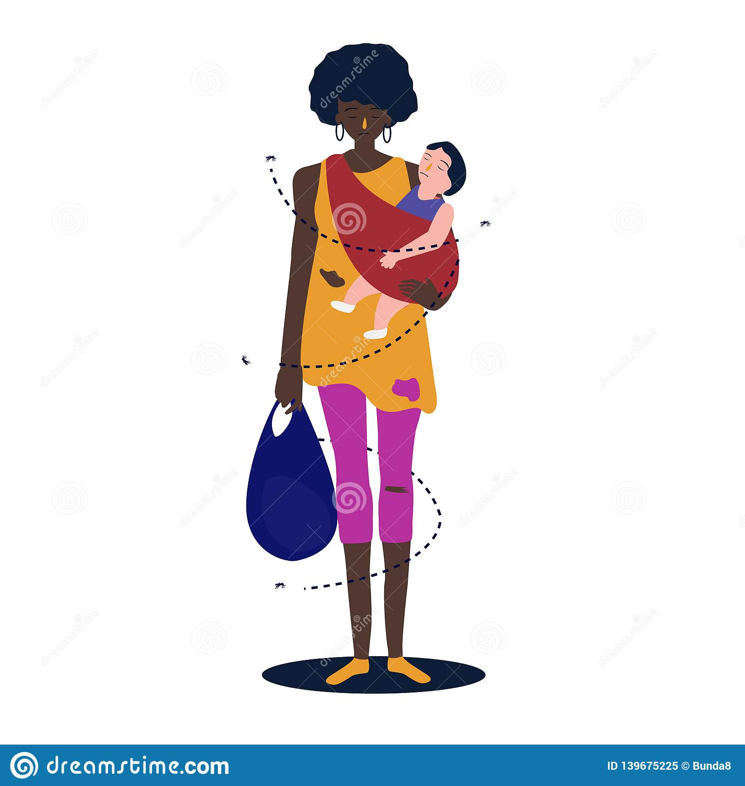
Causes of child marriage
Poverty
Notes:
Now that we know what it is lets talk about its causes :
In general there are three main causes of child marriage around the world and the most important of which is:
Poverty : Child marriage is first and foremost a product of sheer economic need. Girls are costly to feed, clothe, and educate, and they eventually leave the household. Marriage brings a dowry to the bride’s family. The younger the girl, the higher the dowry, and the sooner the economic burden of raising the girl is lifted

Slide 6
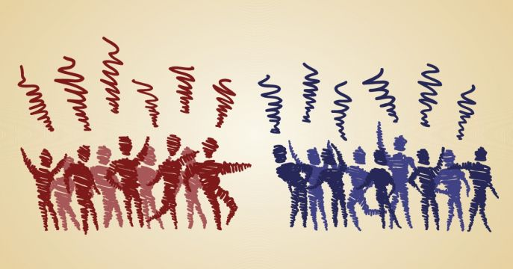
Causes of child marriage
Improving social ties
Notes:
Another cause is to
Improve social ties : By marrying their daughter to a “good” family, parents also establish social ties between tribes or clans and improve their social status

Slide 7

Causes of child marriage
Believing it provides protection
Notes:
The last main cause is
Believing that it provides protection : they also believe that marrying their daughters young protects them from rape, premarital sexual activity, unintended pregnancies, and sexually transmitted infections, especially human immunodeficiency virus (HIV) and AIDS or when families live in unsafe regions, parents may genuinely believe that marrying their daughters is the best way to protect them from danger

Slide 8
Other causes
Lack of education
Tradition in some countries
Notes:
Other causes include
Tradition : Because marriage often determines a woman’s status in many societies, parents also worry that if they don’t marry their daughters according to social expectations, they will not be able to marry them at all
And Lack of education : In many countries, educating girls often is less of a priority than educating boys. When a woman’s most important role is considered to be that of a wife, mother and homemaker, schooling girls and preparing them for the jobs may be given short shrift. And even when poor families want to send their daughters to school, they often lack access to nearby, quality schools and the ability to pay school fees. It is usually safer and economically more rewarding to spend limited resources on educating sons than daughters. This boxes families into early marriage as the only viable option for girls

Slide 9
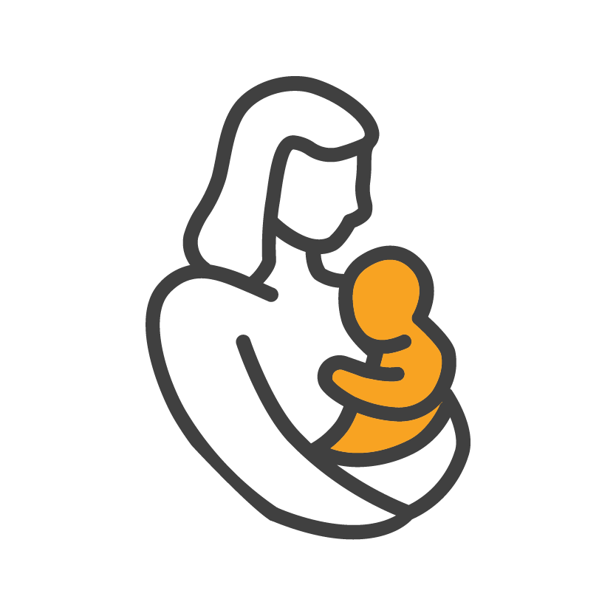
Complications of child marriage
Maternal and infant health
Notes:
Now lets discuss the complications of child marriage and the most important one is
Maternal and infant health : Girls who marry and give birth before their bodies are fully developed are more at risk of death or terrible injury and illness in childbirth. In 2007, UNICEF reported that a girl under the age of 15 is five times more likely to die during pregnancy and childbirth than a woman in her 20s.11 Risks extend to infants, too: if a mother is under age 18, her baby’s chance of dying in the first year of life is 60 percent greater than that of a baby born to a mother older than 19 In addition to death, young girls face tremendous health risks in childbirth, including a serious condition known as obstetric fistula. Obstetric fistula results when a young mother’s vagina, bladder and/or rectum tear during childbirth. It causes urine and feces to leak from her, and without surgery, the condition lasts the rest of the girl’s life. Fistula patients are commonly poor women, ages 15 to 20, many of whom were child brides

Slide 10



Complications of child marriage
Increased chance of STDs
Notes:
Another one of the more common complications is
Increased chance of STDs : although many families marry their children in order to protect them from STDs studys revealed that married girls aged 15-19 were 75 percent more likely to contract HIV than sexually active, unmarried girls of the same age

Slide 11

Complications of child marriage
Domestic and sexual violence
Notes:
domestic and sexual violence : Girls who are married early are more likely to be abused sexually, physically and emotionally.A study in India shows that girls who married before age 18 reported experiencing physical violence twice as often, and sexual violence three times as often as girls who married at a later age

Slide 12
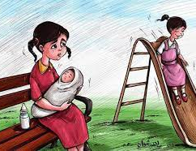
Complications of child marriage
Loss of childhood and future
Notes:
And finally Loss of childhood and future : More than anything else, early marriage deprives girls of their childhood. They are thrust into the full burden of domestic responsibility, motherhood and sexual relations rather than playing with friends, dreaming about a career or fretting about a school exam. . In many countries, young married girls move away from their parents’ home to live with their husband and his family, where they have no friends, no support, and little say in their own lives or in household matters Outside the family, the doors to schooling are usually closed to young married girls in most countries. This means that they have little chance to prosper later in jobs. Often dependent and with little knowledge and income to support or invest in their children, child brides also end up raising daughters who face the same challenges as their mothers

Slide 13
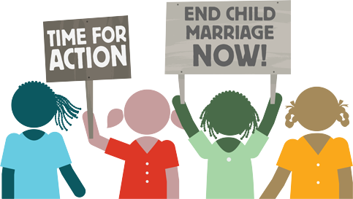
Preventing child marriage
Notes:
We know the problem is forced child marriage. We know the causes and consequences are terrible. But the good news is that we also know solutions, before launching any new program, it’s critical to first talk to girls. They are the starting point for any solution to ending forced child marriage Girls understand acutely the obstacles that bar them from opportunities, and they have clear ideas about what needs to change in their lives in order to succeed. It’s also important to support parents who support their daughters’ decision to continue their studies and enjoy their childhood – delaying the choice to become a wife and mother. These parents who are bold enough to go against what tradition dictates can be renounced from their community , over the past few years many programs to end child marriage have been launched but the ones that succeeded the most were focused on three main points
1) Providing girls with life skills such as numeracy, literacy, using a telephone or articulating their needs and interests to elders;
2) Raising awareness and commitment among parents, teachers, religious leaders and other influential adults to eradicate forced child marriage; and
3) Working with young people—including boys—to understand and build peer support on the idea of preventing forced child marriage.

Slide 14
CONCLUSION
child marriage is a brutal act to any child , it many dangerous and fatal complications but it is not that hard to prevent
Notes:
In conclusion child marriage is a brutal act to any child , it many dangerous and fatal complications but it is not that hard to prevent

Slide 15
Refrences
https://plan-international.org
https://www.unicef.org
Nour NM. Child marriage: a silent health and human rights issue. Rev Obstet Gynecol. 2009;2(1):51-56
Malhotra, A., 2010. [ebook] Washington D.C: International Center for Research on Women, pp.3-10. Available at: <https://www.icrw.org/files/images/Causes-Consequences-and%20Solutions-to-Forced-Child-Marriage-Anju-Malhotra-7-15-2010.pdf> [Accessed 12 January 2022].
Notes:
Here are my refrences

Slide 16

Notes:
Thank you

