Slide 1


Politeness Theory
Libyan International Medical University
Faculty of Business Administration
Name: Jude Boughgalia
ID: 3766
Email: Joud_3766@limu.edu.ly

Slide 2
Table of Contents
01
Introduction
02
The Positive Face
03
The Negative Face
04
The Impact of Politeness on Relationships
05
The Four Politeness Strategies
06
Reflection
Conclusion
07
02

Slide 3
Learning Objectives
01
Explain The Politeness Theory
02
Recognize The Impact of Politeness on Relationships
Identify The 4 Politeness Strategies
03
By the end of this presentation you’ll be able to:
03

Slide 4
Introduction
The basis of politeness theory is the idea that we have 2 different "faces": a positive face and a negative face.
Positive face is an individual's desire to be liked and appreciated by others. Think of this as a person's self-esteem.
Negative face is an individual's desire to protect their personal rights, such as their freedom of speech and action.
04

Slide 5
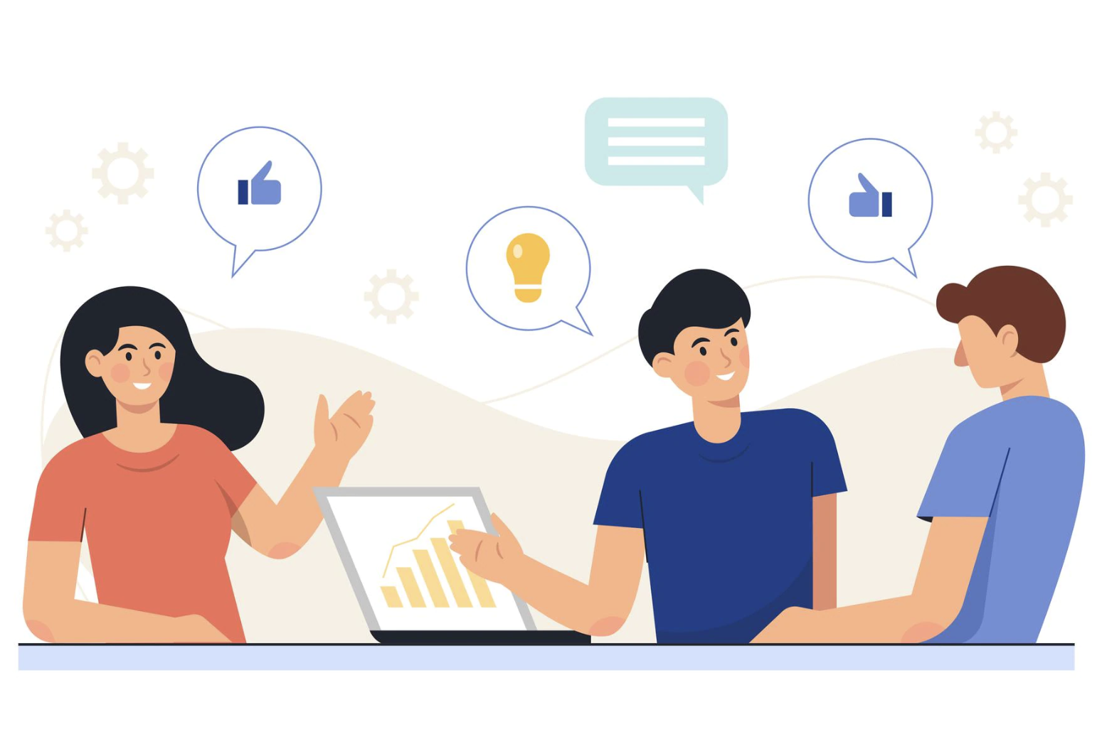
Positive Face
Positive face is the need to be thought of highly—to be valued, to be esteemed. In communication terms, respect for positive face entails the exchange of compliments, praise, and general positivity
Example: “This piece of work is really fantastic. Well done! "
05

Slide 6
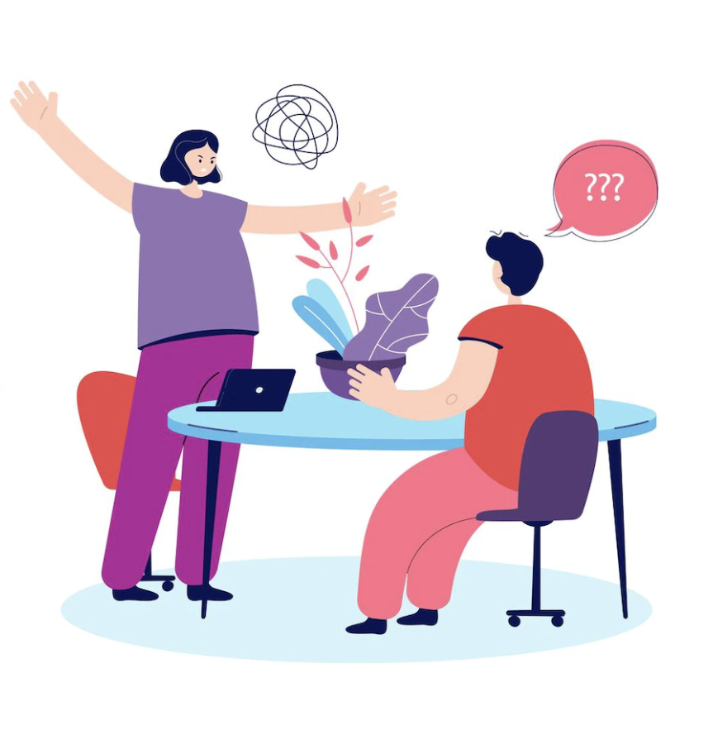
Negative Face
Negative face is the need to be in control of one’s own behavior, to not be obligated to do something. In communication terms, respect for negative face entails the exchange of permission requests messages indicating that a person’s time is valuable and respected.
Example: "I know it's a real pain, and I hope you don't mind, but could you please print these off for me?"
06

Slide 7
The Impact of Politeness on Relationships
Relationships are maintained when the rules of politeness are maintained. And relationships deteriorate when the rules of politeness are bent, violated too often, or ignored completely. Relationship repair is affected by a process of reinstituting the rules of politeness.
07

Slide 8
Politeness Strategies
We usually use these strategies to avoid embarrassing someone or making them feel uncomfortable. Brown and Levinson propose four politeness strategies: Bald on-record, Positive politeness, Negative politeness, and Off-record (indirect).
08

Slide 9
Politeness Strategies
1. Bald On-Record
We usually use this strategy when there is a sense of urgency if we know the listener well, or if there is a low risk of threat to the listener's face. When we use this strategy, we get straight to the point and do not use any additional language to help soften our message.
Example: "Watch out!" - Sense of urgency.
09

Slide 10
Politeness Strategies
2. Positive Politeness
Positive politeness strategies include: finding common ground; criticism with compliments; telling jokes; and using statements of friendship. These strategies make the listener feel good about themselves and avoid conflict or offence by emphasizing friendliness and politeness.
Example: “I love your shoes, and your hair looks great. I'm not sure about that top, though...”- a criticism with compliments.
10

Slide 11
Politeness Strategies
3. Negative Politeness
We use negative politeness strategies when we presume that our speech will impose on the listener in some way and wish to avoid feelings of awkwardness or embarrassment. Such strategies include hedging, minimizing the imposition, apologizing, being indirect, and using questions rather than commands.
Example: "I'm so sorry, but could you help me?" - Being apologetic.
11

Slide 12
Politeness Strategies
4. Off-Record (Indirect)
This strategy involves some serious indirectness; the speaker typically avoids saying the potentially face-threatening act altogether. Instead, the speakers' intentions are implied, and it is up to the listener to interpret them.
Example: Speaker: "Is there a free chair over there?"
Listener: "Yes, here you go."
12

Slide 13
Conclusion
13

Slide 14
Conclusion
Politeness theory works on the assumption that we each have two different types of face: Positive face and Negative face. When we appeal to a person's positive face, we want to make them feel good about themselves. When we appeal to a person's negative face, we want to make them feel they haven't been imposed upon.
14

Slide 15
Reflection
15

Slide 16
Reflection
Politeness theory is when two people develop a relationship when each respects, contributes to, and acknowledges the positive and negative face needs of the other; the same relationship deteriorates when they don’t.
16

Slide 17
References
17

Slide 18
References
DEVITO, J. O. S. E. P. H. A. (2022). Interpersonal communication book. PRENTICE HALL.
Politeness theory. StudySmarter US. (n.d.). Retrieved December 20, 2022, from https://www.studysmarter.us/explanations/english/pragmatics/politeness-theory/
18

Slide 19
Thanks!

