Slide 1


1
Libyan International Medical University
Faculty of Business Administration
The Importance of Interpersonal Communication
Personally & Professionally
Prepared and presented by:
Heba N Bushiha
ID Number :
3285

Slide 2
TABLE OF CONTENTS
01
03
02
04
2
The Importance of Interpersonal Communication In Professional Life.
Introduction .
Conclusion.
The Importance of Interpersonal Communication In Personal Life.
05
Refences.

Slide 3
Introduction
3
What is Interpersonal Communicational?
Interpersonal communication is the process of sharing ideas and emotions verbally and nonverbally with another person.
It allows us to interact with and understand others in our personal and professional lives.
(Indeed Editorial Team,2021)

Slide 4
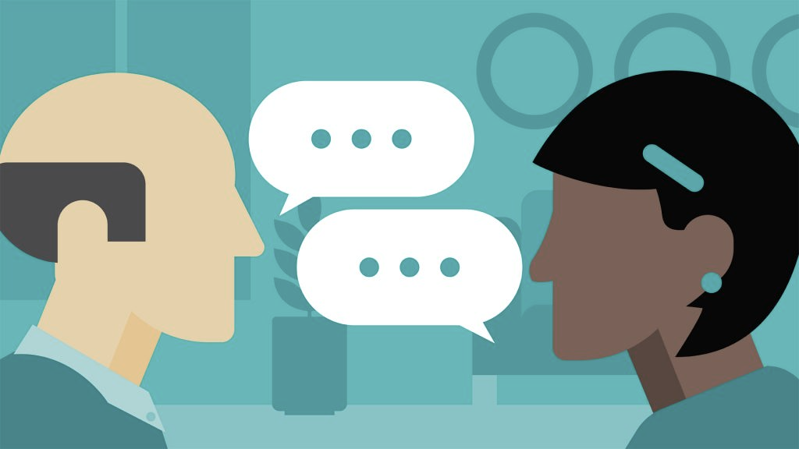
Importance Of Communication In Personal Life
4
According to some researches, Interpersonal communication is very important in everyday life, it helps us build a relationship with another, it also helps us to satisfy our physical needs, identity needs, social needs and practical goals.
Good interpersonal skills help you to communicate more effectively with family and friends and is likely to be particularly important with your partner.

Slide 5

Importance Of Communication In Professional Life
5
Some theorists claimed that Interpersonal communication skills can help you be productive in the workplace, build strong and positive relationships with your colleagues and complete team projects smoothly and effectively.
In the workplace, managers often look for employees with strong interpersonal skills who will collaborate and communicate well with their colleagues.

Slide 6


CONCLUSION
6
In conclusion, effective communication in personal life and workplace is fundamental to reaching all goals, as well as it sets organizational goals and helps co-workers collaborate better with each other.

Slide 7
REFRENCES
7
Indeed Editorial Team. “Everything You Need to Know about the Importance of Interpersonal Communication at Work.” Indeed Career Guide, 19 Mar. 2021, www.indeed.com/career-advice/career-development/importance-of-interpersonal-communication.
Khan, Hani. “The Causes & Effects of Poor Communication in the Workplace.” Simpplr, 19 Apr. 2021, www.simpplr.com/blog/2021/causes-effects-poor-communication-workplace/.
“The Role of Interpersonal Communication in Everyday Life | 123 Help Me.” Www.123helpme.com, www.123helpme.com/essay/The-Role-Of-Interpersonal-Communication-In-Everyday-751006.
“Everything You Need to Know about the Importance of Interpersonal Communication at Work.” Indeed Career Guide, www.indeed.com/career-advice/career-development/importance-of-interpersonal-communication#:~:text=Interpersonal%20skills%20are%20important%20for.

Slide 8
THANK YOU
8
Heba N Bushiha

