Slide 1






Antibiotic Resistance
Azza Hassan Eljazwi
3104
Second year
3-4-2022
Block: PTS
1

Slide 2









OBJECTIVES
Antibiotic & antibiotic resistance
ILLUSTRATE
types of antibiotic resistance
mechanism of antibiotic resistance
DISCUSS
Diagnosing of antibiotic resistant infection
Prevention of antibiotic resistance
2

Slide 3

INTERODUCTION
Antibiotic resistance occurs when bacteria change in response to the use of these medicines.
More than 2.8 million antibiotic resistance infections occur in the U.S each year . More than 35.000 people die as a result
a And it can affect people at any stage of life, as well as the
therefore it leads to higher medical costs, prolonged hospital stays, increased mortality
This makes it one of the world’s most urgent public health problems
3

Slide 4
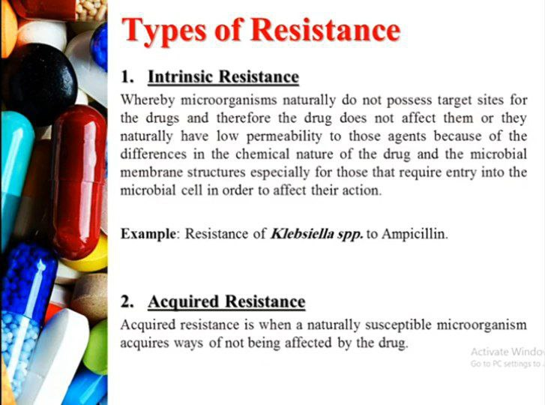

4

Slide 5
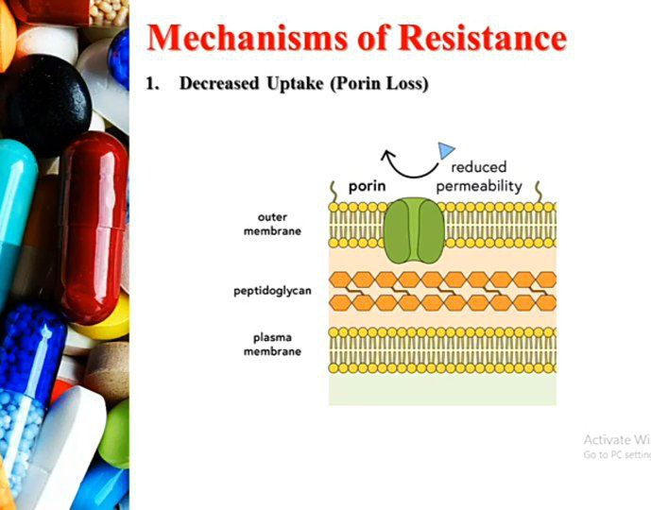
5

Slide 6
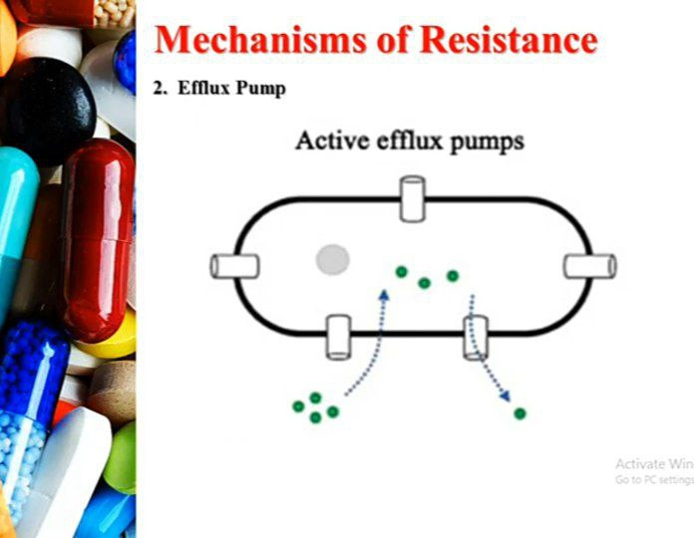
6

Slide 7
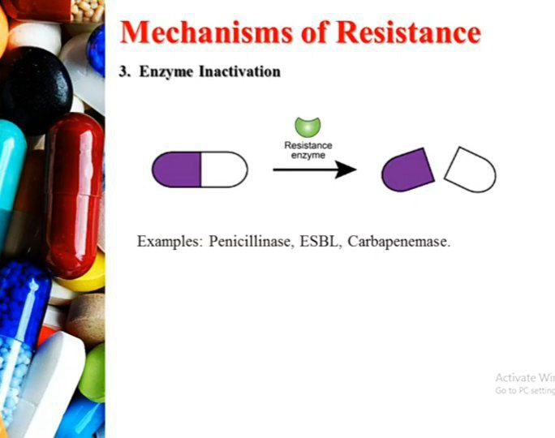
7

Slide 8
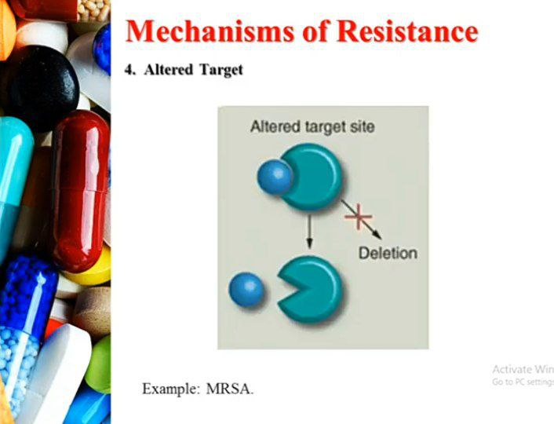
8

Slide 9

Diagnosing Antibiotic-Resistant infection
1
Blood test
A rapid test can detect an organism in as little as two
The blood can also be tested to determine whether
the genetic material in the pathogen is from MRSA or
less dangerous form of Staphylococcus aureus bacteria
2
Bacterial culture
Specialists in a laboratory expose the bacteria in the sample to different antibiotics . If the bacteria continue to grow , they are thought to be resistancce to the medications . If they are destroyed , they are susceptible to the antibiotics
9

Slide 10
PREVENTION
To prevent and control spread
1
2
3
USE
NEVER
FOLLOW
Antibiotic when prescribed by certified health professional
Demand antibiotics if your health worker says don’t
Your health workers advice
4
5
6
NEVER
PREVENT
PREPARE
Share or use leftover antibiotics
Infections by washing hands, , avoid close contact
Food hygienically following WHO five keys
10

Slide 11
WHO FIVE KEYS TO SAFER FOOD
1
2
3
4
5
KEEP
SEPARATE
COOK
KEEP
USE
Your food clean
Raw and cooked food
Your food thoroughly
Food at safe temperature
Safe water and row materials
11

Slide 12

CONCLUSION
Antibiotic resistance has spread around the world , and it's making some diseases , such as Meningitis or pneumonia, more difficult to treat. You might need stronger more expensive drugs, or you might need to take them longer. You also might not get well as quickly, or you could develop other health issues.
Therefore , it is a very serious problem and you must be careful and follow the instruction I mentioned earlier
12

Slide 13
REFRENCES
Blair JM, Webber MA, Baylay AJ, Ogbolu DO, Piddock LJ. Molecular mechanisms of antibiotic resistance. Nat Rev Microbiol. 2015;13(1):42-51. doi:10.1038/nrmicro3380
Frieri M, Kumar K, Boutin A. Antibiotic resistance. J Infect Public Health. 2017;10(4):369-378. doi:10.1016/j.jiph.2016.08.007
Grossman TH. Tetracycline Antibiotics and Resistance. Cold Spring Harb Perspect Med. 2016;6(4):a025387. Published 2016 Apr 1. doi:10.1101/cshperspect.a025387
Khardori N, Stevaux C, Ripley K. Antibiotics: From the Beginning to the Future: Part 2. Indian J Pediatr. 2020;87(1):43-47. doi:10.1007/s12098-019-03113-0
13

Slide 14

THANK YOU !
14

