Slide 1



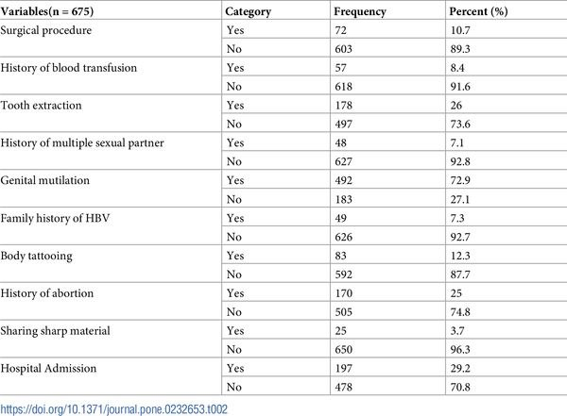
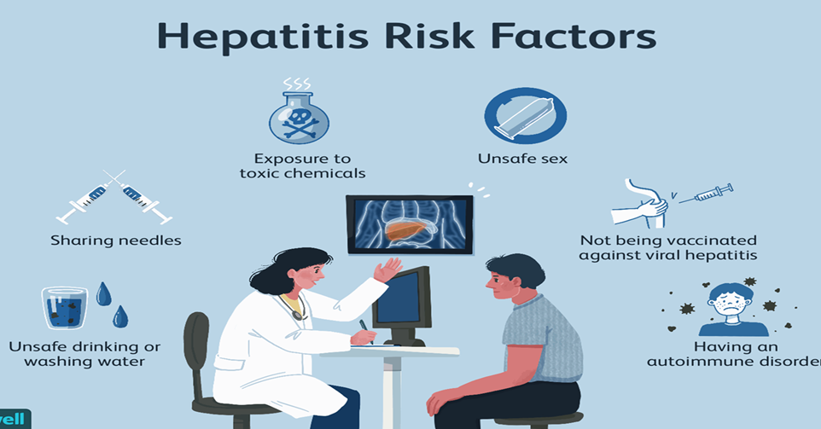
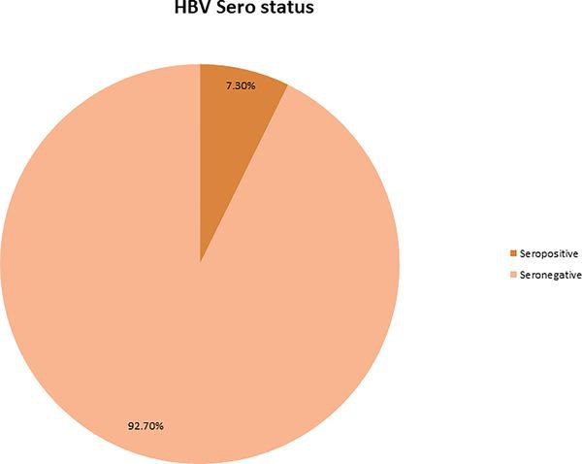
Hepatitis B during pregnancy
Libya international medical univeristy
Mahmoud ali alseihdi 2942 2nd year dentistry student
introduction
study1
Conclusion
Hepatitis B virus (HBV) infection is a serious public health problem in sub-Saharan Africa pregnant women. HBV Infection has high tendency of vertical transmission and have adverse effect on both the mother and child. However, there is no evidence on prevalence of hepatitis B virus among pregnant women in Wolaita Zone. Therefore, this study aims to determine prevalence of hepatitis B virus infection among pregnant attending Antenatal clinics of public Hospitals of Wolaita Zone.
.
The seroprevalence of HBV is in intermediate range in the study settings as per WHO classification of HBV endemicity. Contact with jaundice patients, multiple sexual partners, and sharing sharp materials were associated with increased risk of HBV infection. These factors are behavioral and hence, HBV infection can be prevented through modification of these factors.
Reference
Risk factors
. Korea Centers for Disease Control & Prevention . Korea National Health and Nutrition Examination Survey (KNHANES) 2016 [Internet] Cheongju (KR): KCDC; 2016. [cited 2019 Feb 11]. Available from: http://knhanes.cdc.go.kr. [Google Scholar
] Mohammed Seid B.G., Abate Assefa, Sero-prevalence of HBV and HCV Infections Among Pregnant Women Attending Antenatal Care Clinic at Dessie Referral Hospital, Ethiopia. ADVANCES IN LIFE SCIENCES AND HEALTH, 2014. 1(2).
‏THOMAS, David L., et al. Viral hepatitis in health care personnel at the Johns Hopkins Hospital: the seroprevalence of and risk factors for hepatitis B virus and hepatitis C virus infection. Archives of internal medicine, 1993, 153.14: 1705-1712
Method and material
Result
An institution based cross sectional study was conducted among pregnant women attending antenatal clinics of Wolaita Zone from October—November, 2018. Systematic random sampling was used to get respondents. A pretested, structured questionnaire was used to collect socio-demographic characteristics and other variables. In addition, 5 ml of venous blood was collected from each study participants
The final calculated sample size was 675.
From total of 675 study participants, 49(7.3%) were positive for HBsAg and the rest 726(92.7%) were negative for HBsAg
WHO recommends that all infants receive the hepatitis B vaccine as soon as possible after birth, preferably within 24 hours, followed by 2 or 3 doses of hepatitis B vaccine at least 4 weeks apart to complete the vaccination series. Protection lasts at least 20 years and is probably lifelong
the use of antiviral prophylaxis for the prevention of hepatitis B transmission from mother-to-child
Notes:
To change this poster, replace our sample content with your own. Or, if you'd rather start from a clean slate, press the New Slide button on the Home tab to insert a new page. Now enter your text and pictures in the empty placeholders. If you need more placeholders for titles, subtitles or body text, copy any of the existing placeholders, then drag the new one into place.

