Slide 1
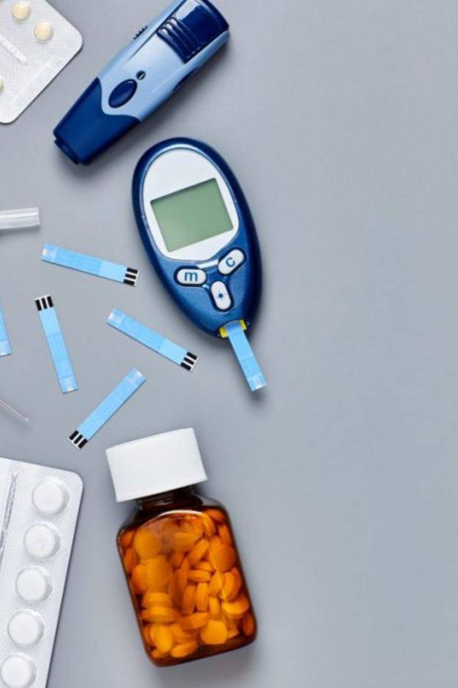


Diabetes in children
Name: Noor Alhuda Ibrahim Boud
Roll number: 3522
Academic year: First year
Block: PTS
Date: 18/5/2022

Slide 2
Objectives:
1- Define diabetes and list types of diabetes.
2- Outline the causes of diabete in children and symptoms.
3- Discuss the complications of diabetes.
4- Discuss the diagnosis of diabetes.

Slide 3

Diabetes:
mellitus is a group of metabolic disease characterized by long-term hyperglycemia caused by insulin secretion, insulin action, or both.
Types of diabetes:
Type 1
Type 2
Gestational Diabetes.

Slide 4
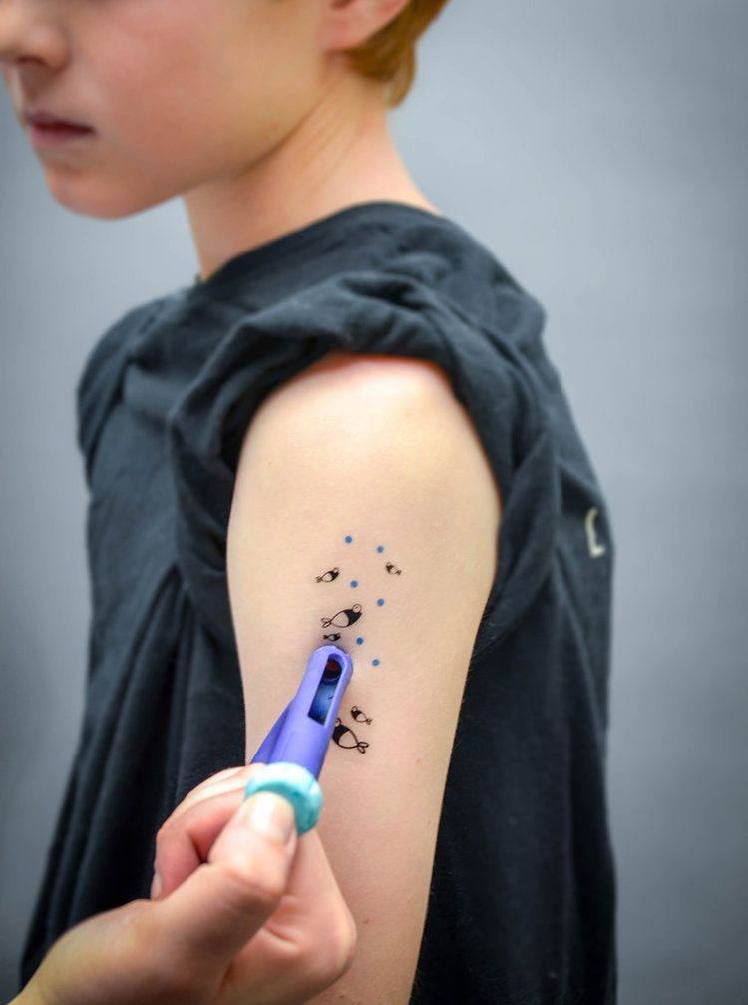
Causes:
1- Auto immune reaction
β-cell destruction which leads to absolute insulin deficiency
2- Certain genes

Slide 5
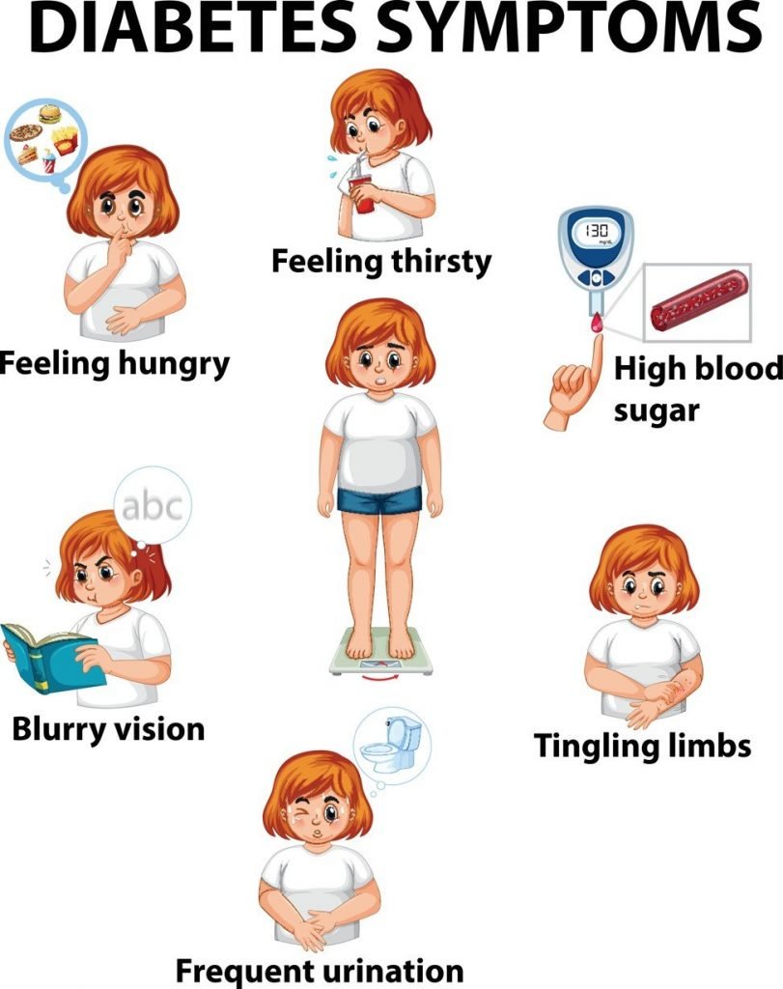
Symptoms:
Increased thirst and urination.
Increased hunger.
Blurry vision.
Numbness in the feet or hands.
Cuts that are slow to heal.
Unexplained weight loss.

Slide 6
Complications:
Sores and infections can develop on the feet and skin.
Blood pressure and cholesterol control may be more difficult if you have diabetes.
Diabetes might cause your immune system to deteriorate.
You can have issues digesting your food.
The body's nerves might be injured.
Increases the risk of bone diseases.
Vision problems.
Kidney damage.

Slide 7
Diagnosis:
HbA1c ≥ 6.5 % (≥ 48 mmol/mol).
Random plasma glucose ≥ 200 mg/dl (≥ 11.1 mmol/l).
Fasting plasma glucose ≥ 126 mg/dl (≥ 7.0 mmol/dl).
OGTT 2‑hour glucose in venous plasma ≥ 200 mg/dl (≥ 11.1 mmol/l).

Slide 8
Conclusion:
Diabetes is a growing health problem and people are required to lock after themselves most of the time.
People with diabetes need good support and education to self manage their condition well and this should include facts about healthy eating, exercise, diabetes monitoring, taking diabetes medication, problem solving with diabetes and health coping.
It is valuable to recognize for diagnosis, management and treatment.

Slide 9
References:
[Intern] D1wqtxts1xzle7.cloudfront.net. 2022 [cited 17 May 2022]. Available from: https://d1wqtxts1xzle7.cloudfront.net/48916558/Definition_epidemiology_and_classificati20160917-14131-1fzbbru-with-cover-page-v2.pdf?Expires=1652818887&Signature=ReKb05bqcXmvDlr8Zzho4i0tCLfZ~0GFocotvWHl7X70iSVm2Ntfl35iSgv8s2bjVPYiU4oJJ3iSzd3FcZeA0LOH1prjsIRi597twuQG2u7ZO-2GM16Qp4COkuautzmN6-3whO6QOA-L3Q9G6JcgrqIoMelSdUEv8w42Np0~PsUvwQShraGK-dsLQhY9f-ESPL9F6RO40bwQcct3mvCBxWsHhR02ixCgVF9DBS2~uZYnw6HOHgMo3x6JsWKsAYBBhJ4Wl3xIt8SgDvEvVYNC2r3I~4SbYIxKGpDA9OqwsZMVjZYh~JbGSnqO~cQ-zYxuj40pxgtkSciI08BmX7lBJA__&Key-Pair-Id=APKAJLOHF5GGSLRBV4ZA
Type 1 Diabetes - Symptoms | ADA [Internet]. Diabetes.org. 2022 [cited 17 May 2022]. Available from: https://www.diabetes.org/diabetes/type-1/symptoms
Topics H. Diabetes Complications | MedlinePlus [Internet]. Medlineplus.gov. 2022 [cited 17 May 2022]. Available from: https://medlineplus.gov/diabetescomplications.html
Diagnosis of Diabetes | NEJM [Internet]. New England Journal of Medicine. 2022 [cited 17 May 2022]. Available from: https://www.nejm.org/doi/full/10.1056/NEJMcp1103643

Slide 10
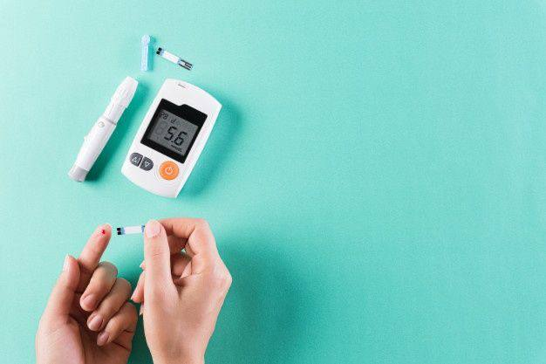
Thank you

