Slide 1


LIBYAN INTERNATIONAL MEDICAL UNIVERSITY
FACULTY of BUSINESS ADMINISTRATION
Political Ideology
NAME : Ali Bubaker
ID NUMBER : 3329

Slide 2
Table of Contents
01
02
03
04
DEFINITION OF POLITICAL IDEOLOGY
THE 4 POLITICAL IDEOLOGIES
WHY DO WE STUDY POLITICAL IDEOLOGY?
CONCLUSION

Slide 3
WHAT IS POLITICAL IDEOLOGY?
Political ideology is a set of ideas, beliefs, values, and opinions, exhibiting a recurring pattern, that competes deliberately as well as unintentionally over providing plans of action for public policy making in an attempt to justify, explain, contest, or change the social and political arrangements.

Slide 4
THE 4 POLITICAL IDEOLOGIES
Beyond the simple left–right analysis, Liberalism, Conservatism, Libertarianism and Populism are the four most common ideologies in the united states, apart from those who identify as moderate.

Slide 5
WHY DO WE STUDY POLITICAL IDEOLOGY?
Ideologies are important because they shape how we perceive and interact with the world. In politics, they affect the voting choices we make and the policies we support. Define fundamentalism

Slide 6
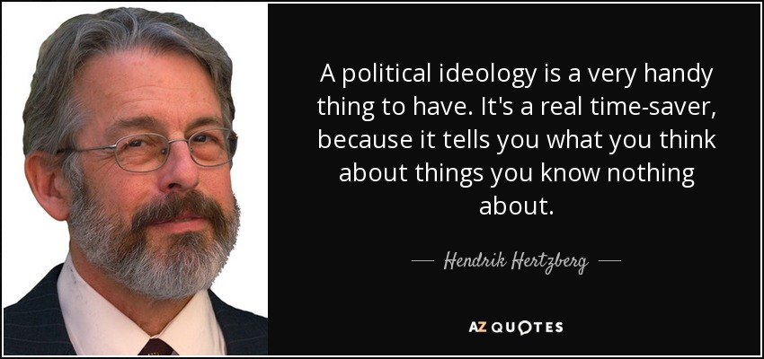
—Someone Famous
“This is a quote, words full of wisdom that someone important said and can make the reader get inspired.”

Slide 7
CONCLUSION
Ideology is about an idea that has the bases of economic and political theories
People have these ideas usually from there culture or traditions
Nowadays they don’t use idealism because people don’t concentrate on old traditions anymore.

Slide 8
REFRENCES
Zabady, M. (n.d.). Ideology. Retrieved November 03, 2021, from https://www.britannica.com/topic/ideology-society

Slide 9
Thanks!
Do you have any questions?

