Slide 1


Mental crisis in adolescents
1
Name:Saad Altawel
Role no: 2849
Date:4th/ April/ 2022
Block: PTS

Slide 2
Objectives
List types of mental illness.
Outline causes of mental illness.
Diagnostic criteria of mental illness.
Outline the complications of mental illness.
Management of mental illness.
2
.
.
.
.
.

Slide 3
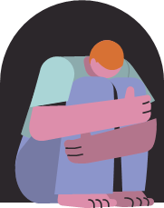
Introduction
3
Notes:
. Mental health disorders in adolescence are a significant problem,
relatively common, and amenable to treatment or intervention.
The doctors see that adolescent patients are highly likely to be seen with one or more mental health disorder;
Some of these disorders may interfere with a patient’s ability to understand or articulate their health concerns and seek for treatment.

Slide 4
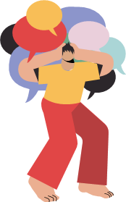
What are the common types of mental diseases in adolescent ?
4

Slide 5
Common types
ADHD
Anxiety
Behavior disorders
Depression
5
Mood changes
Notes:
Anxiety Disorders: the most common type are GAD
GAD= ): Excessive anxiety and worry about a number of events or activities.
mood disorders, Adjustment Disorder With Depressed Mood: The development of emotional or behavioral symptoms in response to an identifiable stressor(s) low mood, tearfulness, or feelings of hopelessness are predominant.
ADHD, Attention Deficit Hyperactivity Disorder -Symptoms of inattention and hyperactivity for at least 6 months to a degree that is inconsistent with developmental level
Depression or Major Depressive Disorder (MDD): A period of at least 2 weeks during which there is either depressed mood or the loss of interest or pleasure in nearly all activities.
and behavior disorders. Repetitive and persistent pattern of behavior that violates the basic rights of others or the age-appropriate societal norms, including aggression to people and animals, destruction

Slide 6
Causes
6
Biological factors
Environmental factors
1
Genetic
1
Psychological trauma
2
Brain injury
2
Unsafe living conditions
3
Infection/diseases
3
Cultural/ social expectation
4
Prenatal damage
4
Natural disasters
5
Substance abuse
5
Early loss of family
6
Bullying
Notes:
Biological factors refer to anything physical that can cause an adverse effect on a person’s mental health.
Genes can be responsible for abnormalities in an adolescent’s development
Genes may influence one’s susceptibility (or vulnerability) to depression, anxiety, personality, and/or substance abuse disorders. Children and adolescents who have a first-degree relative with mental illness (i.e. – depression, anxiety, PTSD) are at a higher risk for the development of their own mental health disorder(s).
SUBSTANCE ABUSE
Any substance abuse, especially long-term use and abuse, can cause the development of mental illness

Slide 7
ESTIMATES
7
-2019 .
-Globally .
-1 in 7 mental disorder.
-166 million .
-Females
-77 million
-Males
-89 million
Notes:
Stat by the UNICEF globally in 2019
46% female
54%male

Slide 8
Diagnosis
Memory difficulties
Personality changes
Loss of interest
Physical aches
Sleep problems
Suicidal thinking
8

Slide 9
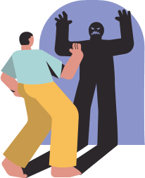
Complications
9
Unhappiness and decreased enjoyment of life.
Relationship and Social difficulties.
Problems with tobacco, alcohol and other drugs.
Poverty and homelessness.
Weakened immune system.
Heart disease and other medical conditions.
Self-harm and harm to others, including suicide or homicide.
Notes:
Immune reaction: so your body has a hard time resisting infections.

Slide 10
Management
Herbal treatment
Talk therapy
Psychopharmacolgic agents
10
Notes:
Treatment depends on severity (mostly the treatment is by psychopharmacological agents and center therapies

Slide 11
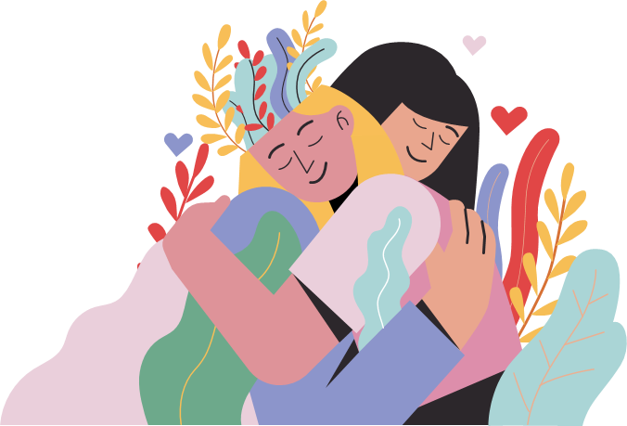
Prevention
11
Pay attention to warning signs.
Get routine medical care.
Get help when you need it.
Take good care of yourself.
Notes:
There's no sure way to prevent mental illness. However, if you have a mental illness, taking steps to control stress, to increase your resilience and to boost low self-esteem
. Work with your doctor or therapist to learn what might trigger your symptoms
Don't neglect checkups or skip visits to your primary care provider, especially if you aren't feeling well.
. Mental health conditions can be harder to treat if you wait until symptoms get bad
-Sufficient sleep, healthy eating and regular physical activity are important. Try to maintain a regular schedule.

Slide 12
—DWAYNE”THE ROCK”JOHNSON
12
“WITH DEPRESSION, ONE OF THE MOST IMPORTANT THINGS YOU COULD REALIZE IS THAT YOUR’E NOT ALONE…
YOUR’E NOT THE FIRST ONE TO GO THROGH IT;
YOUR’E NOT GOING TO BE THE LAST ONE TO GO THROUGH IT.”

Slide 13
Conclusions
13
A mental illness can make you miserable and can cause problems in your daily life, such as at school or work or in relationships. In most cases, symptoms can be managed with a combination of medications and talk therapy (psychotherapy).
Notes:
: If your loved one shows signs of mental illness, have an open and honest discussion with them about your concerns. You may not be able to force someone to get professional care, but you can offer encouragement and support

Slide 14
References
14
Mental Health Disorders in Adolescents. (2022). Retrieved 28 March 2022, from https://www.acog.org/clinical/clinical-guidance/committee-opinion/articles/2017/07/mental-health-disorders-in-adolescents#:~:text=The%20most%20common%20mental%20illnesses,people%20aged%2015%E2%80%9324%20years.
Mental Health Disorders in Adolescents. (2022). Retrieved 28 March 2022, from https://www.acog.org/clinical/clinical-guidance/committee-opinion/articles/2017/07/mental-health-disorders-in-adolescents#:~:text=The%20most%20common%20mental%20illnesses,people%20aged%2015%E2%80%9324%20years.
Center, P. (2022). Retrieved 28 March 2022, from https://polaristeen.com/articles/what-causes-mental-illness-adolescence/
Mental illness - Symptoms and causes. (2022). Retrieved 28 March 2022, from https://www.mayoclinic.org/diseases-conditions/mental-illness/symptoms-causes/syc-20374968

Slide 15
15
Thanks!
Any question?!

