Slide 1


Libyan International Medical University Faculty of Business Administration
Management of Healthcare Institutions
Health Insurance System
By: Sondos Almghrbi 2683
Majdouleen Elabbar 2296
Alaa Elmahgoub 1993

Slide 2
Contents
What is Health Insurance?
Types of Health Insurance
Benefits of Health Insurance
How to Choose Health Insurance Plan?
The pros and cons of Health Insurance
Cons of Health Insurance
Health care in Canada:
Access our universal health care system
Conclusion
Reference

Slide 3
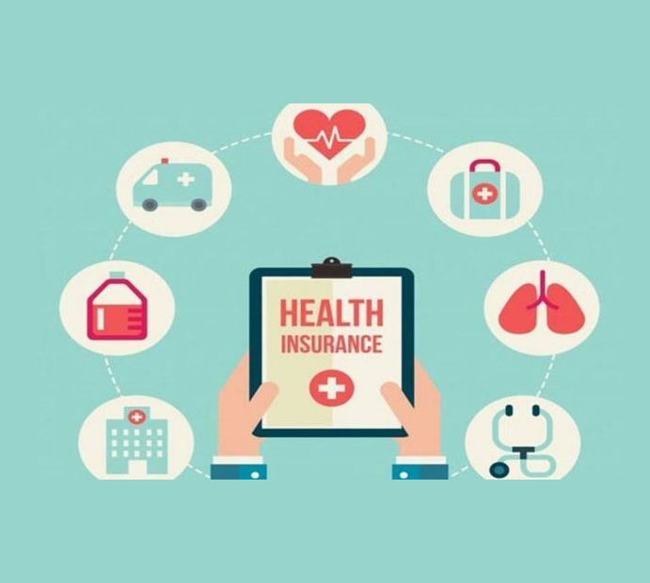
What is Health Insurance?
Health insurance is an insurance product which covers medical and surgical expenses of an insured individual. It reimburses the expenses incurred due to illness or injury or pays the care provider of the insured individual directly.

Slide 4




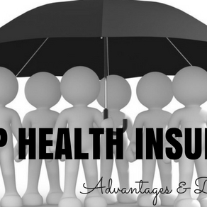
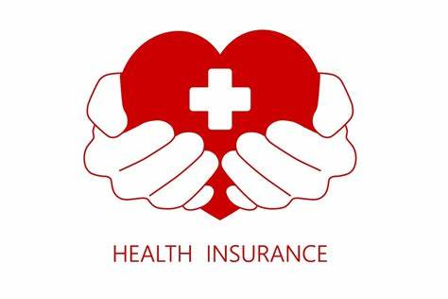
Types of Health Insurance
1.Individual Health Insurance
2.Family Floater Health Insurance
3. Senior Citizens Health Insurance
4. Critical Illness Insurance
5. Group Health Insurance

Slide 5
Benefits of Health Insurance
Purchasing health insurance is crucial for a number of reasons. Let's take a look at the most important benefits of our health insurance policies:

Slide 6
How to Choose Health Insurance Plan?
1. Check the Sum Insured
2. Scout the Network Hospitals
3. Check the Fine Print
4. Look for Additional Benefits
5. Examine the Exclusions and Other Clauses

Slide 7
The pros and cons of Health Insurance
Pros of health Insurance
1. Keeps You Financially Protected
2. Availability of Options
3. Cashless Hospitalization
4. No Claim Bonus (NCB)
5. Availability of Add-Ons or Riders
6. Peace of Mind

Slide 8
Cons of Health Insurance
1. Premium Increases with Age
2. Waiting Period for Existing Health Problems
4 .The Bottom Line
3. Co-Pay Clause

Slide 9

Health care in Canada: Access our universal health care system
Canada has a universal health care system funded through taxes. This means that any Canadian citizen or permanent resident can apply for public health insurance.
Each province and territory has a different health plan that covers different services and products. There are some important differences between each plan so make sure you know what your plan covers.
Once your province or territory adds you to their health system, you’ll get a health card. Show this card at hospitals or medical clinics to get non-emergency services.

Slide 10
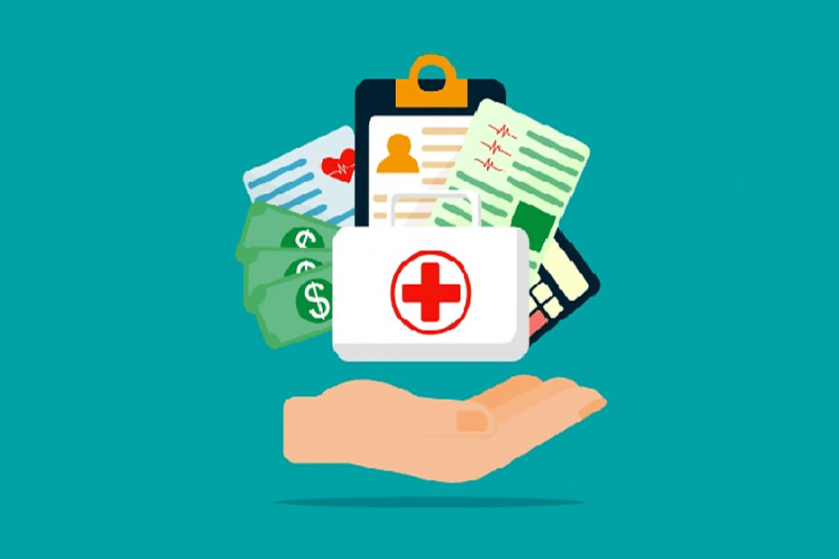
Conclusion
Conclusions The whole family can be affected by any member's lack of insurance. If anyone in the family is uninsured, the financial and emotional well-being of the entire unit is at risk, as well as the health of those who are uninsured. Employment-based and public insurance programs leave gaps in coverage for many families.

Slide 11
Reference
Astran, J., & Astran, J. (2021, May 11). Pros and Cons of Health Insurance. HealthMed.org. https://healthmed.org/pros-and-cons-of-health-insurance/#:~:text=Pros%20and%20Cons%20of%20Health%20Insurance%201%201
What is Health Insurance? - Meaning and Types | HDFC
Life

Slide 12
Thank you

