Slide 1


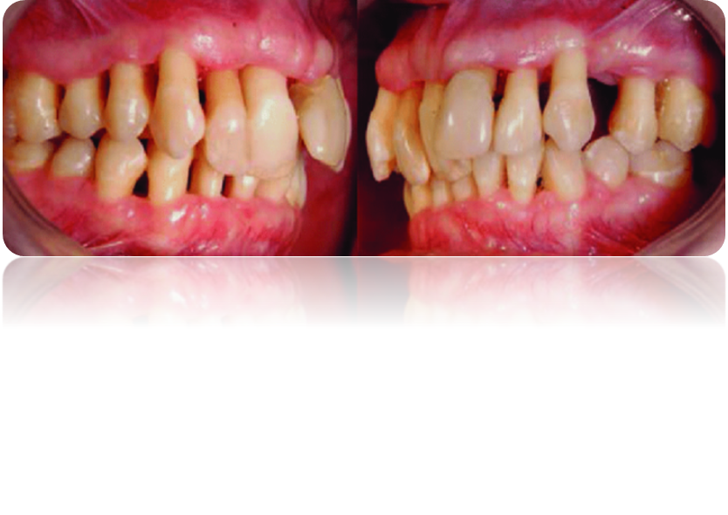
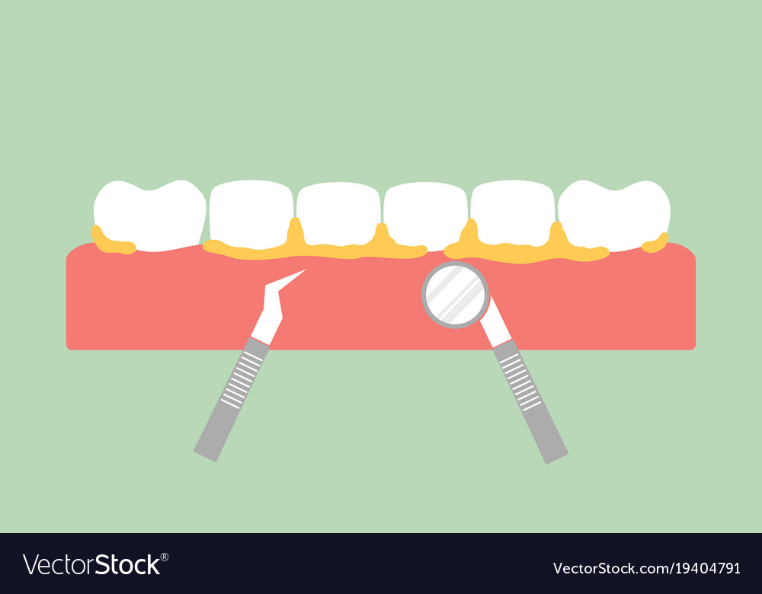
AGGRESSIVE PERIODONTITIS
Presented by :Abdullah ibraheem
Student ID : 2435
Block :PTS
Date :2022/5/10
1

Slide 2
objectives
01
02
03
Define aggressive periodontitis
Describe common findings of disease
Discus Classfecation of aggressive periodontitis
2

Slide 3
01
definition
3

Slide 4
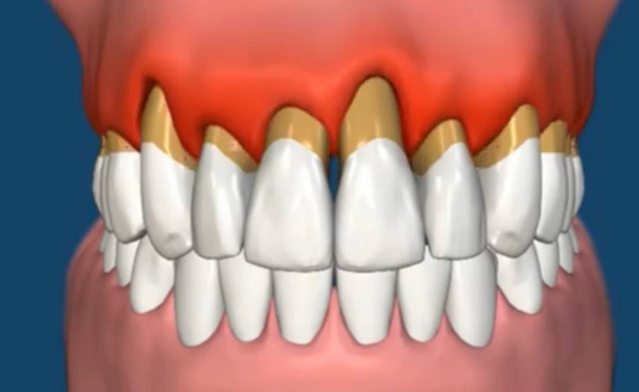
Define aggressive periodontitis
Aggressive periodontitis is a destructive disease characterized by the involvement of multiple teeth with a distinctive pattern of periodontal tissue loss; a high rate of disease progression; an early age of onset; and the absence of systemic diseases
4

Slide 5
common findings of disease
02
5

Slide 6
COMMON FINDINGS:
Patient otherwise clinically healthy, usually < 30 years
Characterized by rapid bone &attachment loss
Absence of large amounts of plaque & calculus
Family history – genetic trait
6

Slide 7
OTHER FINDINGS
Host response abnormalities (phagocytosis, chemotaxis)
Hyperactive macrophages
Produce excess amounts of prostaglandins, interleukin – 1
Disease may be self-arresting
7

Slide 8
Classification of aggressive periodontitis
03
8

Slide 9
CLASSIFICATION OF AGGRESSIVE PERIODONTITIS
Localised Aggressive Periodontitis
Generalised Aggressive Periodontitis
9

Slide 10
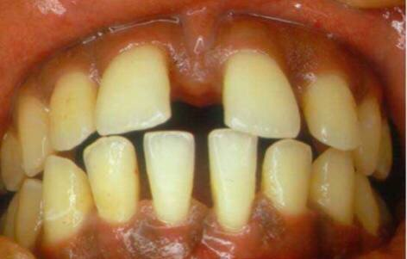
CLINICAL FEATURES OF LAP
Maxillary incisors migrate in distolabial migration – diastema
Increasing mobility of affected teeth
Periodontal abscess formation
Sensitive root surface
10

Slide 11
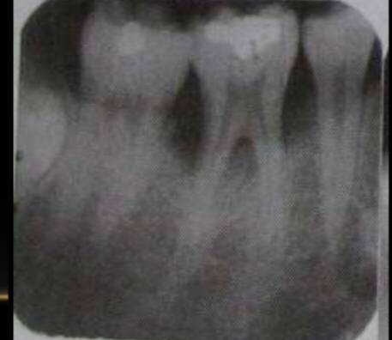
RADIOGRAPHIC FINDINGS
Vertical bone loss :
Usually bilateral affecting first permanent molars & incisors
Vertical loss of bone in an “arc-shape” extending from the distal of the 2nd premolar to the mesial of the 1st molar
11

Slide 12
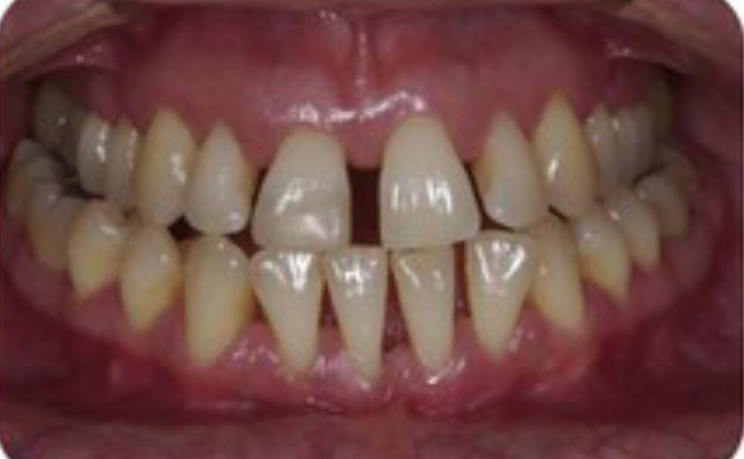
GENERALIZED AGGRESSIVE PERIODONTITIS
12

Slide 13
CLINICAL FEATURES OF GAP
Usually affects persons 30 years & younger but can affect older persons
Bone & attachment loss affects at least 3 teeth other than first molars & incisors
Episodic nature to disease Periods of inactivity
13

Slide 14
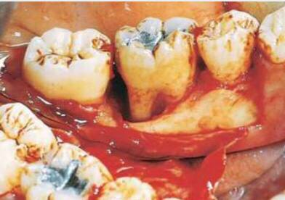
CLINICAL FEATURES OF GAP Destructive phase:
Tissue appears severely inflamed, ulcerated & red
Bleeding with or without stimulation
Suppuration
Active attachment & bone loss
14

Slide 15
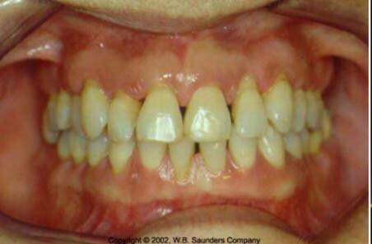
CLINICAL FEATURES OF GAP
Non-destructive phase
Tissues appear pink with some stippling
Lack of inflammation
Probing will reveal deep pockets
Bone & attachment levels relatively stable
15

Slide 16
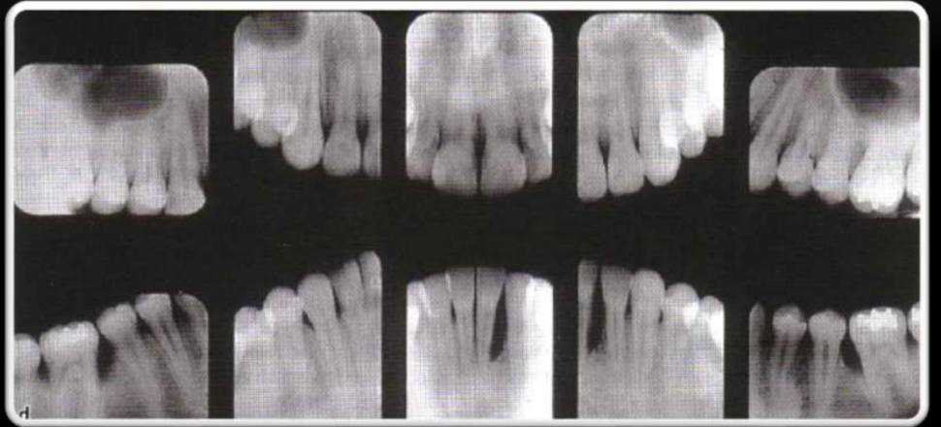
RADIOGRAPHIC FEATURES OF GAP
Majority of teeth affected by advanced bone loss
16

Slide 17
Conclusion
1. – AP is characterized by multiple periodontal tissue loss
2 - It can be related to age or to genetic causes
3 –it can be classified to generalized and localized
4 –LAP can cause sensitive root surface and abscess formation
5 – GAP affect elderly and causes Bone and attachment loss
17

Slide 18
References
Niemiec, B. A. (2008). Periodontal disease. common findings of aggressive periodontitis , 23(2), 72-80.‏
Genco, R. J., & Borgnakke, W. S. (2013). Classification of aggressive periodontitis
. Periodontology 2000, 62(1), 59-94.‏
18

Slide 19
THANK YOU

