Slide 1



Types of Knowledge
Libyan International Medical University
Faculty of Business Administration
Abdullah Abdalsalam 2104

Slide 2
Table of Contents
01
02
03
What is Knowledge
The Types
7 Types of Knowledge
04
05
Conclusion
Reference

Slide 3

What is Knowledge
Your entire organization is built upon knowledge. Knowledge is acquired, transferred, and put into practice in all your company processes – marketing products or services, hiring new employees, participating in daily meetings, etc. This is why knowledge management is critical to an organizations’ success.

Slide 4
7 Types of Knowledge
1- Explicit knowledge
2- Implicit knowledge
3- Tacit knowledge
4- Declarative knowledge
5- Procedural knowledge
6- A priori knowledge
7- A posteriori knowledge

Slide 5

The Types
03

Slide 6

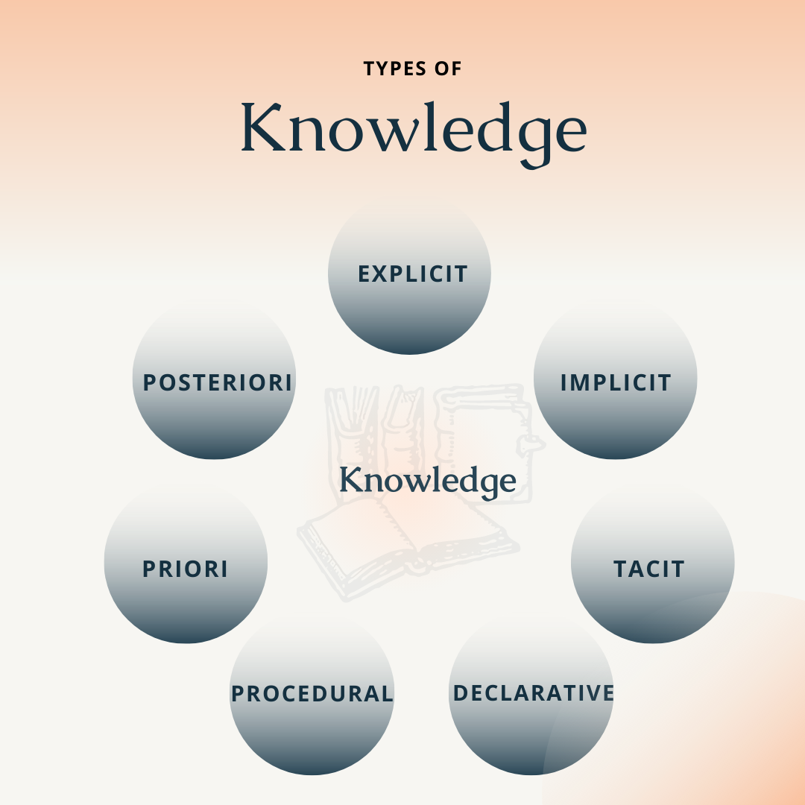

Slide 7
1. Explicit knowledge
Explicit knowledge can be documented, transmitted, and most importantly, learned by outsiders. It’s any information that’s easy to share and understand.
2. Implicit knowledge
Implicit knowledge is a more complex concept and is gained through real-life experience.
3. Tacit knowledge
Tacit knowledge is also achieved through experience, but how is it different from implicit knowledge

Slide 8
4. Declarative knowledge
Declarative knowledge refers to facts that are static in nature. It can be information based on principles, concepts, events, etc. It’s also called descriptive or propositional knowledge.
5. Procedural knowledge
Also known as imperative knowledge, procedural knowledge is the opposite of declarative knowledge.
6. A priori knowledge
Next comes two more opposite knowledge concepts: a priori knowledge and a posteriori knowledge.

Slide 9
7.posteriori knowledge Contrary to a priori knowledge, a posteriori knowledge is derived from experience. The knowledge can be reasoned and logically explained only after an individual has observed a certain event. ficiaries

Slide 10
Conclusion
The differences in various types of knowledge, you can’t identify knowledge gaps that exist within your organization.

Slide 11
Reference
References
7 Types of Knowledge: Explicit, Implicit, Tacit, & More | Whatfix. (2022). Retrieved 5 April 2022, from https://whatfix.com/blog/types-of-knowledge/

Slide 12

THANK YOU

