Slide 1
Cirrhosis of the Liver
Dr .Nadia Zawi
Gastroenterology
BMC

Slide 2
objectives
1-Physiological background of the liver .
2-Description and definition of cirrhosis.
3-Specific causes, clinical picture of cirrhosis .
4- Evaluation of cirrhosis.
5 - the most common complications, and their management .

Slide 3
FUNCTIONS OF THE LIVER
Regulating blood glucose level by making glycogen, which is stored in hepatocytes.
Synthesizing blood glucose from amino acids of lactate through gluconeogenesis.
Converting ammonia produced from gluconeogenetic by-products and bacteria to urea.
Synthesizing plasma proteins such as albumin, globulins, clotting factors, and lipoproteins.
Breaking down fatty acids into ketone bodies.
Storing vitamins and trace metals.
Affecting drug metabolism and detoxification.
Secreting bile.
Notes:
3

Slide 4
Definition of cirrhosis
Is a chronic disease characterized by scaring and necrotic tissue replaced by fibrotic tissue . Resulting in hepatic insufficiency and portal hypertension

Slide 5
causes
1- Chronic alcoholic abuse.
2- Non alcoholic steatohepatitis.
3- Chronic viral infection(HBV,HCV).
4- Autoimmune : BPS .PSC,AIH.
5- Genetic disorders:
heamochromatosis, alfa 1 antitrypsine deficiency,wilsons disease.
6- Buddchiari syndrome.
7- Drugs:
amiodarome , methyldopa, methotrexate.

Slide 6
Clinical Manifestations
Onset usually insidious
GI disturbances:
Anorexia
Dyspepsia
Flatulence
N-V, change in bowel habits
Abdominal pain.
Fever
Lassitude (laziness)
Weight loss
Fetor hepaticus
Jaundice
Asterixis
Parotid gland enlargement
Hepatomegaly
Splenomegaly
Caput medusa

Slide 7
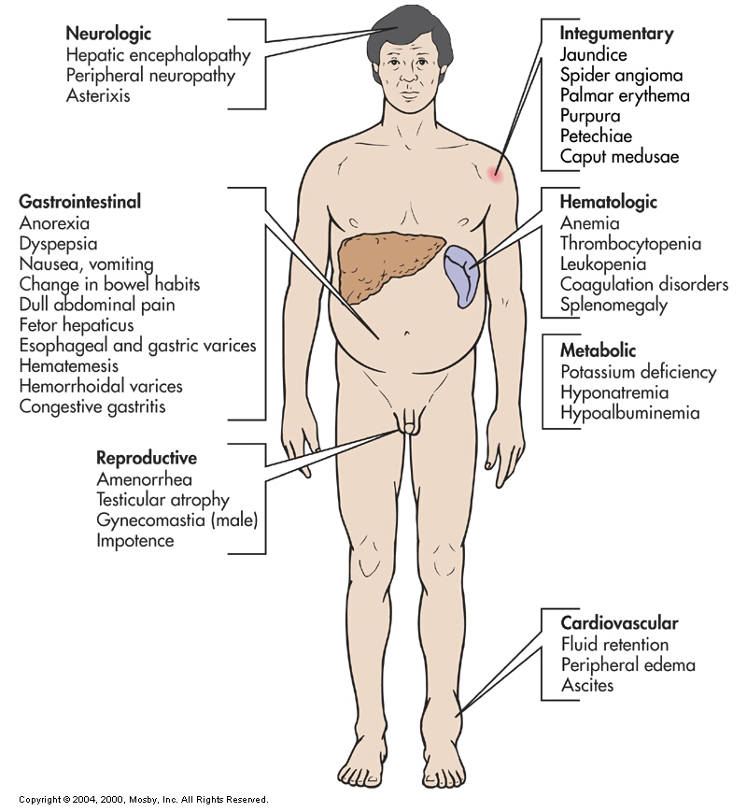
Clinical manifestation of liver cirrhosis

Slide 8
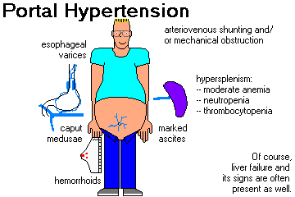

Slide 9
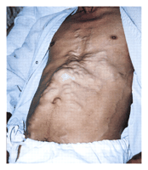

Slide 10
Laboratory Studies
most common measured laboratory test classified as LFTs include
the enzyme tests (principally the serum aminotransferases (AST &ALT), alkaline phosphatase, and gamma glutamyl transpeptidase), the serum bilirubin
tests of synthetic function
(principally the serum albumin concentration and prothrombin time)

Slide 11
Radiologic Modalities
to detect complications of cirrhosis.
Can occasionally suggest the presence of cirrhosis:-
Uss.
Ct scan.
Fibroscan is more sensitive in detecting the degree of fibrosis , eves if uss was normal.
Esophagoscopy to assess varices

Slide 12
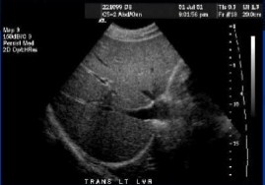
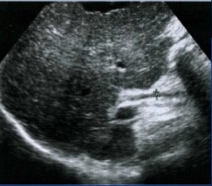
Normal liver
Cirrhotic liver

Slide 13
Liver biopsy
Sensitivity of a liver biopsy for cirrhosis is in the range of 80 to 100.
not necessary if the clinical, laboratory, and radiologic data strongly suggest the presence of cirrhosis.
liver biopsy can reveal the underlying cause of cirrhosis.

Slide 14
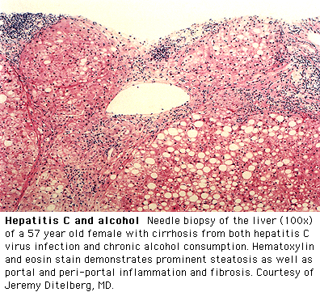

Slide 15
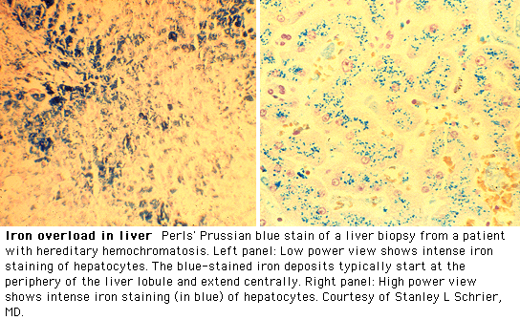

Slide 16
Evaluation of Cirrhosis
No treatment can reverse cirrhosis, or ensure that no further progression occurs.
Medical therapy improve general health and alleviate symptoms .
The main objectives are to
1-Detect treatable causes.
2-Prevent and correct malnutrition.
3- Treat complications.
a specific etiology can usually be determined by the history combined with serologic and histologic evaluation

Slide 17
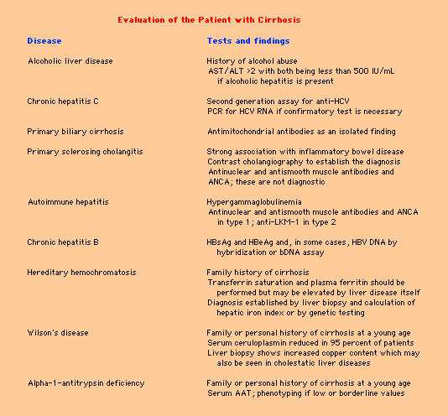

Slide 18
Evaluation of Cirrhosis
Stop alcohol and toxic drugs.
Correct nutritional status by vitamins, nutritional supplements high calorie and low protein.
Treat ascities and fluid over load.
Treatment of other problems associated with liver failure such as anti emetic , lactulose, and streptomycin for hepatic encephalopathy.
esophageal varices.
Liver transplantation .

Slide 19
Regular follow up
Clinical +LFT+CBC every 3 months.
US + AFP 6 months.
Upper Endoscopy 1-2 years.
General check up every year.
(Bl. sugar, KFT, Urine, etc)

Slide 20
Complications of liver cirrhosis
Ascites
Spontaneous Bacterial Peritonitis
Hepatorenal syndrome
Variceal hemorrhage
Hepatopulmonary syndrome
Other Pulmonary syndromes
Hepatic hydrothorax
Portopulmonary HTN
Hepatic Encephalopathy
Hepatocellular carcinoma

Slide 21
Ascites
Accumulation of fluid within the peritoneal cavity, as a result of portal HTN .
Most common complication of cirrhosis .
Other causes of ascites:-
heart failure
renal failure
pancreatic disease
tuberculosis.
cancer .
Hypothyroidism .

Slide 22
Management of ascites
Aim is to relieve dicomfort , or detect other causes.
Assess liver function.
Evaluation of renal and CVS function.
Ascitic fluid analysis.
Imaging study which include:
Ultrasound with Dopplers
Easily confirms ascites
May see nodularity of cirrhosis
Evaluate patency of vasculature
CT / MRI
Evaluation for malignancy

Slide 23
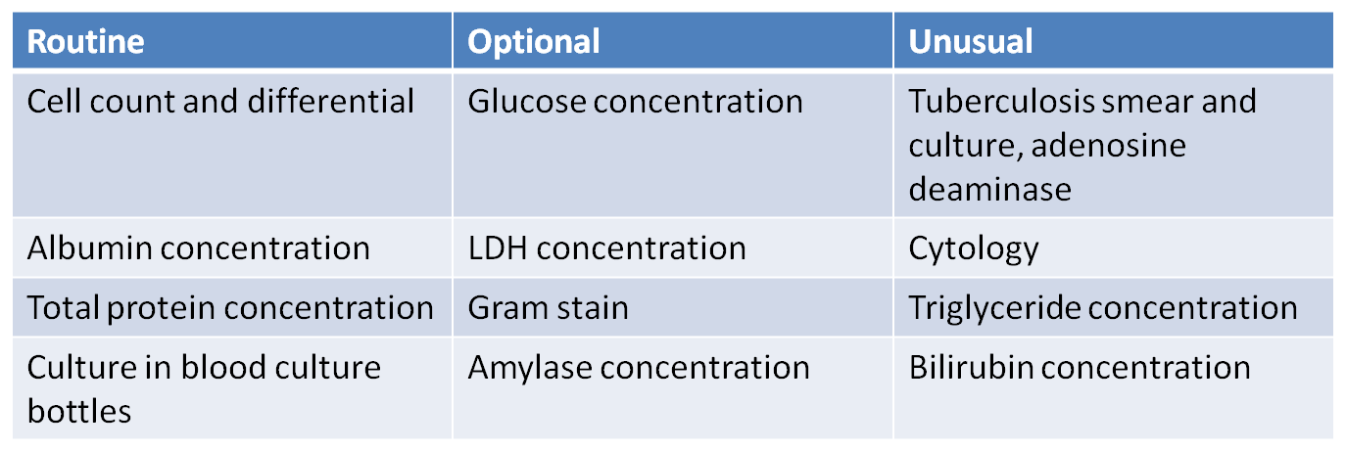
Ascitic fluid analysis

Slide 24
Cell count:
Greater than 250 PMN = Spontaneous bacterial peritonitis( SBP).
If ascites is bloody ( > 50,000 RBC/mm3).
bloody Non-traumatic ascitis → associated with malignancy.
Serum to Ascites Albumin Gradient:
it is superior to the exudate-transudate concept in the differential diagnosis of ascites.
(Serum albumin – ascitic albumin)
97% accurate
SAAG > 1.1 g/dL → Portal HTN
SAAG < 1.1 g/dL → Other causes

Slide 25
Total Protein.
( > 2.5 g/dL) : TB, malignancy , hepatic venous obstruction , pancreatic ascitis .
Glucose.
Infection and cancer consume glucose→low
LDH.
Ascitis/Serum LDH ratio
~ 0.4 in cirrhotic ascites
Approaches 1.0 in SBP
>1.0, usually infection or tumor

Slide 26
Amylase
Uncomplicated cirrhotic ascites
About 40 IU/L. The AF/S ratio is about 0.4
Pancreatic ascites
About 2000 IU/L. The AF/S ratio is about 6
Triglycerides
— run on milky fluid.
Chylous ascites - TG > 200 mg/dL, usually 1000 mg/dL
Bilirubin
— run on brown ascites.
Biliary perforation – AF Bili > serum Bili

Slide 27
Management of ascites
Initial therapy:
Na restriction( low salt diet).
Diuretics:
spironolactone (100-400mg)
Frusemide(40mg)
(stepwise increase as needed to maximal doses).
weight and assess abd girth .
Therapeutic paracentesis
Removing up to 5L appears safe.
No good data on role of volume expanders( iv human aibumin).
Peritoneovenous shunts.

Slide 28
Spontaneous Bacterial Peritonitis
Infection of ascitic fluid
Almost always seen in the setting of end-stage liver disease
The diagnosis is established by:-
A positive ascitic fluid bacterial culture ( Ecoli,klebsiell, strept)
Elevated ascitic fluid absolute polymorphonuclear leukocyte (PMN) count ( >250 cells/mm3).
Clinical manifestations:
Fever , Abdominal pain , Altered mental status.

Slide 29
Cefotaxime or tazocin are effective for 5 days or until sensitivies known.
Prophylactic norfloxacin 400mg is recommended for high risk patients
low albumin.
prolonged INR.
low ascitic albumin.
Previous episode of SBP.

Slide 30
Oesophageal varices
Tortuous, dilated and engorged oesophageal veins, seen along the longitudinal axis of oesophagus.
Elevated pressure in the portal venous system in liver cirrhosis.
Bypassing of portal venous blood from the liver to oesophageal venous plexus.
Manifested clinically by : haematemsis, melena , or fresh rectal bleeding .

Slide 31
Variceal hemorrhage
Occurs in 25 to 40 percent of patients with cirrhosis
Prophylactic measures( b.Blockers, nitrates) that redce portal vein pressure.
Screening EGD recommended for all cirrhotic patients.
Endoscopic band ligation is indicated for advanced or bleeding varices.
Injection of vasopressins.

Slide 32
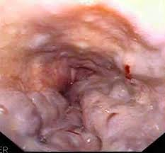
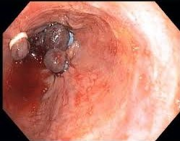
Oesophageal varices
Band ligation

Slide 33
prevention and treatment principles of variceal hemorrhage:
Prediction of patients at risk .
Prophylaxis against a first bleed .
Treatment of an active bleed .
Prevention of Rebleeding .
Risk factors for variceal bleeding :
1- pressure within the varix.
2- variceal size.
3- tension on the variceal wall.
4-severity of liver disease.

Slide 34
Hepatorenal syndrome
acute renal failure coupled with advanced hepatic disease (due to cirrhosis or less often metastatic tumor or severe alcoholic hepatitis) in absence of an identifiable cause of renal failure.
characterized by:
Oliguria
benign urine sediment
very low rate of sodium excretion
progressive rise in the plasma creatinine concentration( no improvement with treatment).

Slide 35
Hepatorenal syndrome
Reduction in GFR often clinically masked
No current use of Nephrotoxic agents confirms the diagnosis of HRS.
Prognosis is poor unless hepatic function improves.

Slide 36
Hepatic Hydrothorax
Pleural effusion in a patient with cirrhosis and no evidence of underlying cardiopulmonary disease
is usually right-sided
Diagnosis -pleural fluid analysis
reveals a transudative fluid
serum to fluid albumin gradient greater than 1.1
Treatment with :
Diuretics(frusemide).
Pleural fluid aspiration indicated if patient developed respiratory emparssement.

Slide 37
Hepatic Encephalopathy
Spectrum of potentially reversible neuropsychiatric abnormalities seen in patients with liver dysfunction
Diurnal sleep pattern pertubation
Asterixis
Hyperactive deep tendon reflexes
Transient decerebrate posturing

Slide 38
Hepatic Encephalopathy
Monitoring for events likely to precipitate HE [i.e.- variceal bleeding, infection (such as SBP), the administration of sedatives, hypokalemia, and hyponatremia]
Reduction of ammoniagenic substrates
Lactulose / lactitol
Dietary restriction of protein
Zinc and melatonin

Slide 39
Hepatocellular Carcinoma
Patients with cirrhosis have a markedly increased risk of developing hepatocellular carcinoma
Incidence in well compensated cirrhosis is approximately 3 percent per year
Symptoms are largely due to mass effect from the tumor
Pain, early satiety, obstructive jaundice, and a palpable mass
Serum AFP greater than 500 micrograms/l in a patient with cirrhosis are virtually diagnostic
Median survival following diagnosis is approximately 6 to 20 months

Slide 40
Treatment Options of liver cirrhosis SUMMARY
The major goals of treating the cirrhotic patient include:
Slowing or reversing the progression of liver disease directed to under lying cause.
Preventing superimposed insults to the liver.
Preventing and treating the complications.
Determining the appropriateness and optimal timing for liver transplantation .

Slide 41
Liver Transplantation
Liver transplantation is the definitive treatment for patients with decompensated cirrhosis
Depends upon the severity of disease, quality of life and the absence of contraindications

Slide 42
Thank you

