Slide 1
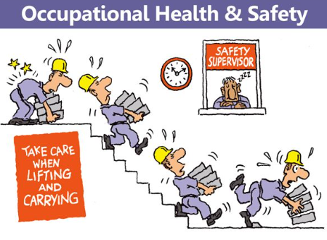
Occupational Health
By Dr. Nuha Boo Daboos, MD, MPH

Slide 2
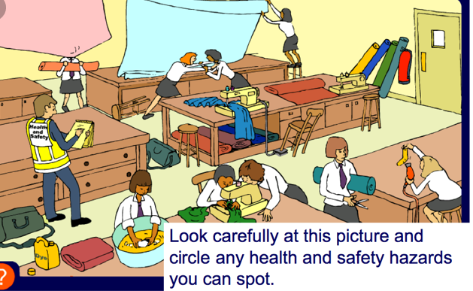
Contents:
Definitions
Types of occupational
hazards
Occupational diseases
Prevention of occupational
diseases

Slide 3
Occupational Health:
Is the promotion and maintenance of the highest degree of physical, mental and social well-being of workers in ALL occupations. WHO added 3 important points which are: 3 Ps
1- Prevention of health problems
2- Protection of workers from hazards in their occupations
3- Placing and maintenance of the workers in an occupational environment adapted to their physiological and psychological conditions.

Slide 4

Occupational safety: Means risk identification at the workplace and preventive measures taken to reduce the hazard’s effect.

Slide 5

Occupational disease: Any disease caused by exposure to agents at workplace environment

Slide 6


Occupational Hazards
1- Physical Hazards
  a) Heat and cold:
    Occupations: Firefighter, bakery workers and metal, petroleum industries, Also any job which require working at low temperature indoors or outdoors.
    Health effects: Heat syncope or stroke, peripheral vasoconstriction of skin vessels, hypothermia and death.
    Prevention and control: Proper selection of workers and use of PPE, control heat at source by using barriers or reflective devices.

Slide 7

b) Noise: Unwanted sounds with a frequency ranges between 3000- 10000Hz
Occupation: Steel Pipe factory, construction place,
Shipyard.
Assessment: Noise at workplace assessed by sound level meter and workers hearing loss is assessed by audiometry
Health effect: Acoustic trauma, difficulty of hearing and occupational deafness
Prevention: Pre-employment and periodic examination and reduction of exposure or use of PPE.

Slide 8
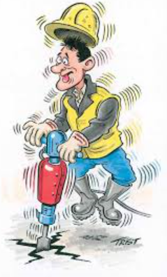

C) Vibration:
Occupation: Driver either tractor or transport workers, construction.
Health effect: headache, fatigue, lack of concentration, back pain. Also vascular changes that called Raynaud phenomenon of occupational origin

Slide 9

d) Pressure changes:
Occupation: Divers, frog man, submarine, pilots, mountain climbers.
Health effect: Decompression sickness (Caisson’s disease): At high pressure, some gases such as nitrogen get into the blood and when the pressure increase nitrogen bubbles are formed causing air embolism which might affect joints, muscles leading to severe pain and in severe condition leads to neurological and cardiovascular paralysis.
Prolonged exposure to high pressure leads to aseptic bone necrosis.

Slide 10
Pressure changes:
Acute mountain sickness: It includes nausea, vomiting, dizziness and insomnia.
High altitude pulmonary edema: Over inflation of lungs leads to pneumothorax and emphysema.
High attuite cerebral edema: Decreased O2 leads to increase blood flow to brain causing cerebral edema and increased intracranial pressure that may cause coma and death
Prevention: Periodic medical examination and proper selection of workers with training

Slide 11

e) Radiation:
Ionizing radiation: medical X-ray, radiation from TV, video display terminals.
Occupation: Radiologist, Uranium miners
Health effect: Acute radiation syndrome (high dose of radiation causes burning of internal organs leading to intestinal bleeding, diarrhea, dehydration and CNS damage and death), acute radiation dermatitis, cataract, sterility and genetic changes with fetal toxicity
Prevention:
Periodic medical examination, use PPE such as barriers and shields

Slide 12
Radiation:
Non-Ionizing: radiation: Light, light glare or contrast
Occupation: Miners, workers in dark places
Health effect: Eye strains, congestion headache can lead to miner’s nystagmus.
Other radiation such as ultraviolet, infrared, microwaves and laser
Health effect: Cataract and eye damage, testicular damage, skin burn, skin cancer such as basal cell carcinoma

Slide 13
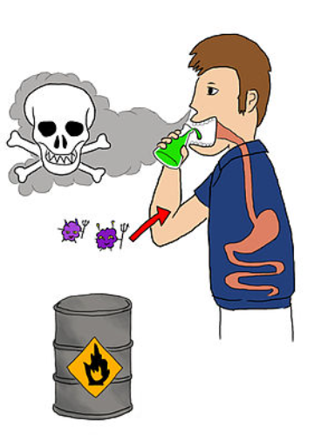
2- Chemical Hazards:
a) Gases and vapor:
Asphyxiant gases: CO, hydrogen sulfide
From oven and mines, sewers.
Health effect: Anemia and asphyxia
Irritant gases: Ammonia, Chlorine
from fertilizer manufacture, air pollution.
Health effect: irritation of skin and eye.
Toxic gases: Arsine
Health effect: hemolysis, anemia and jaundice
Smoke such as firefighter
Health effect: Cough, dyspnea, pulmonary edema

Slide 14
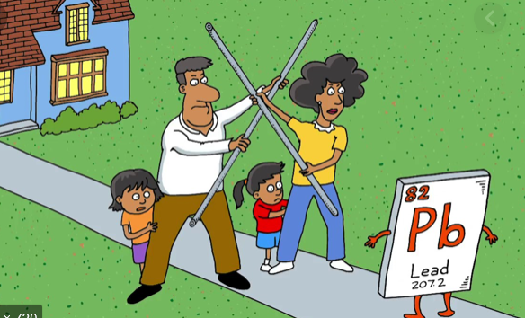
b) Metals:
Lead: From painting, pipe manufacture
Health effect: Blue line on gums, constipation, foot and wrest drop, encephalopathy.
Mercury: From manufacture of thermometer and manometer.
Health effect: Pneumonia, pulmonary edema with renal damage, tremor, psychosis
Zinc: Batteries manufacture
Health effect: Irritation of skin, dermatitis and bronchitis

Slide 15
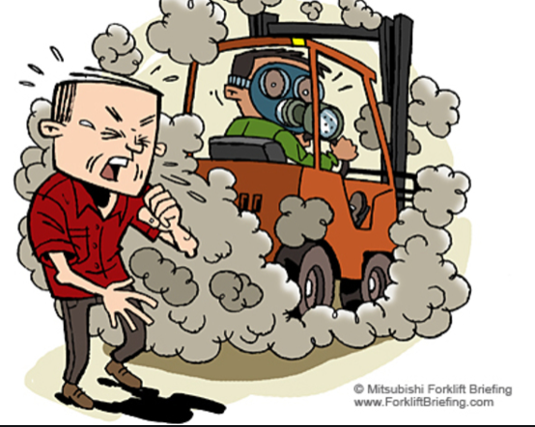
C) Dust:
Inorganic dust:
Coal dust: Coal mines cause anthracosis
Silica: Glass and soap industries cause silicosis
Asbestos: Asbestosis
Iron: Welding cause siderosis
Organic dust:
Cotton, cane, hay and tobacco cause: Byssinosis, Bagassosis, , farmers lung and tobacossis

Slide 16
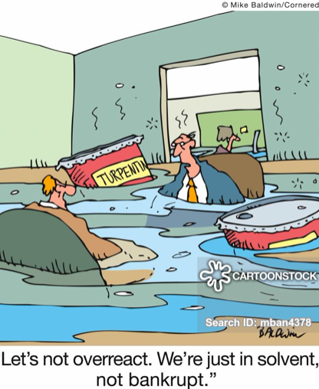
d) Solvent:
Hydrocarbon solvents, alcohol, benzene
Health effect: Cause headache, peripheral neuropathy, unconsciousness and death
Respiratory irritation and pulmonary edema, kidney failure, anemia, leukemia

Slide 17

3-Biological Hazards:
Farmers: Leptospirosis, schistosomiasis
Slaughterhouse workers: Q fever
Wool sorter, veterinarians: Anthrax
Health care worker: Hepatitis B, C and HIV

Slide 18

4) Mechanical Hazards:
Injury and accident
Causes of accident and injury:
Human factors:
Physical factors, physiological factors and psychosocial factors
Environmental factors:
General presence of hazards at workplace or unsafe machine or poor ergonomic

Slide 19

5- Psycho-social hazards:
Poor workers relationships, risky work, work pressure and long working hours all these factors can cause workers strikes and mass leave or reduction in production.

Slide 20
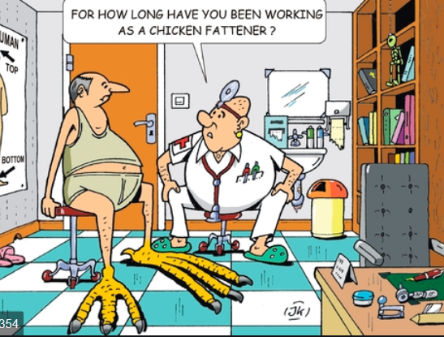
Occupational Diseases:
1- Skin cancer:
Worker exposed to UV radiation
2- Lung cancer:
Asbestos industry workers and nickel or chromium workers.
3- Bladder cancer:
Among rubber workers
4- Leukemia:
Among ionizing radiation workers or benzene products workers

Slide 21
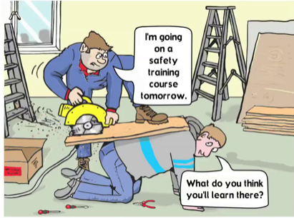
Preventive and control of occupational diseases:
1- Medical control measures: Pre-employment and periodic medical examination
2- Engineering measures: Place and design, good ventilation and housekeeping
3- Ergonomic applications: To prevent motor system disorders and accidents
4- Health education: Use of PPE

