Slide 1
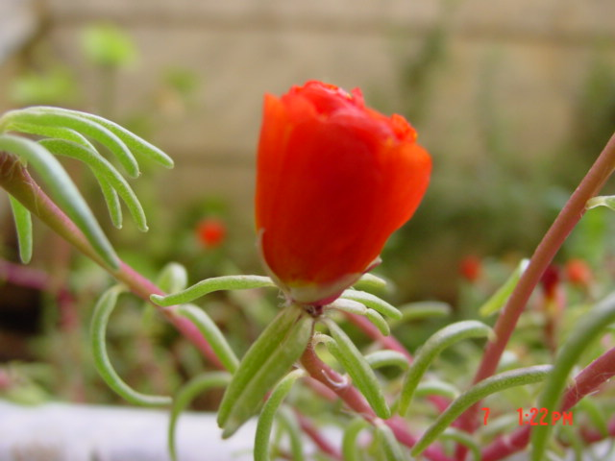


Slide 2
Slides for orbit and ocular tumours
Dr. Raja S. Bengharbia

Slide 3
THE ORBIT

Slide 4
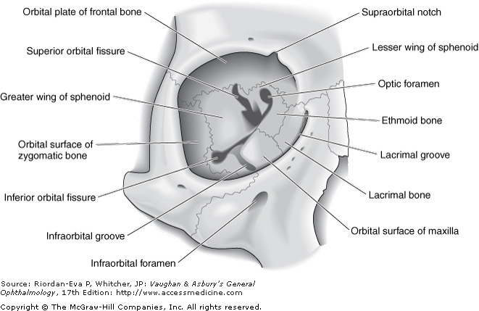

Slide 5
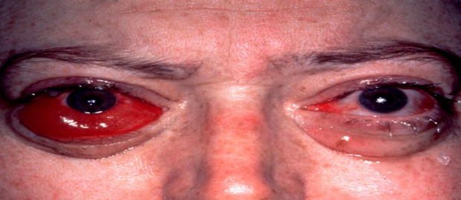
Thyroid eye disease (Graves disease )

Slide 6
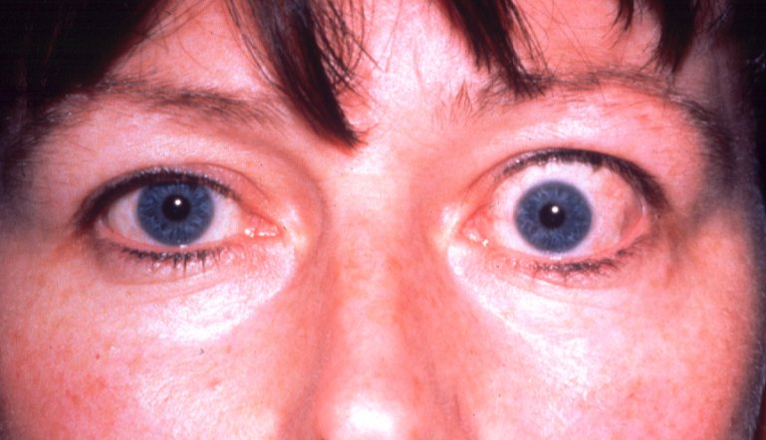
Axial proptosis

Slide 7
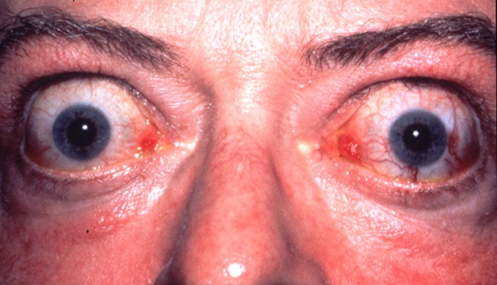

Slide 8
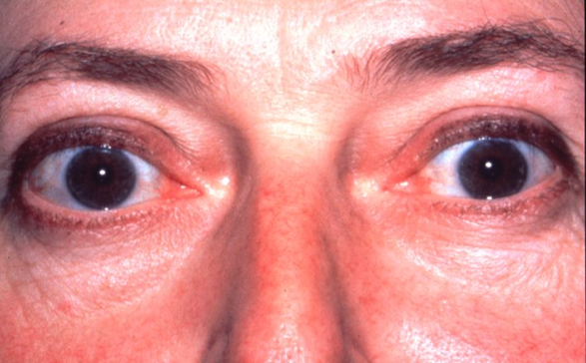
Bilateral lid retraction

Slide 9
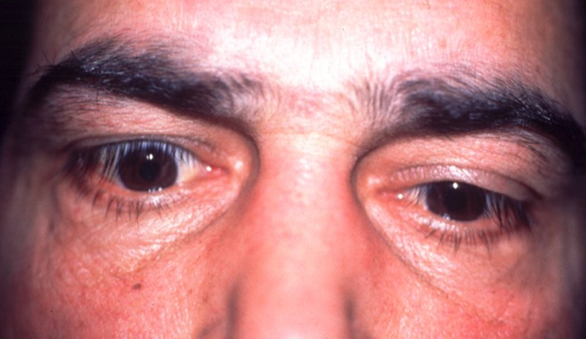
Lid lag

Slide 10
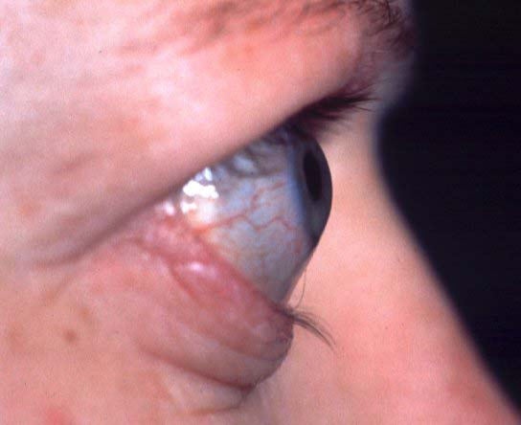
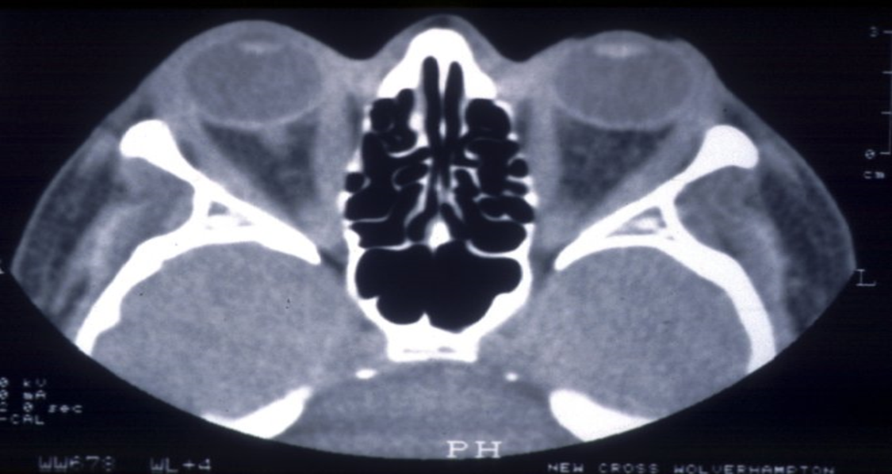
Proptosis +neuropathy

Slide 11
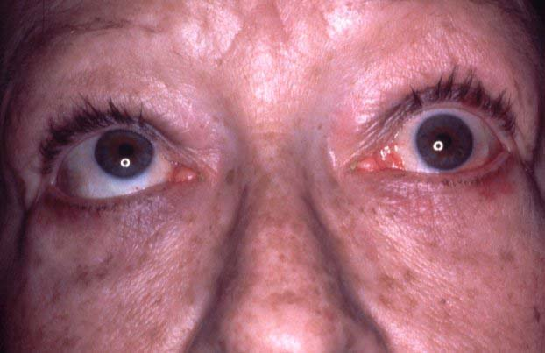
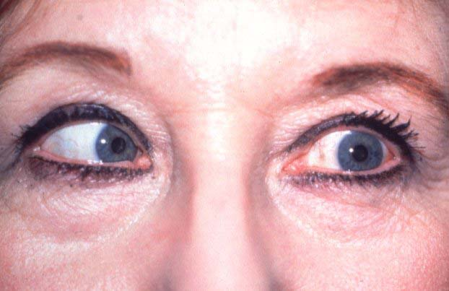
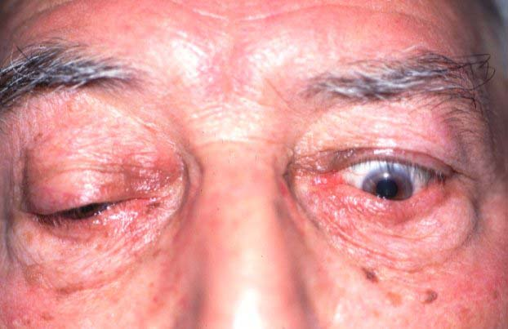
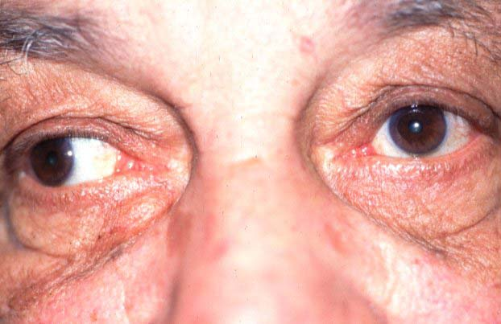
Restrictive myopathy
Occurs in about 40%
Due to fibrotic contracture
Elevation defect - most common
Abduction defect - less common
Depression defect - uncommon
Adduction defect - rare

Slide 12
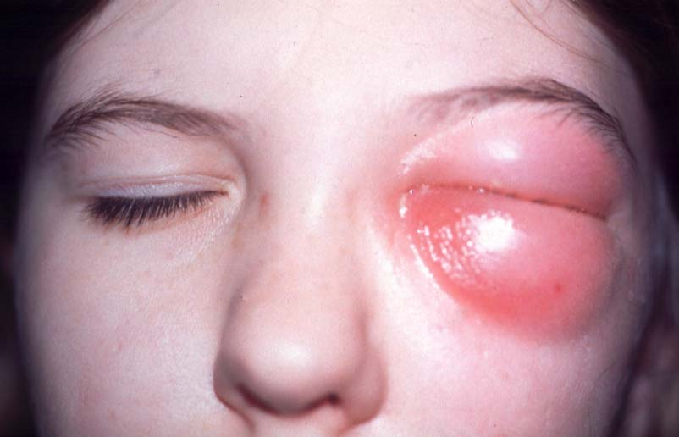
Preseptal cellulitis

Slide 13
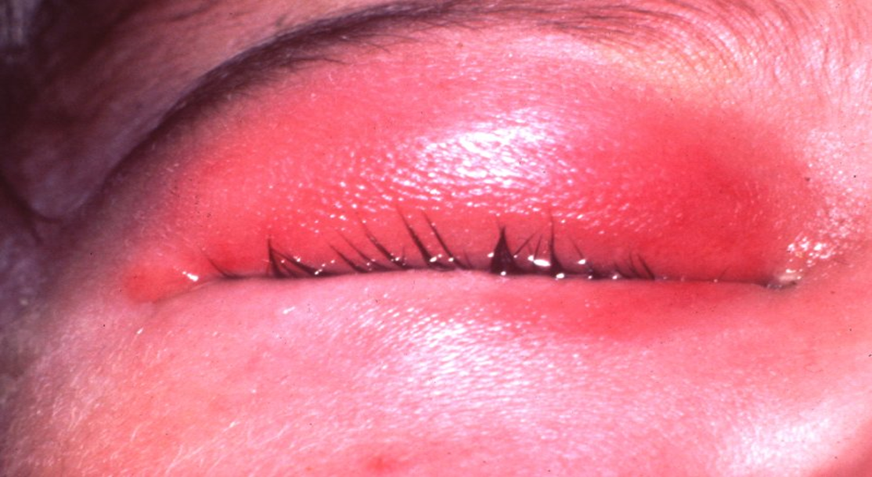
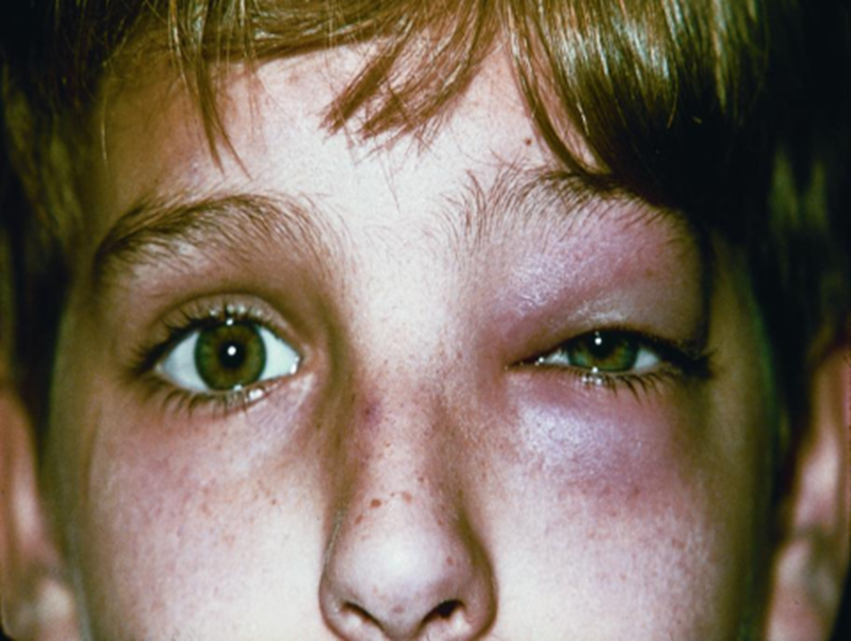

Slide 14
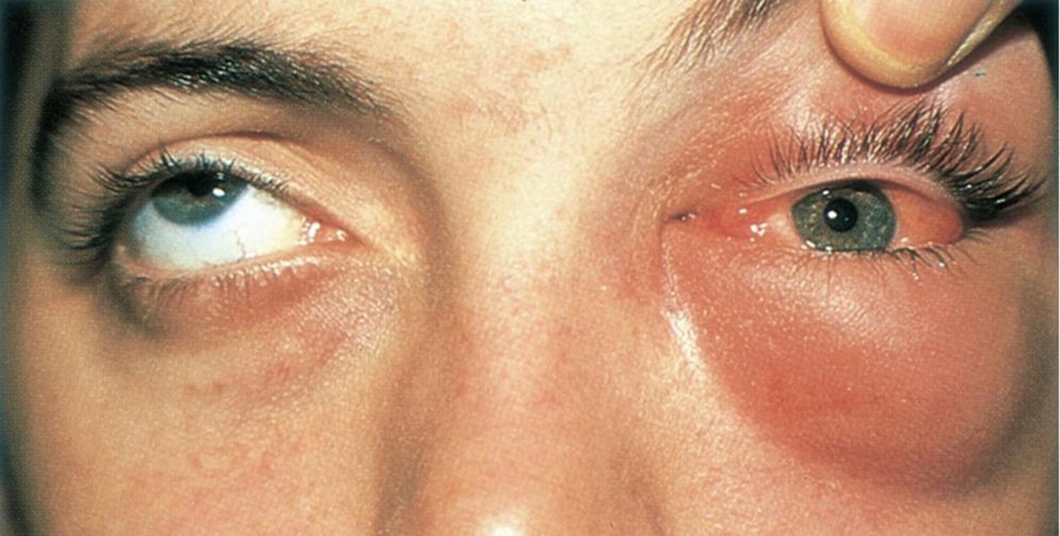
Orbital cellulitis

Slide 15
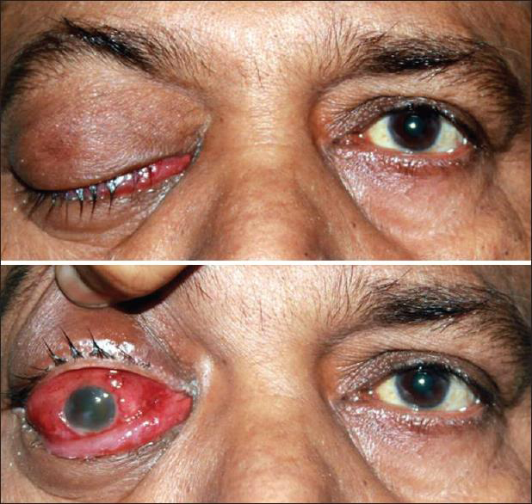

Slide 16
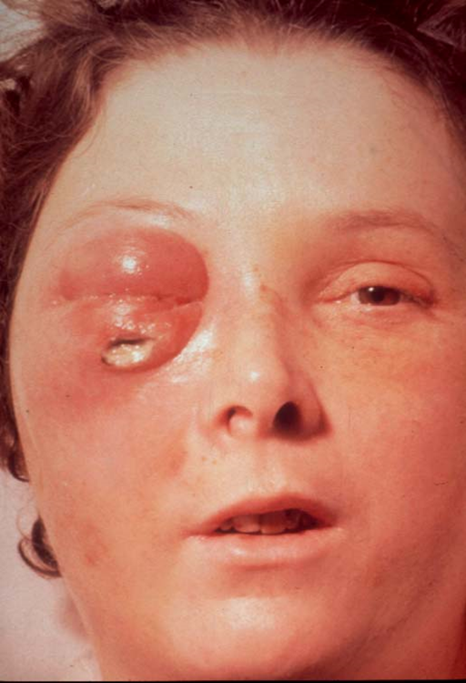

Slide 17
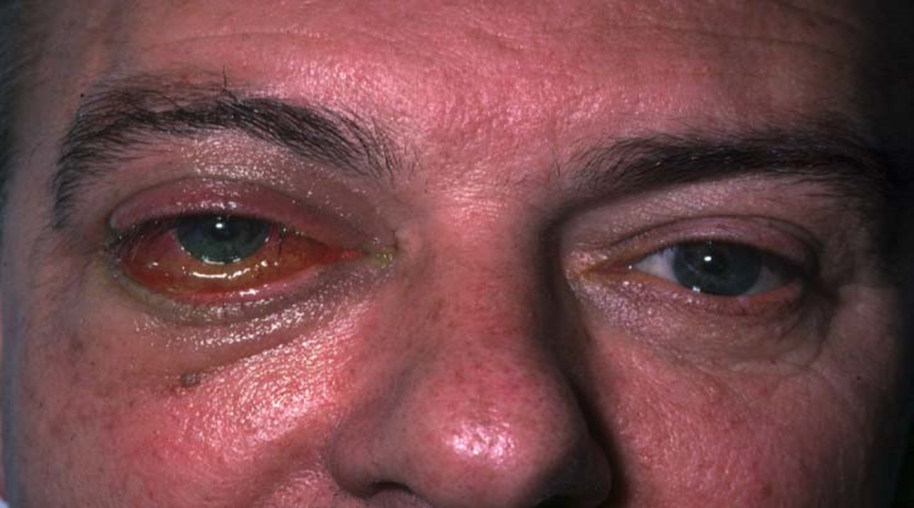
Idiopathic orbital inflammatory disease (psudotumour)

Slide 18
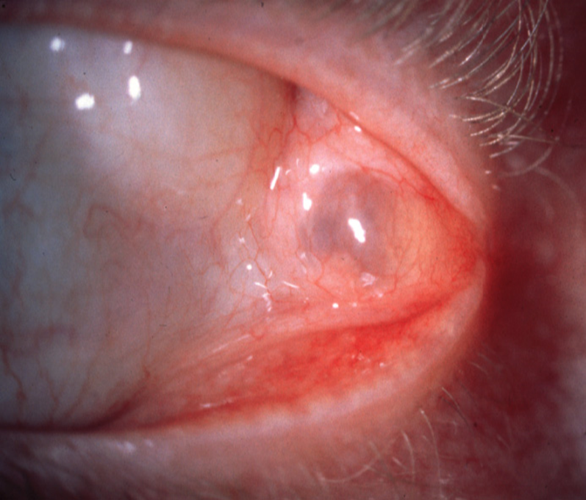
Dacryops

Slide 19
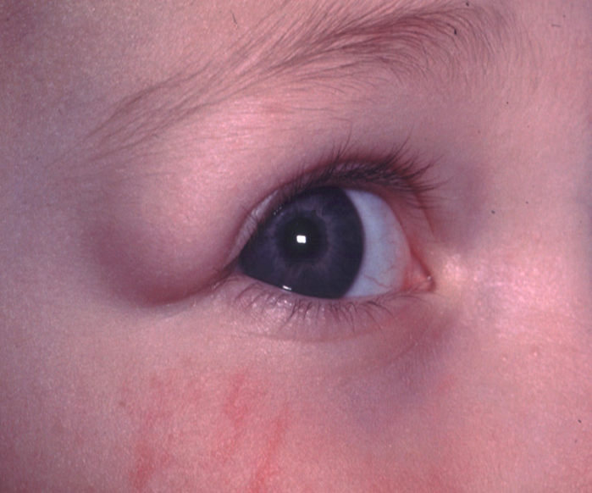
Dermoid cyst

Slide 20
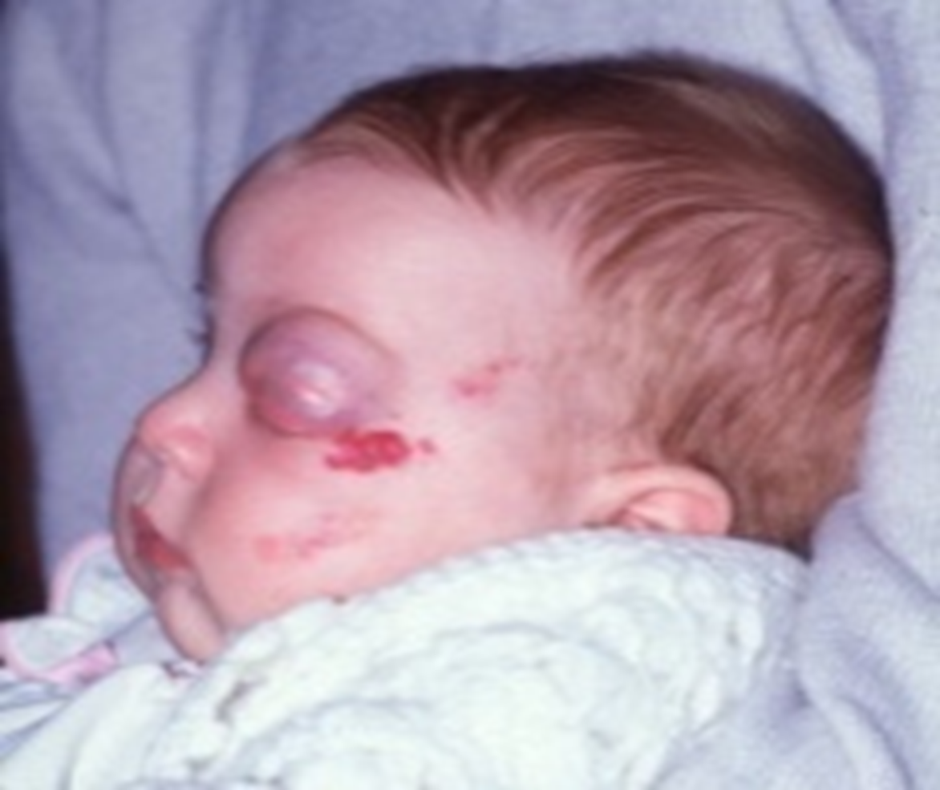
Capillary haemangioma

Slide 21
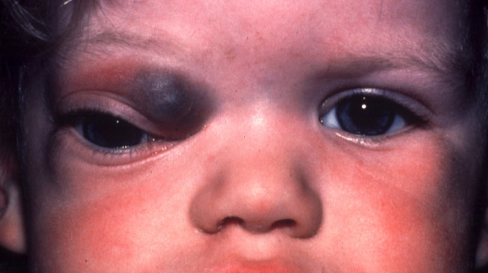
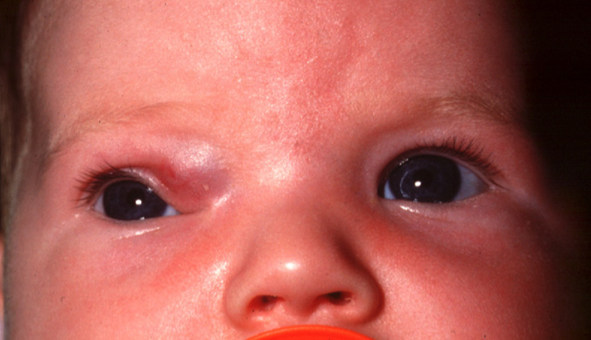

Slide 22
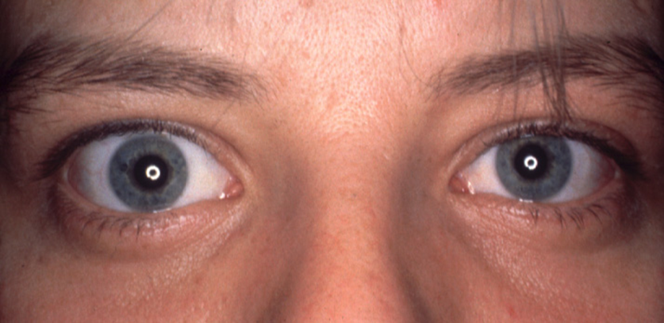
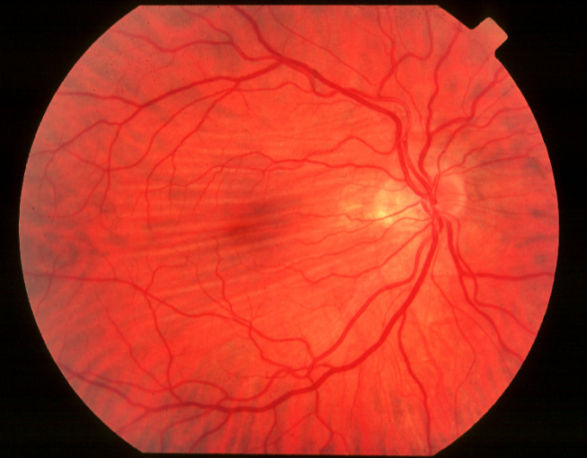
Cavernous haemangioma

Slide 23
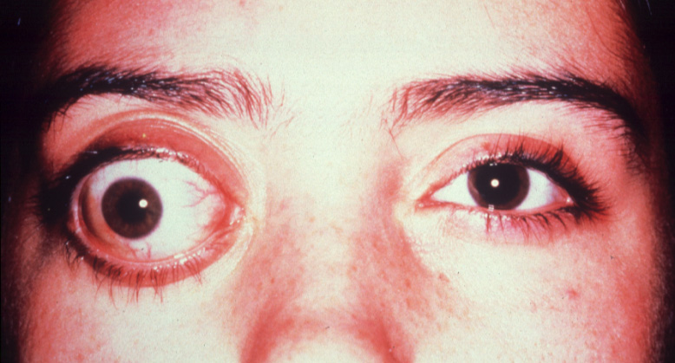
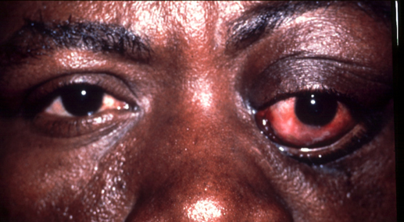
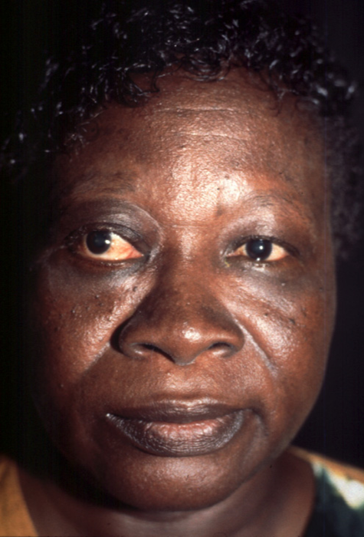

Slide 24



Slide 25
The conjunctiva

Slide 26
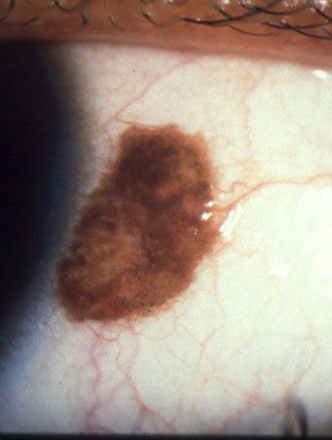
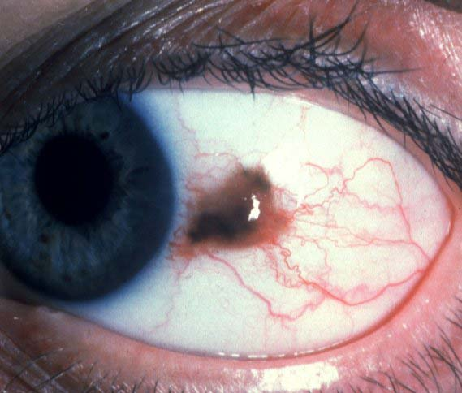
Naevus vs conj.melanoma

Slide 27
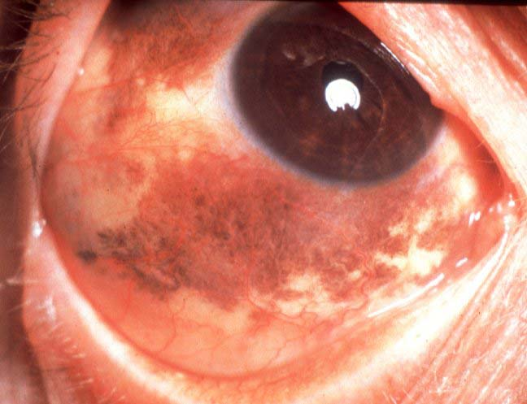
Primary acquired melanosis

Slide 28
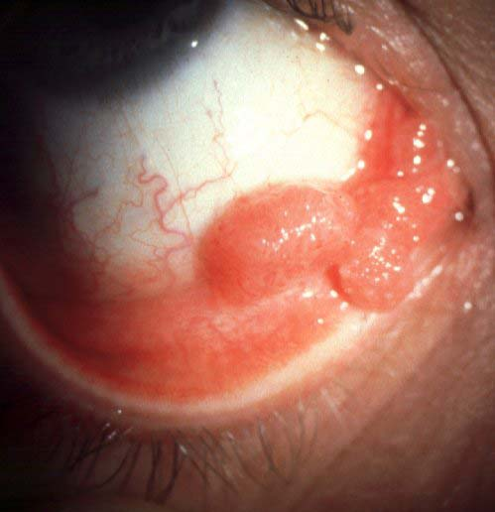
Conj. Papilloma

Slide 29
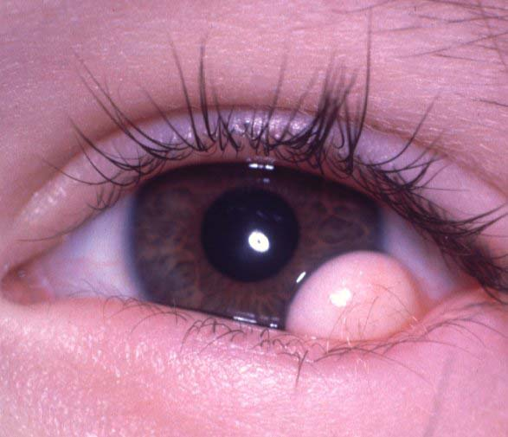
Dermoid cyst (limbal)

Slide 30
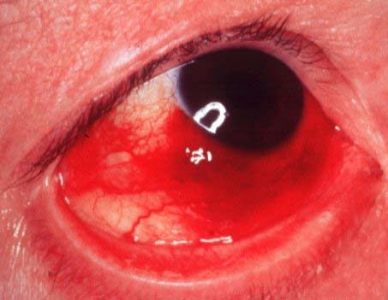
Kaposi sarcoma

Slide 31
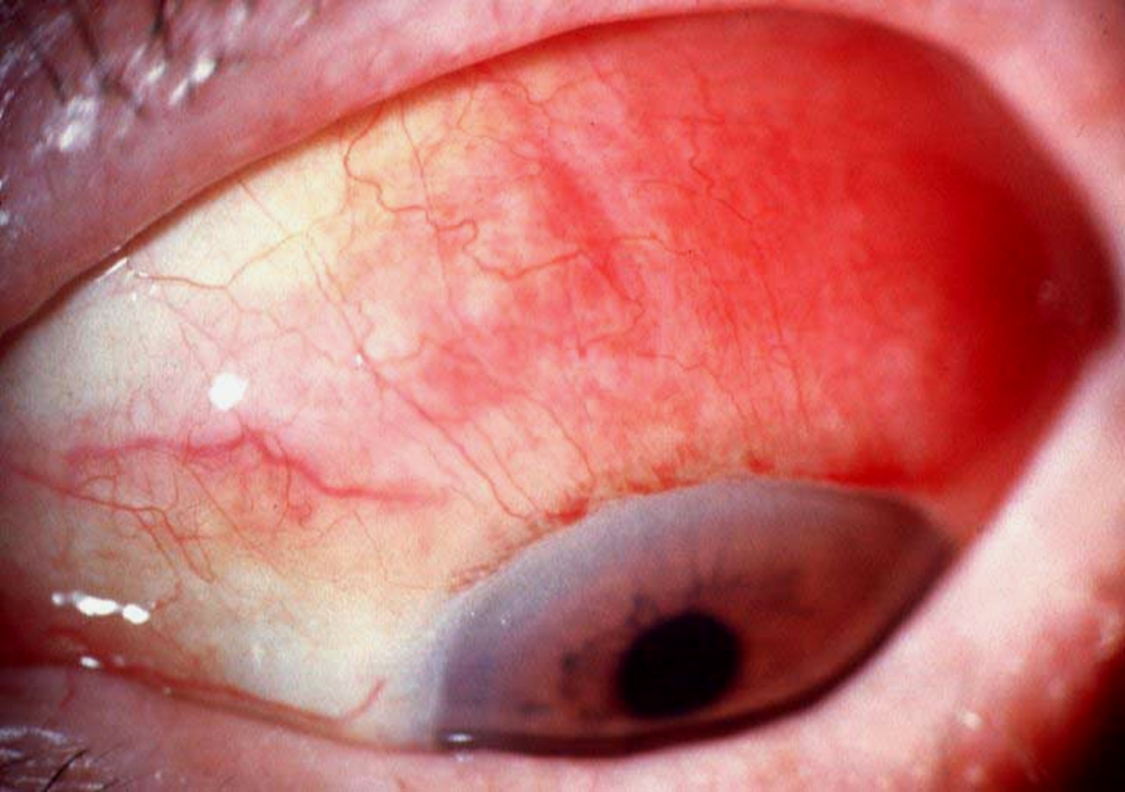
lymphoma

Slide 32

The iris

Slide 33
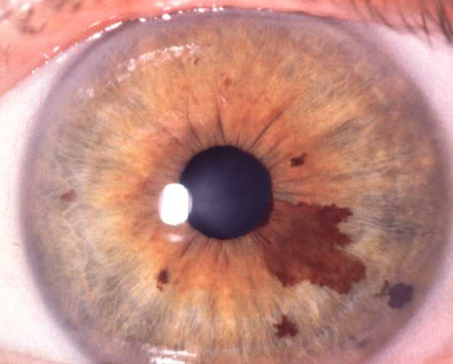
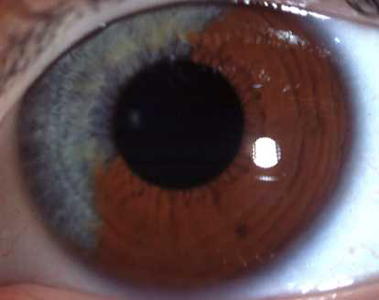
Naevus

Slide 34
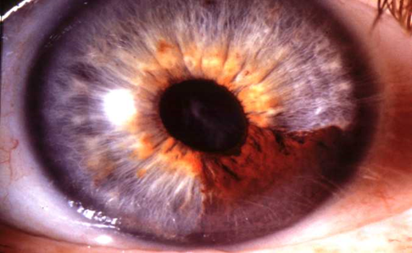
Pupillary distortion, ectropion uveae and cataract

Slide 35
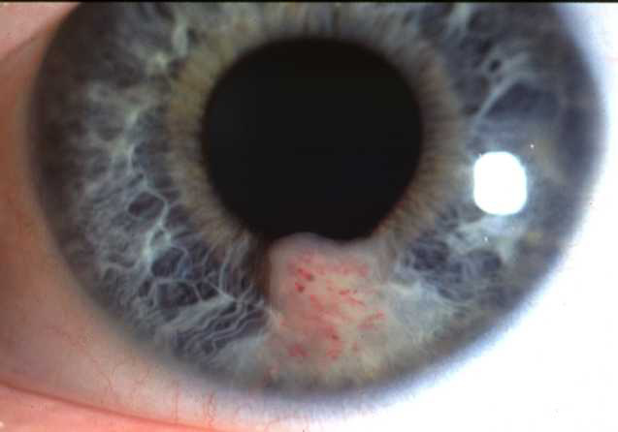
non-pigmented Surface vascularization

Slide 36
Ciliary body

Slide 37
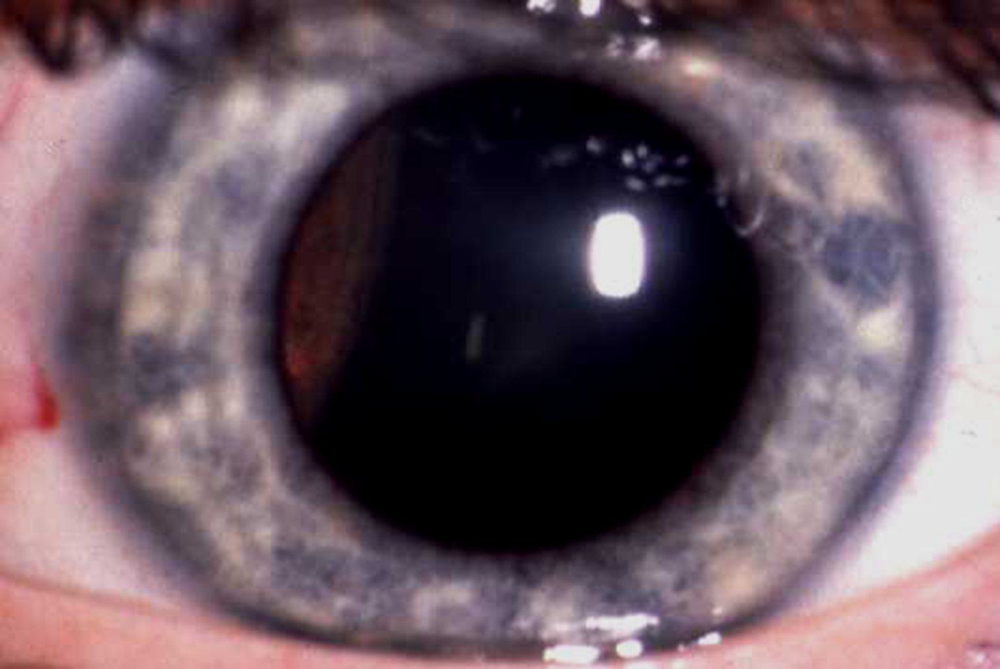
Ciliary body melanoma

Slide 38
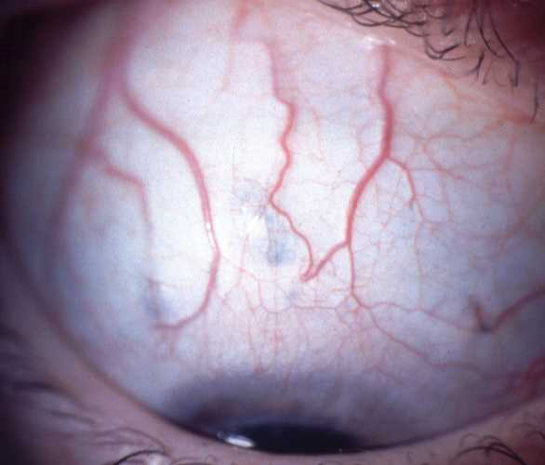
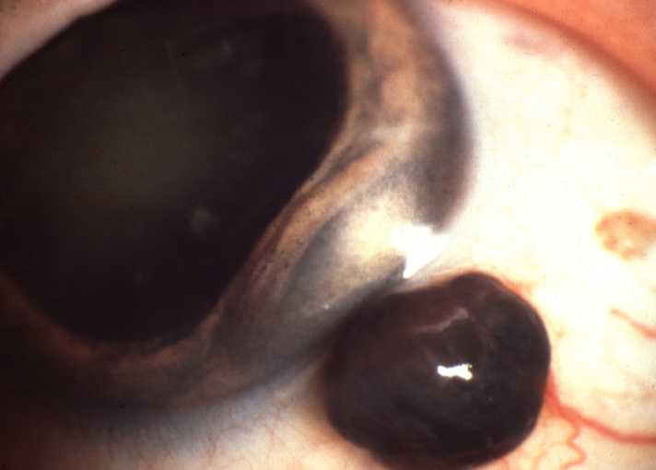
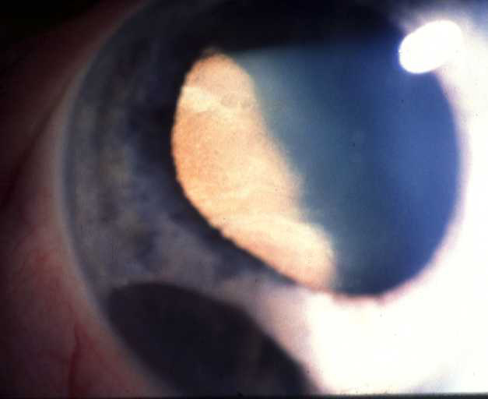
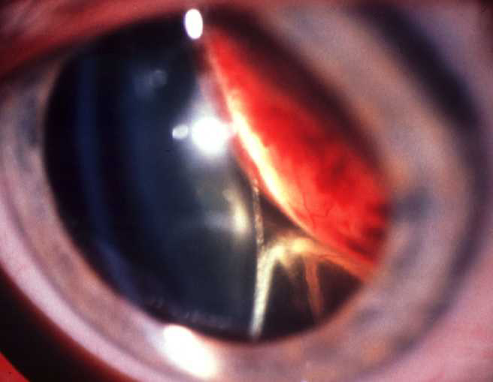
Signs of ciliary body melanoma
Sentinel vessels
Extraocular extension
Erosion through iris root
Lens subluxation or cataract, RD

Slide 39
choroid

Slide 40
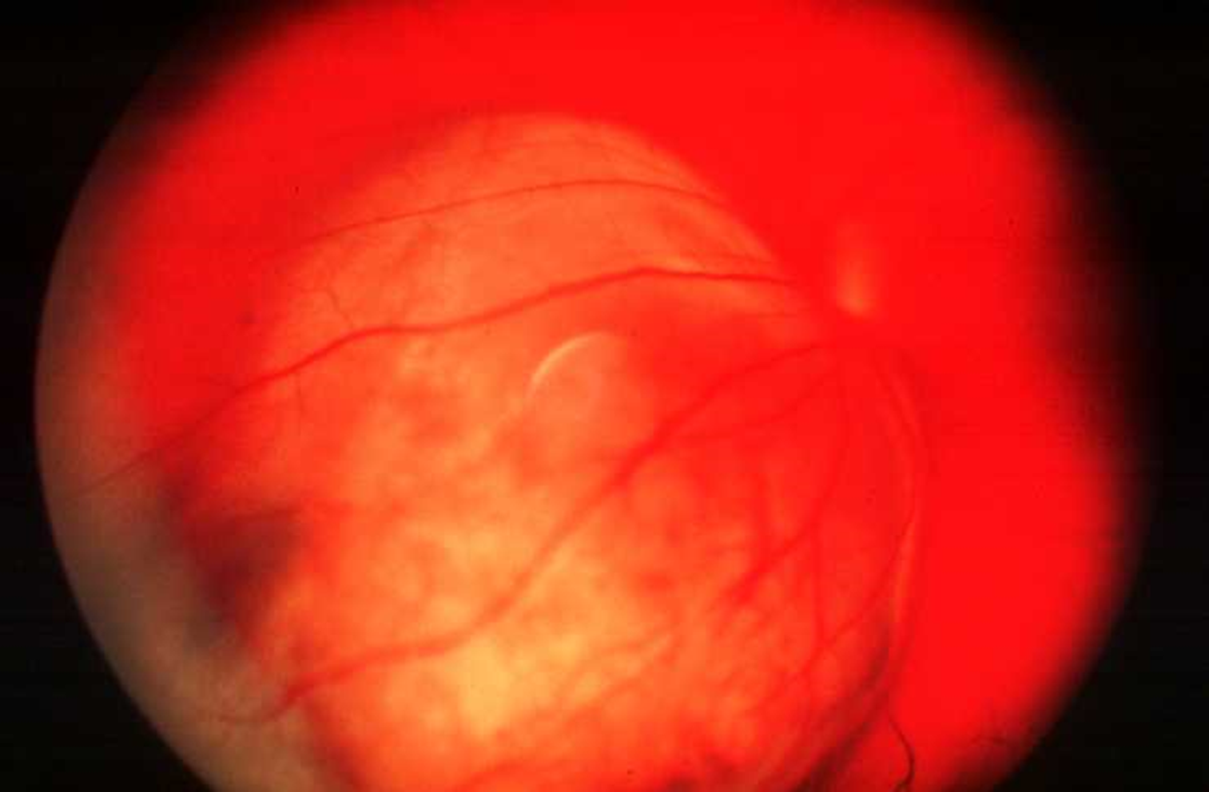
Choroidal melanoma

Slide 41
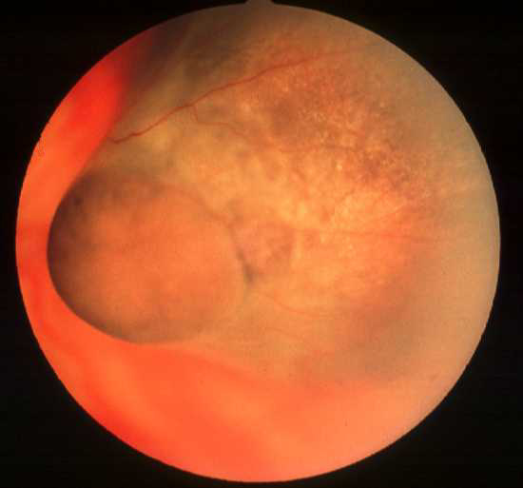

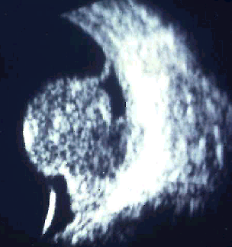
Ultrasound - acoustic hollowness,
choroidal excavation and orbital
shadowing

Slide 42
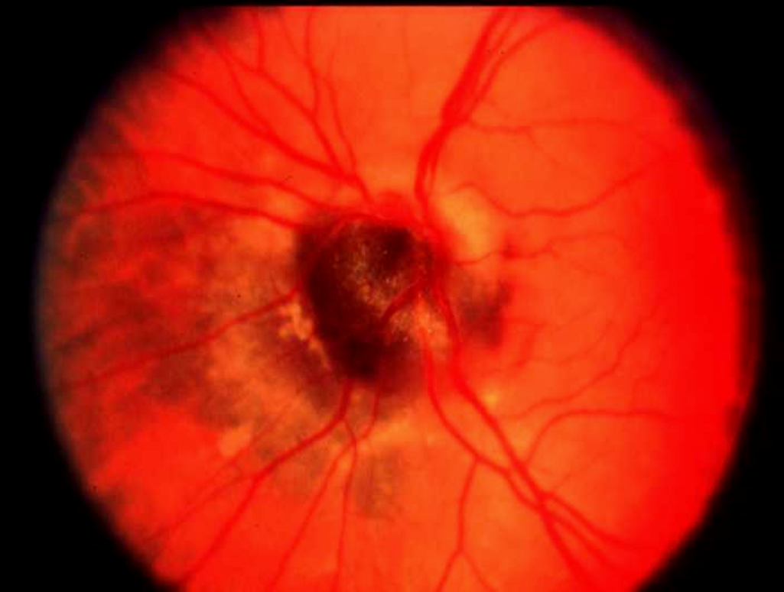
melanocytoma

Slide 43



Slide 44

Retionoblastoma

Slide 45






Presentations of retinoblastoma
Secondary glaucoma
Leukocoria - 60%
Strabismus - 20%
Anterior segment invasion
Orbital inflammation
Orbital invasion

Slide 46

Early endophylitic retinoblastoma

Slide 47




More advanced endophytic retinoblastoma
Friable white mass
Cottage cheese appearance
Fine surface blood vessels
Vitreous seedings

Slide 48

Exophytic retinoblastoma
Multiglobulated white mass with overlying retinal detachment

Slide 49


Slide 50



