Slide 1


Libyan International
Medical University
Faculty of
Business Administration
The Difference between Business and Consumer Buyer Behavior
Prepared and presented by:
Heba N Bushiha
Email:hbitalla_3285@limu.edu.ly
ID Number:
3285
Notes:
Download more minimal templates here: https://crmrkt.com/GK9Dwa

Slide 2
Introduction
Difference Between Business and Consumer Buyer Behavior
Contents
Characteristics Affecting Consumer Behavior
Characteristics Of Business Buying Behavior
B2B Marketing
Conclusion
References
Notes:
Download more minimal templates here: https://crmrkt.com/GK9Dwa

Slide 3
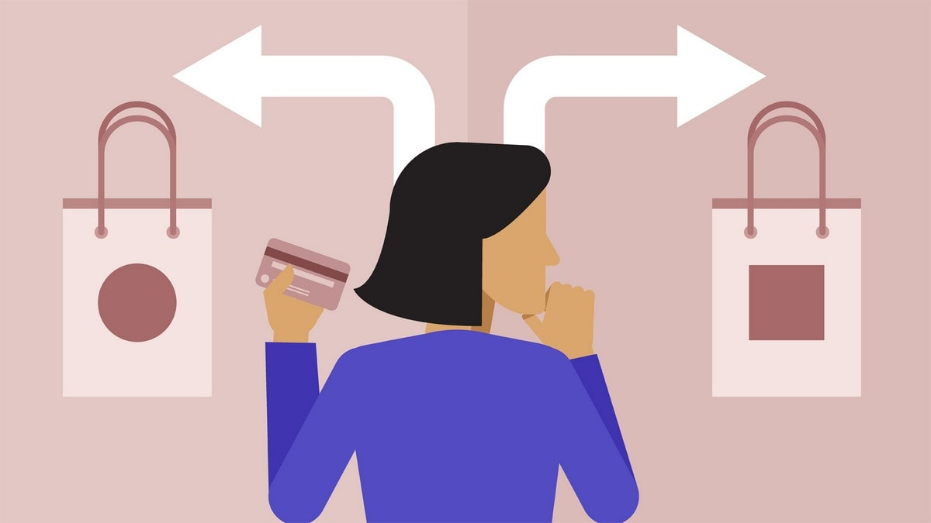
Introduction
Businesses and consumers have completely different buying behaviors. (Milano , 2020)
Businesses purchase what they require, whereas consumers regularly purchase optional things.
B2B marketing (Business-to-Business) is an exchange or trade action that takes place between one business and another, such as a wholesaler.(Chen , 2020)
Notes:
Download more minimal templates here: https://crmrkt.com/GK9Dwa

Slide 4
Difference Between Business and Consumer Buyer Behavior
Business Buyer Behavior
Consumer Buyer Behavior
Business buyer behavior refers to the buying behavior of organizations that purchase products and services for selling or renting it to others.
Consumer buyer behavior refers to the action taken by a consumer when buying product or a service for personal consumptions.
(Ehrlich , 2020)
Notes:
Download more minimal templates here: https://crmrkt.com/GK9Dwa

Slide 5
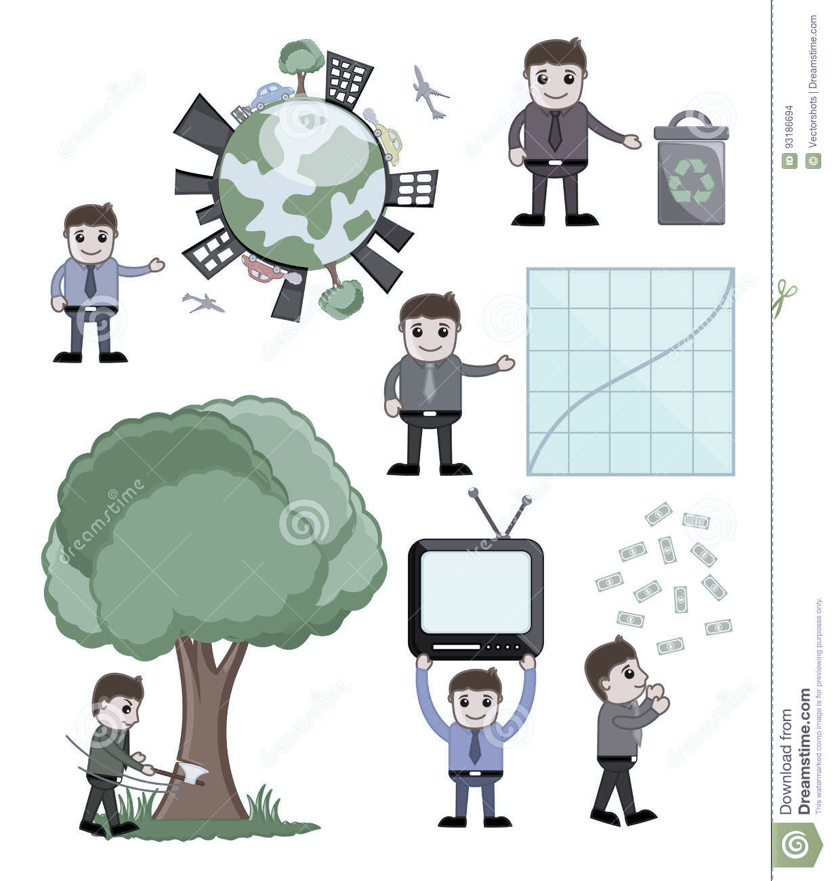



Characteristics Affecting Consumer Behavior
Cultural
Social
Personal
Psychological
Notes:
Download more minimal templates here: https://crmrkt.com/GK9Dwa

Slide 6
Characteristics Of Business Buying Behavior
Geographical Concentration
Professional
Buying
Characteristics Of Business Buying Behavior
Derived
Demand

Slide 7

B2B Marketing
Business-to-business advertising refers to any marketing efforts directed toward other businesses rather than to individual consumers. Business-to-business advertising, or B2B advertising, takes place between companies that are typically found in the middle of the supply chain for any product or service that does not reach the average consumer. (Kenton,2020)
Notes:
Download more minimal templates here: https://crmrkt.com/GK9Dwa

Slide 8

Conclusion
To sum up, business and consumer buying behavior are different and they also have different characteristics.
B2B marketing stands for business to business trading.

Slide 9
References:
“Differences between a Consumer Buying and a Business Buying Decision Process.” Smallbusiness.chron.com, smallbusiness.chron.com/differences-between-consumer-buying-business-buying-decision-process-20397.html.
Chen, James. “Business to Business (B2B).” Investopedia, 29 May 2020, www.investopedia.com/terms/b/btob.asp.
Ehrlich, Jordan. “What Is Consumer Buying Behavior?” Www.demandjump.com, 24 Jan. 2020, www.demandjump.com/blog/what-is-consumer-buying-behavior.
‌
techthug99. Business Buyer Behaviour - Type, Process, Factors, Roles. 8 Aug. 2019, www.geektonight.com/business-buyer-behaviour-type-process-factors-roles/#:~:text=Business%20buyer%20behaviour%20refers%20to. Accessed 19 Apr. 2022.
“What Is Business-To-Business Advertising?” Investopedia, 2020, www.investopedia.com/terms/b/business-to-business-advertising.asp.x
Notes:
Download more minimal templates here: https://crmrkt.com/GK9Dwa

Slide 10
THANK YOU
Heba N Bushiha
Notes:
Download more minimal templates here: https://crmrkt.com/GK9Dwa

