Slide 1



Infectious diseases prevention
Clostridiodes difficils prevention
Student name: Abrar Khalid Number : 2955
Block:PTS
Date: 23/5/2022

Slide 2

Introduction
Infection control is important in departmental workplaces or any other places.
There are specific diseases that can spread easily in our workplaces if controls are not in place.
To protect your own health as well as the health of those around you, an understanding of infectious diseases, how they are spread and how to control them is fundamental.

Slide 3
How do people get infectious diseases ?
Directly
Indirectly
From person to person
Through the respiratory droplets ex coughing or sneezing
Through body fluids
Direct exposure to infectious agent in environment
During childbirth from mother to fetus transplacenta
Contaminated objects
Animal to person contact
Air born ex tuberculosis
Food and drinking water
3

Slide 4

Objectives
Define the Clostridiodes difficils
Outline the way of transmission Clostridiodes difficils
List the importance laboratory testing of Clostridiodes difficils
Discuss the role of antibiotics to cause Clostridiodes difficils
Discuss the strategies to preventing Clostridiodes difficils infection

Slide 5

Clostridium difficile,
02
01
Pathogenic strains of C. difficile produce two protein exotoxins, toxin A and toxin B, which cause colonic mucosal injury and inflammation.
Clostridium difficile infection is gram positive associated with broad-spectrum antibiotic therapy and is the most common cause of infectious diarrhea in hospital patients
04
Clostridium difficile, an anaerobic toxigenic bacterium, causes a severe infectious colitis that leads to significant morbidity and mortality worldwide
03
. .
Infection may be asymptomatic or (silent' onward transmission.), cause mild diarrhea, or result in severe pseudomembranous colitis.
05
Clostridium difficile infection (CDI) is a common and sometimes fatal health-care–associated infection
5

Slide 6
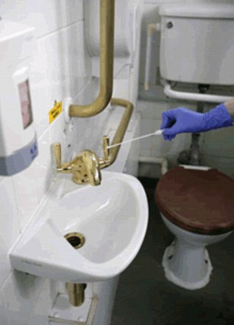


Transmission of c.difficilen
It is transmitted by the fecal–oral route. The hands of hospital personnel are important intermediaries.
Clostridiodes difficils germs are carried from person to person in poop
If someone with Clostridiodes difficils (or caring for someone with C. diff) doesn’t clean their hands with soap and water after using the bathroom, they can spread the germs to people and things they touch.
C. diff can also live on people’s skin

Slide 7

laboratory tests
02
PCR asssy
ELASA test
01
03
DNA based test
04
cytotoxicity test
05
Endoscopy

Slide 8
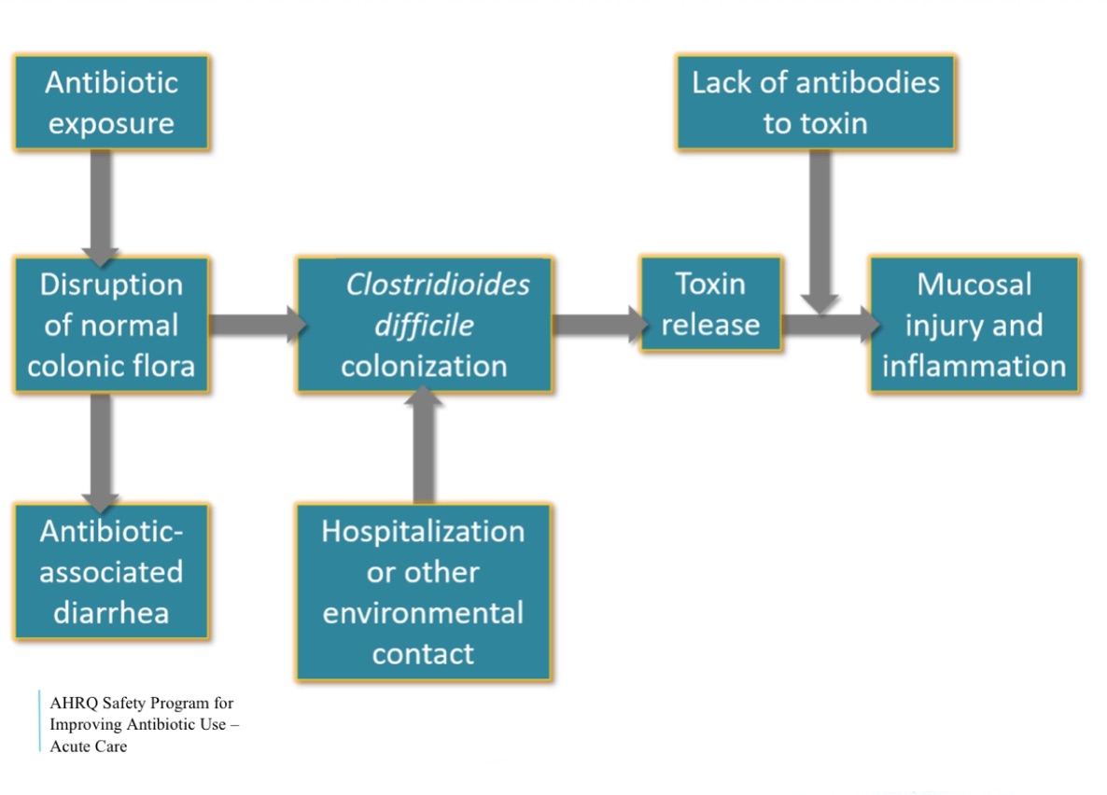

How can antibiotic cause c.diff diarrhea

Slide 9



example of patients get c.diff by antibiotic
Infection in the throat
Amoxicillin
Infection in the kidney
Ciprofloxacin
abscess in a tooth
Clindamycin

Slide 10



Strategies to prevent c.diff
1. Prescribe and use antibiotics carefully. About 50% of all
antibiotics given are not needed, unnecessarily raising the risk
of C. difficile infections.
3. Isolate patients with C. difficile immediately.
2. Test for C. difficile when patients have diarrhea while on
antibiotics or within several months of taking them.

Slide 11



Strategies to prevent c.diff
4. Wear gloves and gowns when treating patients with C.
difficile, even during short visits, Hand sanitizer does not kill them.
5. Clean room surfaces with bleach or another EPA-approved,
spore-killing disinfectant after a patient with C. difficile has
been treated there.
6. When a patient transfers, notify the new facility if the patient has a C. difficile infection.

Slide 12
What patient can do
1-Take antibiotics only as prescribed by your doctor.
2-Tell your doctor if you have been on antibiotics and get
diarrhea within a few months.
4-Try to use a separate bathroom if you have diarrhea,
3-Wash your hands after using the bathroom.

Slide 13
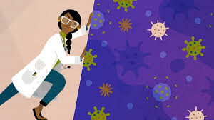
Conclusion
intended to prevent transmission of infectious agents, including epidemiologically important microorganisms, which are spread by direct or indirect contact with the patient or the patient's environment
The best way to avoid infection with C. difficile is to take antibiotics as prescribed by your doctor and never share the medication with others.
dont take any antiboitic without prescribation from your doctor
Prevention of Clostridium difficile infection (CDI) has become extremely important because of increases in CDI incidence and severity.

Slide 14
Reference
Levinson ,Warren. review of medical microbiology and immunology. Thirteenth edition .new York: mcgraw-Hill,2014.
Dinleyici M, Vandenplas Y. Clostridium difficile Colitis Prevention and Treatment. Adv Exp Med Biol. 2019;1125:139-146. doi: 10.1007/5584_2018_322. PMID: 30689174.
Pelleschi ME. Clostridium difficile-associated disease: diagnosis, prevention, treatment, and nursing care. Crit Care Nurse. 2008 Feb;28(1):27-35; quiz 36. PMID: 18238935.
Pelleschi ME. Clostridium difficile-associated disease: diagnosis, prevention, treatment, and nursing care. Crit Care Nurse. 2008 Feb;28(1):27-35; quiz 36. PMID: 18238935.
How Infections Spread | Infection Control | CDC [Internet]. Cdc.gov. 2020 [cited 15 March 2020]
Dubberke ER, Gerding DN, Classen D, Arias KM, Podgorny K, Anderson DJ, et al. Strategies to prevent clostridium difficile infections in acute care hospitals. Infect Control Hosp Epidemiol. 2008;29(Suppl 1):S81–S92

Slide 15
Thank you for listening , do you have any questions?

