Slide 1


Marketplace
Libyan International Medical University
Faculty Of Business Administration
Presented by: Hajer khaled Elsaaiti
ID: 3178
Email: Hajer_3178@limu.edu.ly

Slide 2

CONTENT:
Introduction
Define market place
Examples of marketplace
Conclusion
Reference

Slide 3
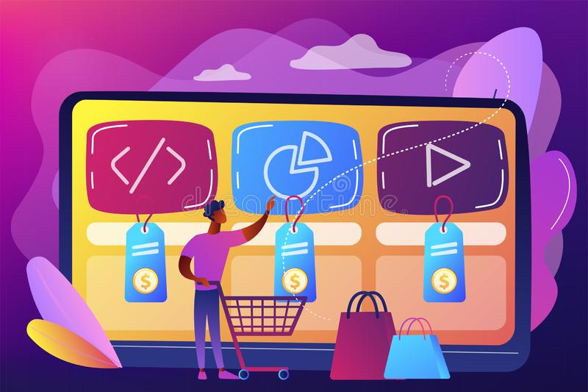
INTRODUCTION:
What is a market place?
A marketplace is an online store or a platform that facilitates both buyer and seller in many ways. An online marketplace is just like an e-commerce website or mobile app where sellers meet buyers and offer products and services. The website is responsible for all the transactions i.e. payments, transactions and process.

Slide 4

EXAMPLES OF MARKETPLACE:
Amazon: This vast internet-based enterprise has taken over the world of online shopping. As a top marketplace, 47% of online shoppers bought their first item on Amazon, It was founded in 1994 and has since grown into the largest internet company by revenue in the world. In 2020, Amazon reported a net income of $21.3B U.S. dollars.

Slide 5

EXAMPLES OF MARKETPLACE:
Alibaba: is also one of the world’s biggest marketplaces. According to an estimate, it has roundabout more than 500 million active clients across the world. The sale volume of its marketplace is much higher. If you’re planning to sell your products/services in some marketplace, then Alibaba is a great choice.

Slide 6

Conclusion:
Market place is important to use a convenient channel to distribute products and services. reach more consumers, this way increasing chances to obtain a significantly higher number of orders and boost sales.

Slide 7
Reference:
Hagiu, A., & Wright, J. (2015). Marketplace or reseller?. Management Science, 61(1), 184-203.

Slide 8

THANK YOU!

